Slide 1


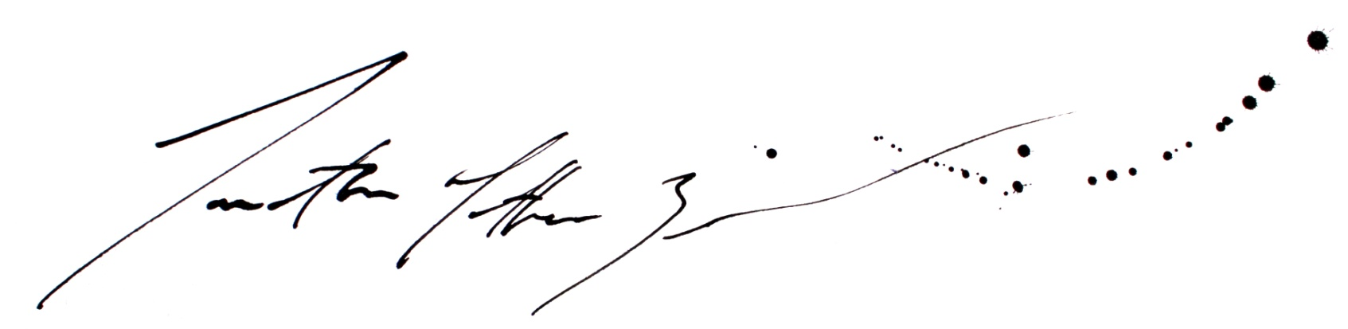
Proposal for the production of Commonwealth Medals – Glasgow 2014
Option A
Silversmithing & Jewellery at Glasgow School of Art

Slide 2
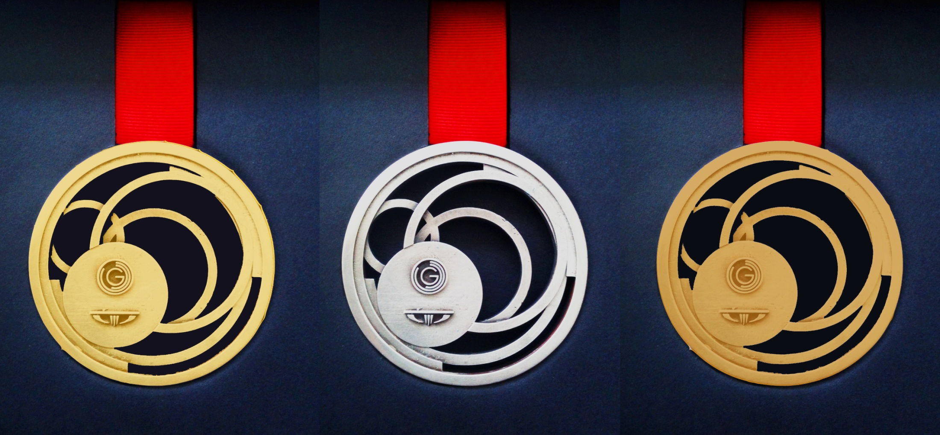
All Prices and figures within this presentation are based on the production of a medal similar to the prototype provided.

Slide 3
Design and Making For Medal Design- Option B
Contents
Page
1-3 Glasgow School of Art and Our Brief
4-6 Design Based Solutions to Higher Metal Costs
7-9 The Design and Production Team
10-13 Our Facilities‘ and the Our Process of Medal Making
14-15 The Costs
Our Proposed Timetable
17 Summary

Slide 4
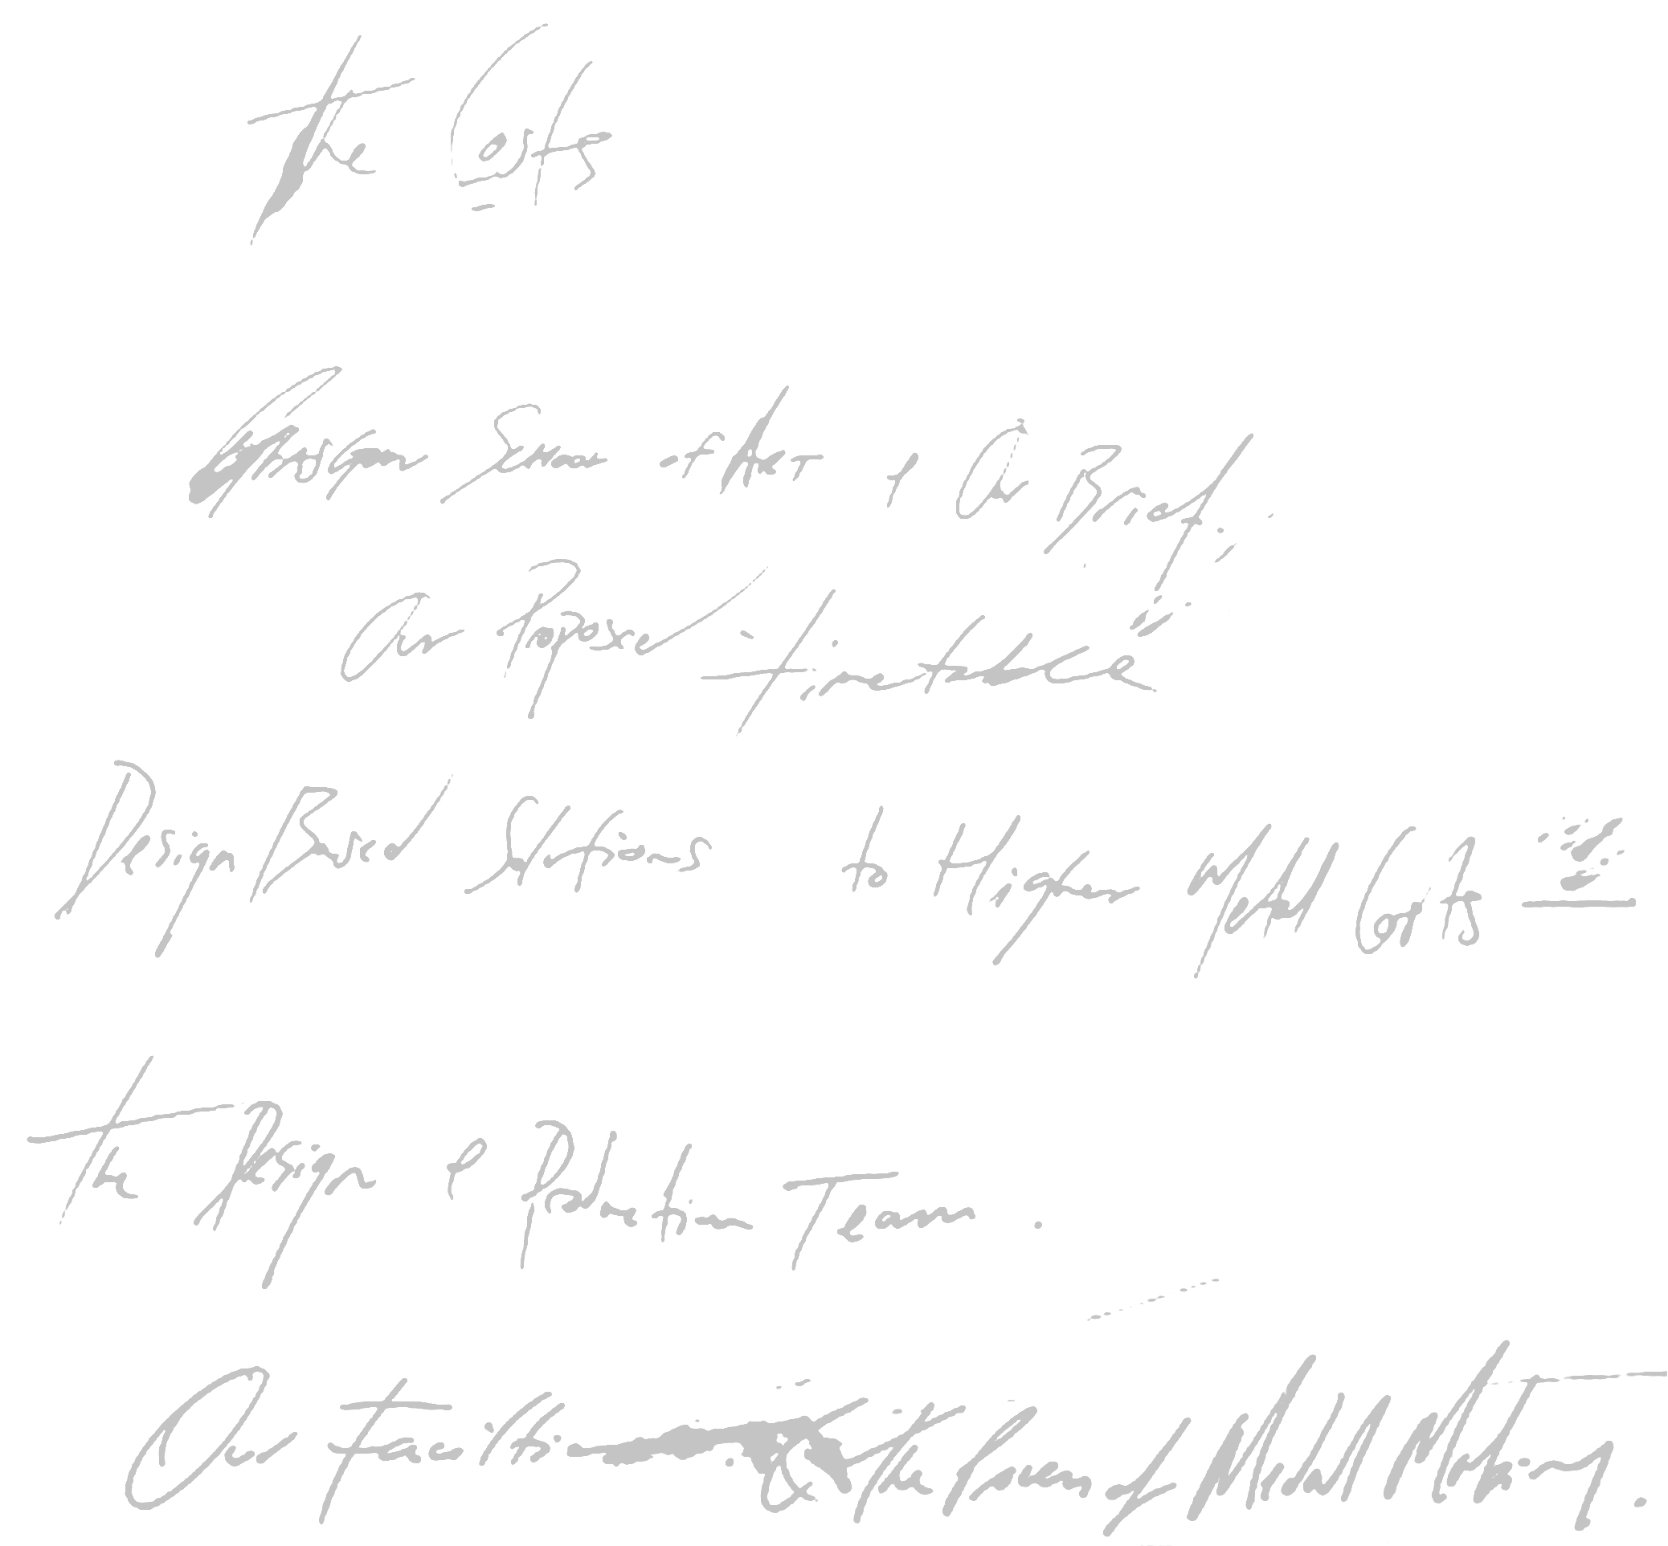
Glasgow School of Art and Our Brief
1

Slide 5
Our Understanding of the Brief
The Glasgow School of Art, Department of Silversmithing and Jewellery, is pleased to submit this proposal to Glasgow 2014 Ltd for the design and production of Podium Medals for the XX Commonwealth Games.
Glasgow 2014 Ltd seeks to commission suppliers to design and produce medals for the XX Commonwealth Games in Glasgow. A total of 1,519 podium medals are required, for gold-, silver- and bronze-winning athletes. In addition, at least 10,000 commemorative medals (potentially as many as 23,500) will be produced for all participating athletes, Games Federation officials and others directly involved in the Games. Pin badges for medal winners may also be commissioned. The podium medals are symbolic of the Commonwealth Games as a whole, and will feature prominently in global media coverage. Delivering an inspiring and innovative design that reflects the ambitions and spirit of the XX Games is an important objective for Glasgow 2014, and would help to define audiences' perceptions of the event and its hosts.
Athletes' medals are clearly an essential element of the Games, and it is therefore vital that they are produced in good time (completed before April 2014), with a minimum of risk. At a time of financial constraint and volatile precious metal prices, it is also extremely important that medal production represents good value for money, and is completed within planned budgets. It is also important that the medals meet standards defined by the Commonwealth Games Federation with regard to size, weight, materials and design features relating to branding. However, we understand that there may be scope to adjust these criteria to some extent, with approval, to fit the particular context of each Games.
Our proposal presents two options for Glasgow 2014 to consider. Option A is for the design and manufacture of all gold, silver and bronze podium medals (including ribbons and presentation boxes), with a further option for the design and production of pin badges. Option A would enable Glasgow 2014 to commission an innovative, contemporary design, enabled by cutting edge technology, but where every single medal is hand-made by a skilled craftsperson. It will also make it possible to use higher grades of precious metals, at lower cost than would be possible with a more traditional design.
Option B is for the creation and prototyping of medal designs only, on the understanding that medal production would be carried out by a third party manufacturer.
Neither option includes production of commemorative medals.
2

Slide 6
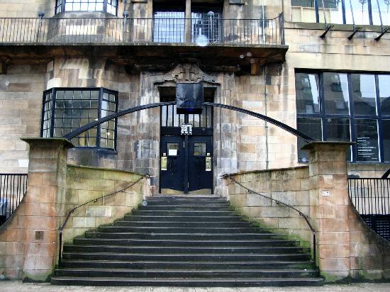
Why Glasgow School of Art?
Glasgow School of Art
The GSA is internationally recognised as one of Europe's foremost university-level institutions for creative education and research in fine art, design and architecture. We foster the conditions for creativity in order to promote critical thinking, experimentation, discovery and innovation. Our distinctive pedagogy and research promote studio culture as the basis for creative communities, the meeting ground for diversity of opinion, independence of thought and learning from each other. Proudly independent and outward-looking, we continuously extend the boundaries of our knowledge, geographic reach and impact through collaboration and partnership locally, nationally and internationally.
Silversmithing And Jewellery
For over 100 years Silversmithing and Jewellery within GSA has produced many of Scotland's best known jewellers, innovators and designers. Students and gradates continue to win awards and recognition keeping the course at the forefront of the jewellery and metalworking industries. The staff of the department, as practising designer/makers/researchers, continually review new developments in the field, evaluate the place of silversmithing and jewellery in changing international cultural environments, and respond to technological advances in design and manufacture. The department has also worked in the past creating other sporting and corporate prizes.
3

Slide 7
Design Based Solution to Higher metal costs.
4

Slide 8
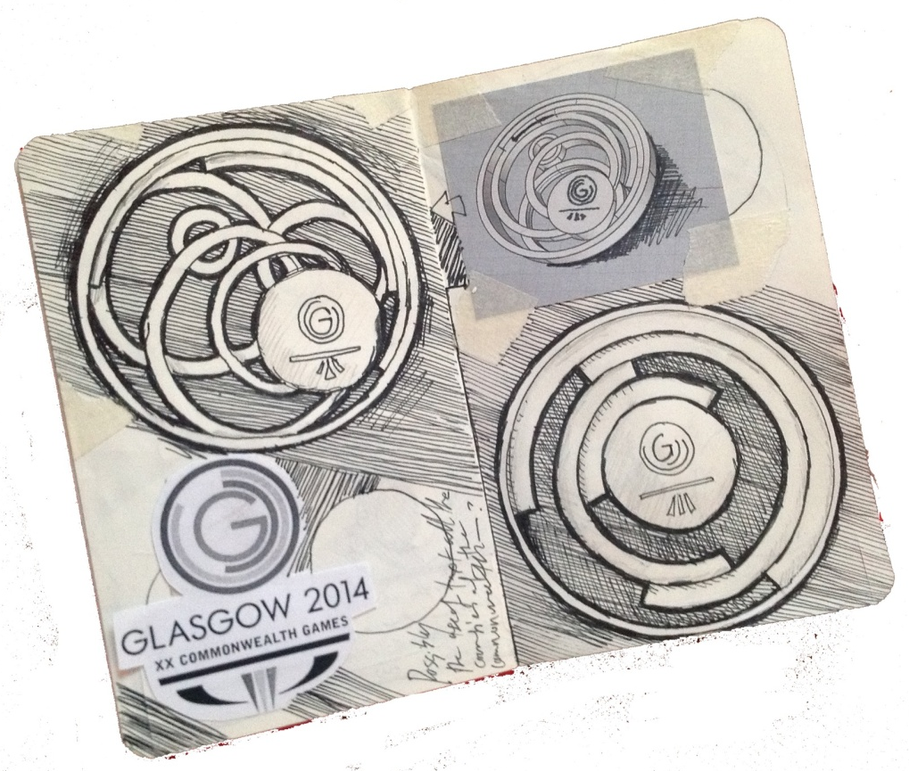
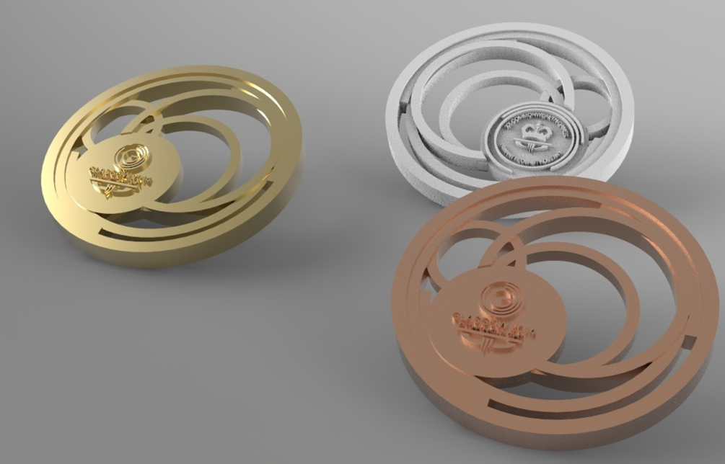
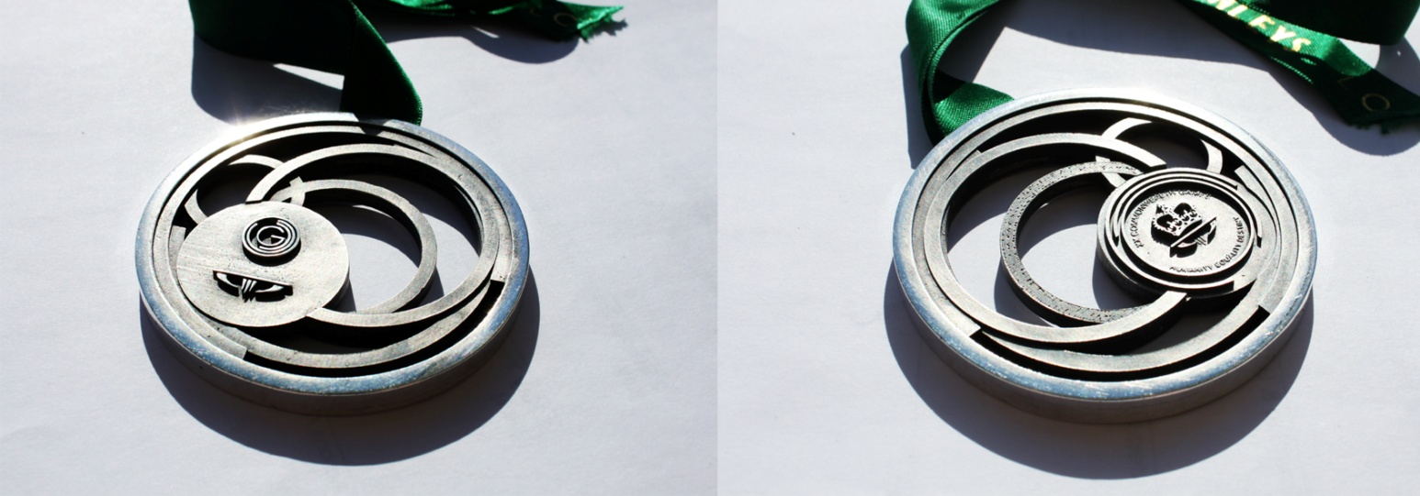
Propose Solutions to higher
costs in precious metals
Working from problems described by the Commonwealth Games team in relation to rises in Precious Metal costs, designer/maker and GSA lecturer Jonathan Boyd produced several designs (these can be seen in the Appendices) which looked to cut down the amount of precious metals used within each metal by 20-50%. Viewing the changes in material led to exciting considerations of a hollow form Medal. This increases the design and innovation possibilities.
5
Initial sketch, Renders and Prototype of potential design

Slide 9
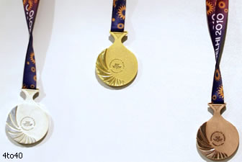
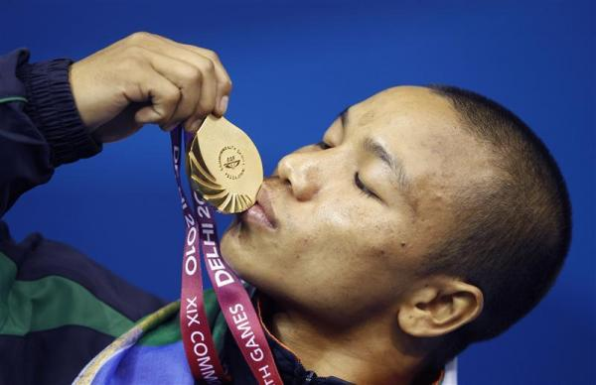
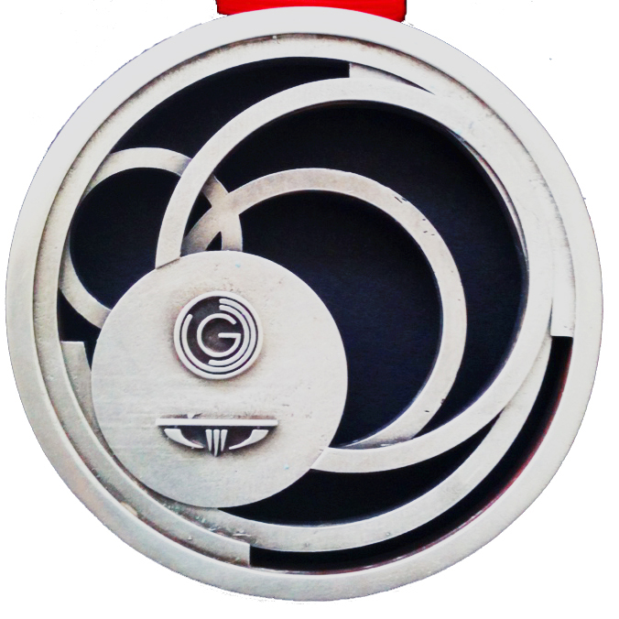
The Proposed Design.
The design Prototype displayed within this proposal takes its influence from the design of 2014 Commonwealth Games logo and aims to display movement and motion.
All information and prices relating to materials are related to the prototype design included. More information on the developing the design can be found in the a prior design presentation (Appendix). This prototype design looks to find a design based solution to rising metals costs by reducing metal weight but keeping volume. By doing this the opportunities for creating unique and interesting medal designs increase. Space and hollow form become areas for experimentation and innovation: still weighing over 100 grams the prototype has a diameter of 70 mm and a thickness of 6.5 mm keeping its large volume. It is understood from conversations that the commonwealth insignia must be kept on the reverse of the medal untouched.
However, as can be seen from Dehli's medal (left), previous designs have reduced and displayed the logo next to the designed/ patterned area in a similar way to presented prototype (right).
The prototype has an inbuilt system for threading the ribbon this should provide strength as a medals weak point is often the connection between medal and ribbon. Additionally this enhances the medal design providing a clean circular outline.
Dehli’s 2010 Games Medal.
Note the shrinking of Commonwealth Logo and pattering on back of medal.
6

Slide 10
‘Hand Crafted In Scotland’
The Design And Production Team
7

Slide 11
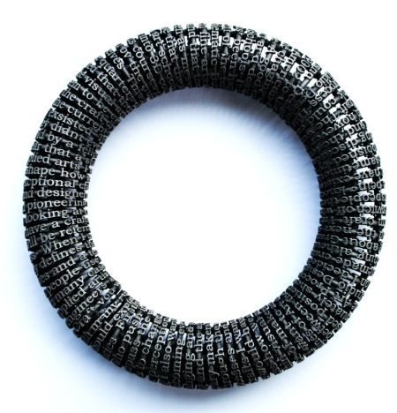
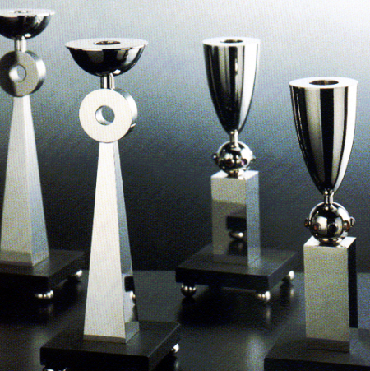
Team Behind Production
The academic staff and the proposed team behind the construction of the Commonwealth medals are some of Scotland's most celebrated and exhibited Applied Artists and Jewellers. Each member of staff bringing a unique set of skills and outlook to the department and this project. All members of staff are Scottish and work and live in Scotland.
Jonathan Mathew Boyd, recently awarded recognition as one of Europe’s leading young Applied Artists by the Bavarian Crafts Council, works and lives in Glasgow. From his studio in the heart of the Barrowlands he produces jewellery and object d’art which are exhibited internationally. A graduate of both GSA (2006) and the Royal College of Art (2009), Jonathan’s works celebrate and question the relationships that exists between object language and the person. He has won multiple awards and recognition for his works.
Helen Marriott graduated from GSA and the Royal College of Art. From her studio in Glasgow Helen has a Silversmithing and teaching career that has spanned thirty years. Helen has made items of silverware that have been shown internationally as well as creating and designing many private and public commissions. Her works resides in collections in Glasgow Museums, 10 Downing Street, Bute House, The Incorporation of Goldsmiths of the City of Edinburgh and The Worshipful Company of Goldsmiths in London.
8

Slide 12
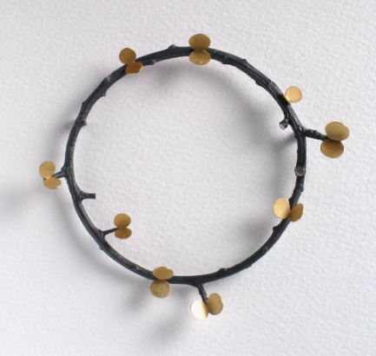
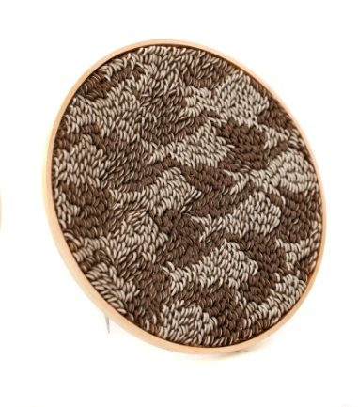
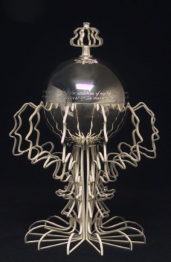
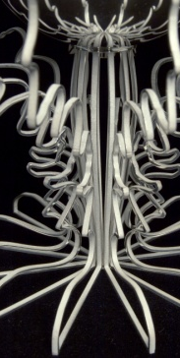
Anna Gordon, graduated from Edinburgh College of Art in 1993 and works alongside Helen Marriott as Head of Department in the Silversmithing and Jewellery Department. Anna has worked as a tutor at Glasgow and Edinburgh colleges of Art for twenty years teaching and influencing some of Scotland's brightest new talents in jewellery. Anna’s jewellery is exhibited worldwide and an in a varied and extensive career she has worked for as a designer for Habitat and the National Library for Women and also has works in several public collections at the Royal Scottish National Museum, Crafts Council, Goldsmiths Hall and Cleveland Crafts Centre.
Andrew Lamb graduated from Edinburgh College of Art in 2000 and the Royal College of Art in 2004. Often described as ‘one of the finest young metalworkers/jewellers of his generation’. Through the use of fine lenticular patterning Andrew creates jewellery that create striking, yet delicately shaped pieces which appear to shift and change as the eye moves across them. Andrew has received enormous recognition for his work including the prestigious 2011 Arts Foundation Fellowship Award.
Nigel Munro. For over twenty years Nigel has worked in the capacity of senior technician within the Silversmithing and Jewellery department. Guiding and instructing hundreds of graduates at Glasgow School of Art this influence has helped many students to become Scotland's leading practitioners in the fields of the Applied Arts. Drawing on years of experience working within the jewellery trade Nigel's practical and technical knowledge is second to none.
9

Slide 13
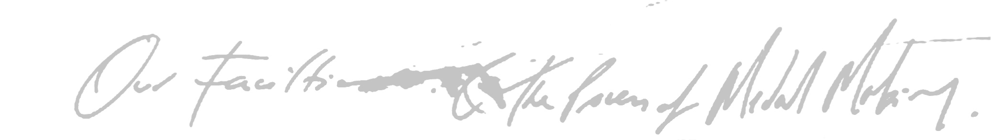
Our Facilities and The Process of Medal Making
10

Slide 14
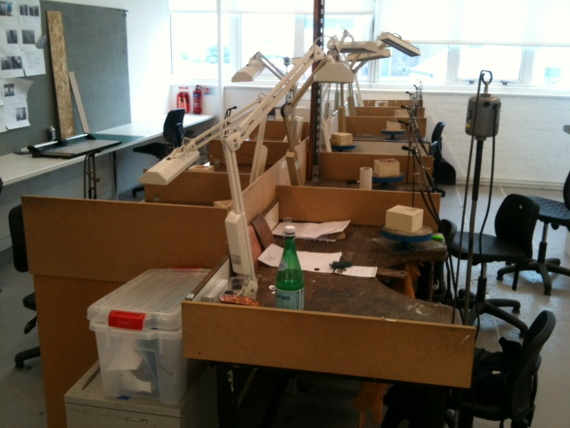
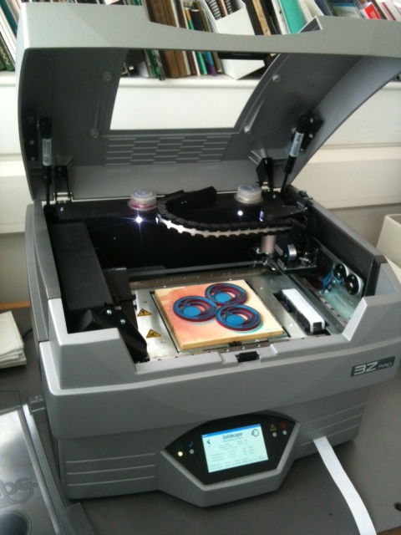
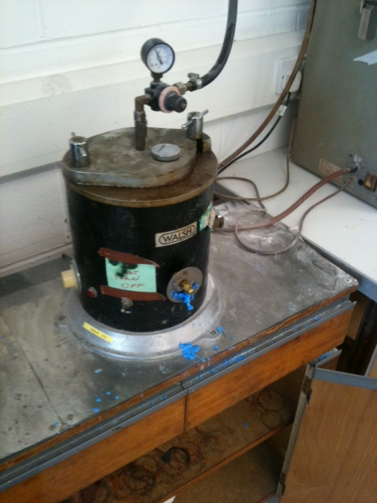
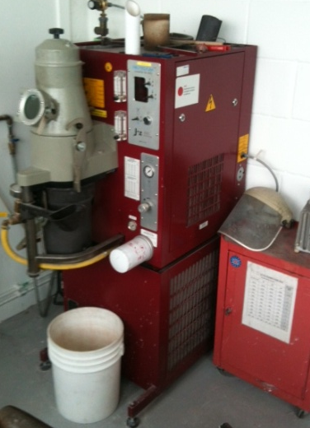
School Facilities
Solidscape and Benches
Besides old fashioned benches where the majority of our metal work and jewellery is fashioned the department also houses as brand-new Solidscape 3ZPro. One of the most defined and high resolution 3D printers on the market. Able to print at a resolution of 0.00254mm (finer than a hair) The Solidscape would be used to make master medals from which moulds would be taken. They would have a high quality finish.
Vacuum Casting Process
Using a process known as lost wax casting. A mould will be taken of our master medals and then replicated in waxes. These waxes will then be cast in Sterling Silver and Bronze. Within the department we use a vacuum casting unit which creates accurate and clean casting of the same quality found in any professional casting firm.
Multiple casts can be done over several weeks and this process of Lost wax castings is widely used within the larger jewellery world when creating multiples. Jonathan Boyd has spent 4 years researching complex casting systems and Nigel Munro has 25 years of precious metal casting experience.
11

Slide 15
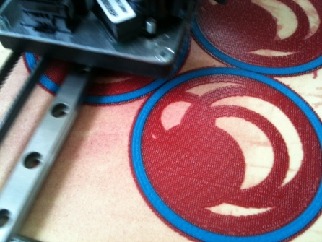
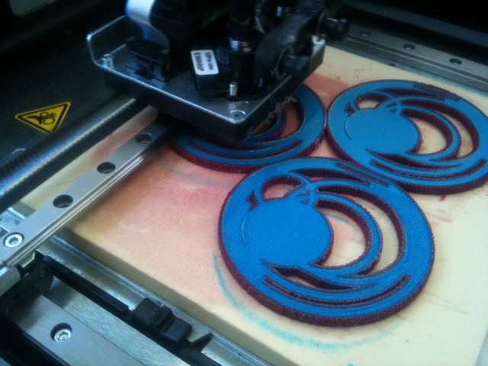
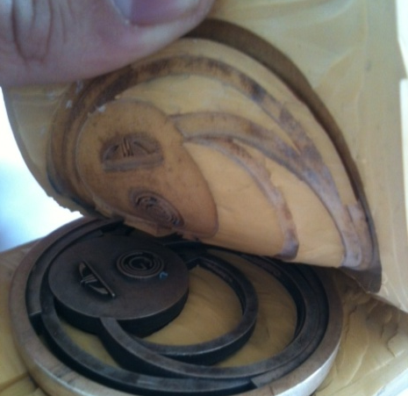
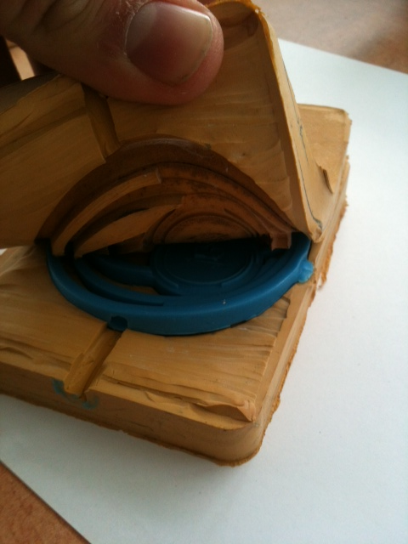
How the medals would be made
To achieve a high standard of production, 'Master' medals will be fabricated in wax on our SolidScape rapid prototyper. The 'Master' will be cast in sterling silver using the lost wax process and then hand finished to a extremely high standard.
Once cast rubber mould will be taken from the 'Masters' and in turn multiple waxes taken from these rubber moulds. These waxes will then be cast in Sterling Silver and Bronze and all finished to the same high standard. Once finished the required amount will be sent to a supplier for gold plating.
12

Slide 16
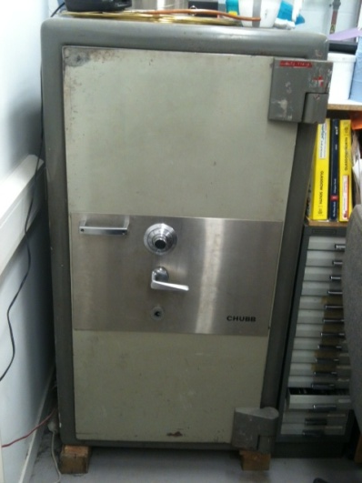
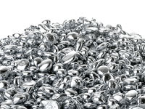
Security & Confidentiality
It is important within this proposal to outline our strategy for security of the material and of confidentially of the design.
Security of stock and medals: The Silversmithing and Jewellery department has a long history and relationship of using Argex (the company that will be supplying our Sterling Silver casting grain) because of this Argex will allow us to purchase our large bulk order of material and store it for us until we need quantities of it. This offers two positives, firstly it means that the we will only have on site the material we are working with that month and secondly the remaining material will be held safely by our supplier.
Whilst in production silver grain and medals in production will be housed in a specially designed locked storage unit held within our safe at S&J. The safe measures approximately 5 x 3.5 feet is a solid unmovable object which can only be accesses by Nigel Munro and Helen Marriott.
It is also our suggestion that Medals be delivered to the Games Team in units. This would provide the Games Team and committee with confidence in the production of medals and out timetable as well as keeping the stock held within GSA at a lower level.
Confidentiality: As with the prototype designs shown within this proposal GSA will not outsource or discuss any potential deal with the Commonwealth Team until they have announced an arrangement publicly. Regarding the working process used for the making of the medals it would be our suggestion that this is a source of interest rather than secrecy. Where our proposal may differ from other producers is the hand crafted and production techniques by well known jewellers. We think this could be a great PR opportunity for both GSA and the Commonwealth Games.
13

Slide 17

The Costs
14

Slide 18
Provisional Fee Quotation
Project Budget
Design & Prototyping Fee | £25,000
Materials | £107,450
Production fee (silversmithing and facilities) | £43,750
Estates & Indirect costs (HE FEC/TRAC) | £48,000
Total | £224,200
Fee Quotation
Materials | £107,450
Production fee (silversmithing and facilities) | £43,750
Sub Total | £151,200
VAT | £30,240
Total | £181,440
Glasgow School of Art Contribution
Design & Prototyping Fee | £25,000
Estates and Indirect costs | £48,000
Total | £73,000
15

Slide 19
Our Proposed Timetable
16

Slide 20
Proposed timetable for production of medals
Fabrication of Master Medals | End of July/August 2013
Waxes Taken | July – October 2013
Casts of 1,500 Medals | July – October 2013
Cleaning and Finishing of Medals | September – December 2013
Gold Plating of 492 Medals | January 2014
Acquisition of Boxes & Ribbon | September- November 2013
Design and Fabrication of Pins | January –February 2014
Finishing of Medals and Packaging | February 2014
Final Handover of Completed Medals | March – April 2014
Dates for arranging Commonwealth team to visit production can be arranged if proposal is given go ahead.
Our Requirements- As part of our timetabling it is key that we are given ample time to get started in the process of making and prototyping.

Slide 21
Summary
In summary we believe that Glasgow School of Art and the staff at Silversmithing and Jewellery can create a bold, beautiful and adventurous design for a medal. We also believe that a design created to solve the problems of higher precious metal costs, like the prototype medal, will not only address aesthetic but also be genuinely innovative reflecting Glasgow's worldwide reputation as a leader in art and design.
Through the production of this proposal we have created a timetable which fits and suits both the Commonwealth Team's need for punctual arrival of medals whilst providing time for the GSA team to create individually hand crafted medals.
At GSA we want to be part of the Games and like the Commonwealth team want to display our pride in the city we live in.
We believe that our proposal offers the Commonwealth Games a fantastic opportunity to have unique hand crafted medals, designed in Glasgow, by an internationally exhibiting Glasgow based jeweller and built by an all Scottish team of world renowned jewellers.
17

Slide 22
All queries to this proposal can be directed to Jonathan Boyd, Helen Mariott and Colin Kirkpatrick
Glasgow School of Art
Jo.boyd@gsa.ac.uk
H.Mariott@gsa.ac.uk
C.Kirkpatrick@gsa.ac.uk
0141 323 4624
Thank you
18

