Slide 1
Rescuing Rennie Mackintosh
Duncan Chappell
Glasgow School of Art

Slide 2
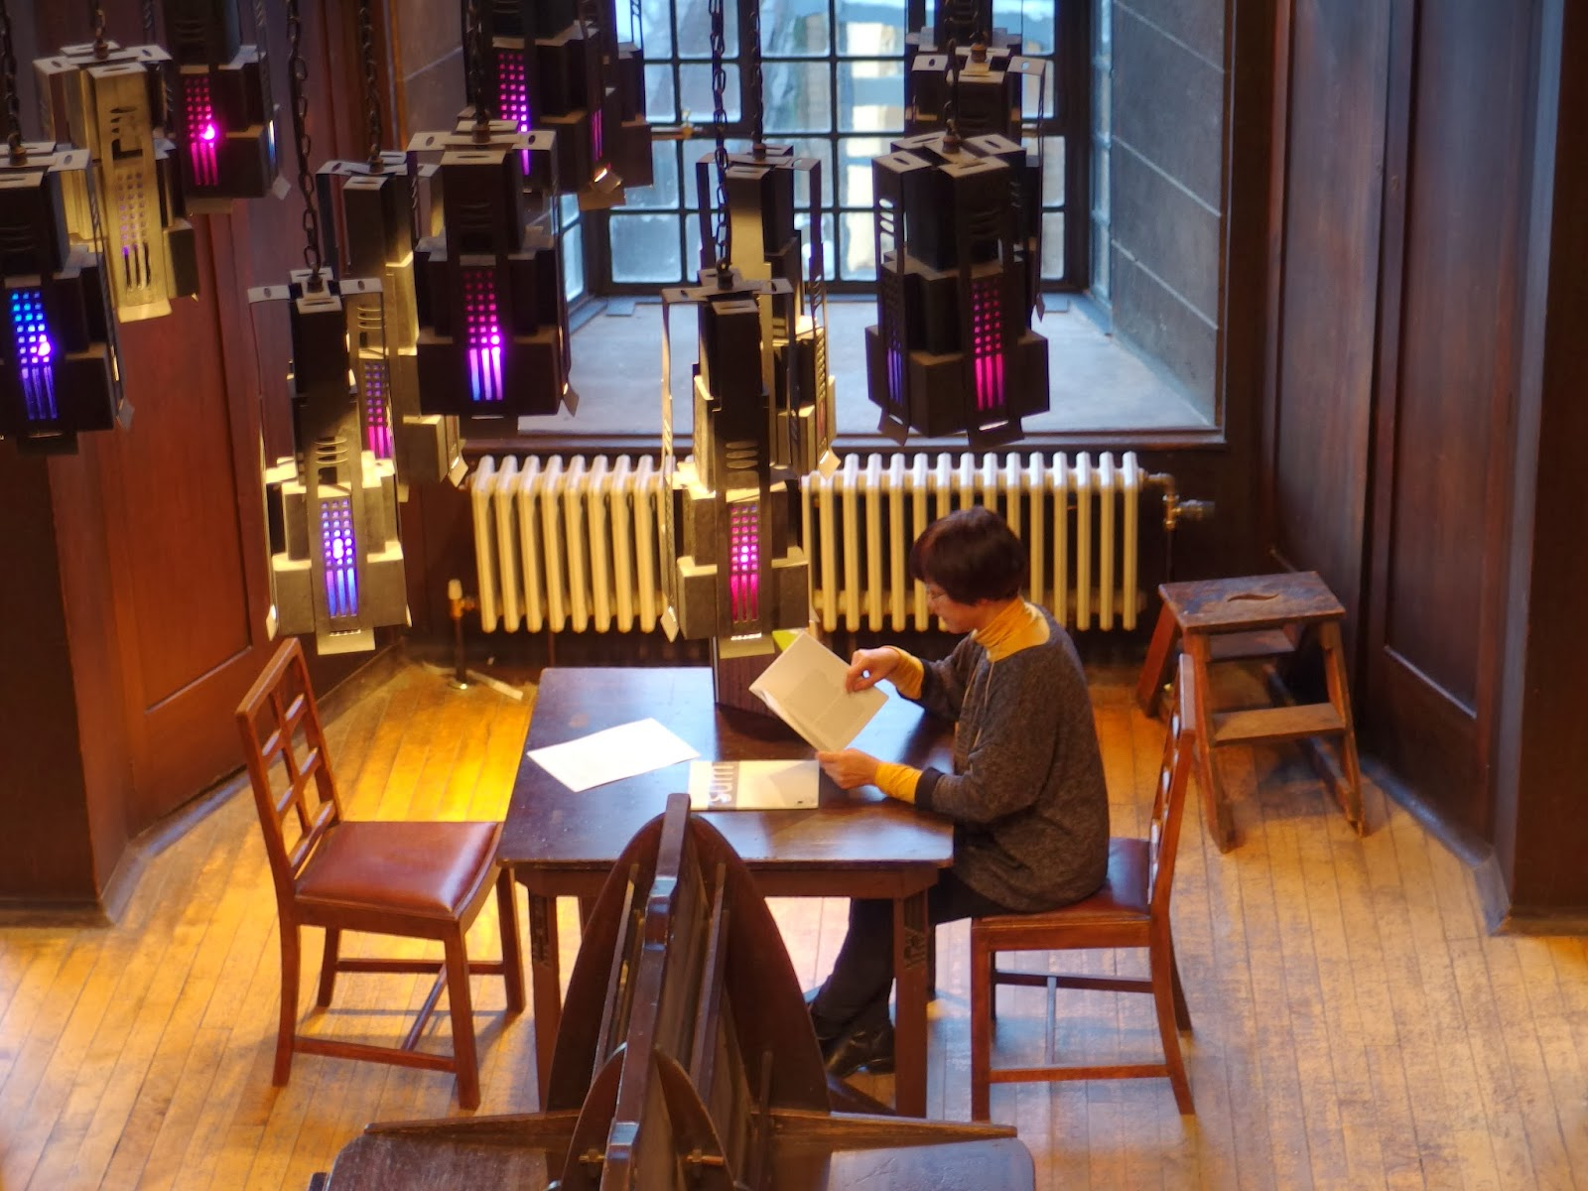
Notes:
Many of you will be aware that on the 23rd of May 2014, a devastating fire at the Glasgow School of Art totally destroyed the world-famous Mackintosh Library and its important historical collections.
One of the most important and widely recognised library spaces in the world, it was designed by Charles Rennie Mackintosh between 1907 and 1909 as part of the second phase of the Art School building.
It was generally accepted as one of the finest Art Nouveau interiors internationally, and any visitor to the space could not help but be moved by its architectural and aesthetic beauty…
…From its hand-painted balusters to its pierced wooden pendants, and from its coloured-glass hanging lamps, to its original tables, Windsor chairs and periodicals desk.

Slide 3
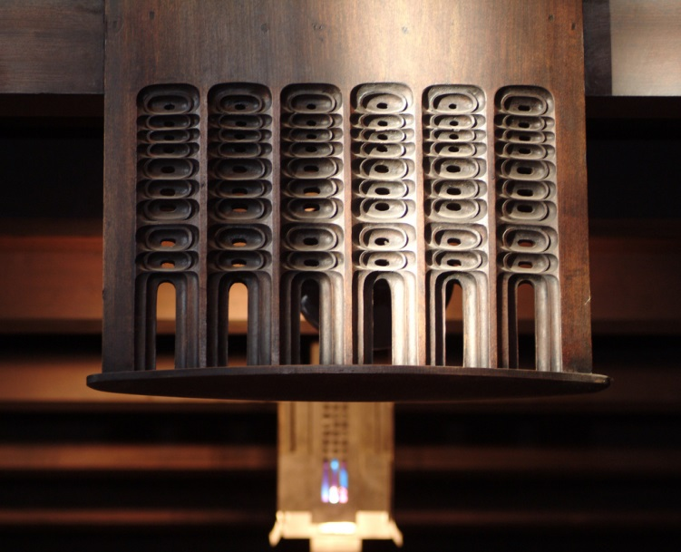
Notes:
Balcony pendant

Slide 4
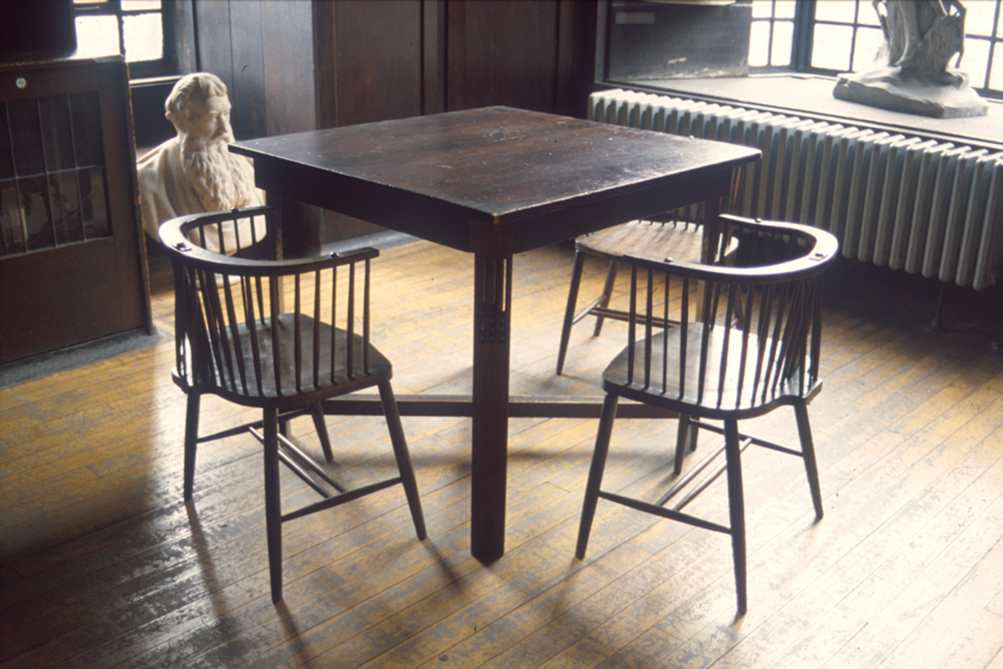
Notes:
Original Windsor chairs with table, the latter with pendants to reflect those above at balcony level.

Slide 5
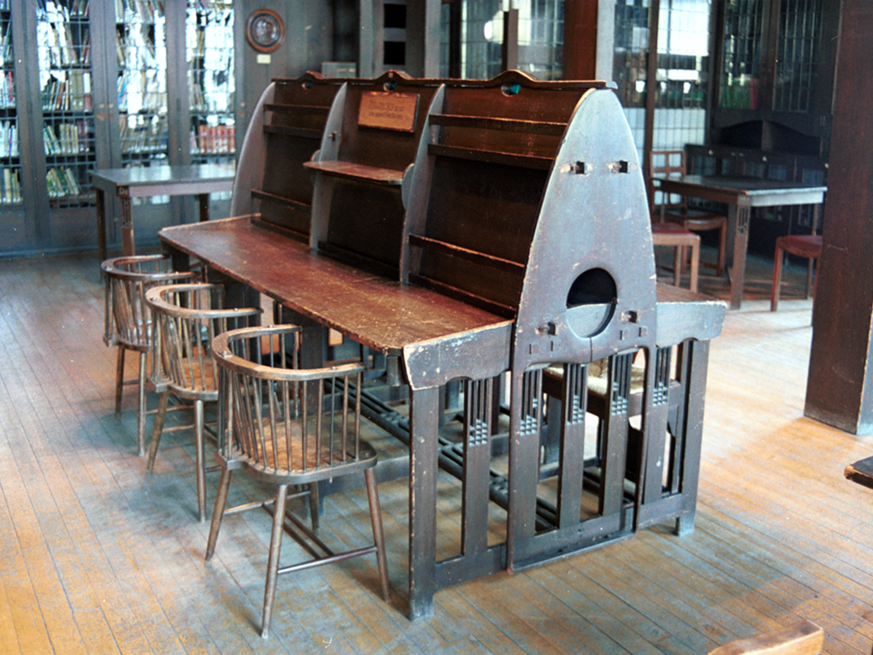
Notes:
Periodicals desk and chairs

Slide 6
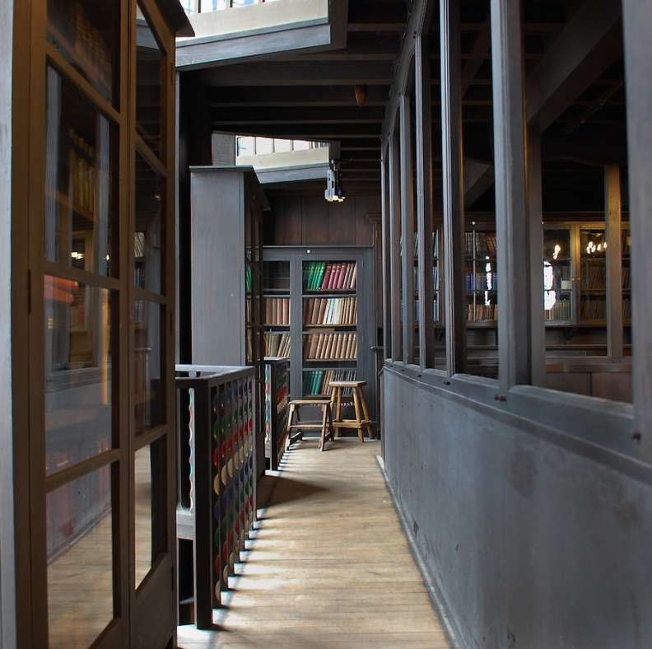
Notes:
Writing on the symbolic allusions of Mackintosh’s design, James Macaulay, in his authoritative 1993 Phaidon account of the building , states “…the library of the Glasgow School of Art is not only an aesthetic experience but the translation of philosophical thought into three dimensions.”
The building as a whole has been described by Sir Christopher Frayling, Rector of the Royal College of Art, as “the only art school in the world where the building is worthy of the subject...this is a work of art in which to make works of art”.
As an architectural space, the Library was built across 3 levels, comprising a ground floor, a mezzanine balcony (which can be seen here) running along all four sides, and a bookstore above (latterly used as a furniture store).
Nearly all the wood employed in the design is oak.
Mackintosh employed some innovative and unusual engineering solutions when constructing these spaces.
The bottom levels were hung from two large cast-iron cross-beams in the store, with hangers dropped through subsequent levels and encased in oak to form dummy columns.
The columns themselves were therefore non-supportive, with all load-bearing undertaken by the cross-beams and hangers.
At ground floor level the dummy columns formed a nave-and-aisle plan, though the space itself was square rather than rectangular.

Slide 7
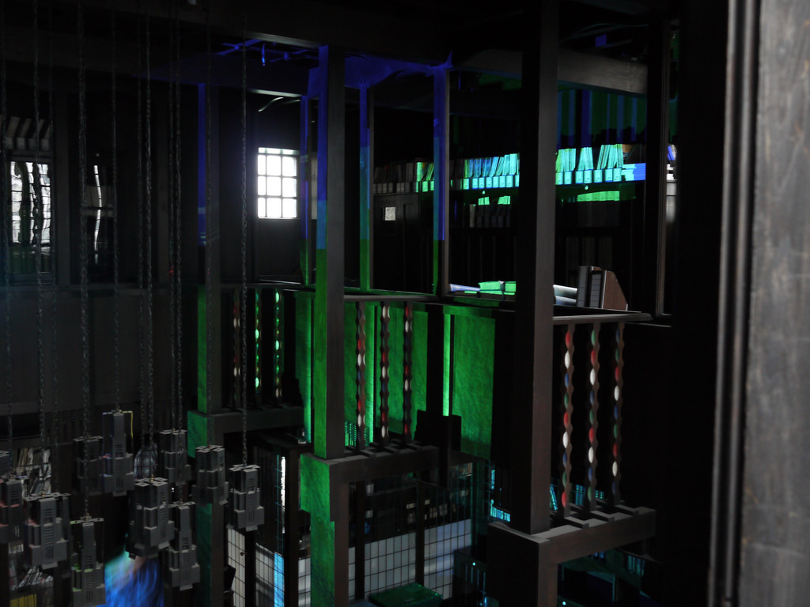
Notes:
You can perhaps gain a better sense of this interrelation of levels in this photo, which shows digital light interventions staged by our Digital Culture students earlier this year.

Slide 8
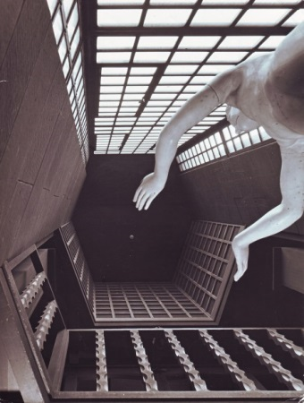
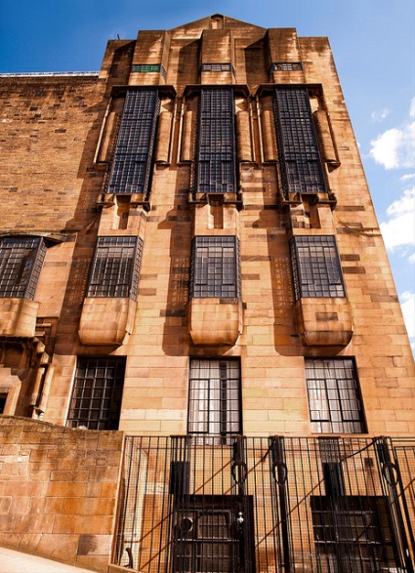
Notes:
Meanwhile, on the west façade, hexagonal voids allowed massive glazed windows to rise up through all three levels, increasing the light available to the space.
Macaulay has compared these vast windows to those at York Minster.
The implications of this construction and layout for the spreading of the fire of 23 May are yet to be fully analysed, but will no doubt form part of the Fire Brigade report to be released later in the year.

Slide 9
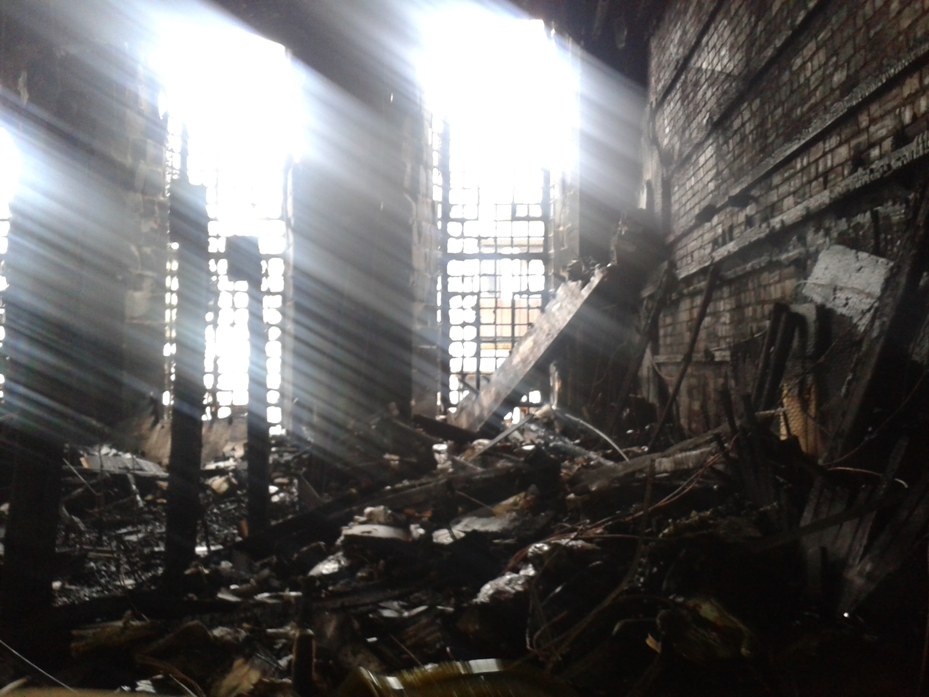
Notes:
Unhappily, On 23 May 2014 all these spaces were destroyed by fire.
These photographs of the destroyed library spaces were taken two days after that fire.
They were taken with a camera phone, so the resolution is very low, but it will give you a good indication of the extent of the devastation.
The remains of the dummy columns can be seen on the left
To the right, the ferocity of the fire is evidenced by how the wood facing has been completely stripped back to bare brick

Slide 10
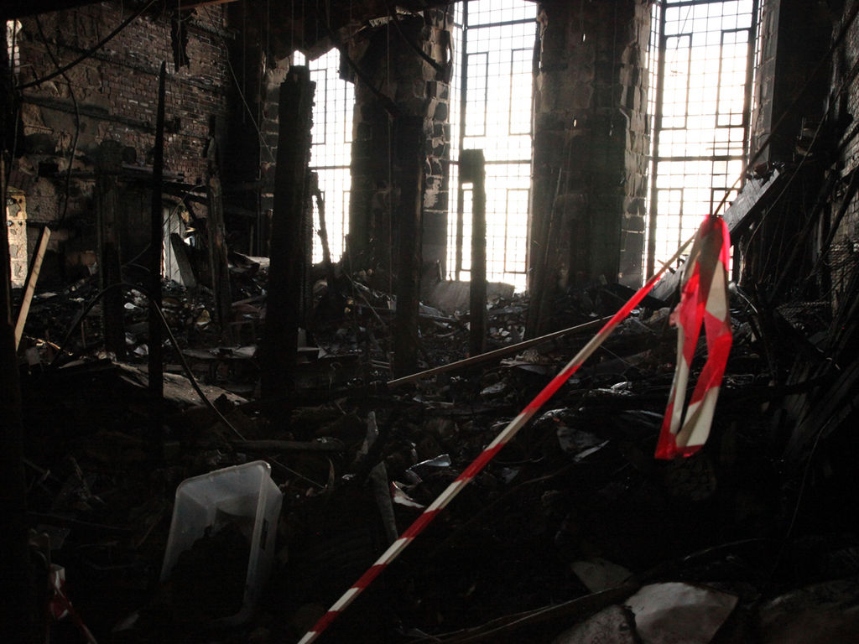
Notes:
Another view of the devastation, looking towards the west windows.
You can see that the former mezzanine level has completely collapsed down onto the ground floor.

Slide 11
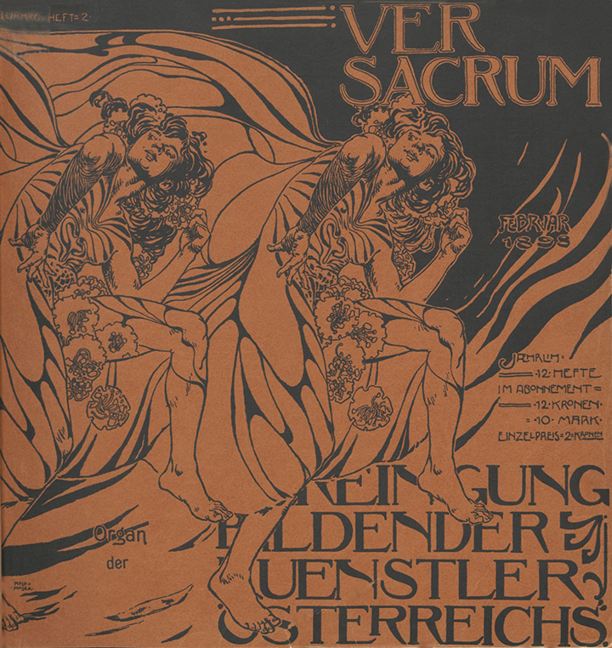
Notes:
But of course any historic library is more than just an architectural space.
We also lost many treasured irreplaceable collections in the fire, including books dating to the 16th century, rare avant-garde journals (such as Ver Sacrum – the journal of the Vienna Secession - that you see here) and 19th century illustrated books by our former staff and alumni

Slide 12
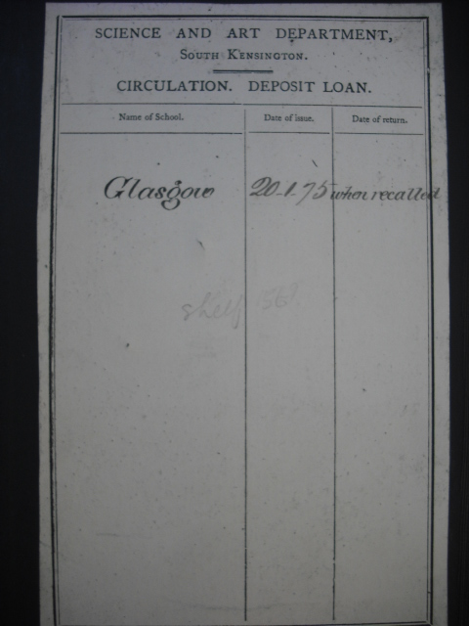
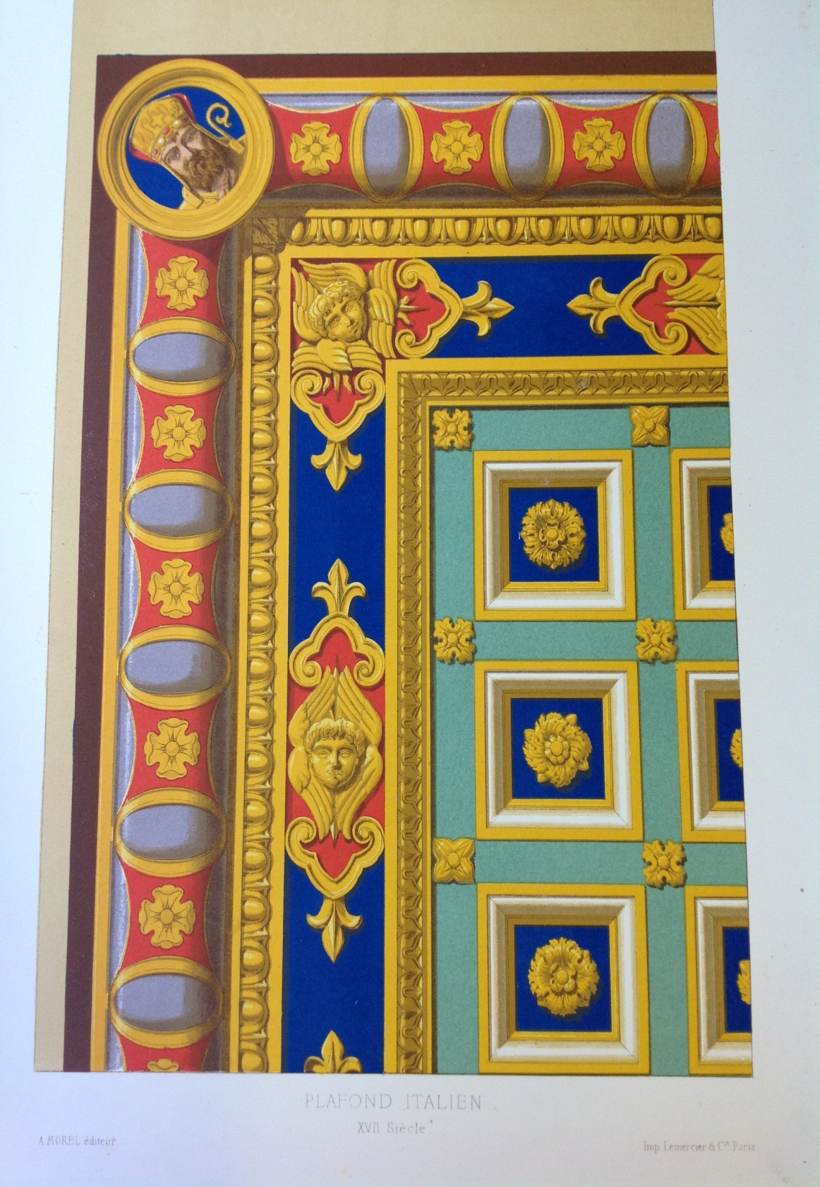
Notes:
We also lost a significant proportion of the School's Foundation Collections, which came to us from the then South Kensington Museum under the South Kensington system of arts education…
This obviously constitutes a great loss to the School’s institutional history

Slide 13
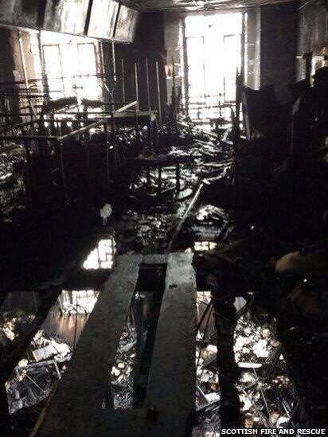
Notes:
Several items from our Mackintosh and non-Mackintosh art collections were stored in the former bookstore above the Library, and so were also lost.
This includes several paintings, some decorative arts, and items of duplicate Mackintosh furniture not then on display in our public furniture gallery.
The photo shows the former library bookstore (latterly the furniture store) looking down through the rafters into the library below.
You can make out the metal skeletons of the former painting racks.

Slide 14
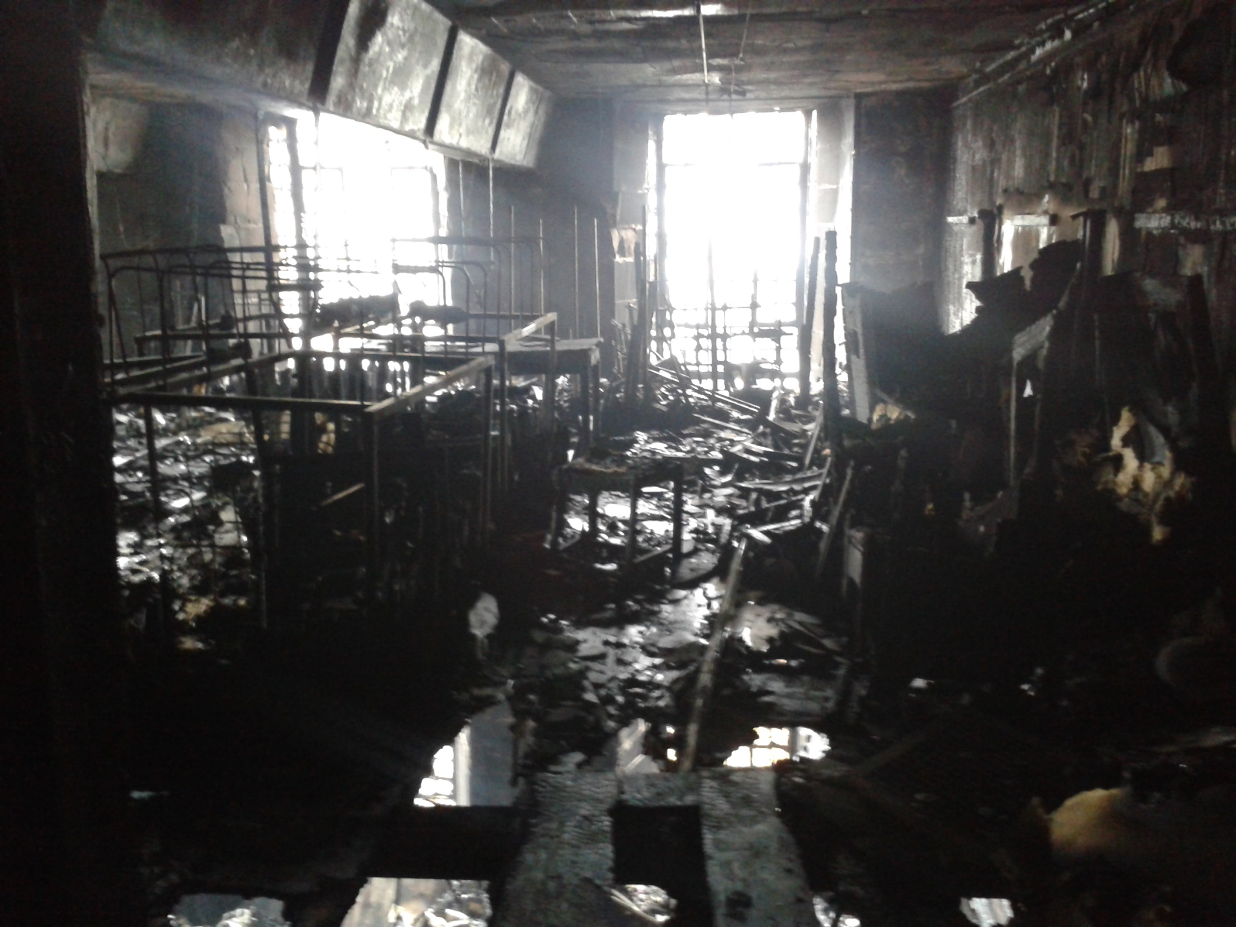
Notes:
You can perhaps get a better view in this image

Slide 15
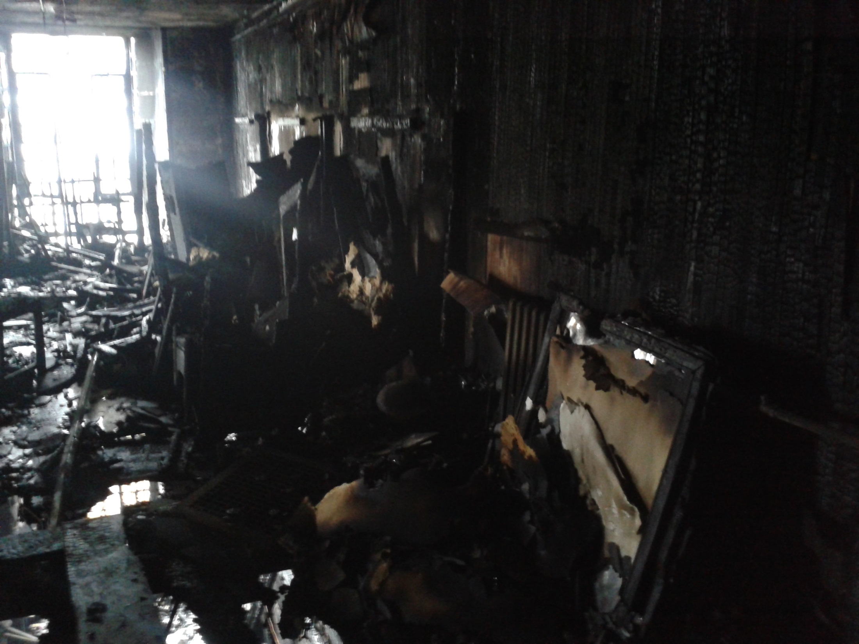
Notes:
And another view of the store with some of the destroyed canvases to the right

Slide 16
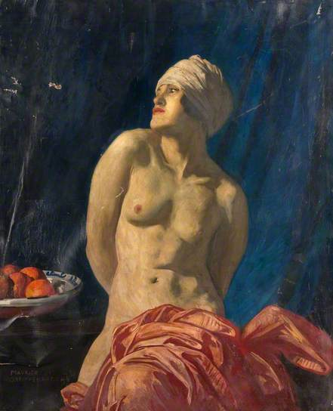
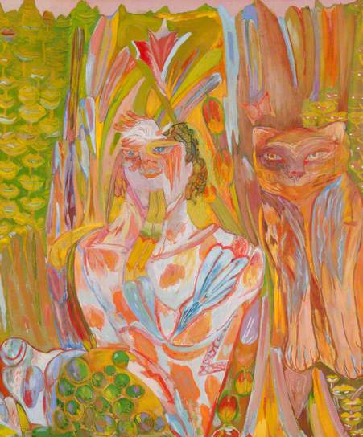
Notes:
Two of our destroyed paintings:
Nude with a wrap by Maurice Greiffenhagen (1924), a former Head of Painting
Pan by Carole Gibbons (1970), a GSA graduate

Slide 17
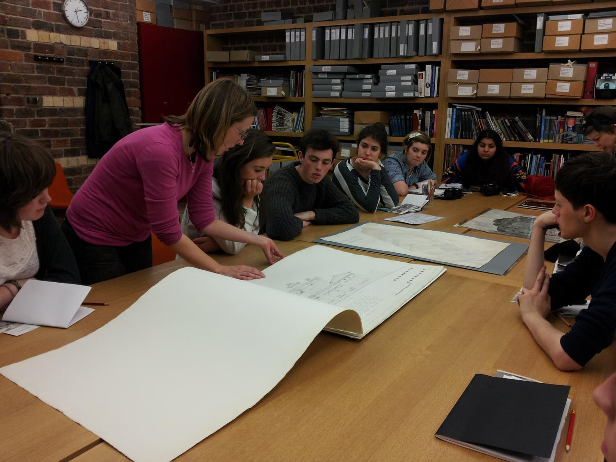
Notes:
The School’s Archives miraculously escaped the fire, despite the fact they were housed in the basement level where the fire originated.
Since 2008 they have been housed in environmentally-controlled stores close to a public reading room.
These were created as part of an HLF-funded Mackintosh Conservation and Access Project which aimed to conserve the fabric of the building and its archive and museum collections, and to enable enhanced access to our heritage assets.
The total project cost in the region of £8.6 million.
Subsequent to the fire, these facilities are now closed for the foreseeable future, and Archives and Collections staff are currently planning for the relocation of their collections and services to elsewhere in the city.

Slide 18
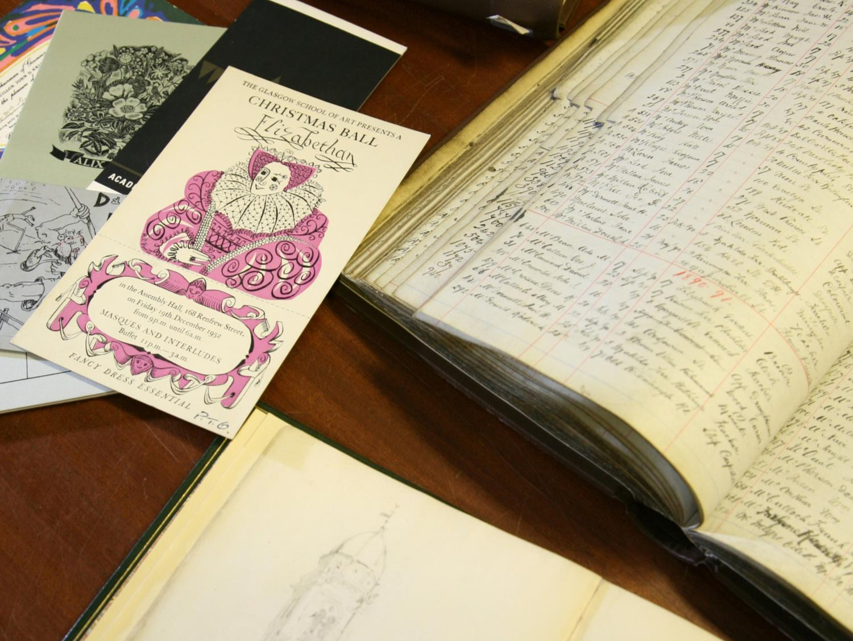
Notes:
These collections include a wide range of material relating to GSA’s history, activities, buildings, staff and students.
Material ranges from paper archives, photographs, sketch books, textiles, architectural designs, and posters.
The sheer variety of artefact obviously complicates subsequent salvage and conservation efforts.

Slide 19
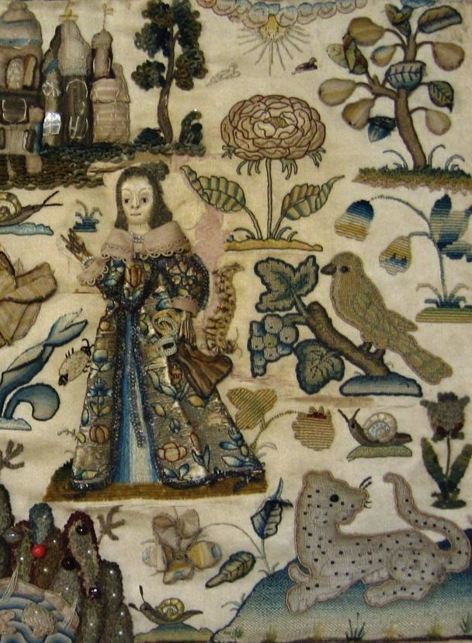
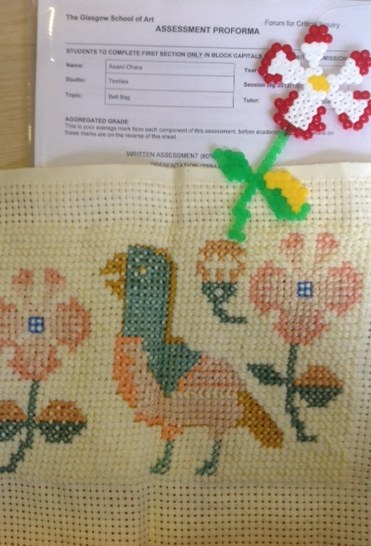
Notes:
Traditionally, Archives have placed a large emphasis on using these artefacts to stimulate and inspire current practice in our students
This is an example of course work created by a second year student in response to a piece of 1652 stumpwork held in our Archives

Slide 20
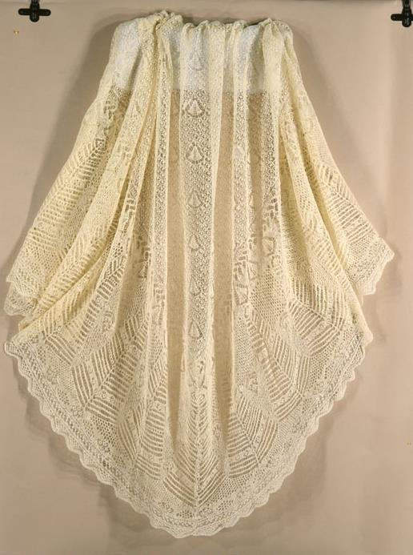
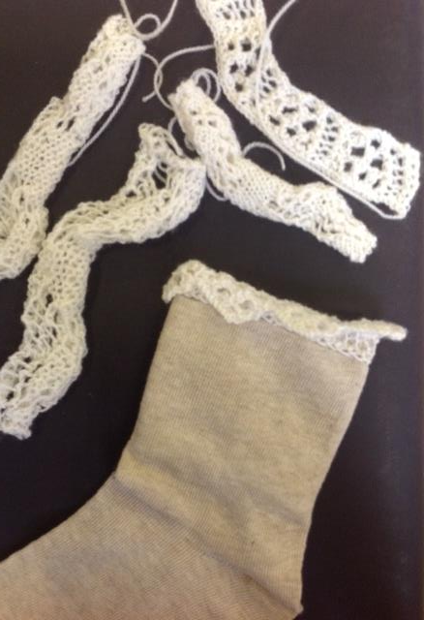
Notes:
And another example of student work, this time in response to a 19th Shetland lace shawl
Our planning for the long-term conservation and storage of these displaced collections therefore has to take into account continued student access
So that the collections can continue to play an active role in the learning and teaching activities of the School

Slide 21
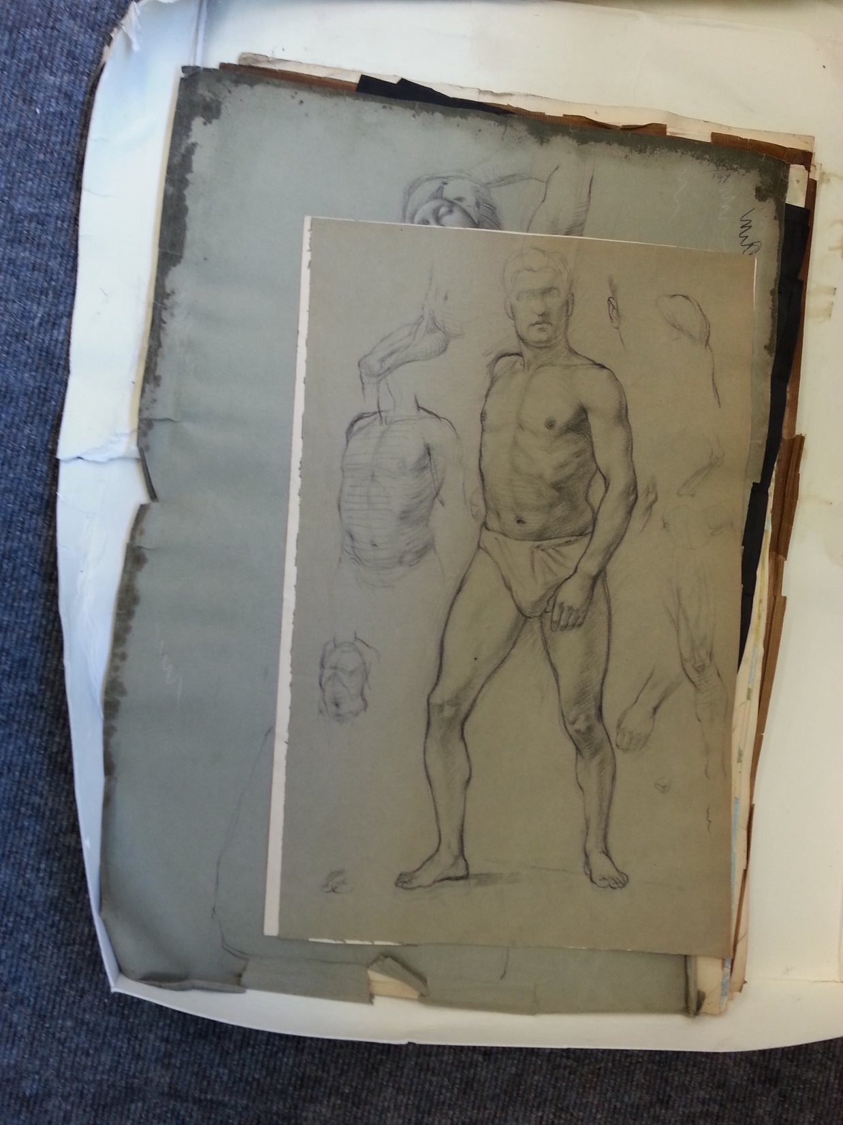
Notes:
Our archives, although safe, did suffer significant water and smoke damage during the fire and subsequent fire-fighting
In the immediate aftermath of the fire, with the loss of the library and much of our collections, our main priority quickly became the salvage of these damaged archives from the Mackintosh Building

Slide 22
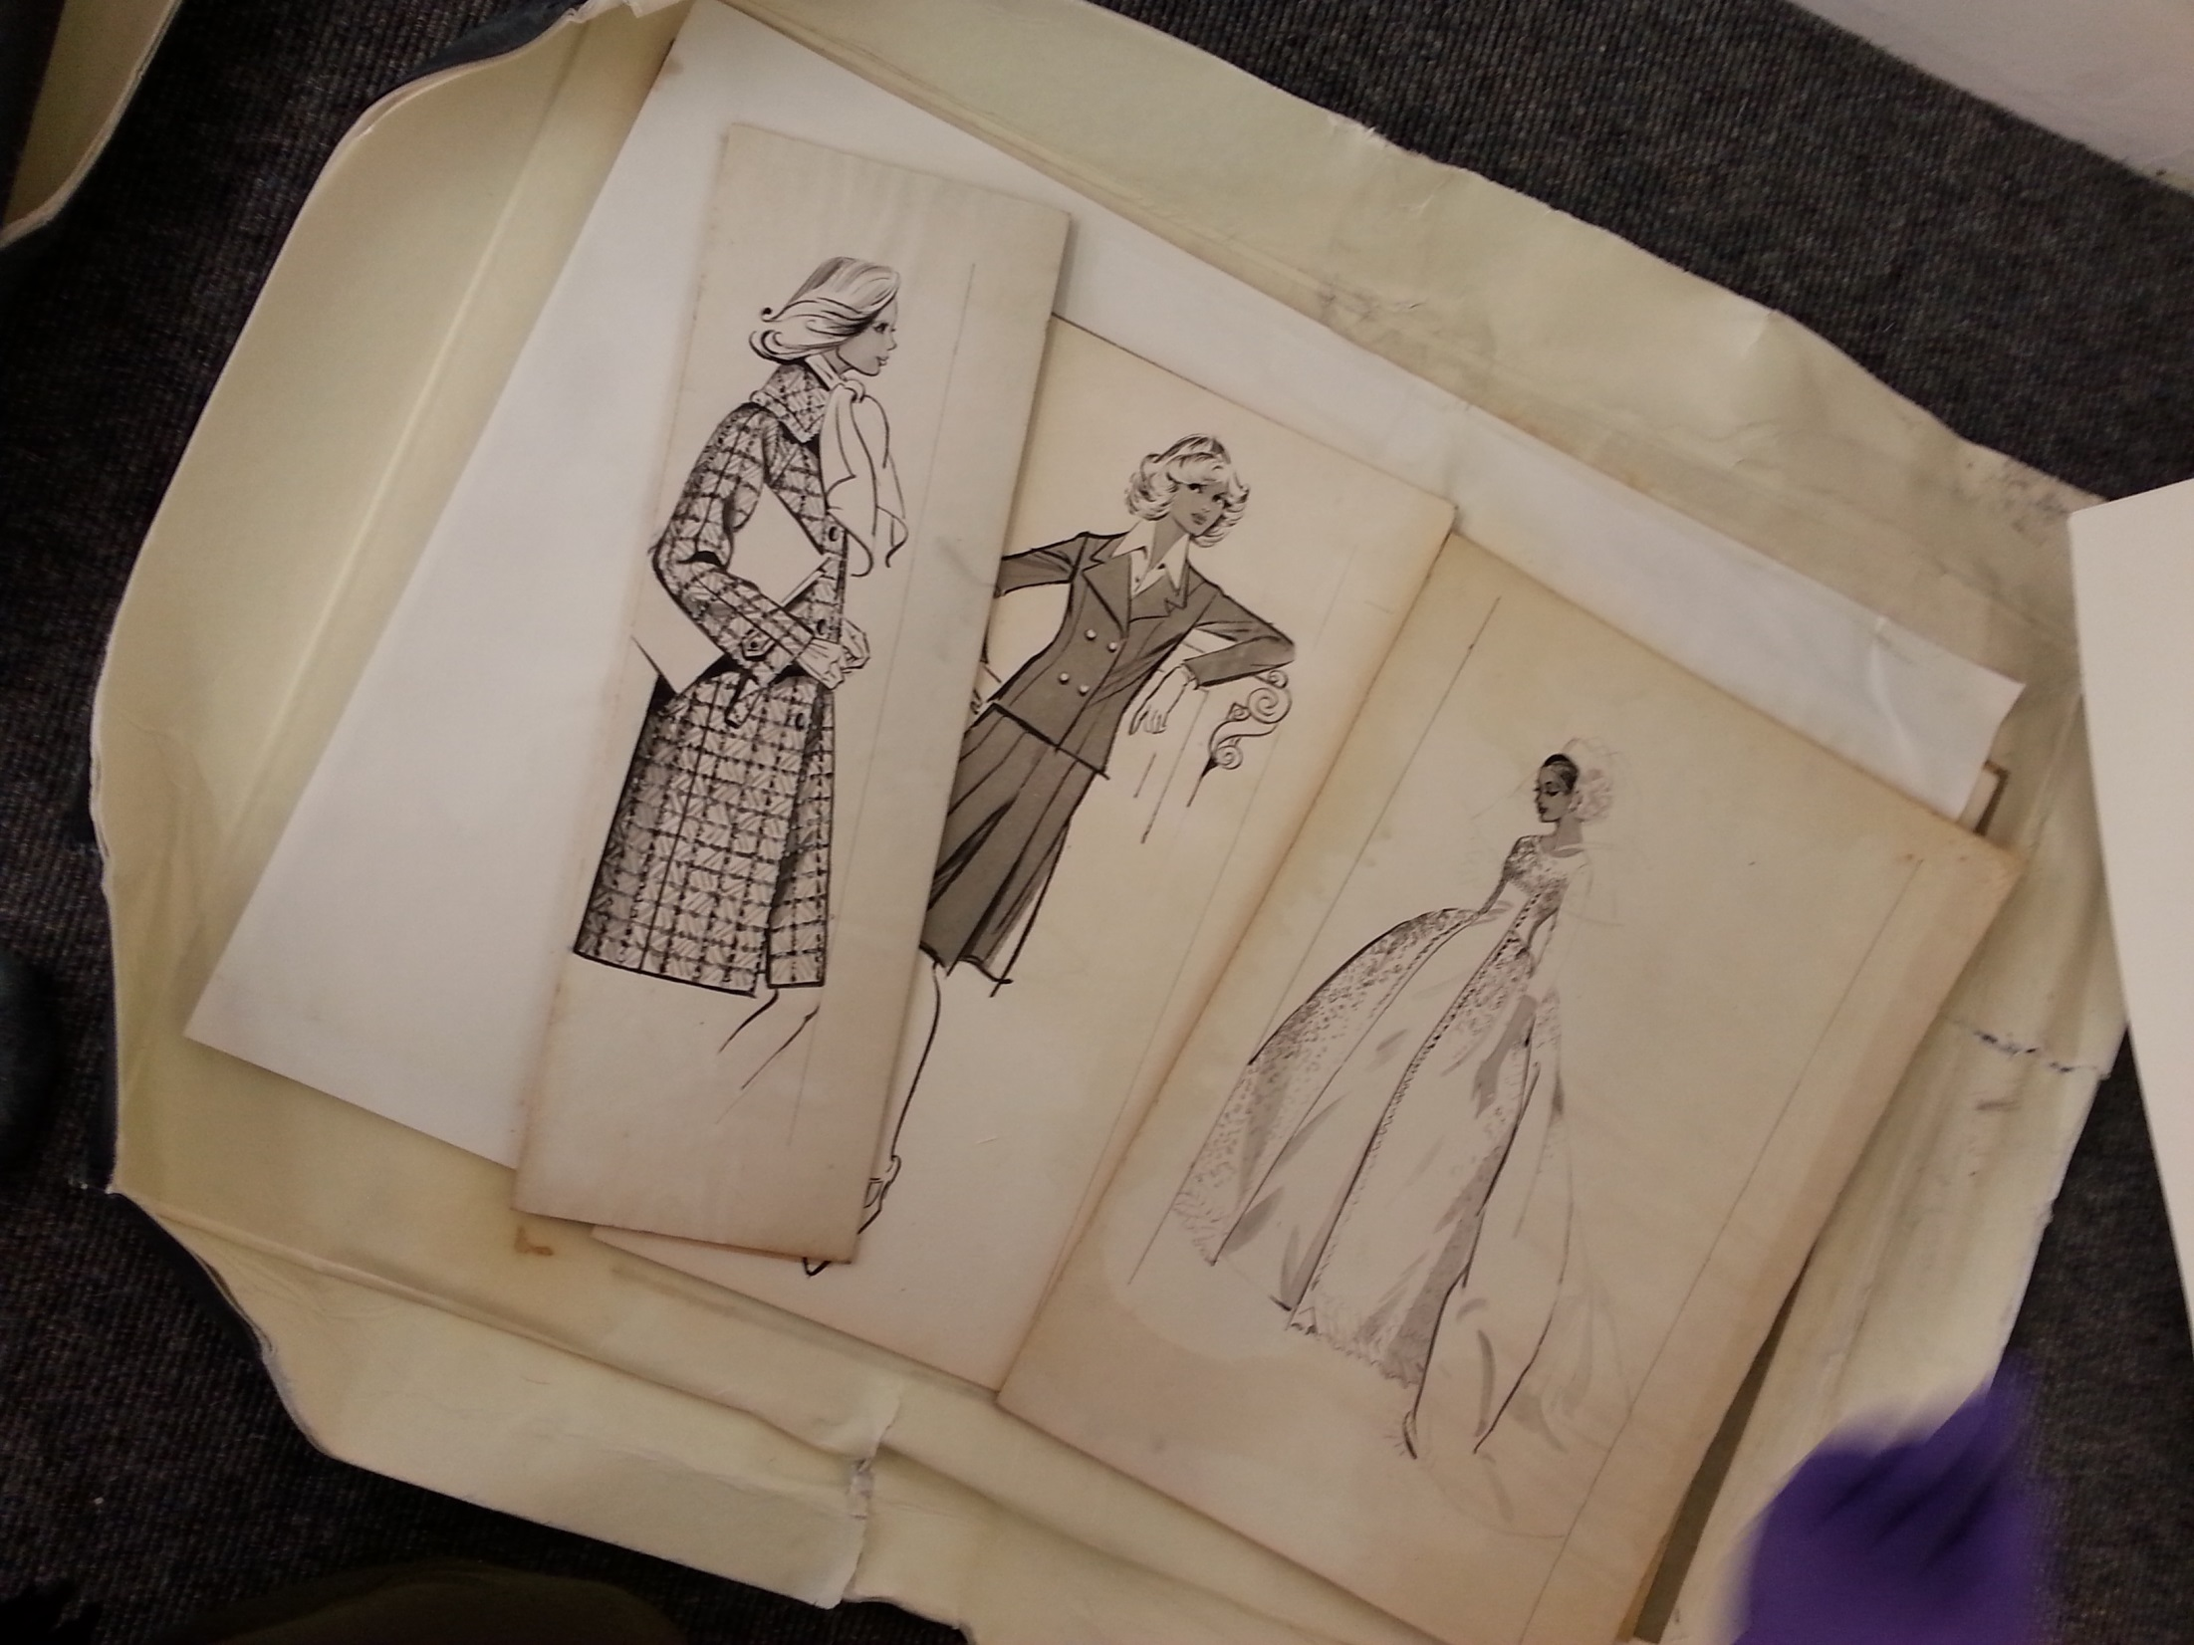

Slide 23
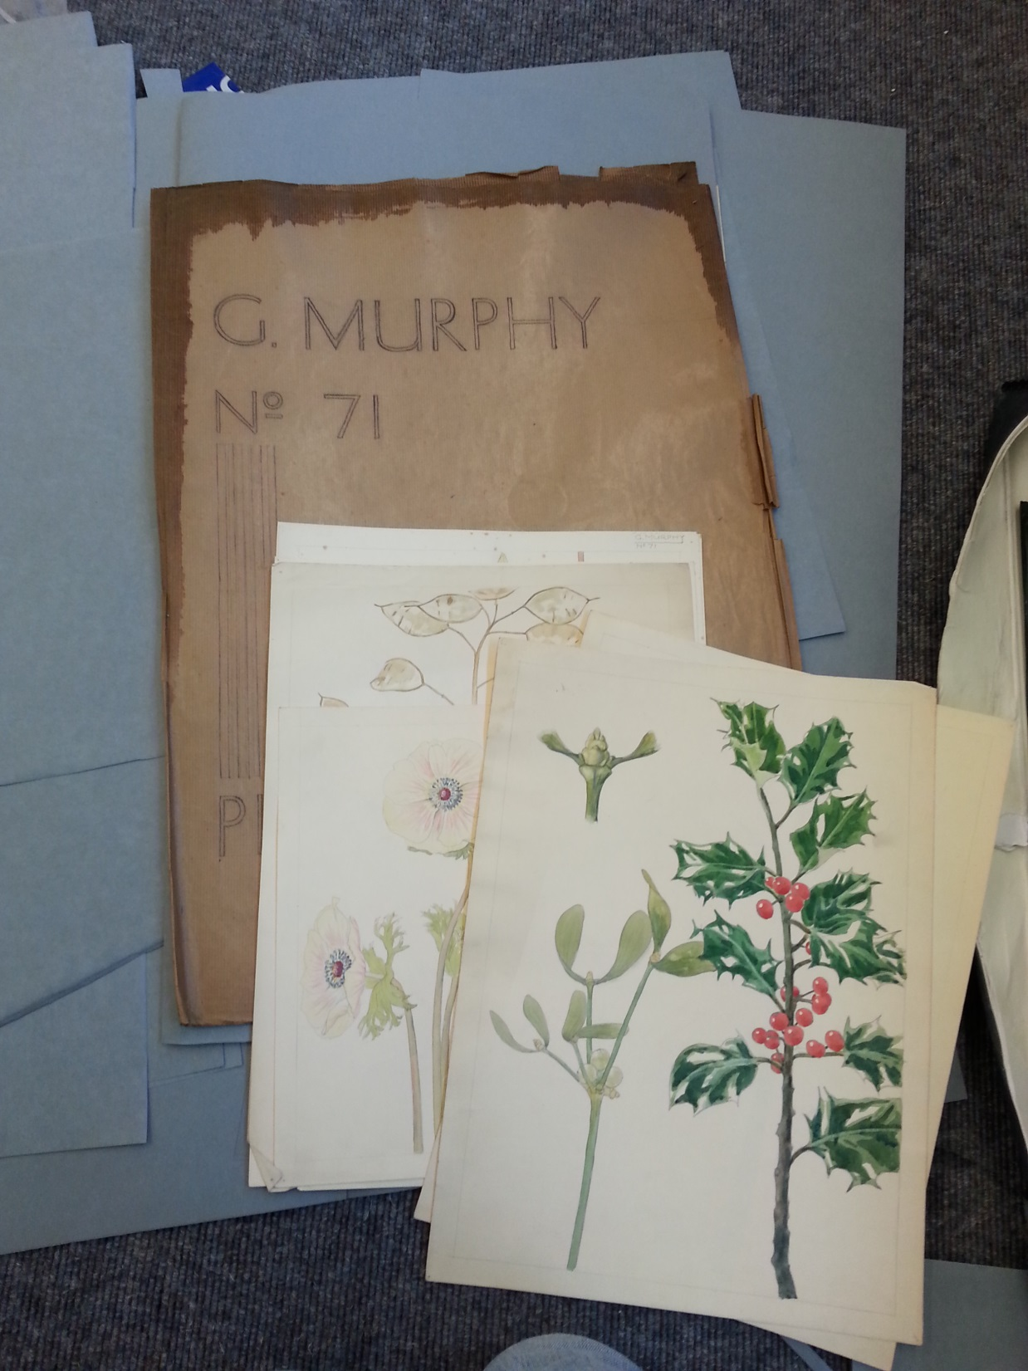

Slide 24
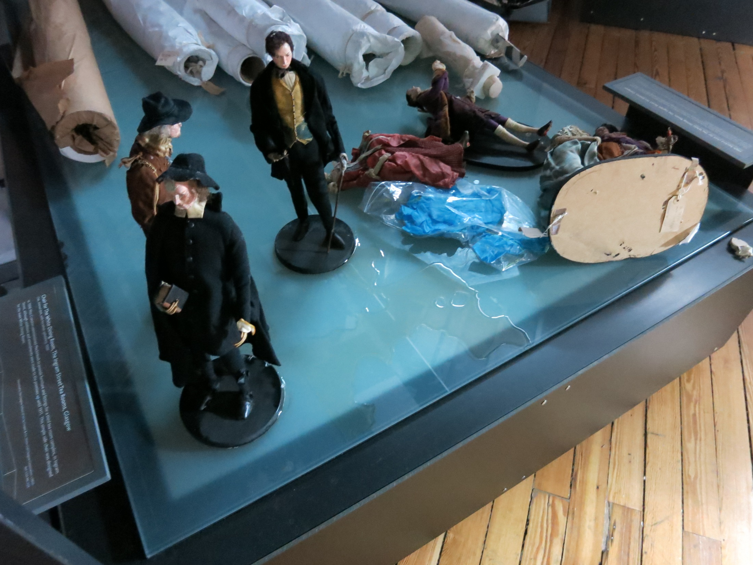

Slide 25
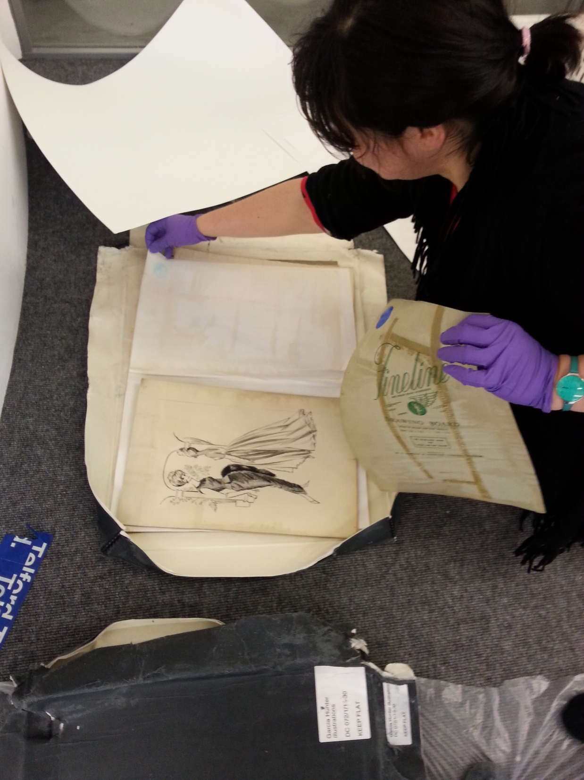
Notes:
We were aided in this salvage by many volunteers – including some academics – who willingly volunteered their time to help us
We were very humbled by the good will shown to us during this time, and by the generosity of all those who gave their time and support
It became apparent incredibly quickly how important it is to maintain a good roster of volunteers who are able to help at these times
And the importance of the close relationships we had built up with our teaching colleagues over a number of years became obvious

Slide 26
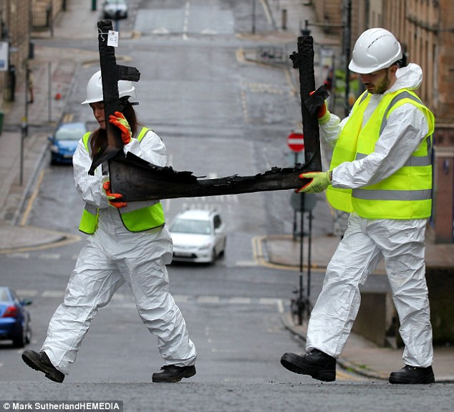
Notes:
For at least 3 days, it was all hands to the pump as we formed human chains to remove the damaged artefacts.
On the advice of conservators and the many other institutions who offered us their guidance, we salvaged almost anything that looked as if it could potentially be of interest
In fact, we probably salvaged items that ultimately are of no use or value, but at this stage we were, to an extent, working blind
So we adopted a conservative approach
The Mackintosh Building is an A-listed structure, so almost immediately after the fire, our colleagues from Historic Scotland were on site
They remained keen to salvage even small details that might later fill in blanks over the construction of the space

Slide 27
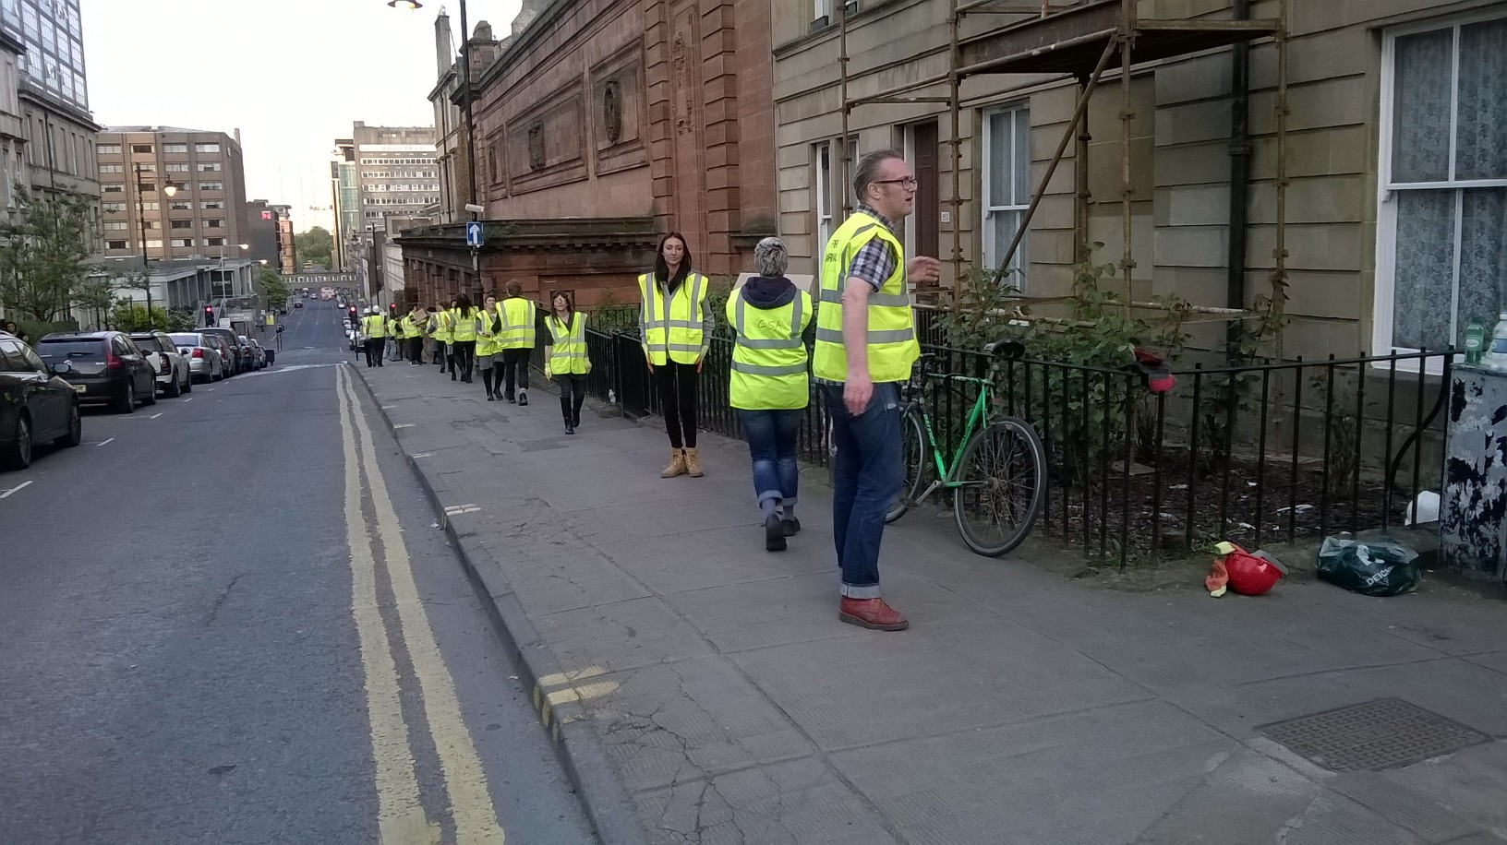
Notes:
Luckily we were able to lease the nearby McLellan Galleries very quickly from Glasgow City Council, in order to store their salvaged remains

Slide 28
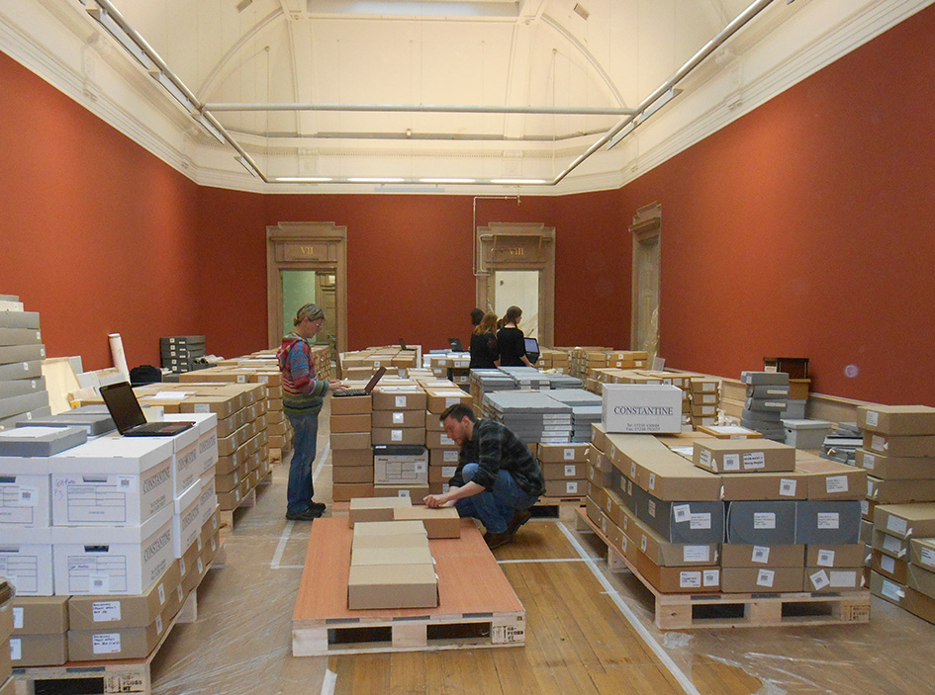
Notes:
A view of the interior of the McLellan Galleries, which some of our damaged, but intact, archives

Slide 29
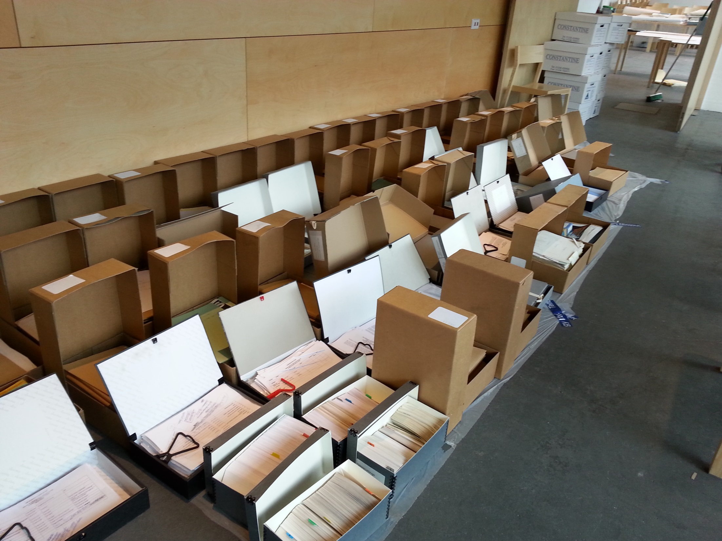
Notes:
We were also lucky to have sizable areas in which to sort and rest our damaged archives.
Phase 1 of our campus redevelopment had just been completed with the opening of our new Reid Building, located directly across the road from the Mackintosh Building.
This meant that we had large areas of floorspace, and a number of seminar rooms, that we could purloin
The fire occurred in May, towards the end of our academic year.
Had it occurred earlier in the year during core teaching weeks, we may not have been able to requisition so much space so quickly.

Slide 30
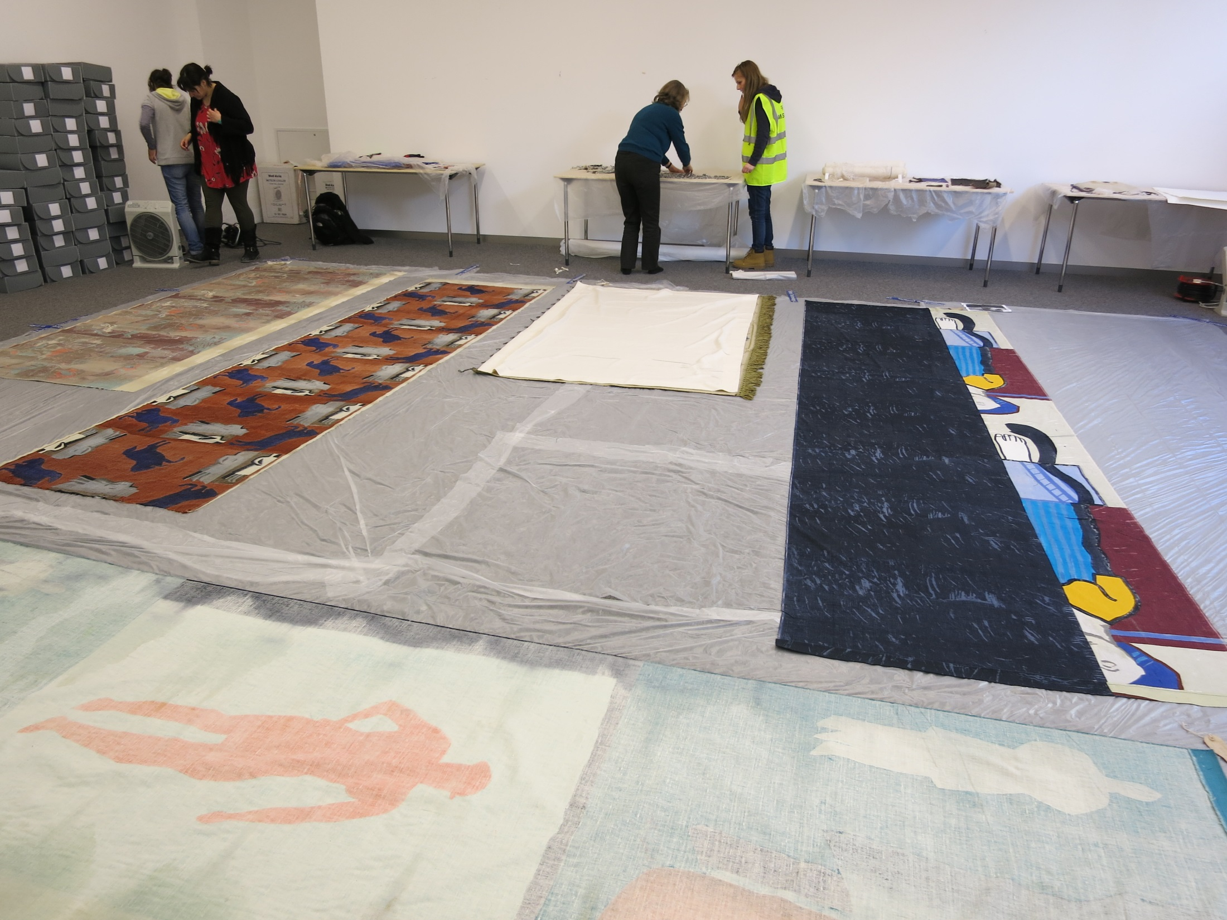
Notes:
We were aided in our salvage efforts by the Glasgow Area Disaster Planning Network
This group was initiated in 2004 by the Scottish Screen Archive and holds regular meetings, organises training events, and offers help to its members should a disaster occur.
Each member organisation is asked to sign an operational agreement and to submit their disaster plans
We were able to draw upon the expertise and skills of many experts across Scotland because of our membership.
This proved particularly important for a small organisation like ours, which does not normally retain conservators on its payroll.

Slide 31
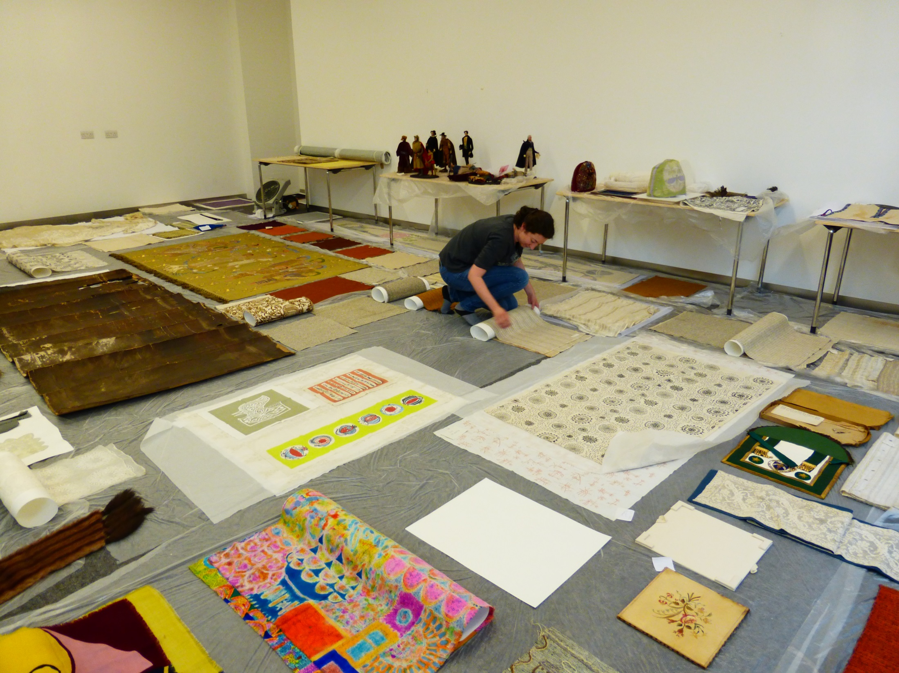
Notes:
Here you can see some textiles from our archives being laid out to dry
Once materials were salvaged, sorted, dried as far as possible, and recorded they were packed for transportation to temporary storage with Constantine’s just outside Glasgow
These facilities provide a humidity-controlled environment with CCTV surveillance
At the time of speaking these collections remain with Constantine’s until a longer term solution for storage and access is found

Slide 32
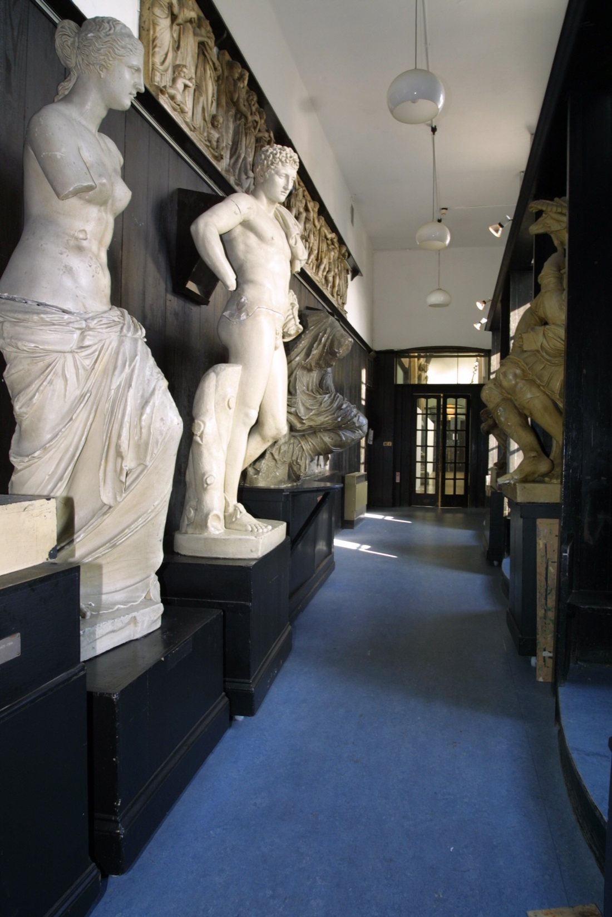
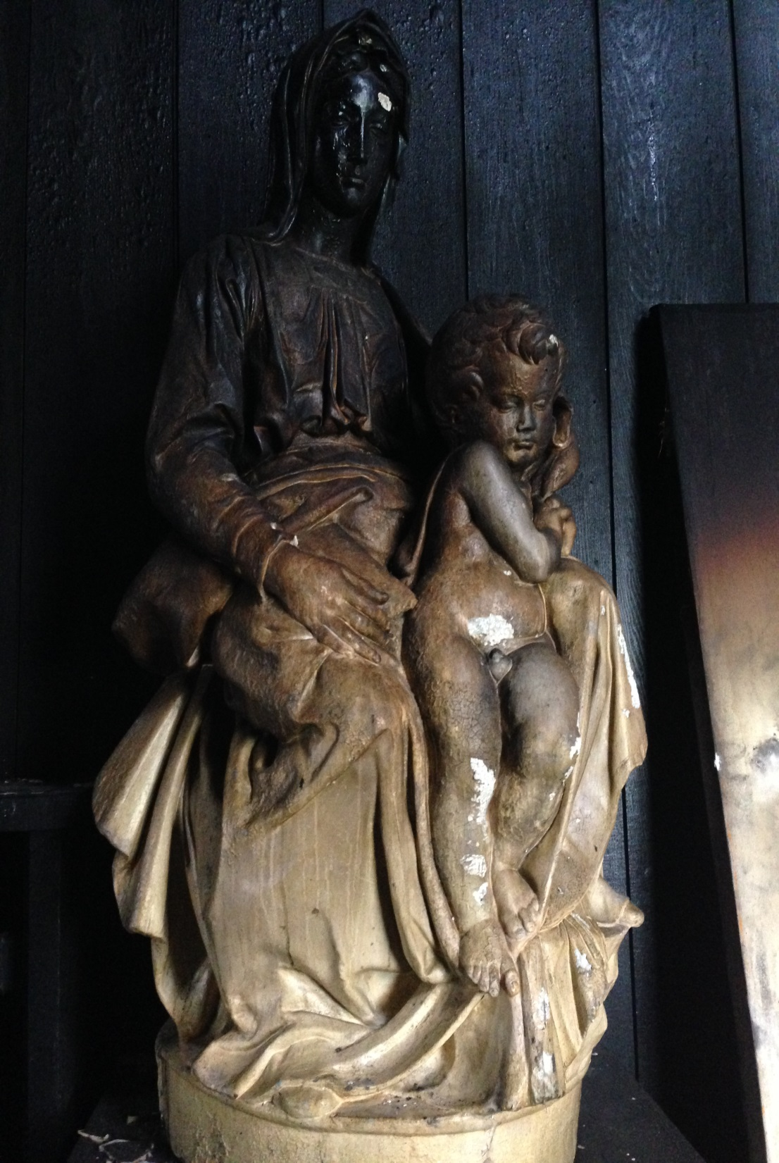
Notes:
The School also possesses a sizable collection of plaster casts of classical and medieval sculptures, purchased in the 19th century for students to draw from
These are much like the casts you will see here in the Cast Courts of the V&A and were a common pedagogical tool in art schools of the time
Some smaller casts were removed from the building during salvage operations, but the larger casts were too big to move safely
Indeed, moving them may in fact have caused more damage than simply leaving them in situ

Slide 33
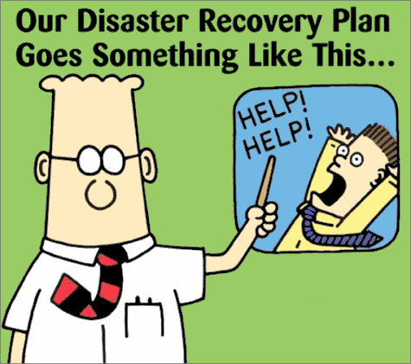
Notes:
Immediately after the fire, and certainly during our salvage operations, our departmental disaster plans provided us with an important overarching framework to guide our activities
Traditionally we have operated two disaster plans: one for the library, and one for archives and collections
But both follow best practice and employ the same consistent format
In common with most disaster plans, they outlined for us how to respond initially to the disaster, how to salvage different types of material, how to prioritise between artefacts, and, perhaps most importantly, how to designate the different team roles that are necessary for successful salvage
Many of you here will be much more acquainted with the drafting and operationalising of disaster plans than me

Slide 34
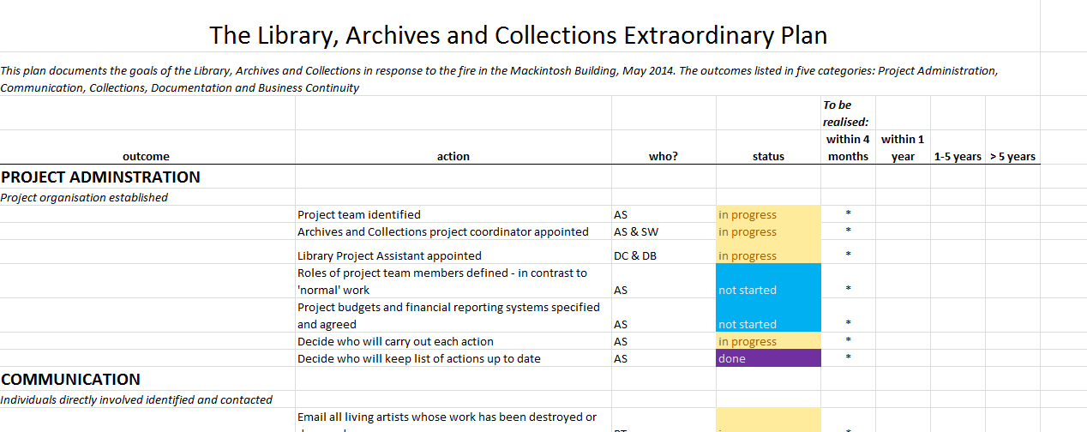
Notes:
Once the initial salvage operation was complete, our Head of Learning Resources convened an extraordinary working group, to take a long-term strategic approach to the disaster
This group now meets fortnightly, and considers issues such as long-term storage, relocation of services, insurance and costs, communications, and business continuity
It has proved invaluable as a way of keeping everyone up to date with developments

Slide 35
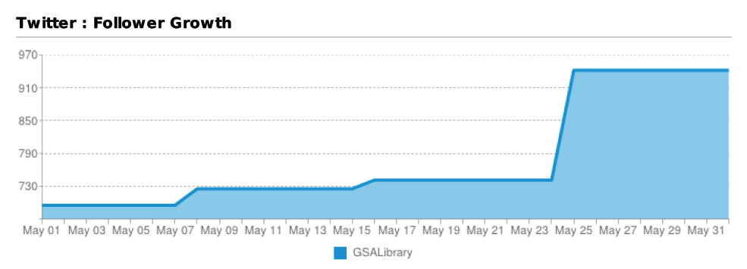
Notes:
One of the areas our disaster plans failed to touch on was social media
In the immediate aftermath of the fire, we were particularly struck by the importance and pressures of these communication channels
It is telling perhaps, that most disaster planning documents fail to mention the extent to which your staff may be inundated with offers of support, guidance from others, or questions from the public via Twitter, Facebook and the other social media your institution may employ
In our experience, it is really important to think now about who you would designate to this role, particularly if your institution is high-profile
This person will need an understanding of the subtle etiquettes of social media and press relations, as you will need to be able to trust them to fly solo
In our experience, the relationships you are able to cultivate over social media at this point will pay huge dividends for you later on

Slide 36
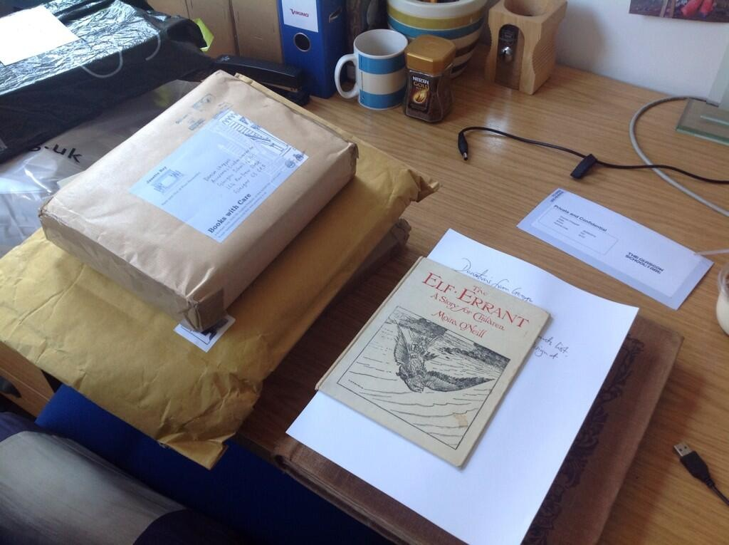
Notes:
Through social media we received significant offers of donations to our library
We were keen to capitalise on this good will, recognising that it provided an opportunity for us to begin to rebuild our lost collections very quickly
We were also keenly aware however that we had lost a significant proportion of our storage space, and that any rebuild needed to be highly focused
We therefore decided to pursue a targeted rebuild, tightly aligned to both the illustrious history and future direction of the Glasgow School of Art.
At the time of speaking, we are clear in only seeking very specific titles that hold particular relevance to our history, our alumni, and our learning, teaching and research activities
You will find that you receive many offers of books, even whole libraries, that you just cannot accept, and will need to employ tact and diplomacy in rejecting these offers
It is imperative to understand where you strategic objectives lie, both as an institution and a department
This strategising can in fact be done now, so that you are prepared if a disaster were to strike.

Slide 37
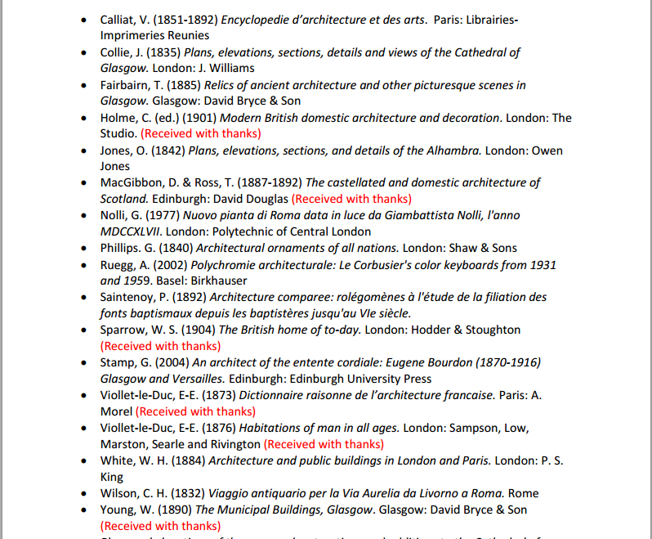
Notes:
We decided to publish wants list of about 700 titles on our website, and publicised this list widely to academic mailing lists, library communities, and other institutions
We could then refer potential donors to this list and solicit only those donations that were key to us
To date, this approach has proved very successful, and we were able to replace 22% of our priority volumes in the first 3 months after the fire
Key to our ability to do this was that our library catalogue was complete – we had excellent computer-readable records for every single item we held
Our task would have been infinitely more difficult had we not possessed the ability to interrogate our catalogue so completely and had we not had such in-depth knowledge of our collection as a totality
Within just a few days of the fire we had a complete list of every single item that was lost from the library
One of the lessons we have taken from our experience, is that in fact this list of priority replacements could have been prepared in advance of a disaster occurring, as part of our general preparedness

Slide 38
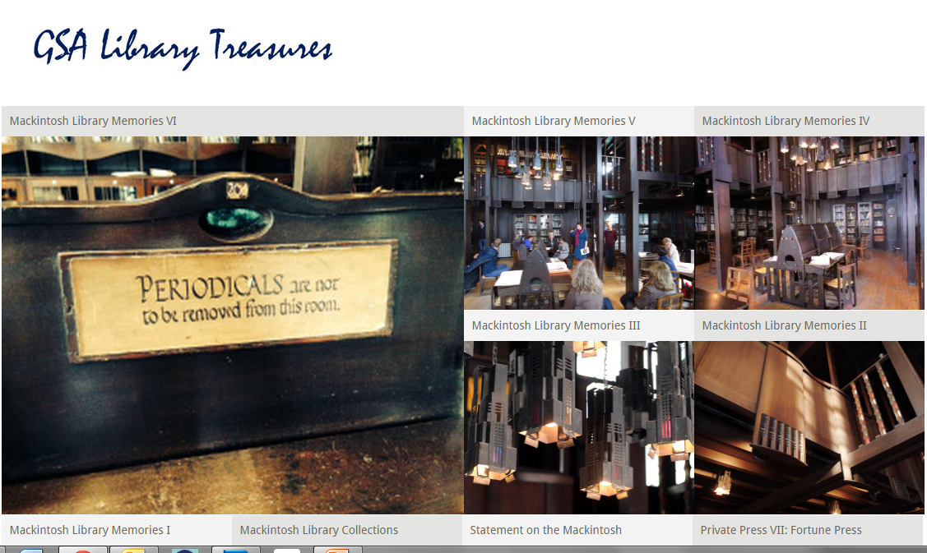
http://gsalibrarytreasures.wordpress.com
#macklibmemories
Notes:
We were also keen to use our relationships and social media channels to record people’s memories of the destroyed library for posterity
We wanted to initiate this project pretty quickly after the fire, as we were conscious of not losing the momentum that the disaster provided
We therefore held interviews via email and in person with students, graduates and academics who had used the library, to record their first impressions of the space, their favourite items in the collection, and ways in which they had used the library in their learning and teaching
In the immediate aftermath of any disaster, the temptation, understandably, is to concentrate on immediate requirements
But we were determined that the fire, though tragic, would leave some kind of lasting legacy
Our suite of Mackintosh Memories, which can be read on our blog and via our Twitter hashtag, will eventually be deposited into the School’s archives, along with all the other documentation we have produced since the fire

Slide 39
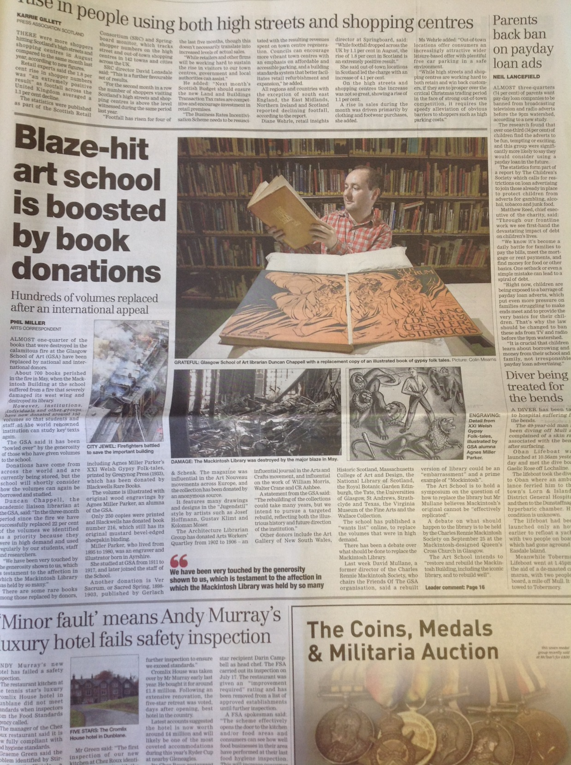
Notes:
We have also worked closely with our colleagues in the Press Office, to publicise our collections rebuild campaign and to mark successful milestones
This article appeared in The Herald on 15 September 2014 to celebrate our receiving 22% of our priority volumes in just 3 months
We’ve also enjoyed coverage in The Times, The Metro, BBC News, Telegraph, Design Week, and The Guardian

Slide 40
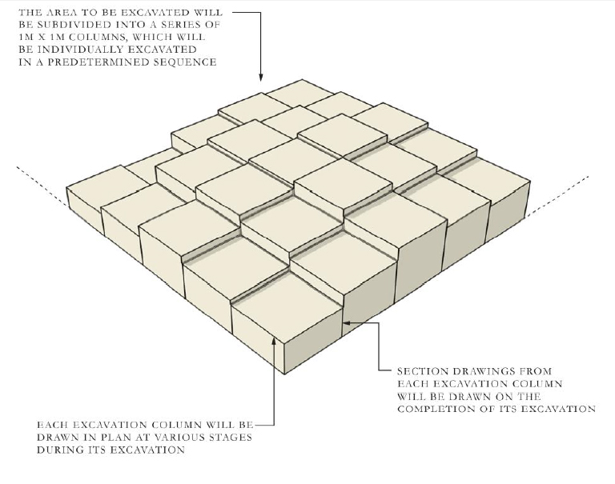
Notes:
The next major milestone for us will be the excavation of the library interior
The School, under the advice of Historic Scotland, has employed Kirkdale Archaeology to undertake this work
They are proposing a systematic excavation based on 1m2 grids, excavating down in columns at 25cm increments
Each layer will be photographed and recorded
Any salvaged artefacts will be recorded following established methodologies, before removal for treatment or conservation
All processes and findings will be archived for posterity

Slide 41
Duncan Chappell
d.chappell@gsa.ac.uk
@duncanchappell

