Slide 1
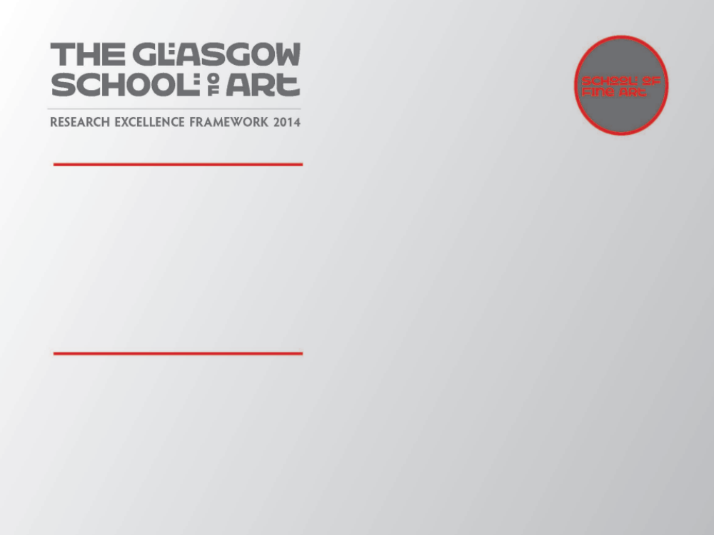
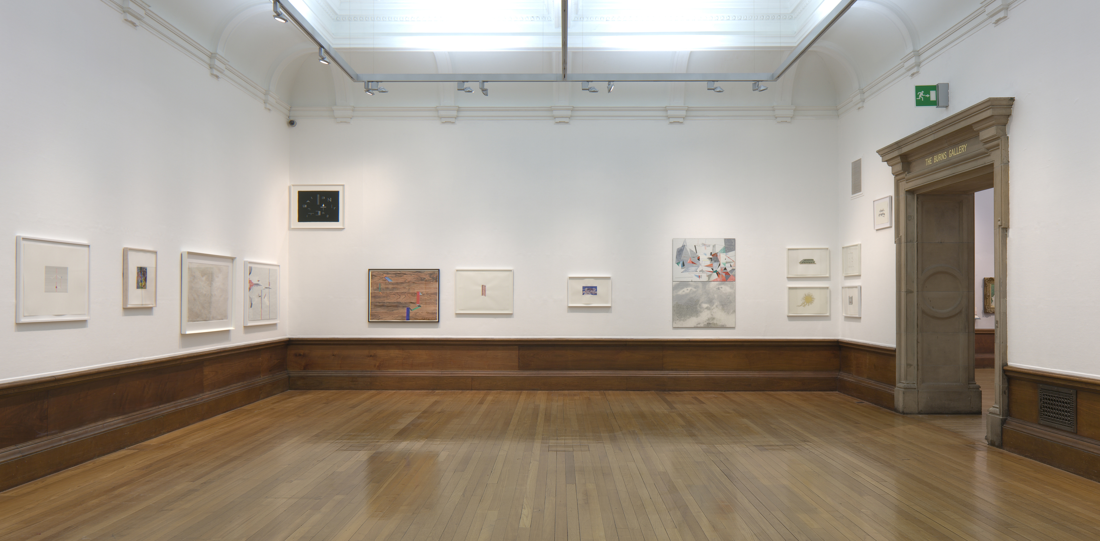
Richard Wright
‘Works on Paper’
An exhibition of works on paper by artist Richard Wright that took place in Kelvingrove Art Gallery & Museum, Glasgow, 20th April – 24th June 2012. The exhibition was the first dedicated to this area of the artist’s practice and brought together 30 works form the period 1998-2011.
Submitted by K.M.Brown
Output No. 1

Slide 2
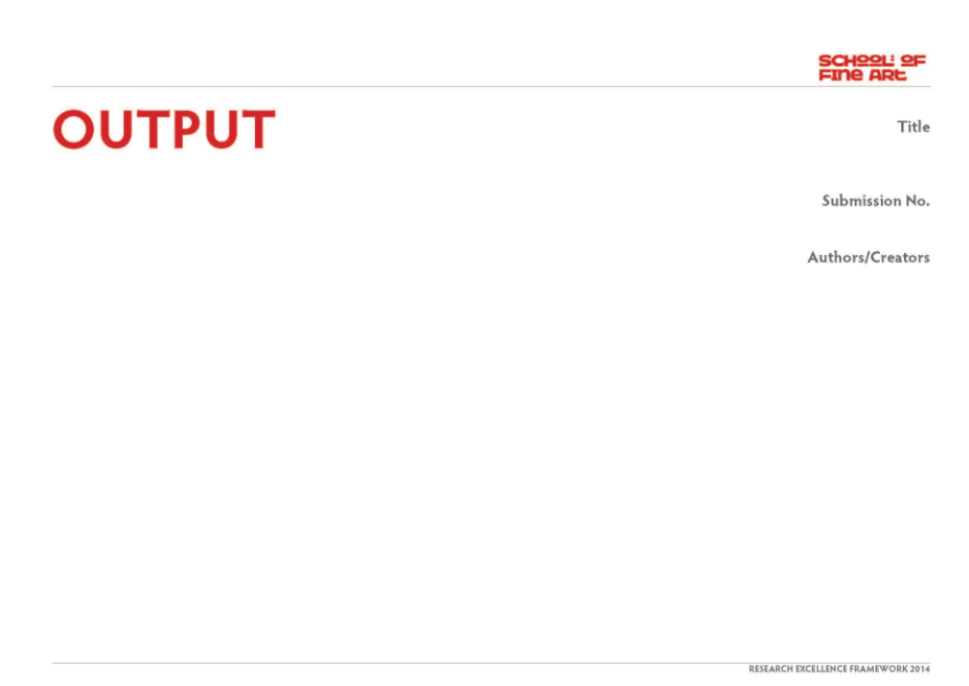
Richard Wright ‘Works on Paper’
The principal output took the form of an exhibition by artist Richard Wright within Kelvingrove Art Gallery & Museum, Glasgow, between 20th April and 24th June 2014.
The exhibition was the first and remains the only exhibition of Wright’s work to date to focus exclusively on his works on paper. It was comprised of a total of 30 works or varying size, made between 1998 and 2011.
The exhibition was part of the main programme for the 2012 Glasgow International Festival of Visual Art.
1
Dr. Katrina M. Brown
Image one & a description of what we are looking at in the context of the project.

Slide 3
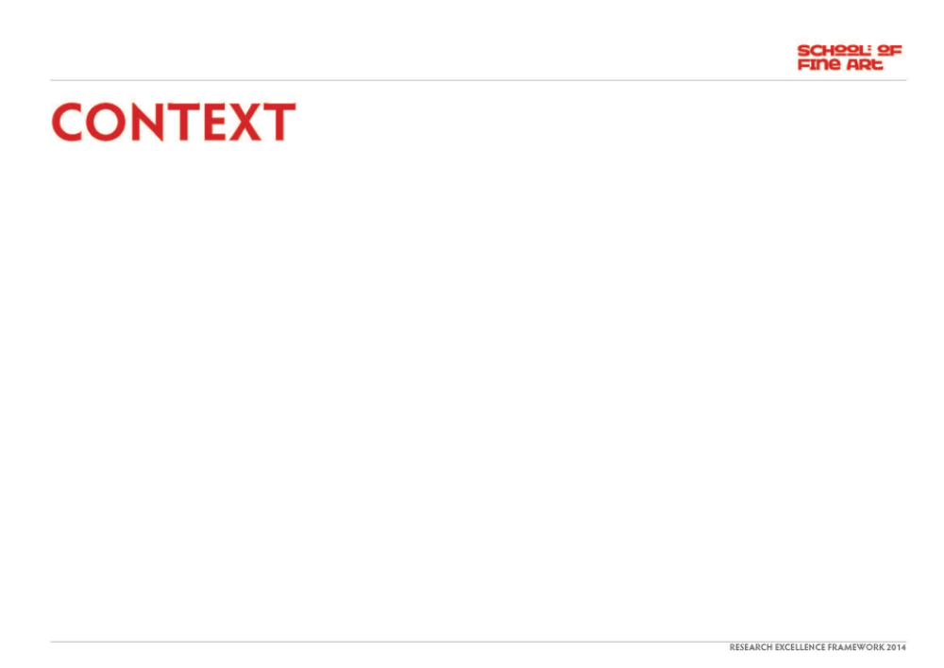
The project stemmed from my established curatorial practice, along with knowledge of the artist’s work and built on previous experience of creating temporary exhibitions of contemporary art in locations and venues not typically used for such purposes, in this case the Italian Art Gallery of Glasgow’s Kelvingrove Art Gallery & Museum. The space was made available for the purpose of creating an exhibition for Glasgow International Festival of Visual Art, following on from the project realised there in 2010 with David Shrigley.
The opportunity to work with such a space at Kelvingrove offered both a meaningful and resonant context for the exhibition in the historical, permanent collection displays and the possibility of reaching an audience beyond the habitual contemporary art audience in the city.
The project also built on my previous work with the artist, Richard Wright, with whom I had worked on a major public project for the Edinburgh International Festival (‘Jardins Publics’, 2007) and a solo exhibition at Dundee Contemporary Arts (2004), which was documented in a publication. The latter had included illustrations of a small number of works on paper, alongside documentation of the wall paintings made in Dundee and a number of other large projects form the same period. Wright had first exhibited works on paper in his first show with Gagosian Gallery, London in 2002.
Image one & a description of what we are looking at in the context of the project.

Slide 4
Richard Wright lives and works in Glasgow. His first solo exhibition took place in 1994 at Transmission Gallery, Glasgow, and since then he has gone on to exhibit world-wide. He has been included in many important international exhibitions including The British Art Show 5, 2000, and Carnegie International, Pittsburgh, 2008. He was awarded the Turner Prize in 2009. In 2010, he realised a major, permanent installation for the Scottish National Gallery of Modern Art Two in Edinburgh.
Wright is best known for his distinctive approach to painting, working directly on the walls and often ceilings of the spaces in which he is invited to exhibit. However, these labour-intensive works are short-lived as they are painted over at the end of the exhibition. Throughout his career and alongside these fleeting works, Wright has however also made paintings on paper. These unique, fragile and rarely seen works together give a sense of Wright’s continuous exploration of how images are made: of the straightforward, immutable effects of colour and line.
Varying in complexity from the very simple to the highly ornate, the works selected for the exhibition offered a rare, expanded perspective on the work of one of Britain’s most acclaimed and respected artists.
GLASGOW INTERNATIONAL FESTIVAL of VISUAL ART takes place across the city for 18 days every two years. It is managed by Glasgow Life.
Image one & a description of what we are looking at in the context of the project.

Slide 5
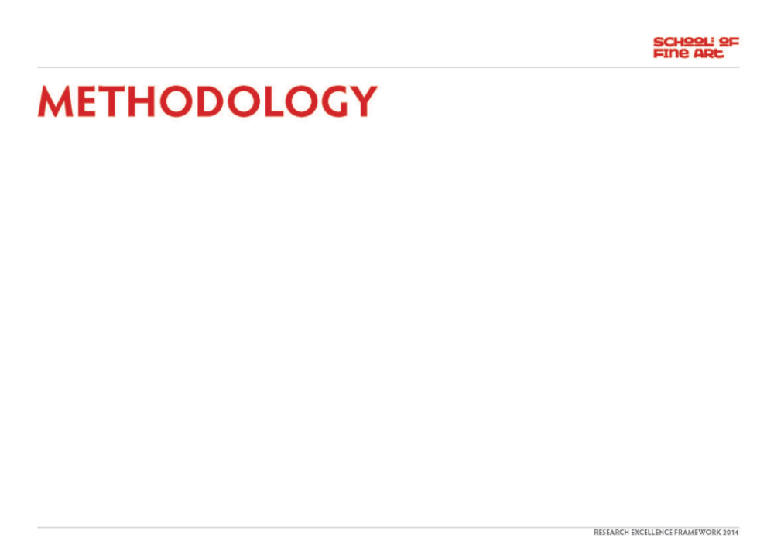
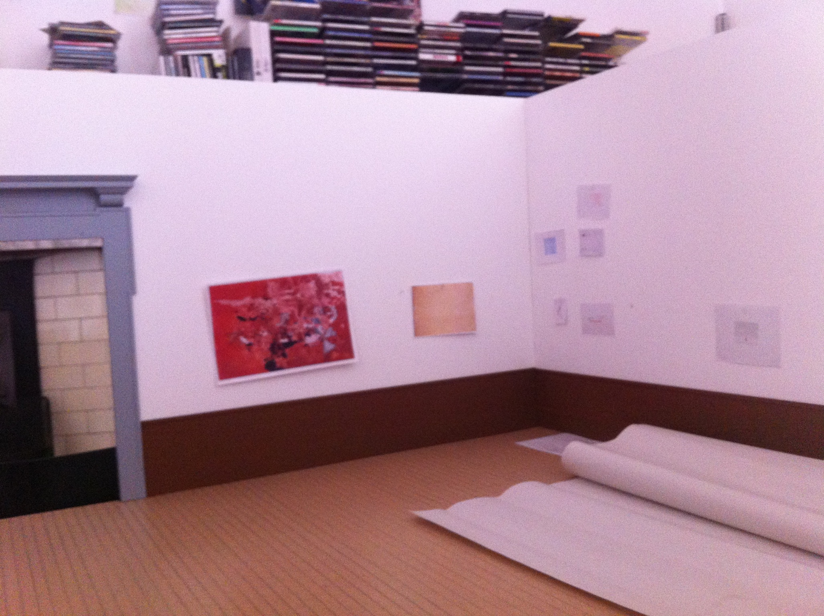
The process that was employed involved:
establishing availability and viability of space to be used for exhibition
securing the participation of artist Richard Wright
discussion with the artist of the idea of developing an exhibition devoted exclusively to his rarely seen works on paper
establishing a long-list of c.50 relevant works known to be in existence, the vast majority of which had been acquired by private and public collections, both in the UK and abroad
collating an image file of all relevant works
developing a database of all relevant works including: date, dimensions, media, ownership, contact details, location (where known)
identifying key initial contacts pertaining to each work
corresponding with the artist’s agents (BQ, The Modern Institute and Gagosian Gallery) in Glasgow, Berlin and London in the first instance
working with those agents to establish ownership of all works and from there principal contacts for current owners
creating a scale model of the exhibition space to be used and to-scale colour copies of each of the works
- agreeing technical requirements with Glasgow Museums staff
Scale model showing exhibition plan in development

Slide 6
developing an installation plan that used the artist’s characteristic approach to space and the viewer’s position within it, working with a primarily visual plan rather than either a chronological or thematicised configuration
establishing a final selection of works based on a feasible hang in the available space
making formal loan requests to a range of public and private collections in the USA, UK, Germany, Switzerland and Norway
A small number of works had to be discounted due to relative inaccessibility and / or cost and complexity of transportation to and from Glasgow.
The final selection of works was made through close discussion with the artist and sought to represent both the full range of the time period involved and the distinct and diverse shifts and developments that had been effected.
This selection comprised a number of works from the late 1990s that had a strong graphic focus, some of which included textual elements, through others with a distinctive use of geometry, demonstrating the artist’s on-going concern the creation of perspective in the two-dimensional plane. The most recent works showed a use or mirroring and inversion, along with an increasing use of silver and gold leaf.
Richard Wright ‘No title’, 2000
Gouache on paper
38.1 x 57.2 cm

Slide 7
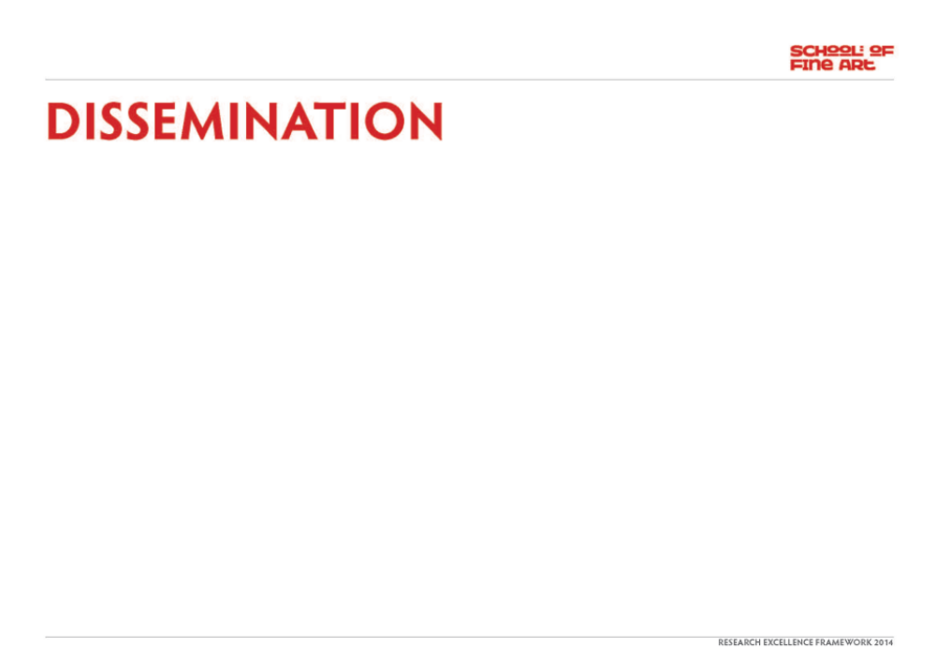
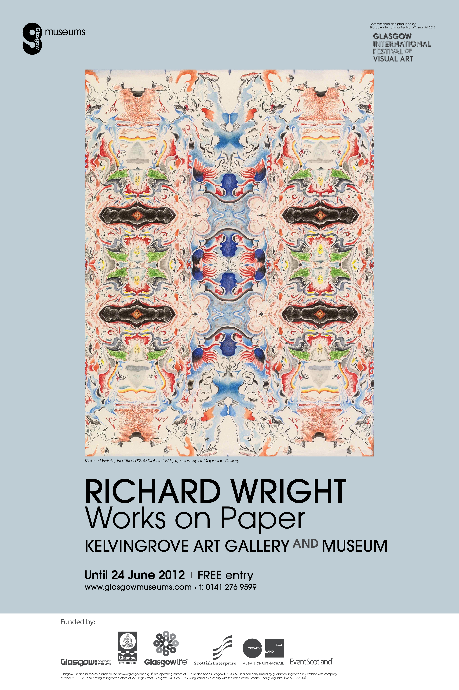
The exhibition was disseminated through a broad range of means, from advance press and publicity campaigns to leaflets and street posters.
Some examples include:
e-flux announcement http://www.e-flux.com/announcements/glasgow-international-festival-of-visual-art-2012/
Glasgow International Festival of Visual Art 2012 Brochure (see page 10) 20,000 distributed locally and nationally http://issuu.com/gifestival/docs/2012guide
Glasgow Museums poster (widespread Glasgow distribution) – see opposite
Image one & a description of what we are looking at in the context of the project.
Glasgow Museums poster

Slide 8
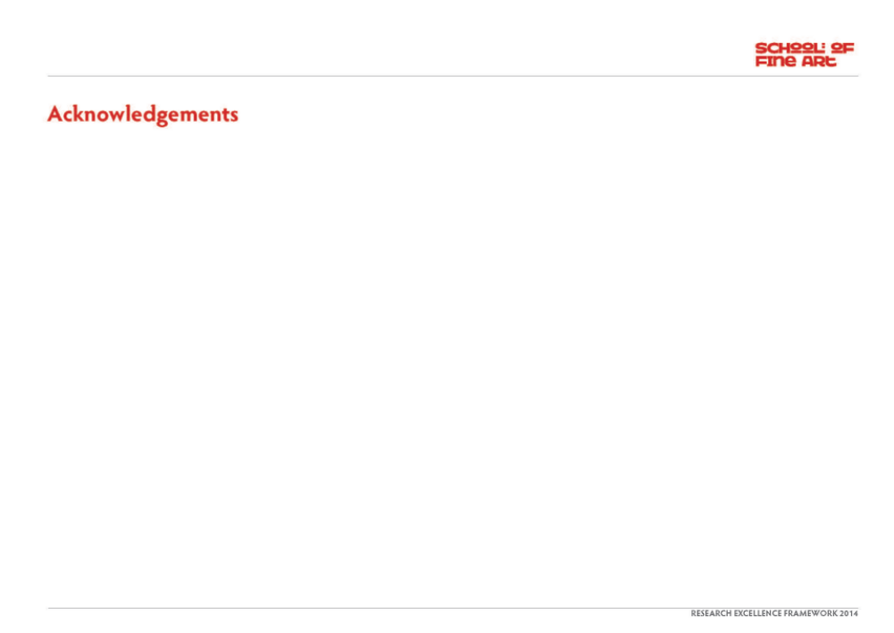
Richard Wright
The Modern Institute, Glasgow
BQ, Berlin
Gagosian Gallery, London, Los Angeles and New York
The Common Guild, including Colin Lindsay (gallery manager) and Hannah Sanderson (intern)
Glasgow Museums
The lenders to the exhibition:
Artists’ Pension Trust (APT London)
Arts Council Collection, Southbank Centre, London
British Council Collection
BSI Art Collection SA, Switzerland
Carnegie Museum of Art, Pittsburgh
Middlesborough Institute of Modern Art
Museum Brandhorst, Munich
The Museum of Modern Art, New York
Jörn Bötnagel and Yvonne Quirmbach, Berlin
Collection Hannelore and Peter Molitor
Collection of Marissa Sackler, London
Melinda and Ealan Wingate
and others who wish to remain anonymous.

