Slide 1
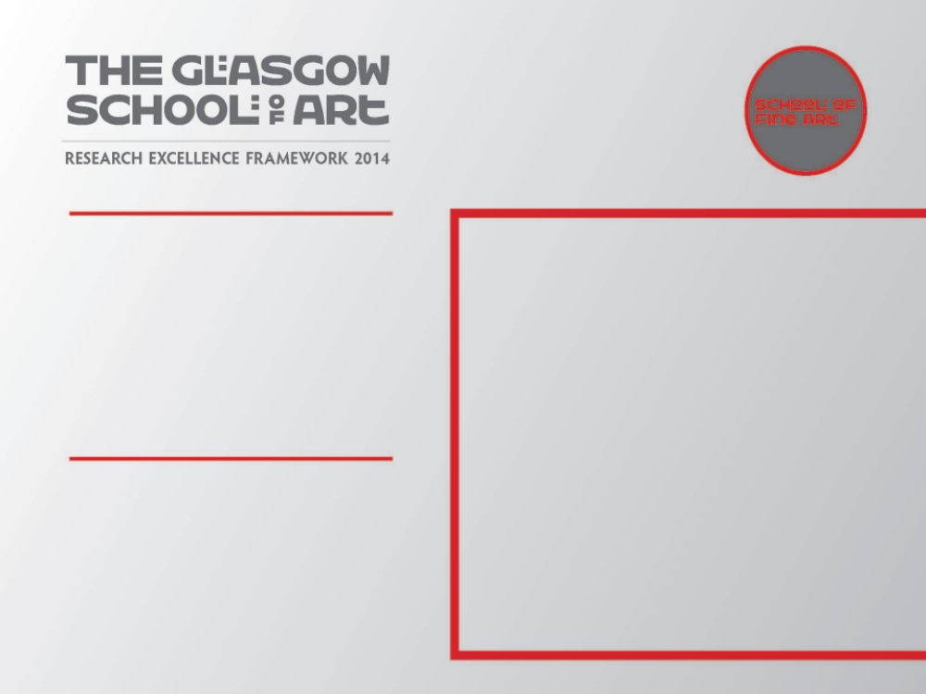
Curious Arts - No. 5
Sculptural sound installation at CCA, Glasgow
1-17 December 2011
This work, produced in collaboration with Jim Harold, juxtaposes a material and phenomenal experience of the world with textual knowledge – historical and contemporary - bringing ideas of the physical and metaphysical worlds into the space of the gallery.
Submitted by Susan Brind
Output No. 2

Slide 2
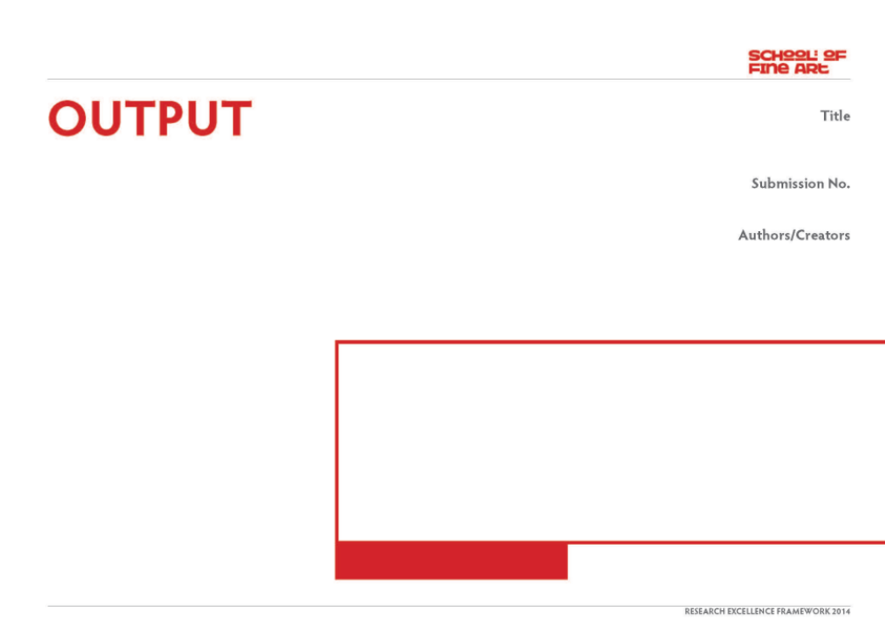
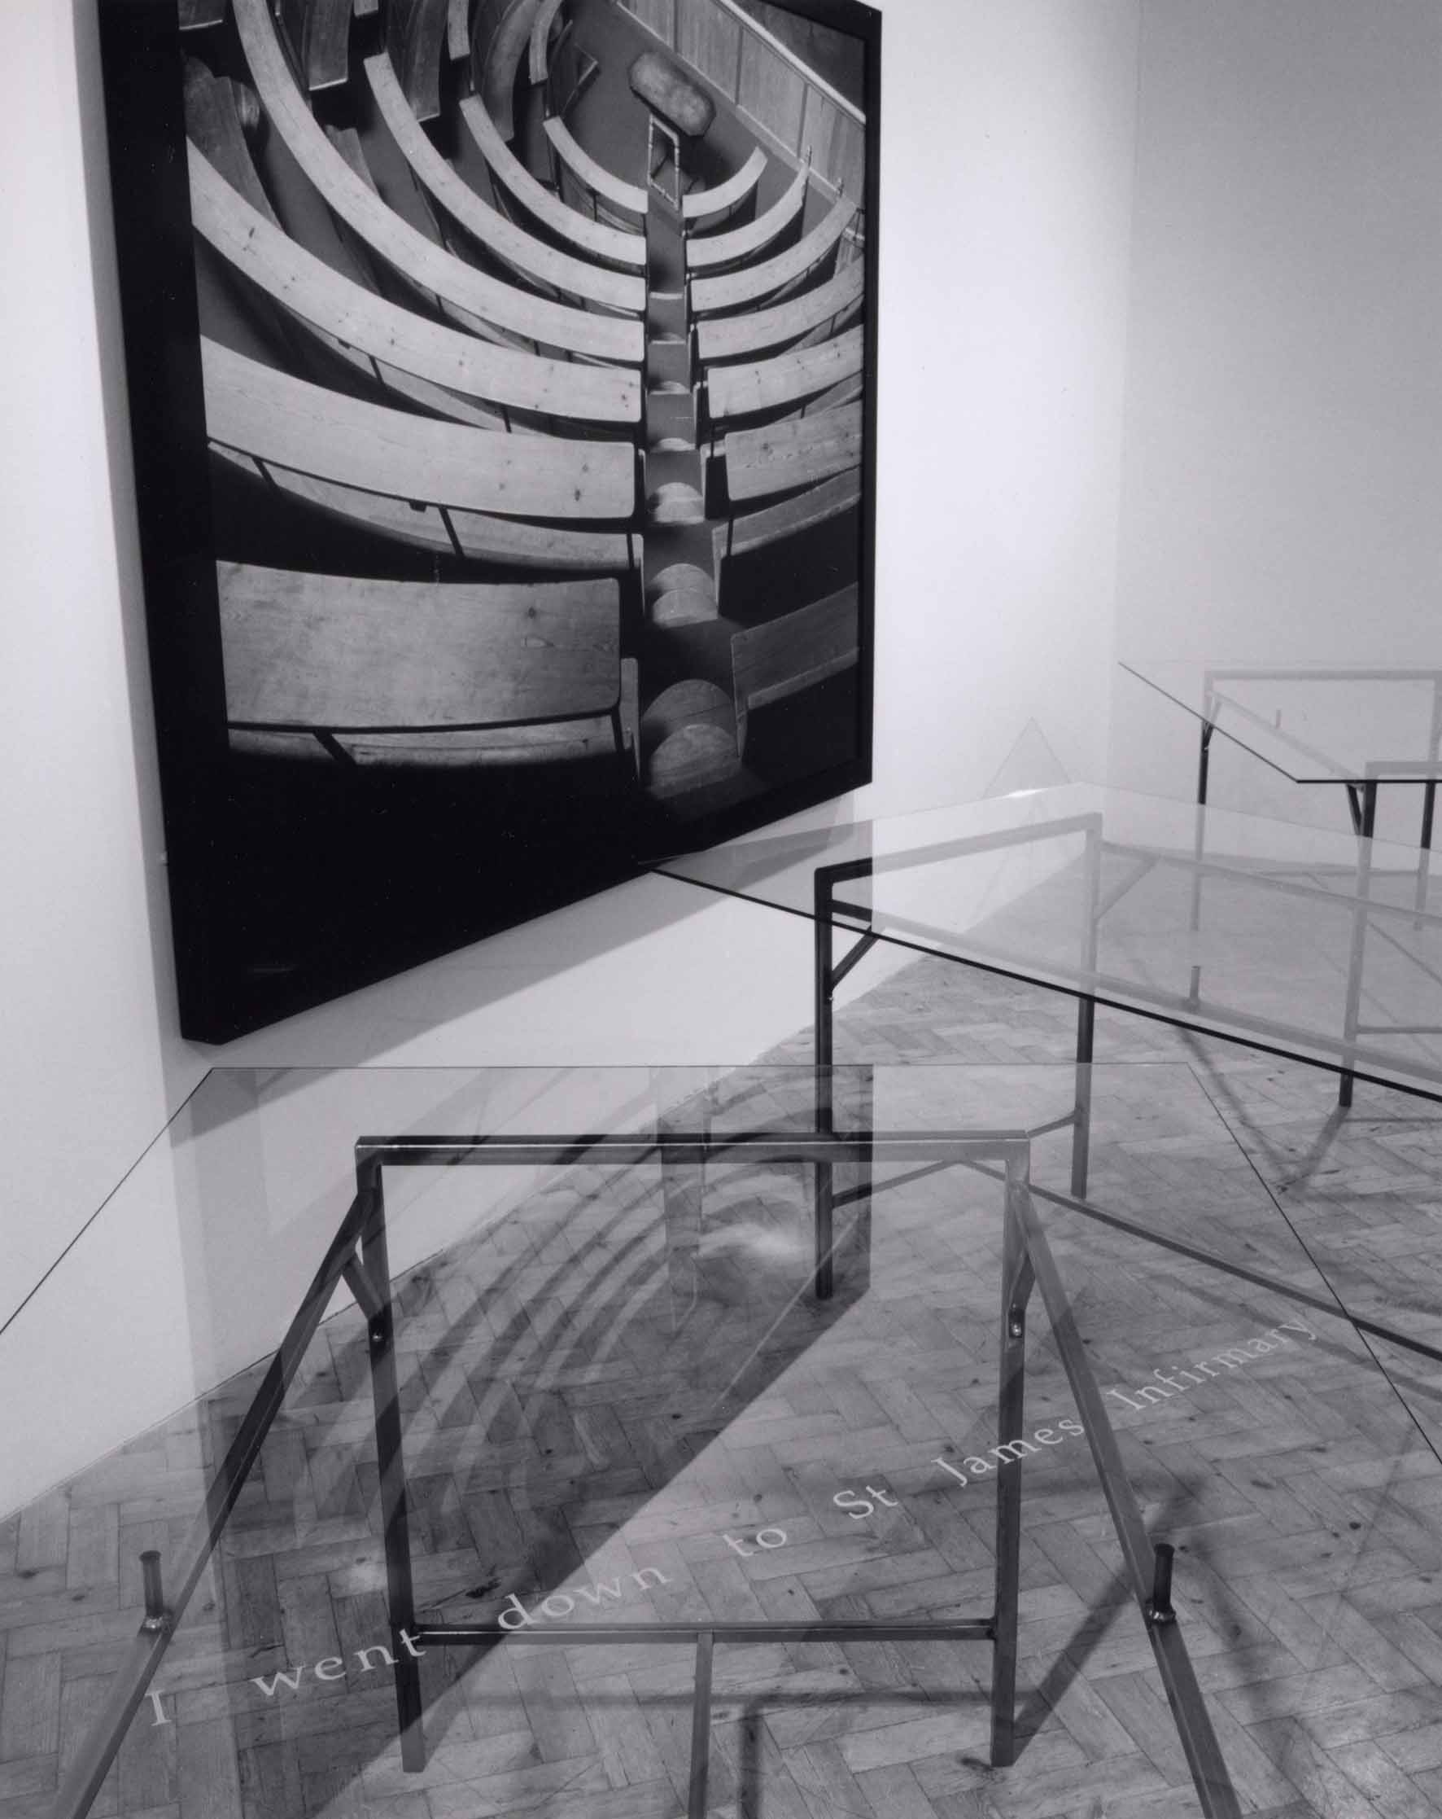
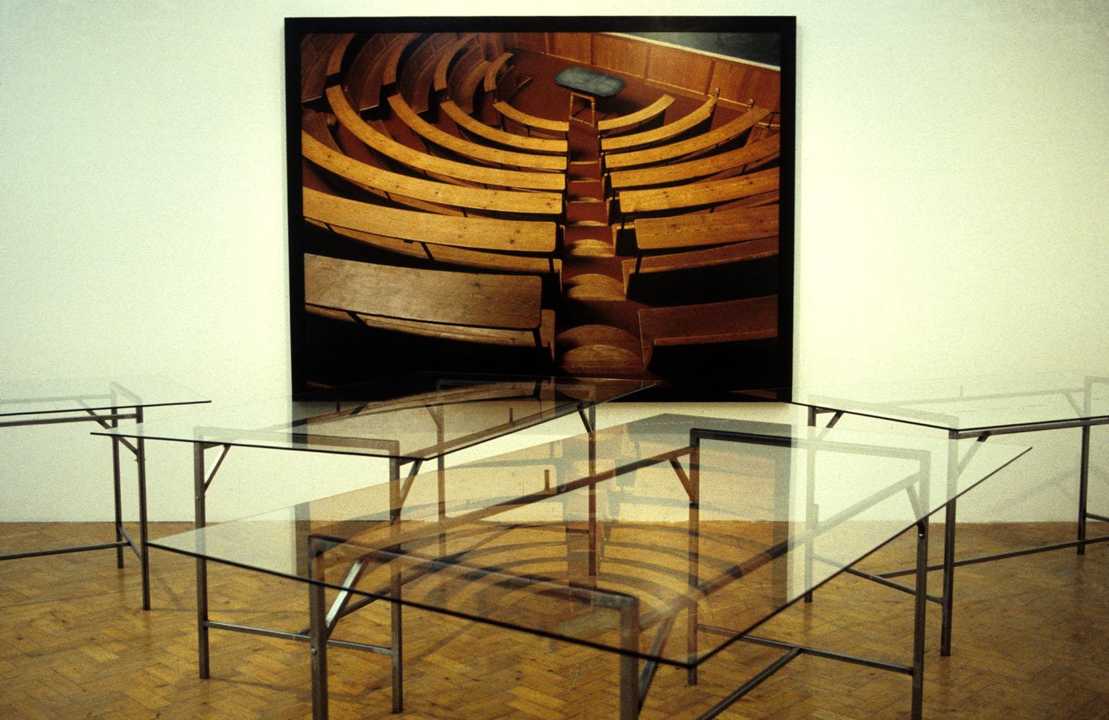
Mysteries of the heart (detail and view)
Commission from Book Works, London
for the exhibition ‘The Reading Room’
at Camden Arts Centre, London, 1994
Since the late 1980s the artist-partners Brind & Harold have worked in collaboration at points when their specific research interests have coalesced. Both artists work across a range of media, including sculpture, installation, text, sound and photography, and site is frequently an integral element within artworks. Their shared concern is how a poetic space of imagining might allow new insights into historical knowledge through contemporary re-interpretation. A notable early example of their collaborative work would be Mysteries of the heart (shown here) which looked at how the subjective body was interpreted by the medical gaze.
During the period 2007-2013, Brind & Harold have worked exclusively as collaborators on a series of works entitled Curious Arts - each with a numerical suffix - which have been developed out of a residency at Hospitalfield House, Arbroath in 2007 (funded by RSA Edinburgh and Hospitalfield House Trust). The artists are equally involved in the research and generation of ideas, as well as the production of artefacts, exhibitions and related written material.
Image one & a description of what we are looking at in the context of the project.

Slide 3
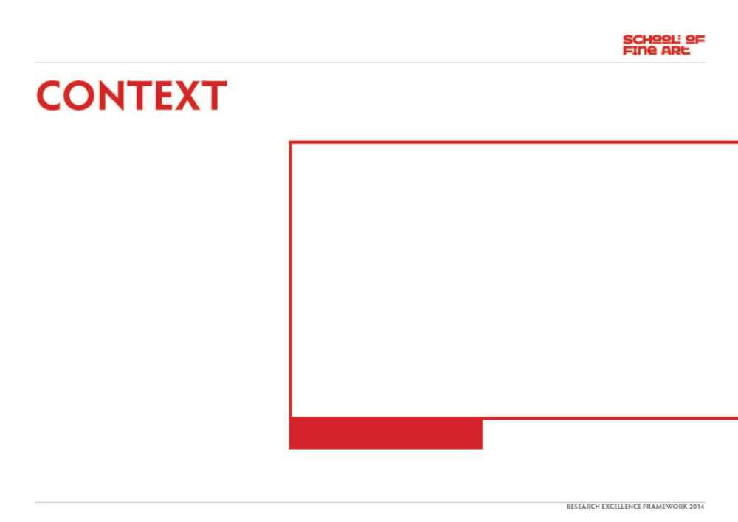
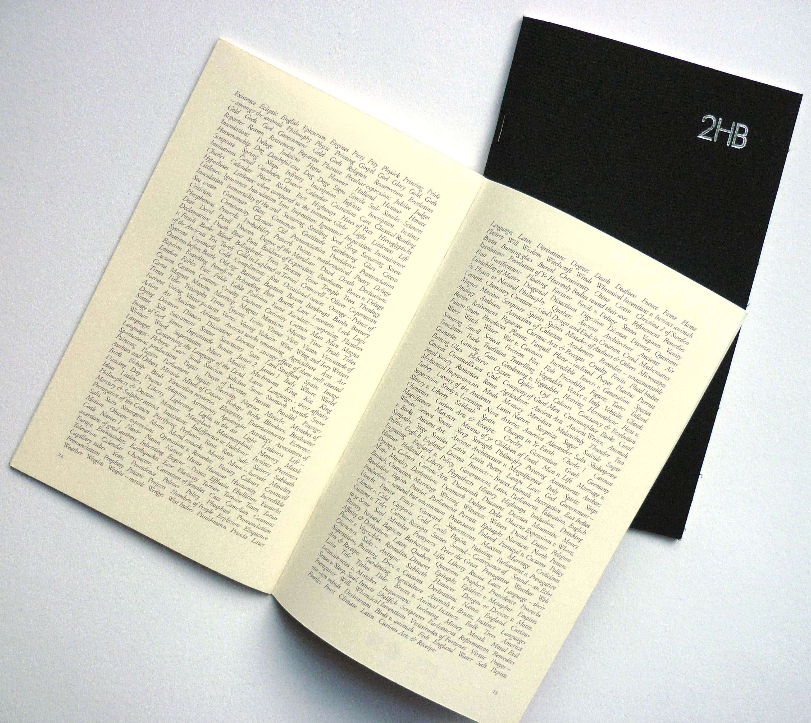
Research Questions:
As a result of contributing a text work (Curious Arts - No. 4) in the form of artists' pages to the publication 2HB, Volume 10, published by CCA (2011), Susan Brind & Jim Harold were invited to make a related artwork for the exhibition, 'What we make with words’ at CCA, Glasgow.
The exhibition curators asked:
“How do artists use language alongside other materials; as a generative force within their practice or as a way of moving between different facets of a practice?”
Image one & a description of what we are looking at in the context of the project.

Slide 4
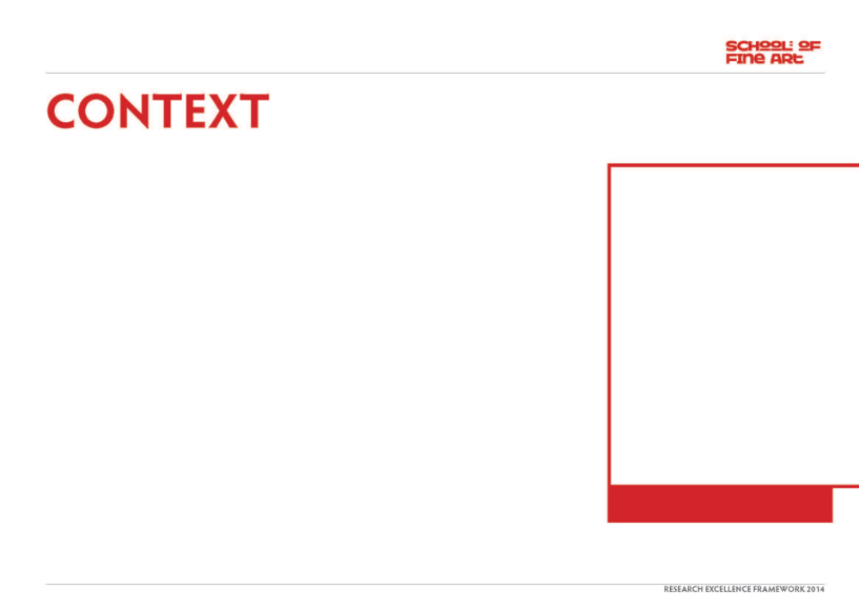
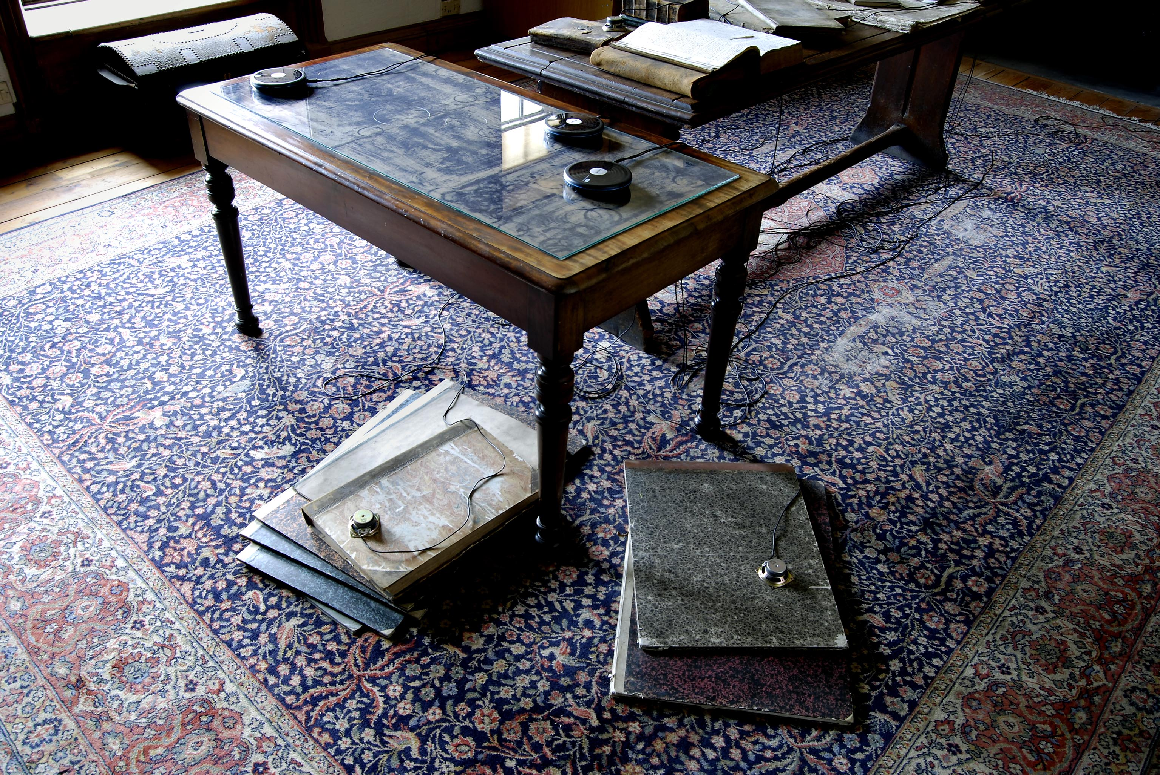
Curious Arts - No. 1 (detail)
Library, Hospitalfield House Research Residency
2007
In consultation with the curators, the artists returned to research undertaken in the production of Curious Arts - No. 1 (2007) and further developed between 2007-2013.
Brind & Harold asked the question:
How does the circle as a form encapsulate the essence of subjects as apparently diverse as time, nature, mathematics, astronomy, mysticism and the metaphor of the journey, as referred to in the writings of Richard Parrot and further explored in the library of Patrick Allan Fraser of Hospitalfield House, Arbroath?
Image one & a description of what we are looking at in the context of the project.

Slide 5
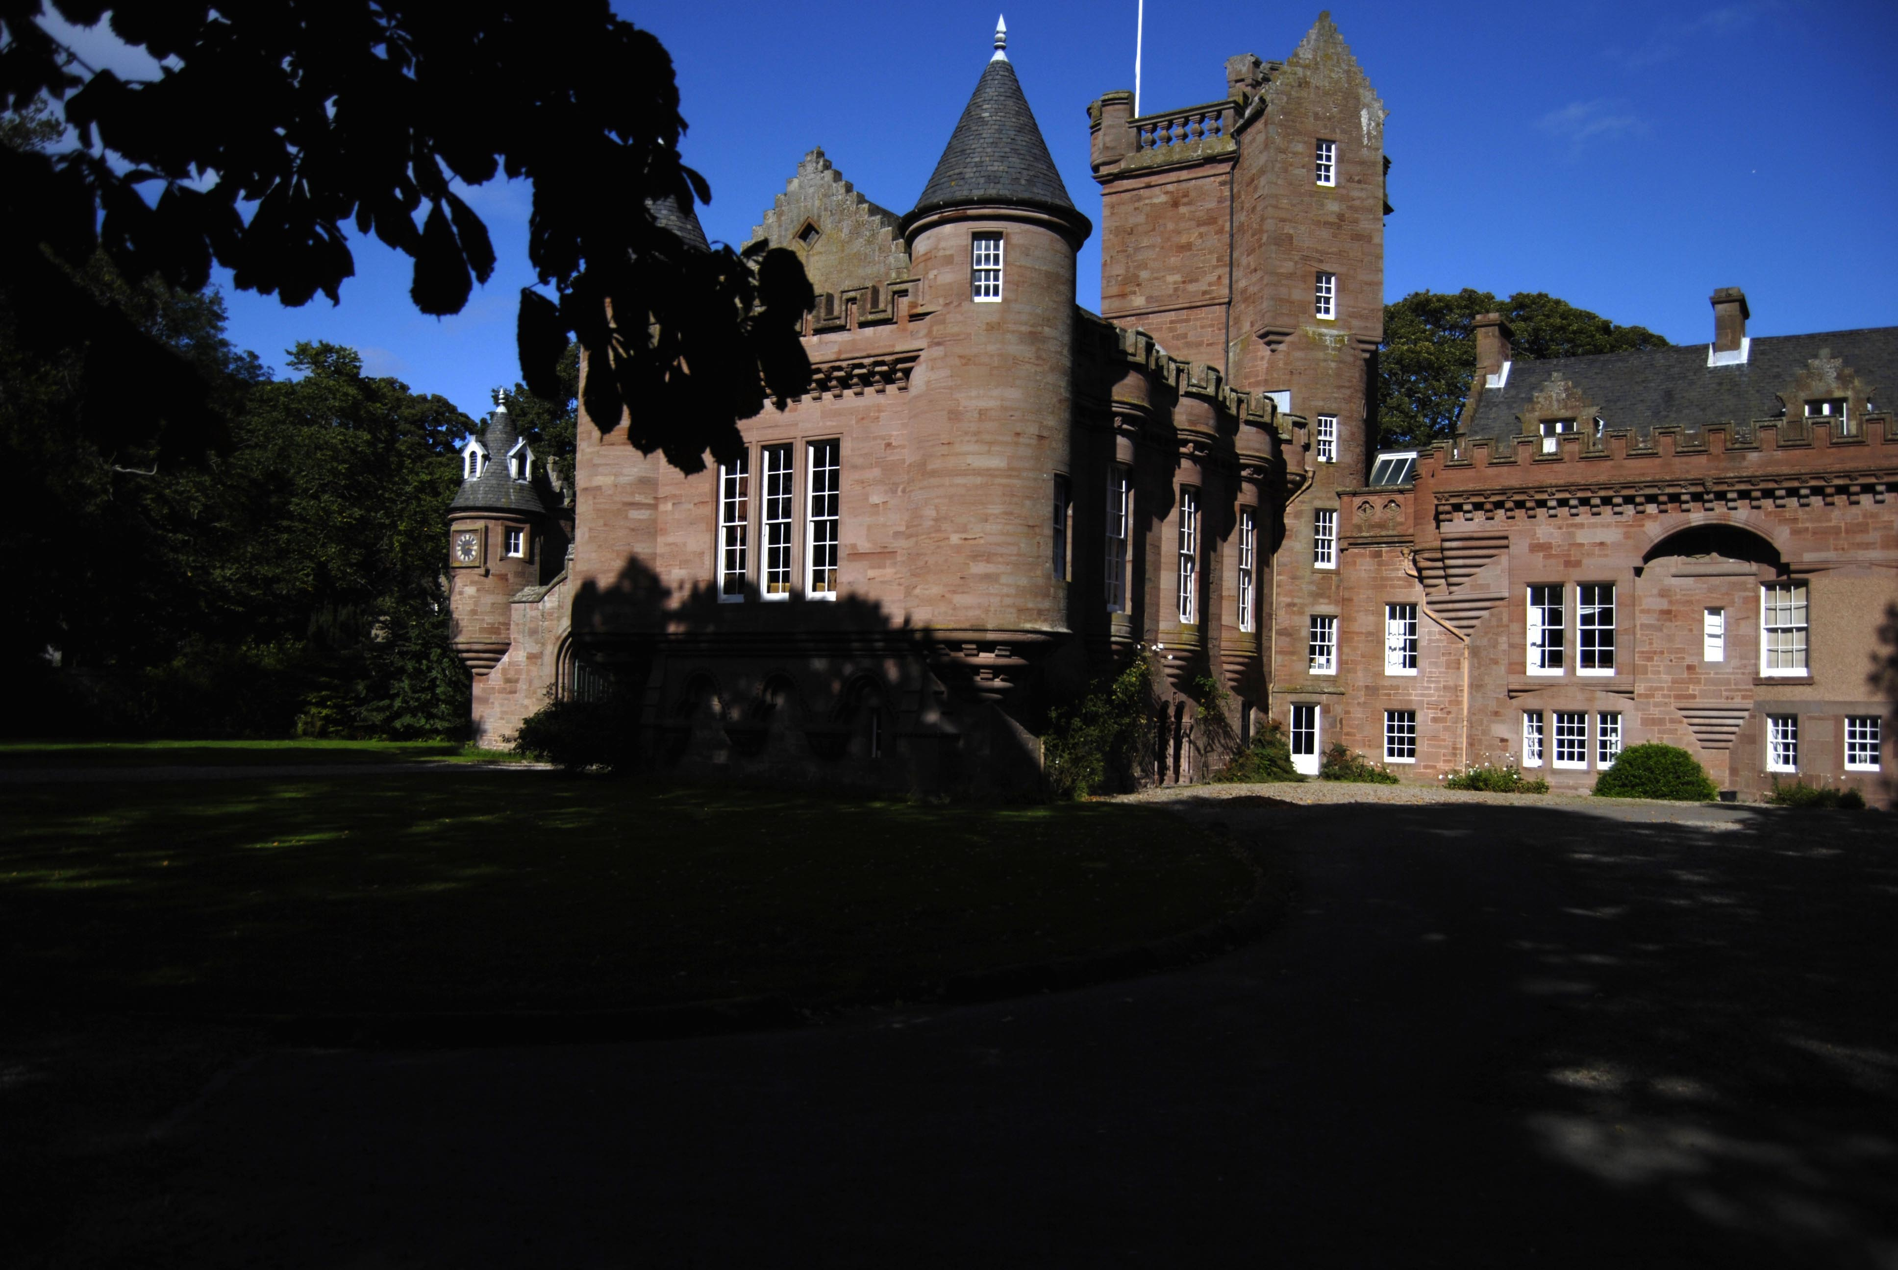
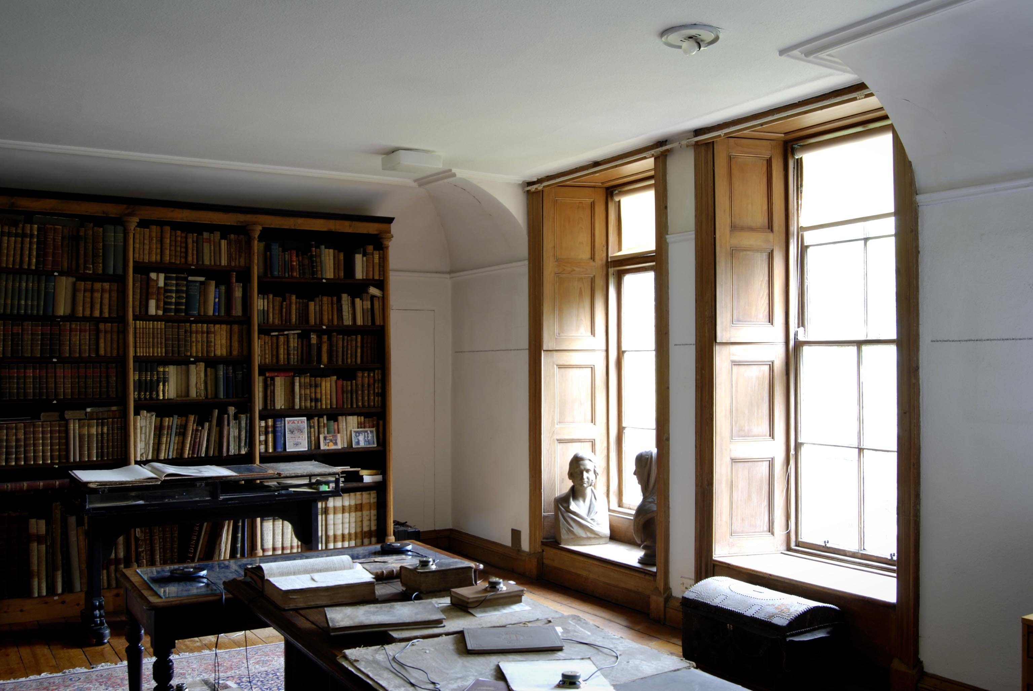
Hospitalfield House and Library
Arbroath
During the period of their residency at Hospitalfield House in 2007, the library (seen here) - filled with books but otherwise, at the time, a neglected space - became both a research resource and a space in which emerging ideas were explored and tested out through: textual research, drawing, writing, photography, sound recording and material investigation. Hence the curators’ interest in this work and process.
Image one & a description of what we are looking at in the context of the project.

Slide 6
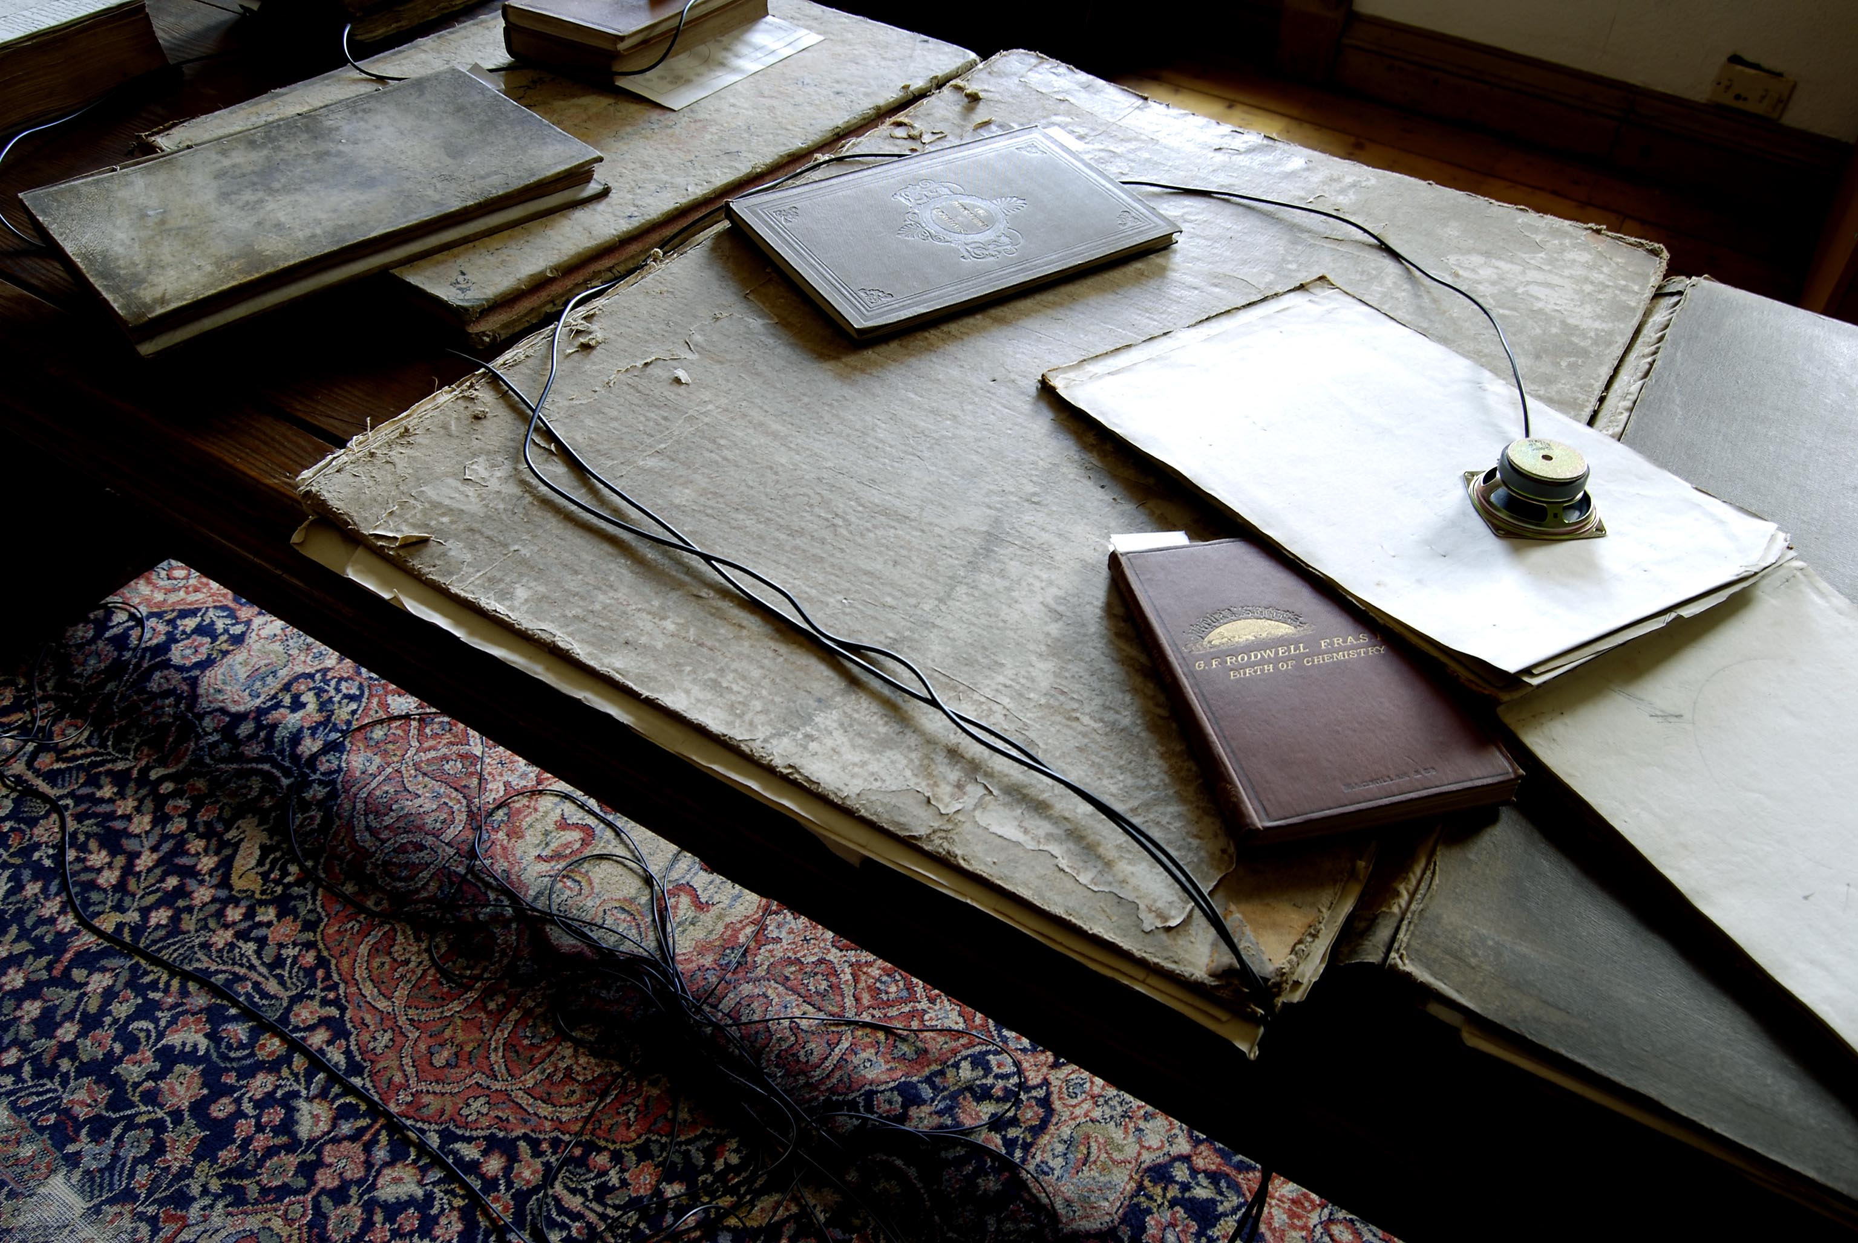
Curious Arts - No. 1 (detail)
Library, Hospitalfield House Research Residency
2007
Image one & a description of what we are looking at in the context of the project.

Slide 7
Curious Arts - No. 5
Background Research

Slide 8
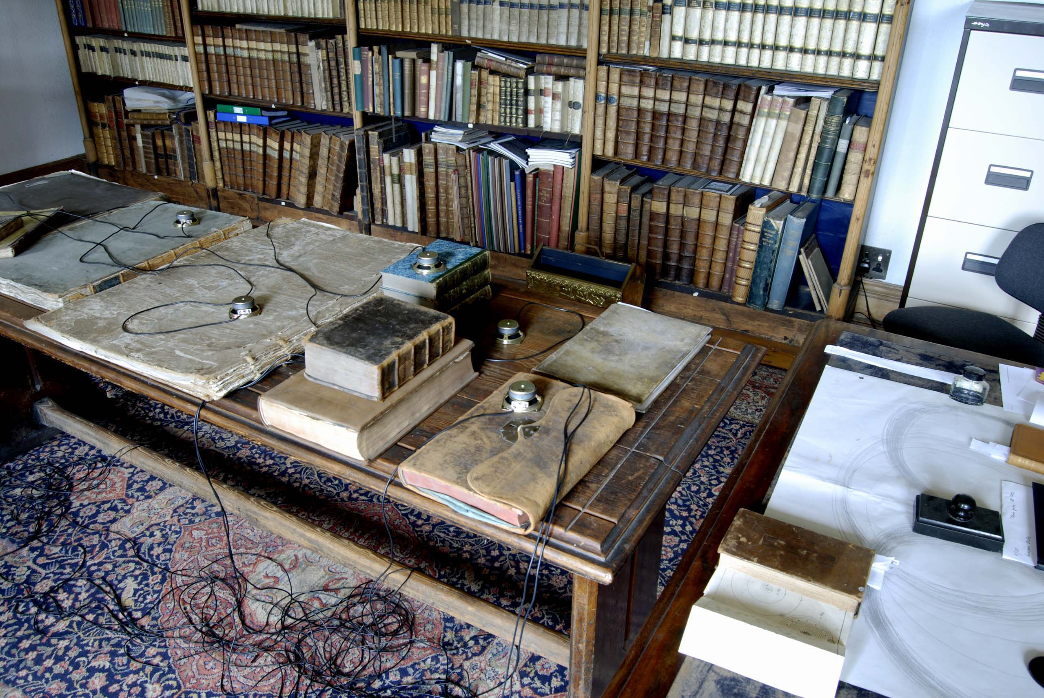
Research undertaken in the
Library, Hospitalfield House
From research carried out in the library at Hospitalfield, it was clear that a fascination with the form and meanings of the circle recurred in Parrot’s journals, in Fraser’s notebooks and in his collection of books on aesthetics. … Despite all the influence of Enlightenment thinking upon both men, the significance of this perfect form extended far beyond purely mathematical and rational analysis.
Image one & a description of what we are looking at in the context of the project.

Slide 9
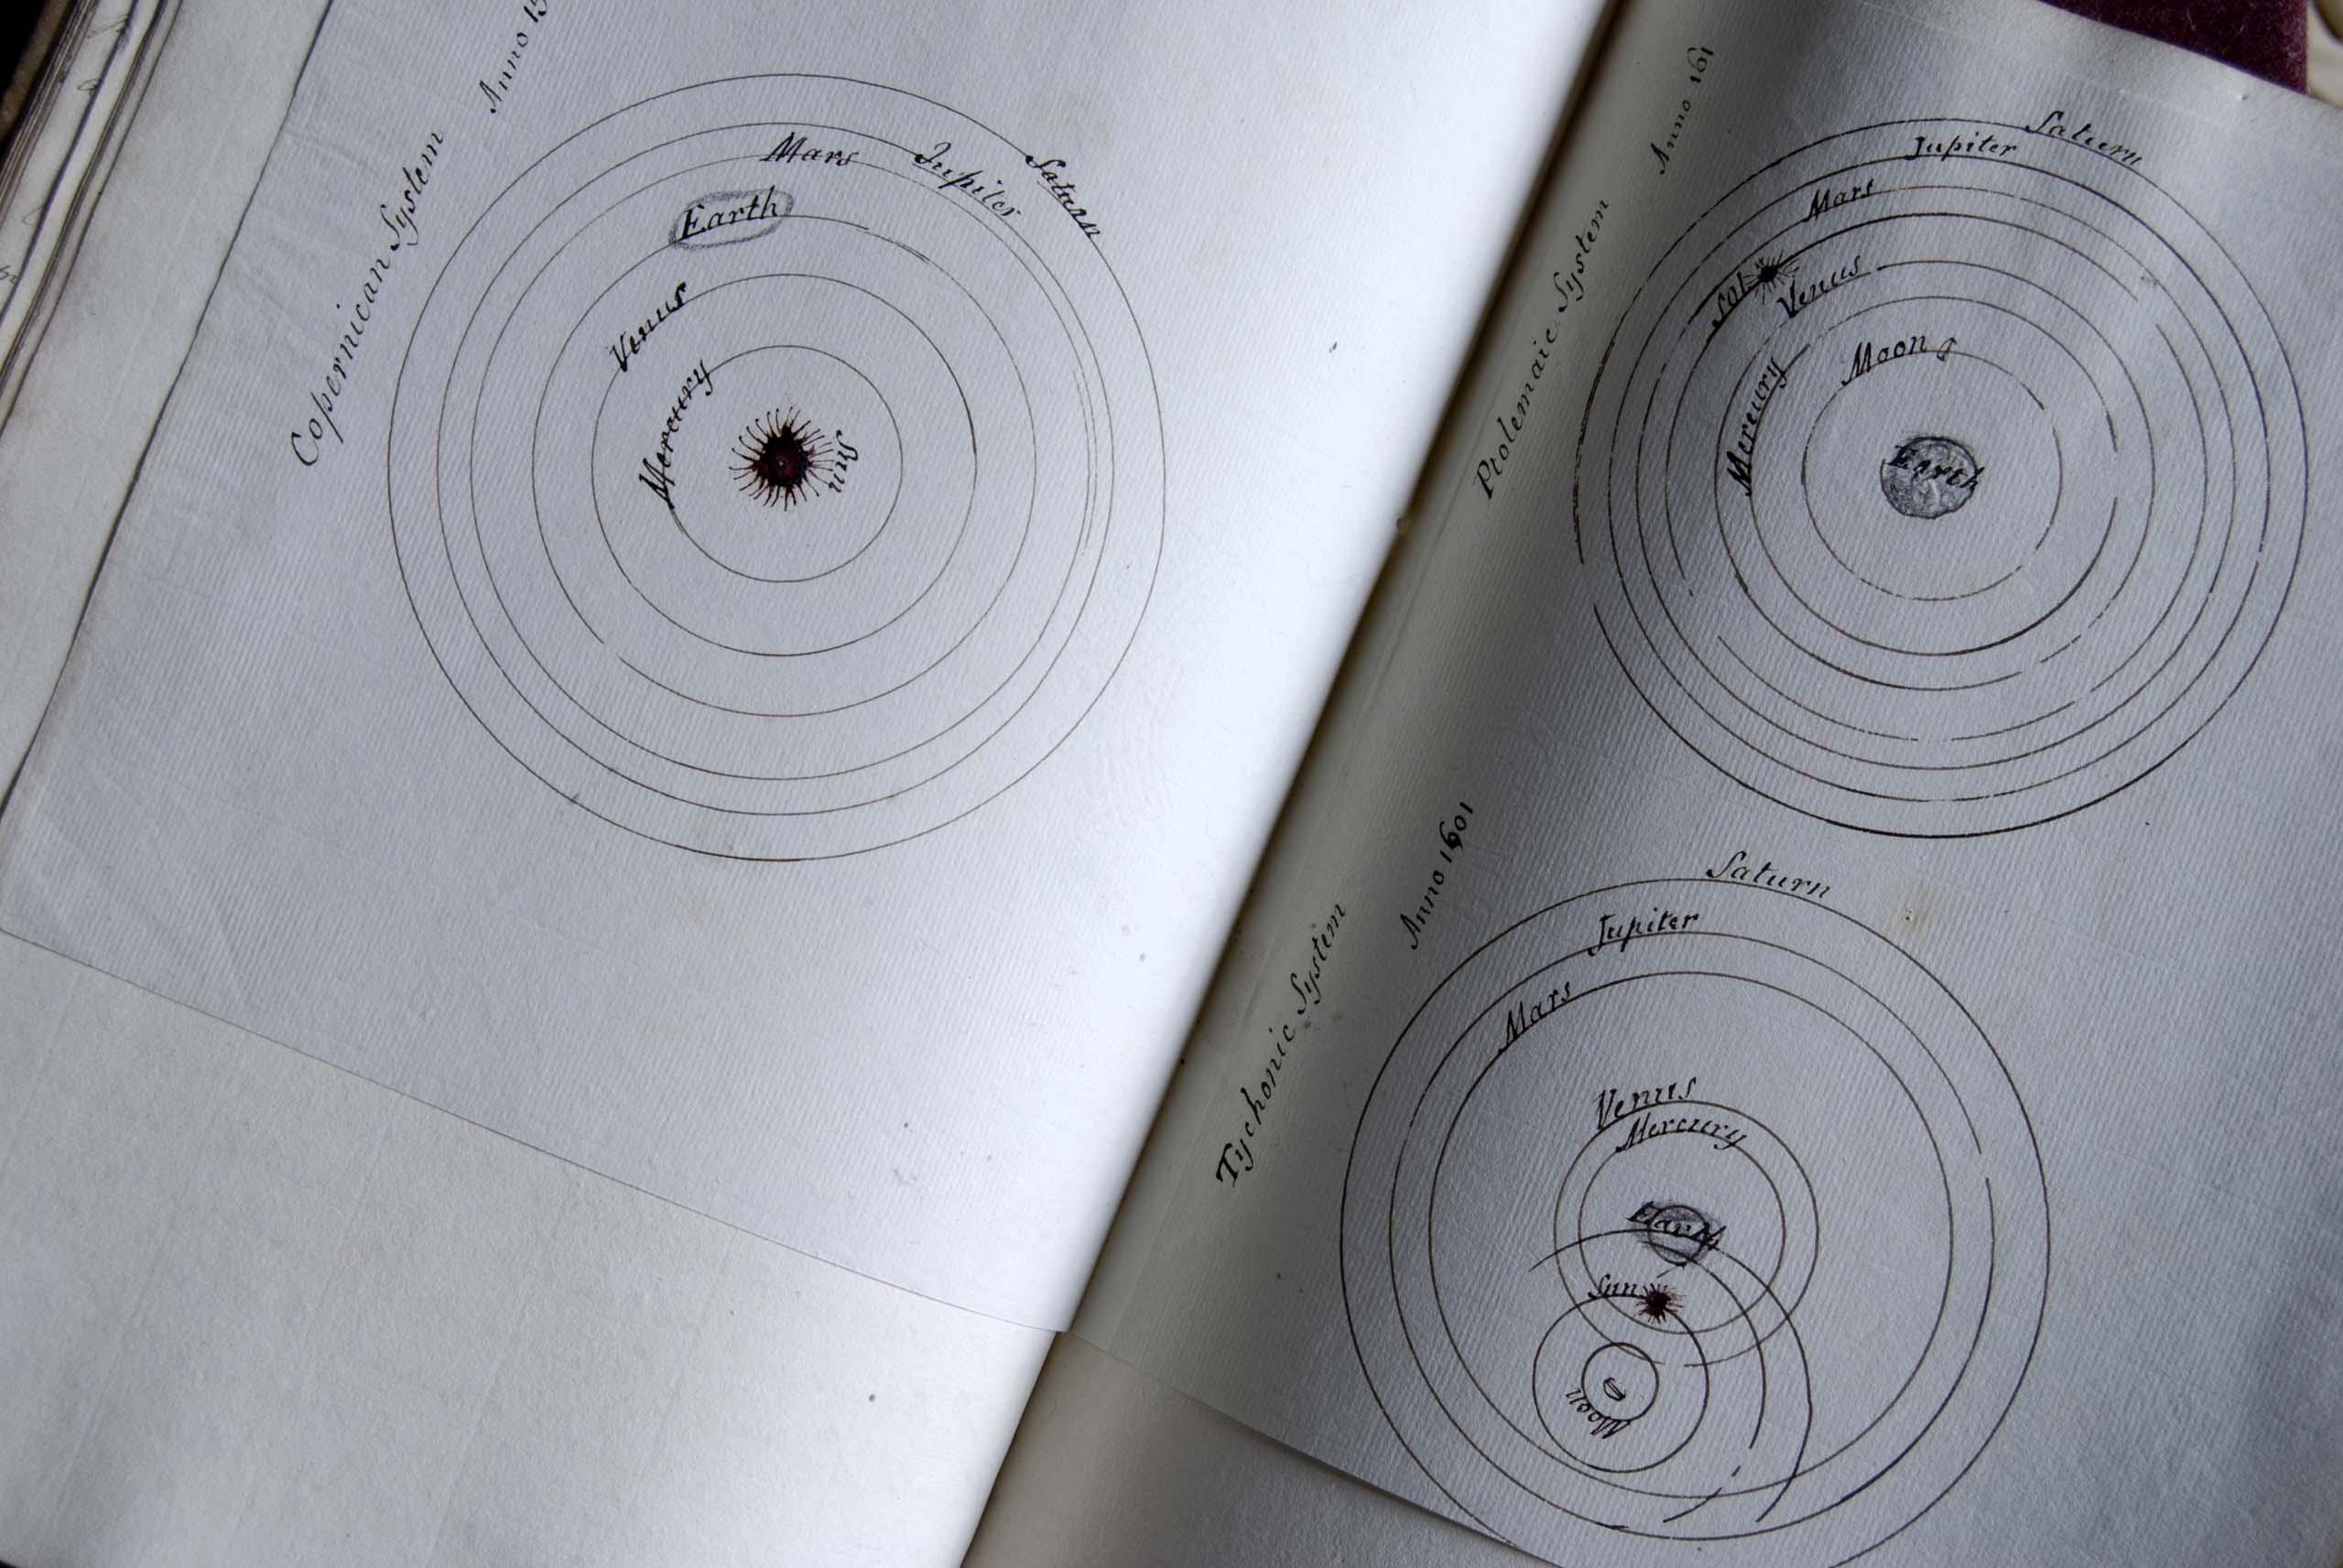
Planetary Systems
Library of Hospitalfield House, Arbroath,
Image one & a description of what we are looking at in the context of the project.

Slide 10
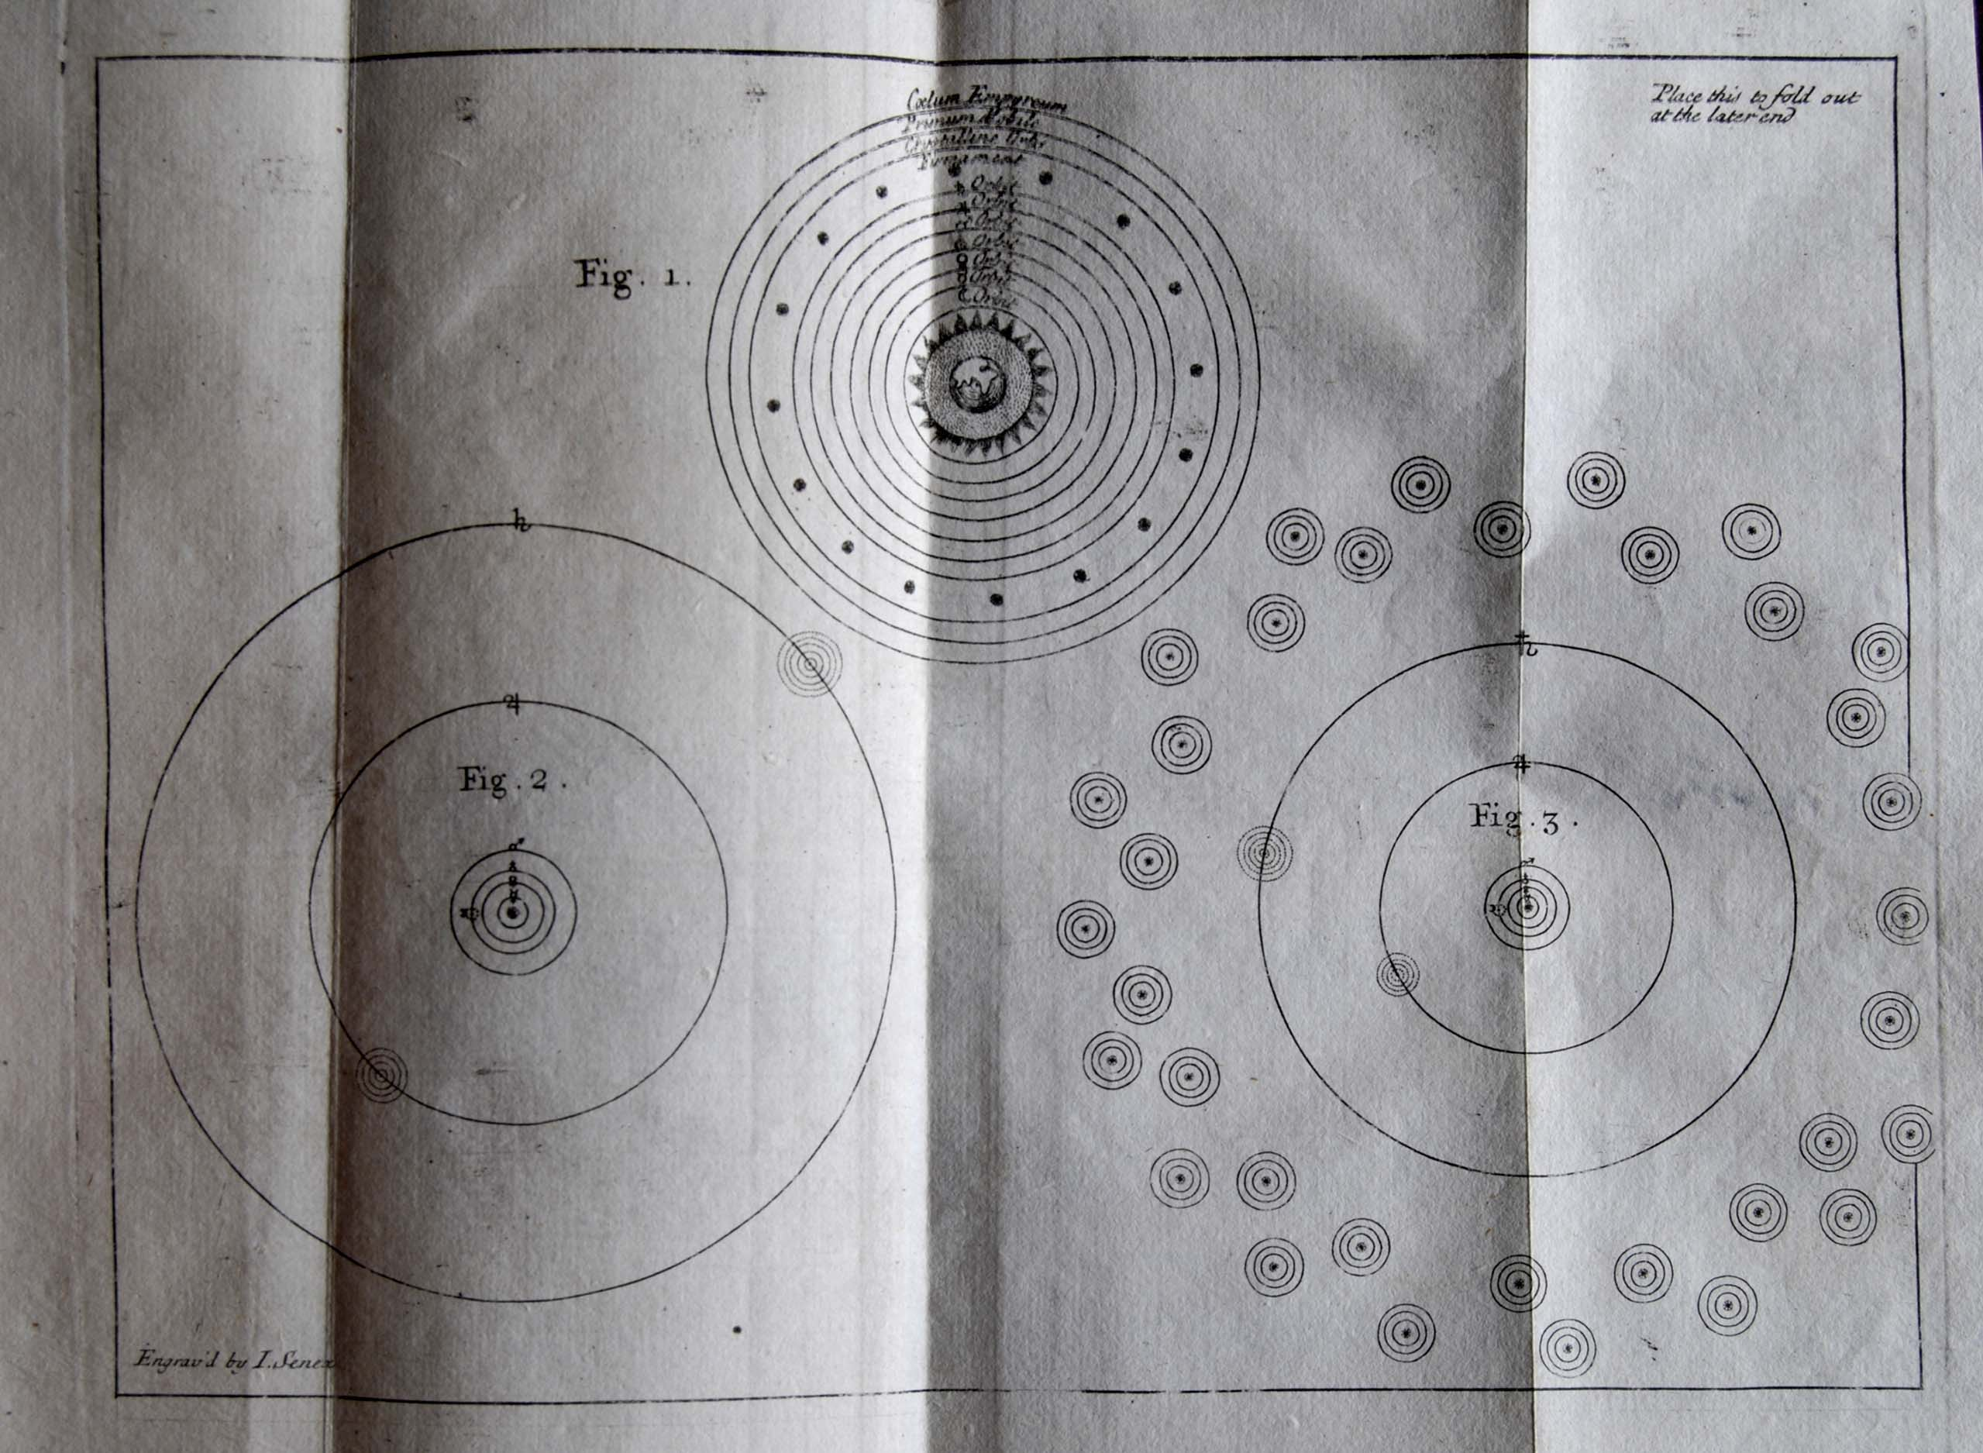
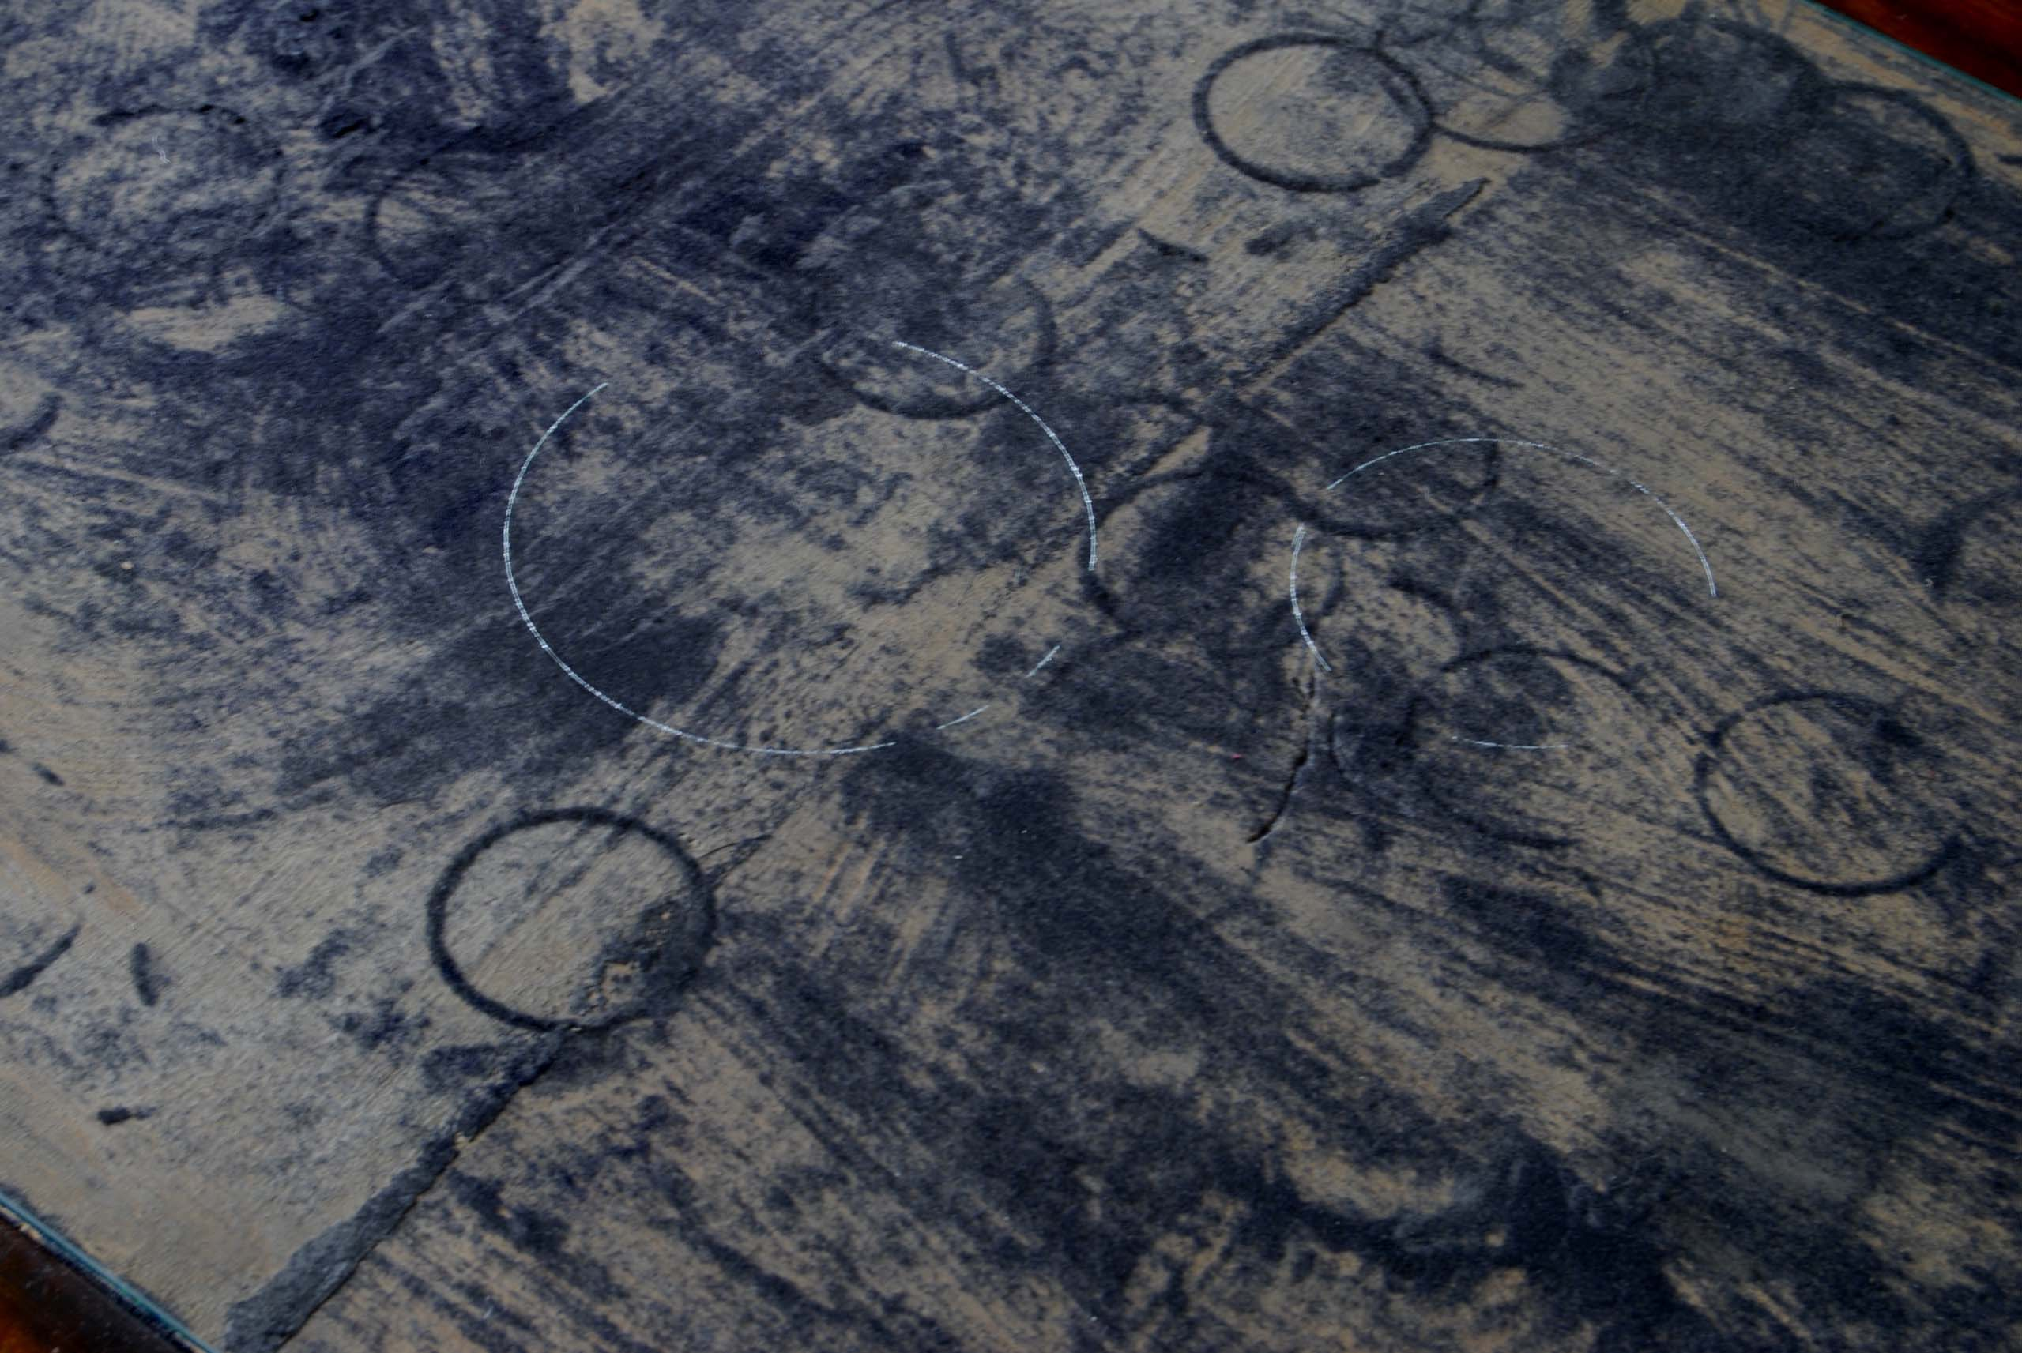
A page from
‘Astro-Theology: or a demonstration of the Being and Attributes of God from a survey of the Heavens’, by
W Derham, Rector of Upminster in Essex, W Innys, Prince’s Arms, St Paul’s MDCCXV.
and the surface of a an antique writing desk
Hospitalfield House Library, Arbroath
Image one & a description of what we are looking at in the context of the project.

Slide 11
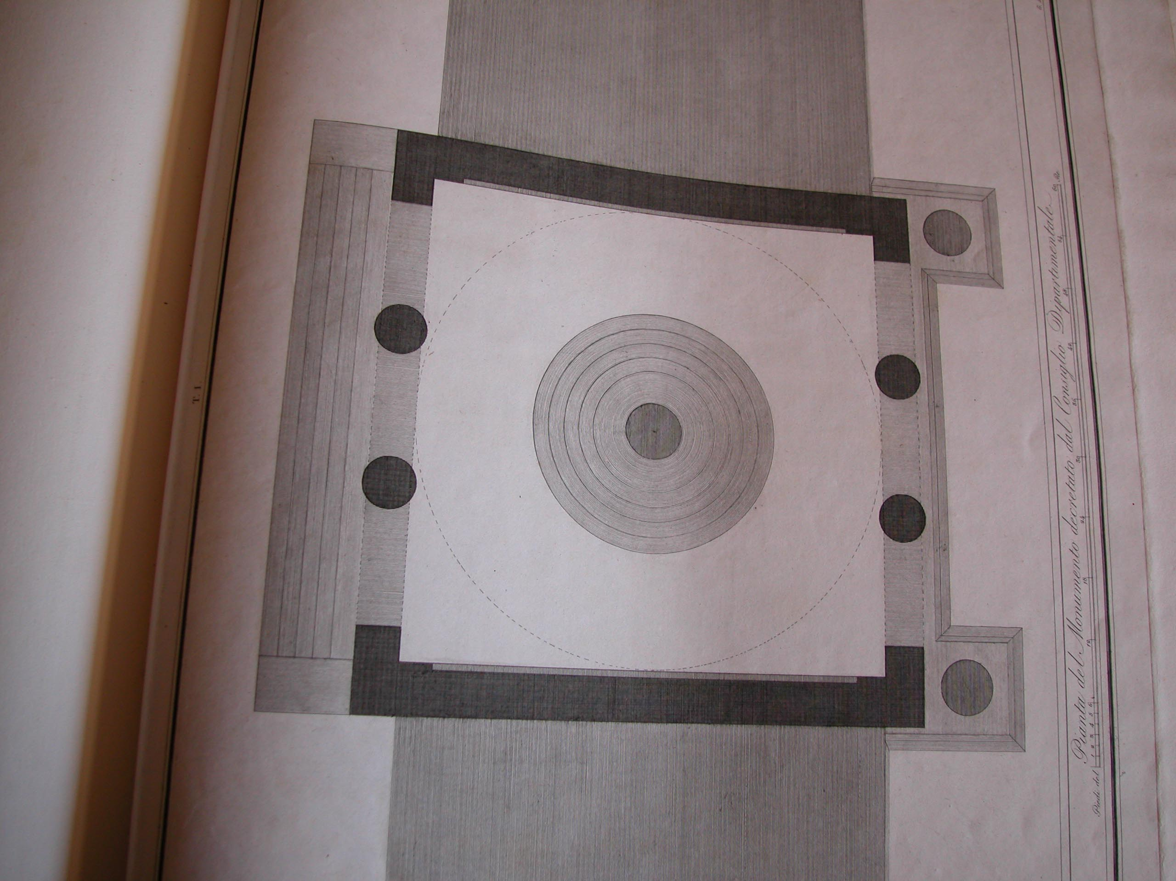
From a collection of architectural designs
Image one & a description of what we are looking at in the context of the project.

Slide 12
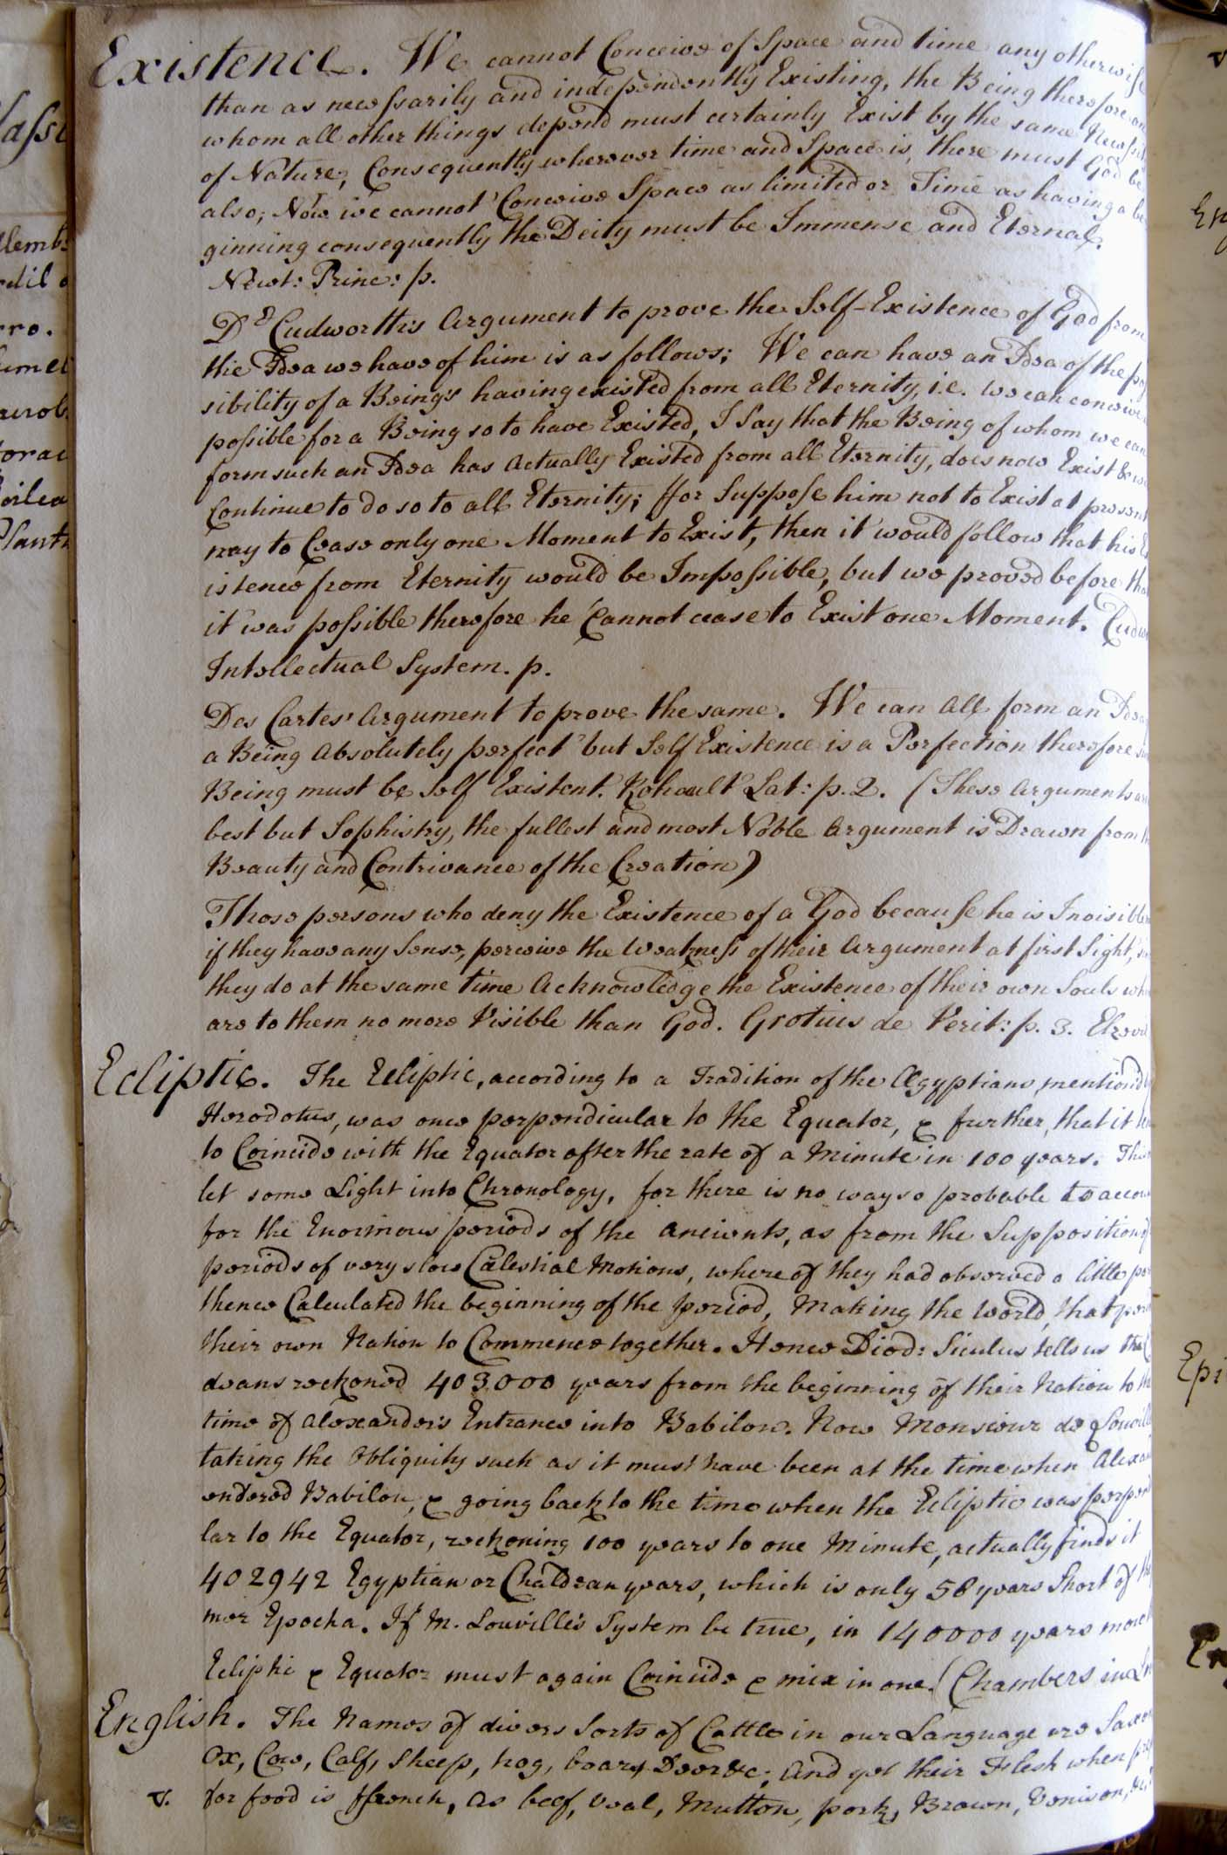
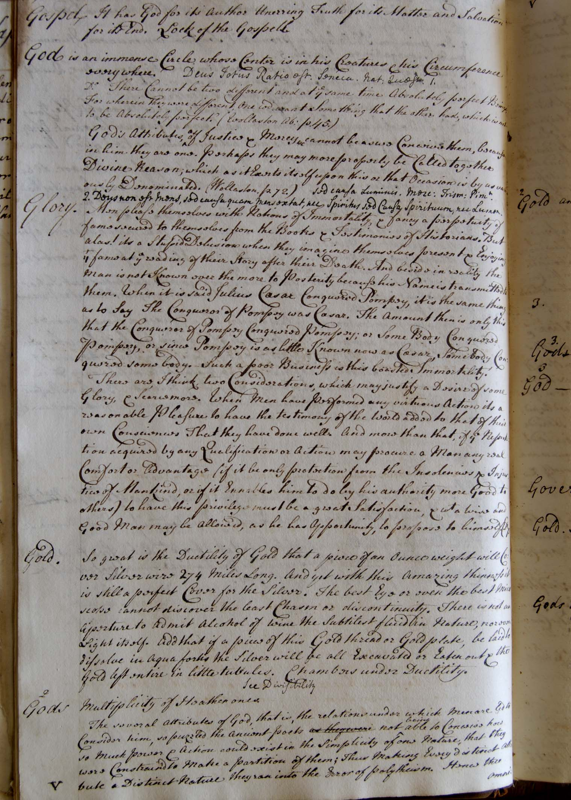
Hospitalfield Library, 2007
The journals of Richard Parrott
written, 1740-1762
Image one & a description of what we are looking at in the context of the project.

Slide 13
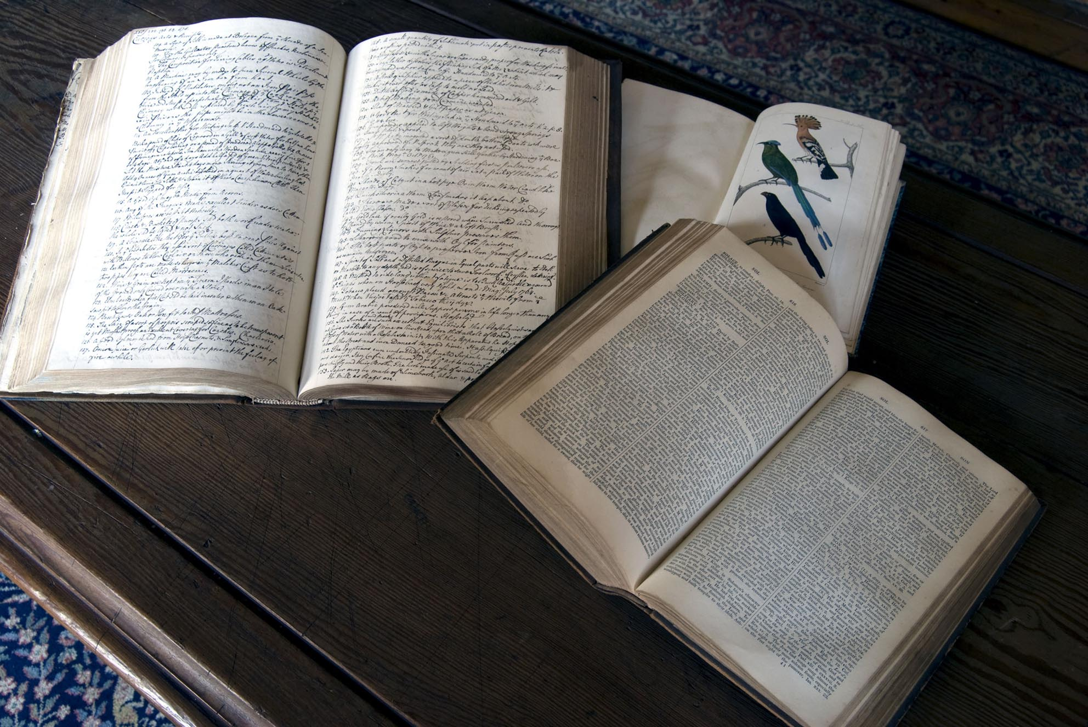
The journals of Richard Parrott cross referenced with the story of King Solomon
and the hoopoe as his messenger. The mystical tale is recounted in Parrott’s journal.
‘Curious Arts’ is the title he ascribes to topics in his journal that he cannot otherwise categorise.
Image one & a description of what we are looking at in the context of the project.

Slide 14
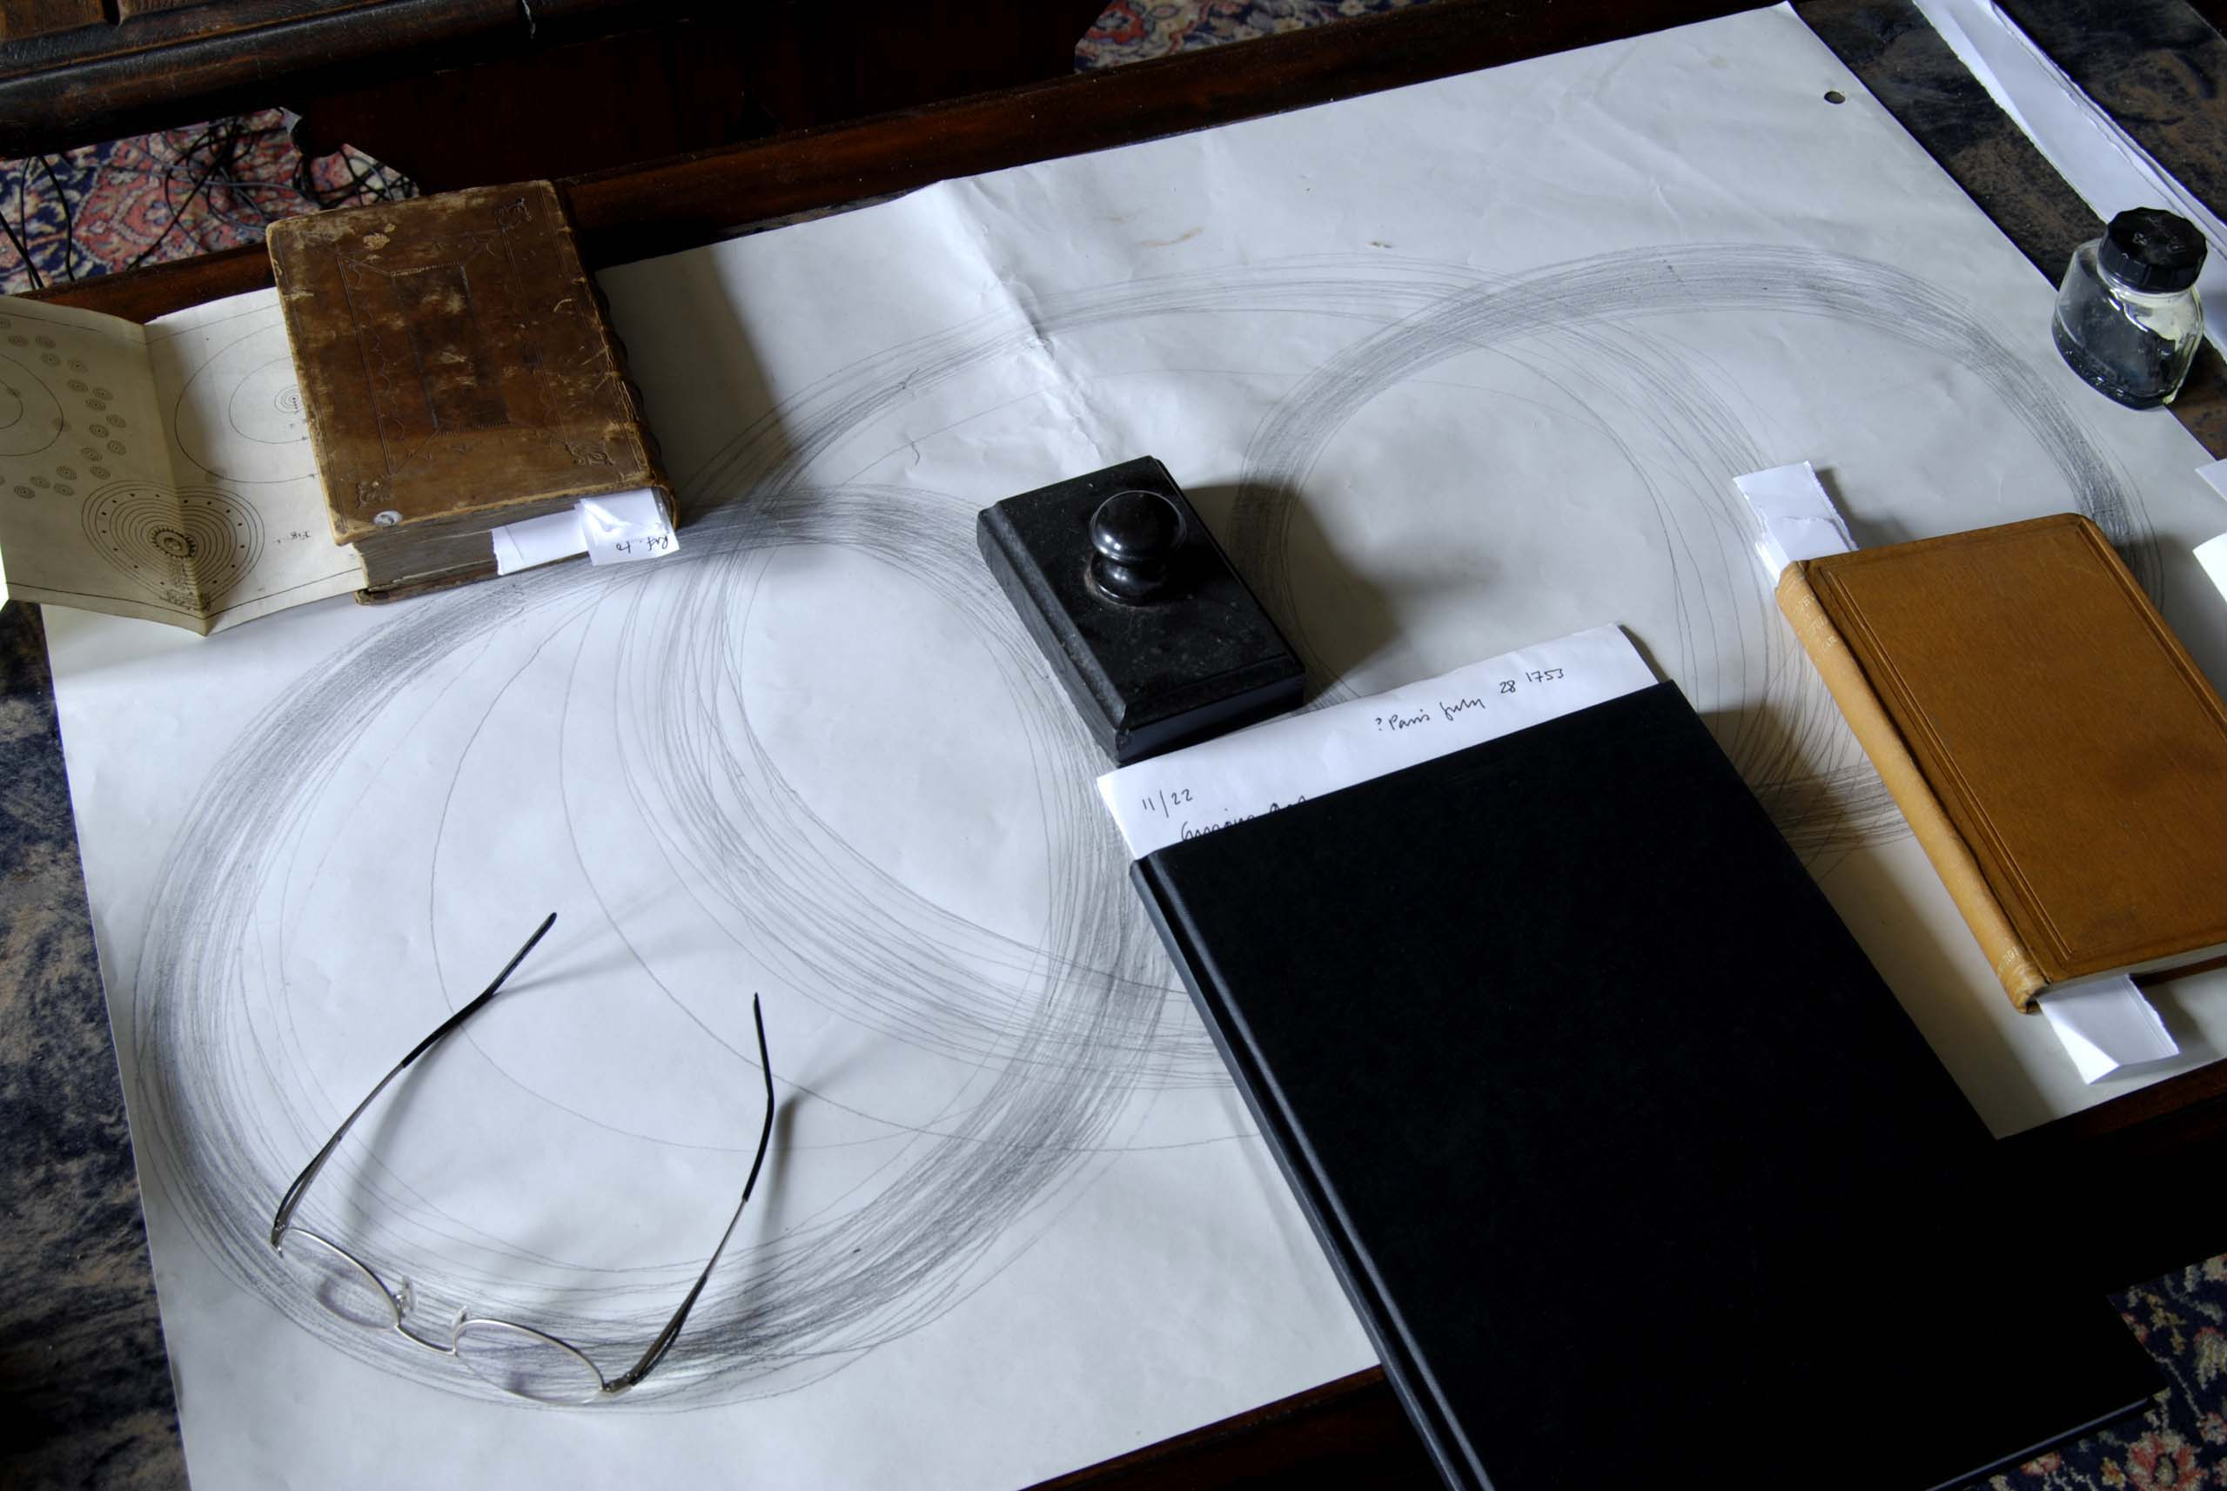
.
Methods: Close readings of historic journals and comparative textual and visual analysis of books, all held in the library, revealed a consistent attempt to understand and order knowledge relating to our relationship to the planet. A pattern of thinking emerged which revealed a curiosity in the relatedness of all things and the significance of the circle as an encompassing form.
Material experiments with drawing and sound recording and playback were used to as a means of tracing form, space and time.
Image one & a description of what we are looking at in the context of the project.

Slide 15
The following books from Hospitalfield Library became key influences in the research:
Three leather bound journals belonging to Richard Parrot and Christopher Wright;
Patrick Allan Fraser’s Notebook containing circle drawings relating to celestial orbits;
Bouffon’s ‘Oeuvres: Histoire des Animaux – Oiseaux 19’
G F Rodwell, Birth of Chemistry, Macmillan & Co, 1874
R W Billings, The Power of Form: Applied to Geometric Tracery, Wm Blackwood & Sons, Edinburgh & London, 1851
John G MacVicar, Philosophy of the Beautiful, Edmonston and Douglas, MDCCCLV
W Derham, Rector of Upminster in Essex, Astro-Theology: or a demonstration of the Being and Attributes of God from a survey of the Heavens, W Innys, Prince’s Arms, St Paul’s MDCCXV.
Also brought to the research:
Farid ud’din Attar, Conference of the Birds, C13th
John Berger, ‘Let us think about fear’ in Hold Everything Dear (April 2003)
Robert Burton, Anatomy of Melancholy, 1881 edition
Johann Wolfgang Goethe, Italian Journey, 1786-1788
Johann Wolfgang Goethe, Theory of Colours, (translated) 1840
Johann Wolfgang Goethe, Autobiography of Goethe
Houari Touati, Islam & Travel in the Middle Ages, 2000
All of these books were included in the sound installation Curious Arts - No. 5 and were available for viewing by the audience at set times.
Image one & a description of what we are looking at in the context of the project.

Slide 16
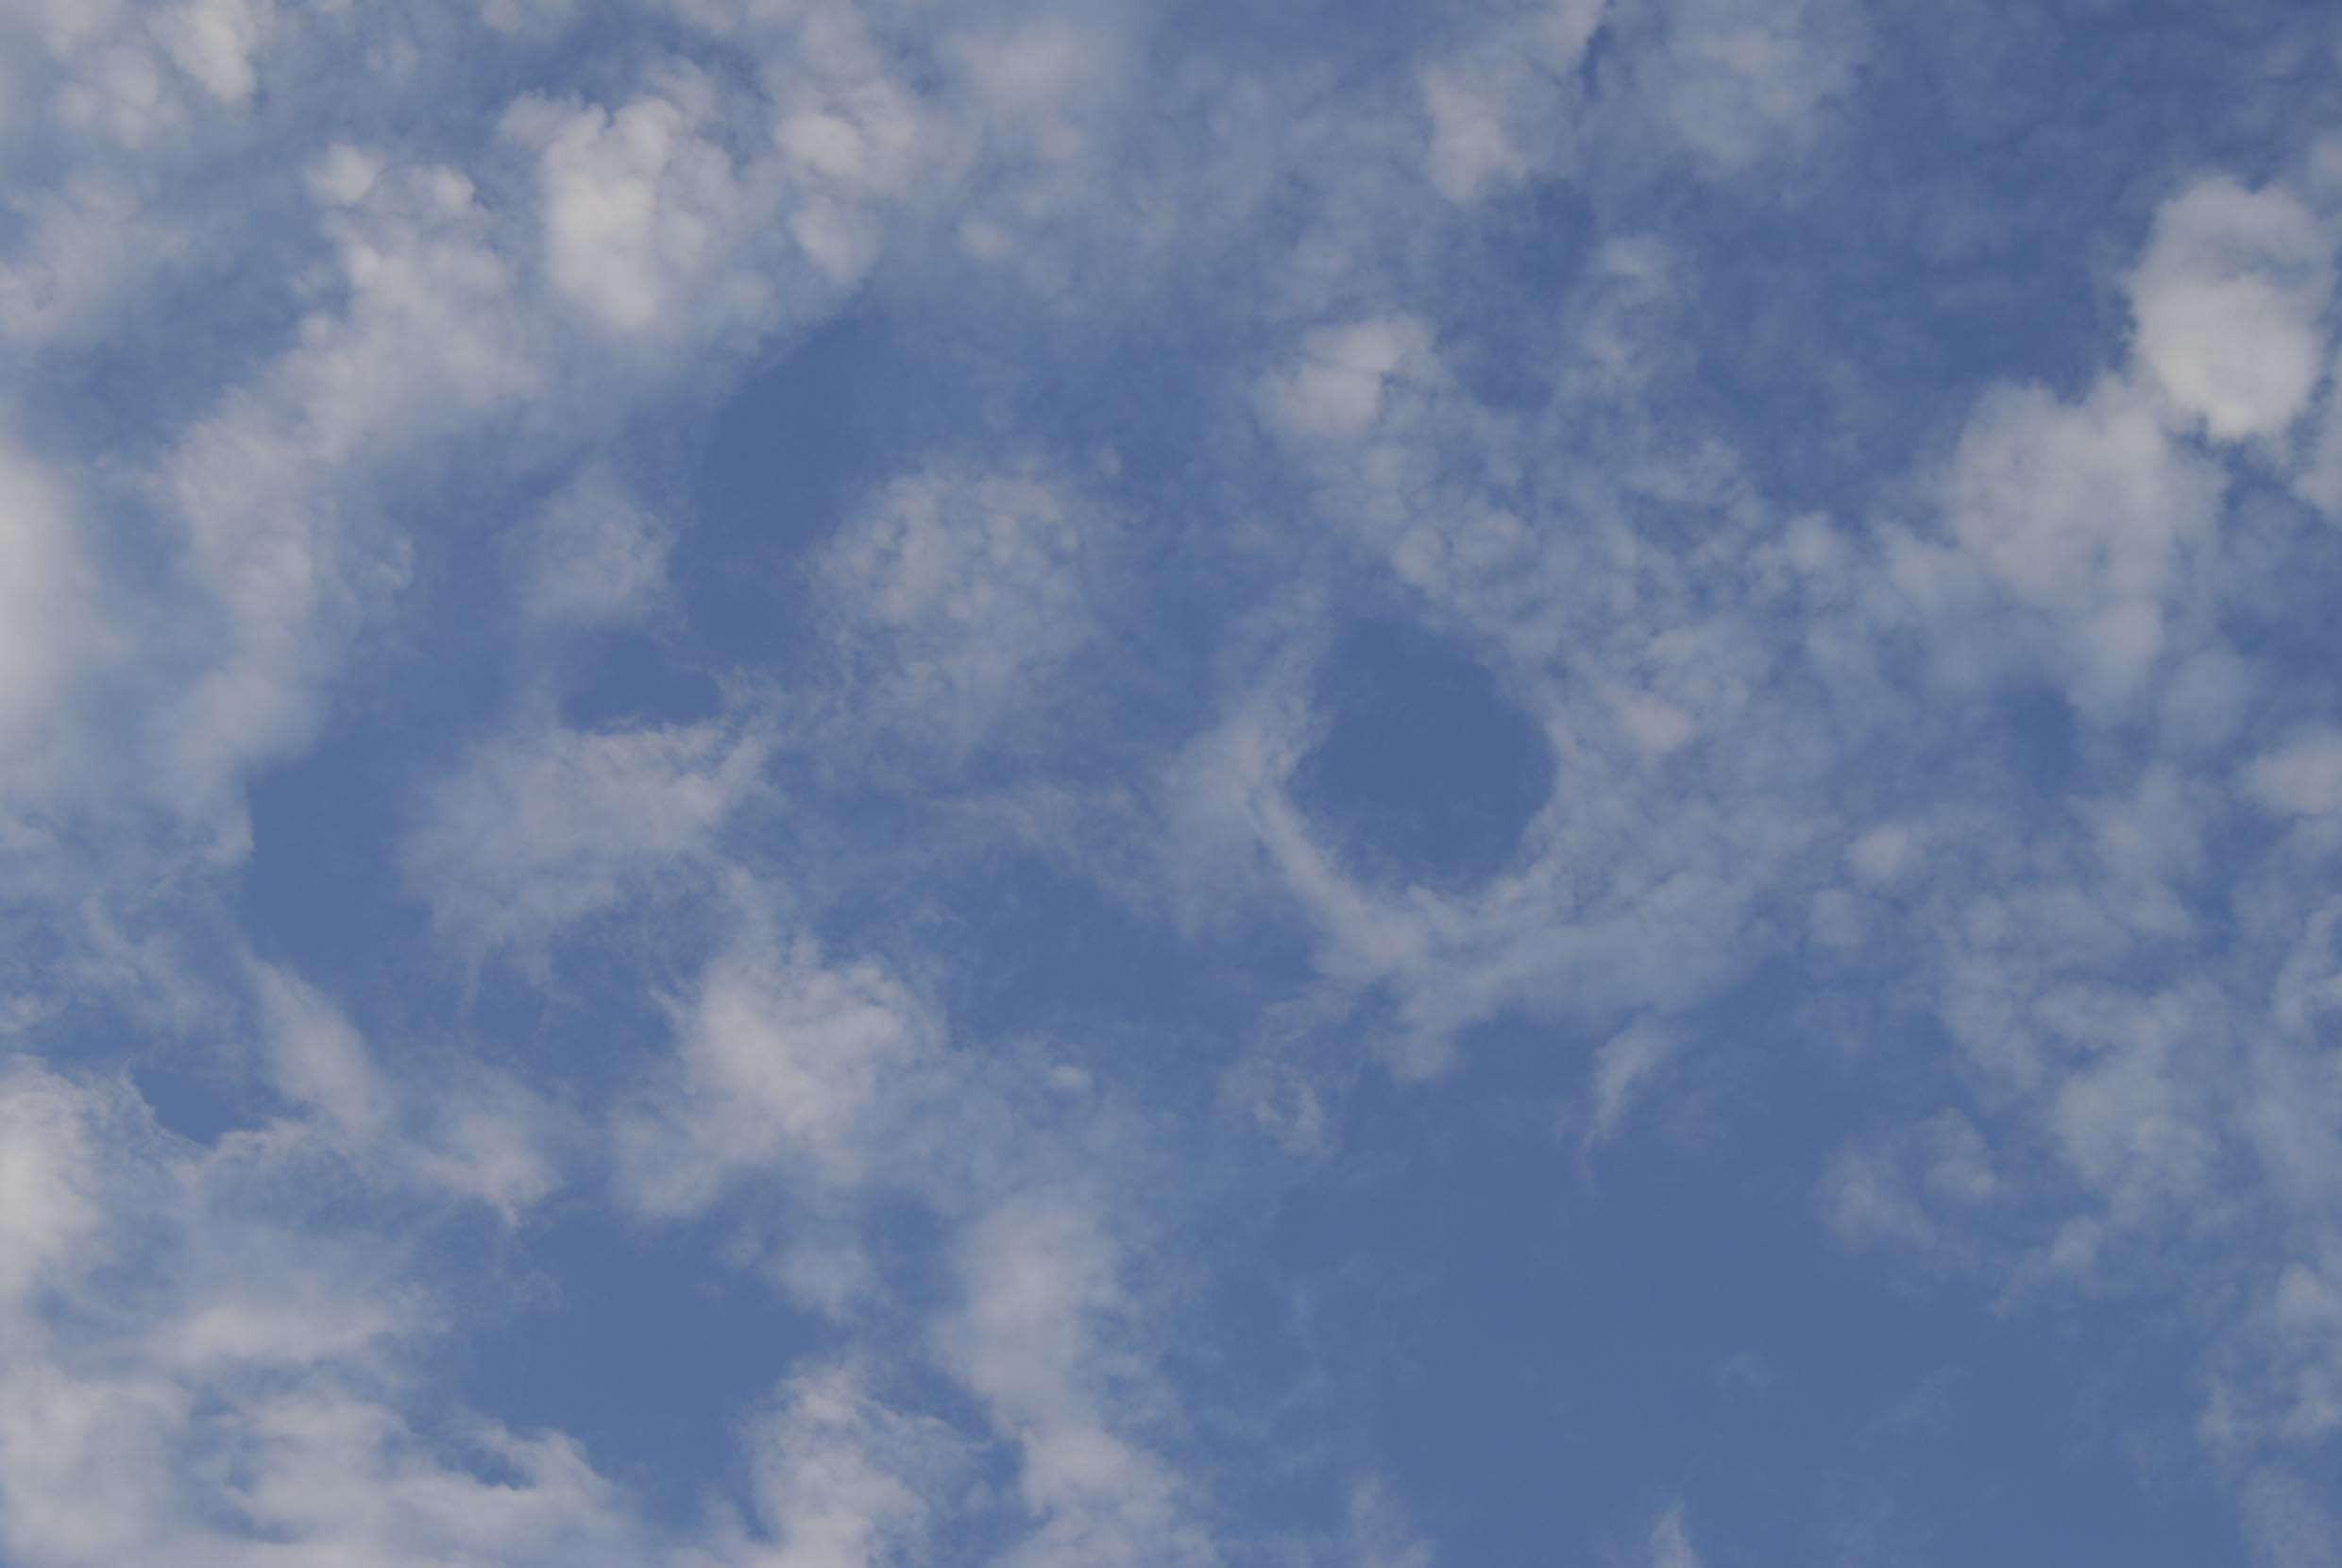
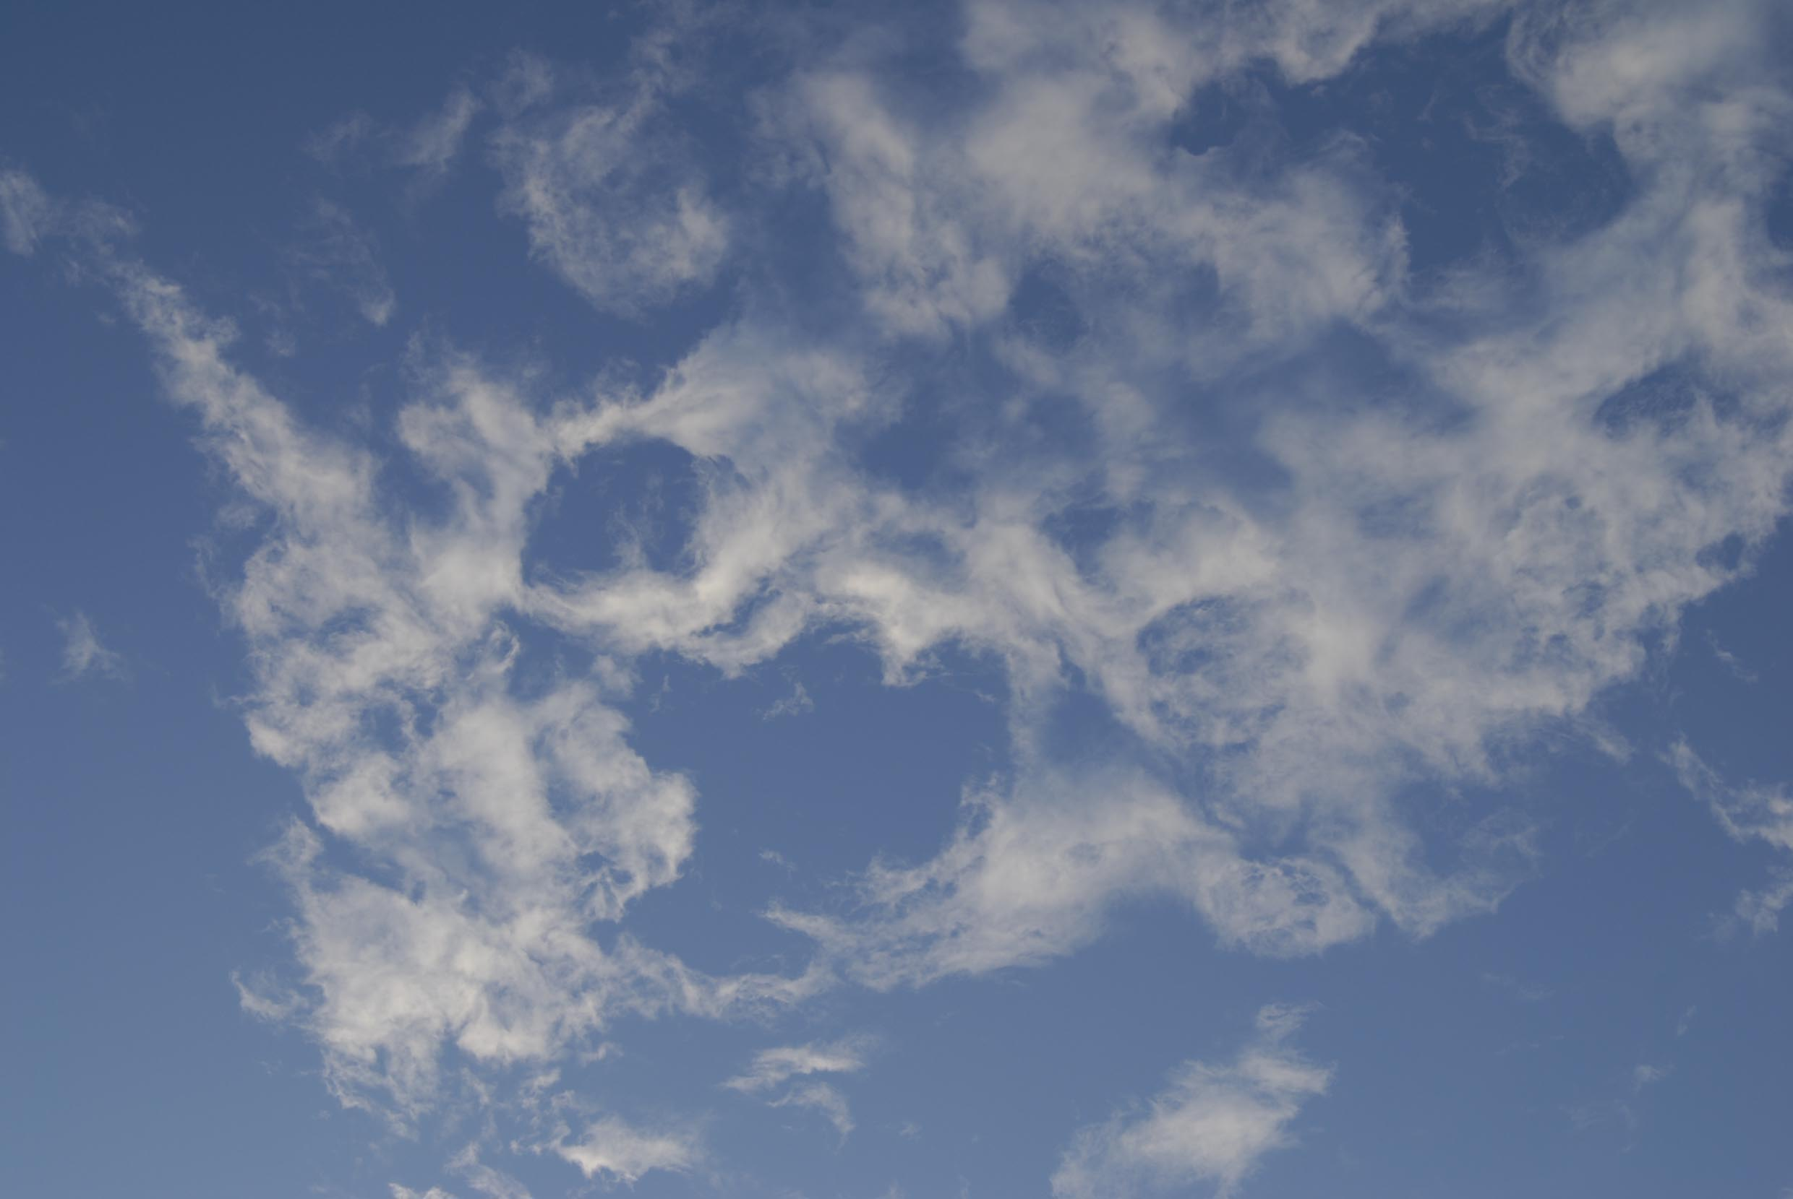
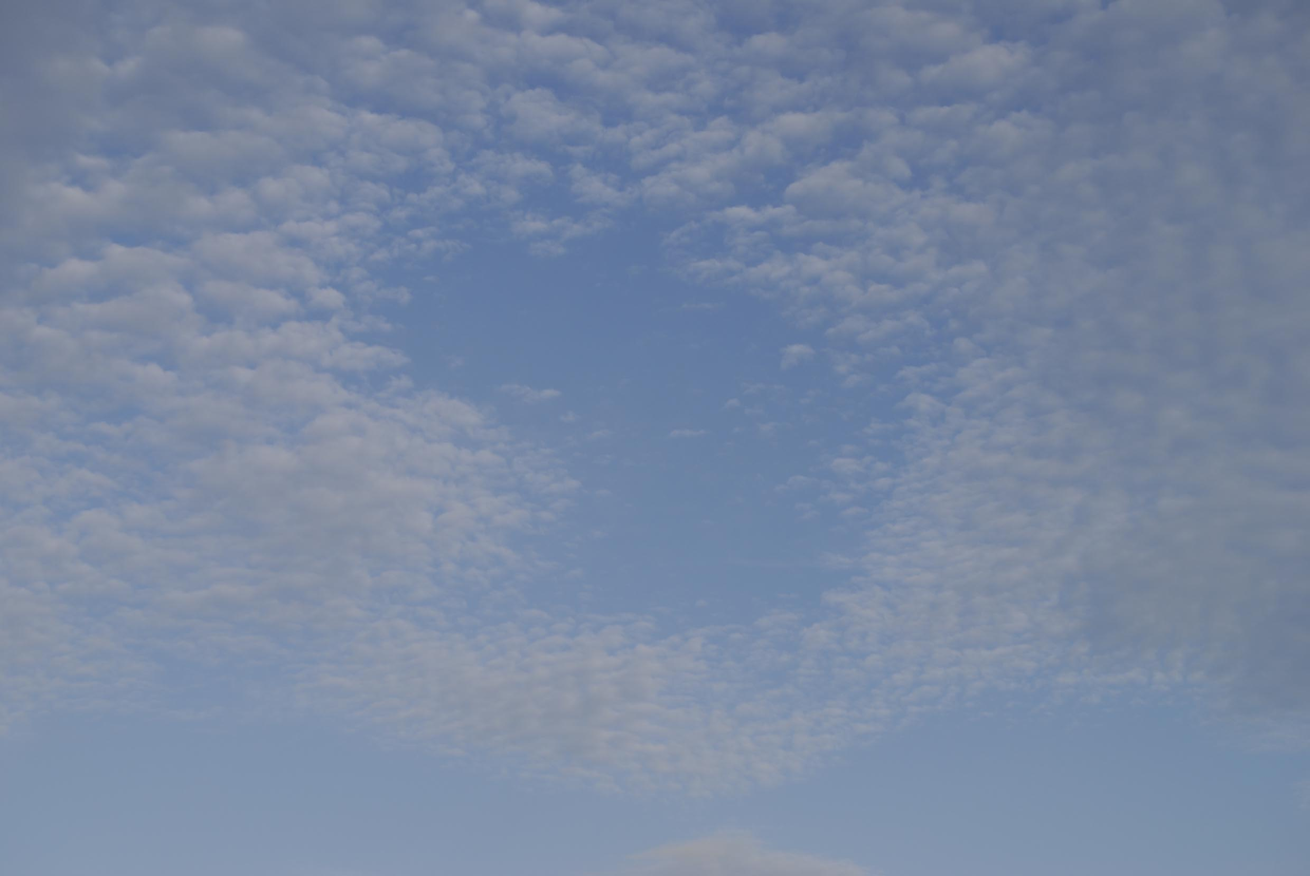
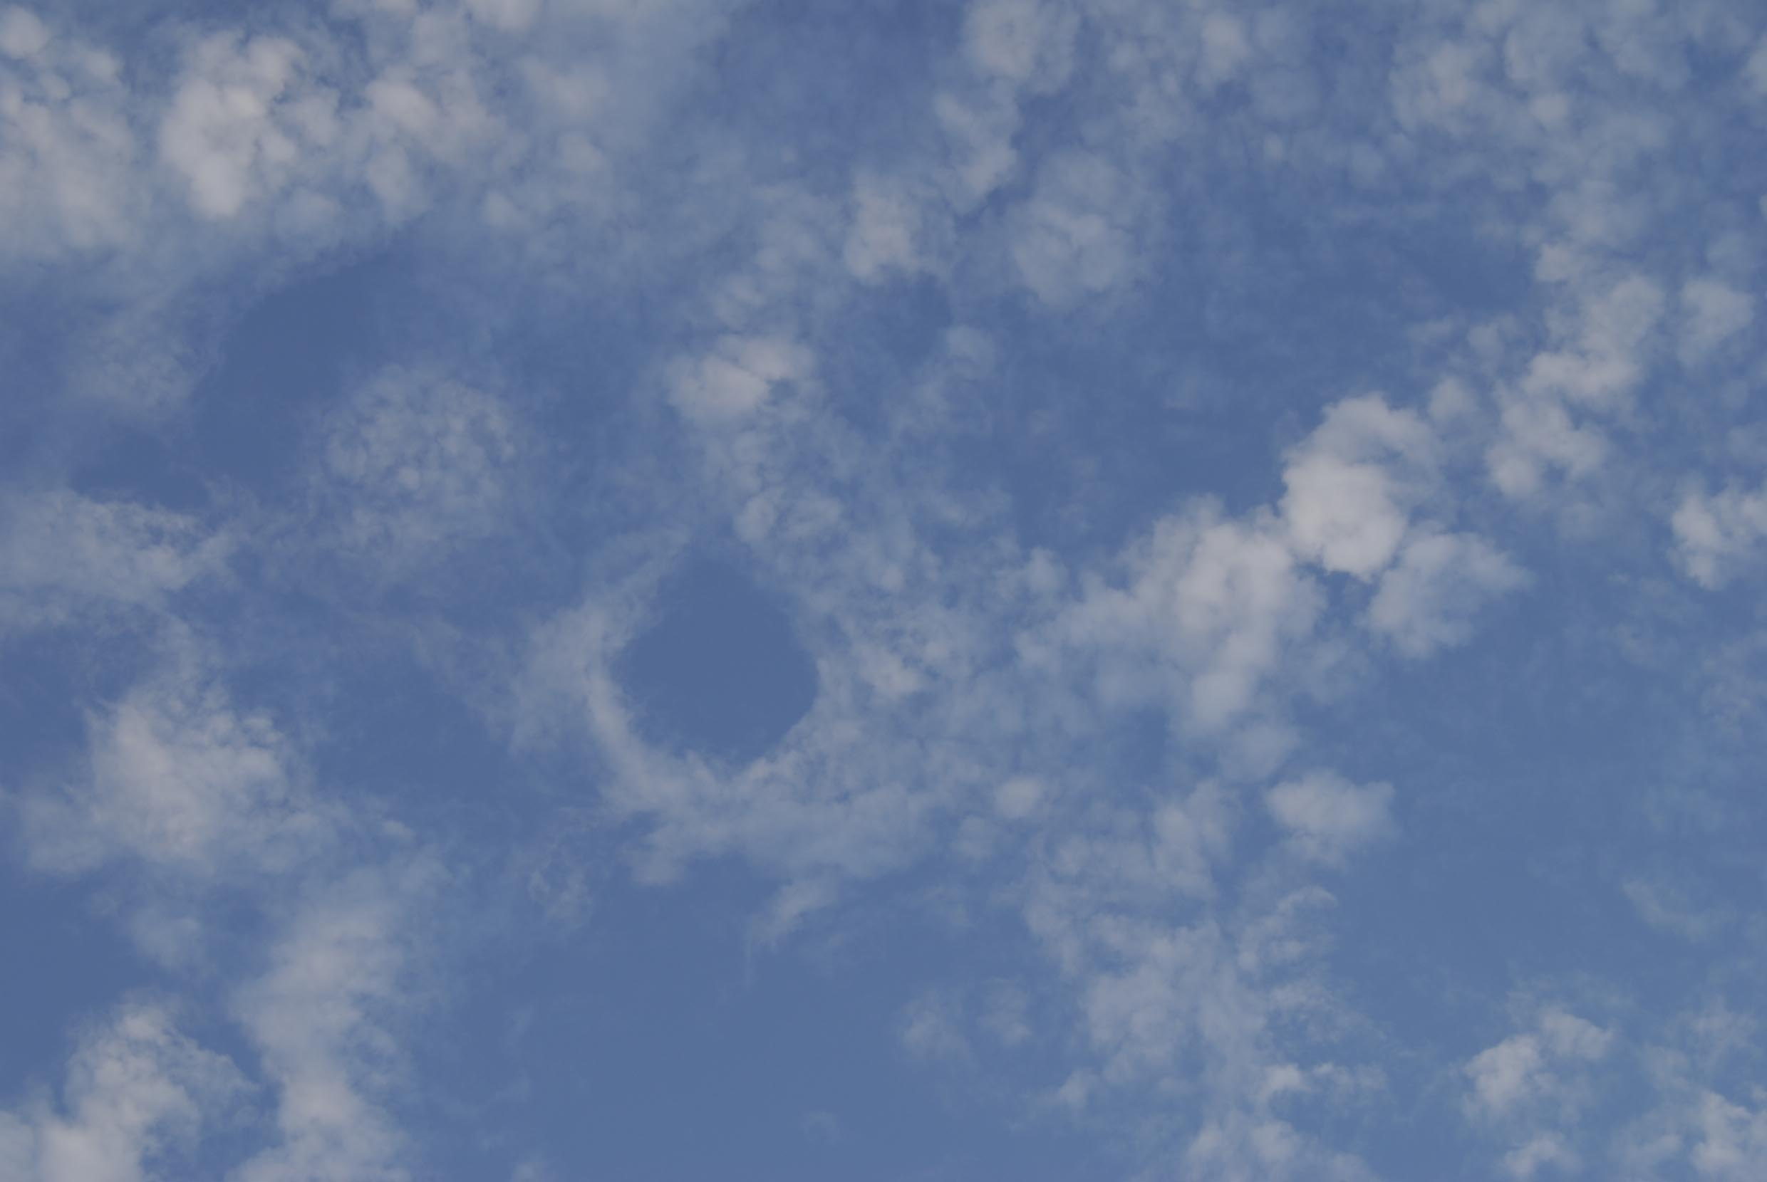
Photographic images of cloud forms, along with ochre coloured markers, were inserted into the books and journals at pages of particular relevance to the work.
Image one & a description of what we are looking at in the context of the project.

Slide 17
The resulting work, Curious Arts – No. 5 is a sculptural sound work, comprising two tables with glass tops and wooden legs, their design reflecting different historical periods. One antique table, from the Library of Hospitalfield House, Arbroath, retains a trace of its former use and provides a surface on which three sound loops play recordings of a wooden implement tracing the circular marks on its surface. The second table provides the surface upon which sits the literature that inspired the work that, like the glass itself, act as resonators for the sound being transmitted via small speakers.
Image one & a description of what we are looking at in the context of the project.

Slide 18
Curious Arts - No. 5
Sculptural sound installation at CCA, Glasgow 1-17 December 2011
Installation size variable, comprising:
2 tables with glass tops: one antique, one contemporary
3 portable CD players and 3 sound loops
6 speakers and cabling
Collection of books
Wooden table and selected books and journals kindly loaned by Hospitalfield House Trust.

Slide 19
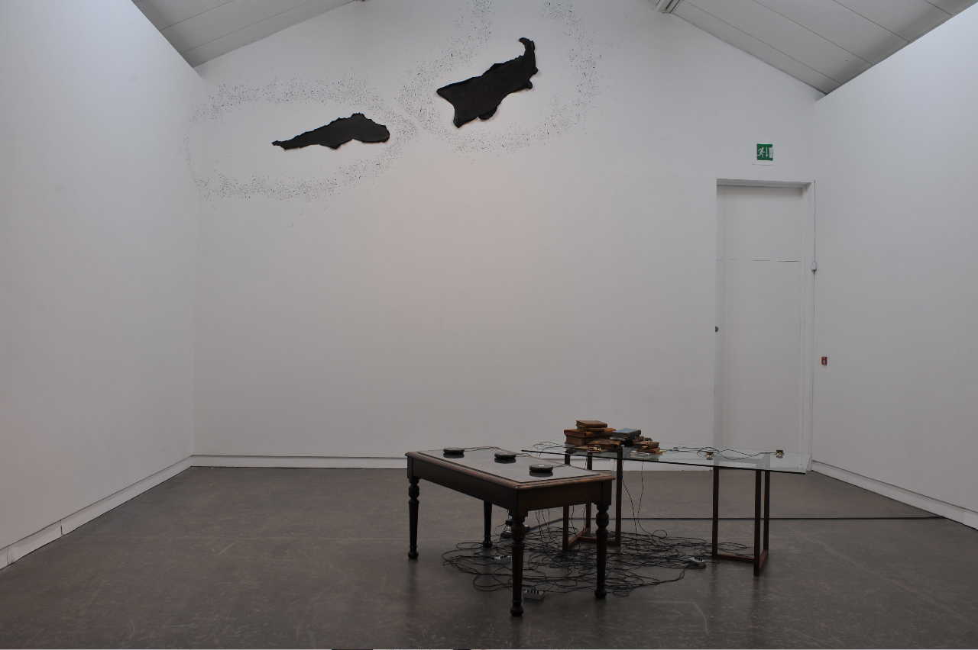

Slide 20
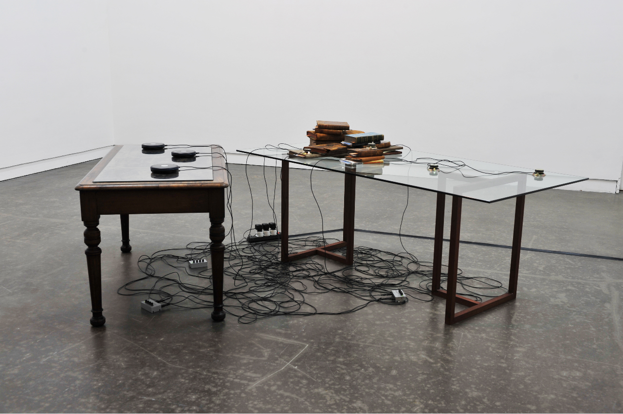

Slide 21
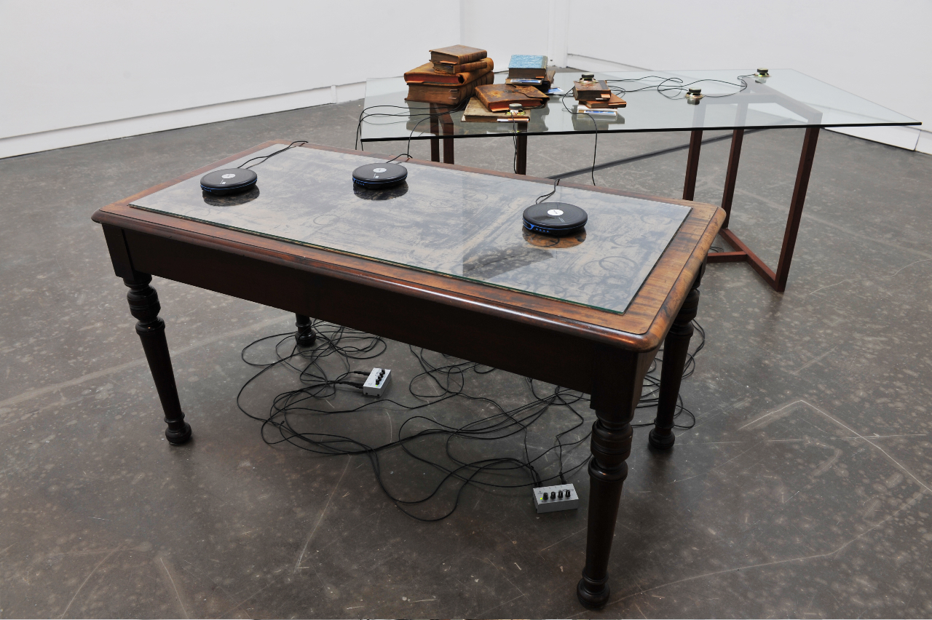

Slide 22
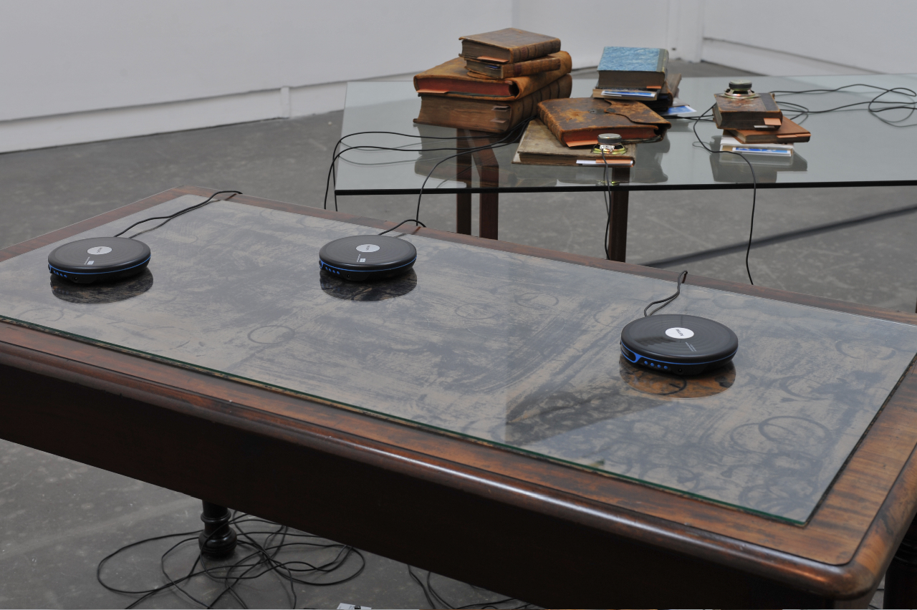

Slide 23
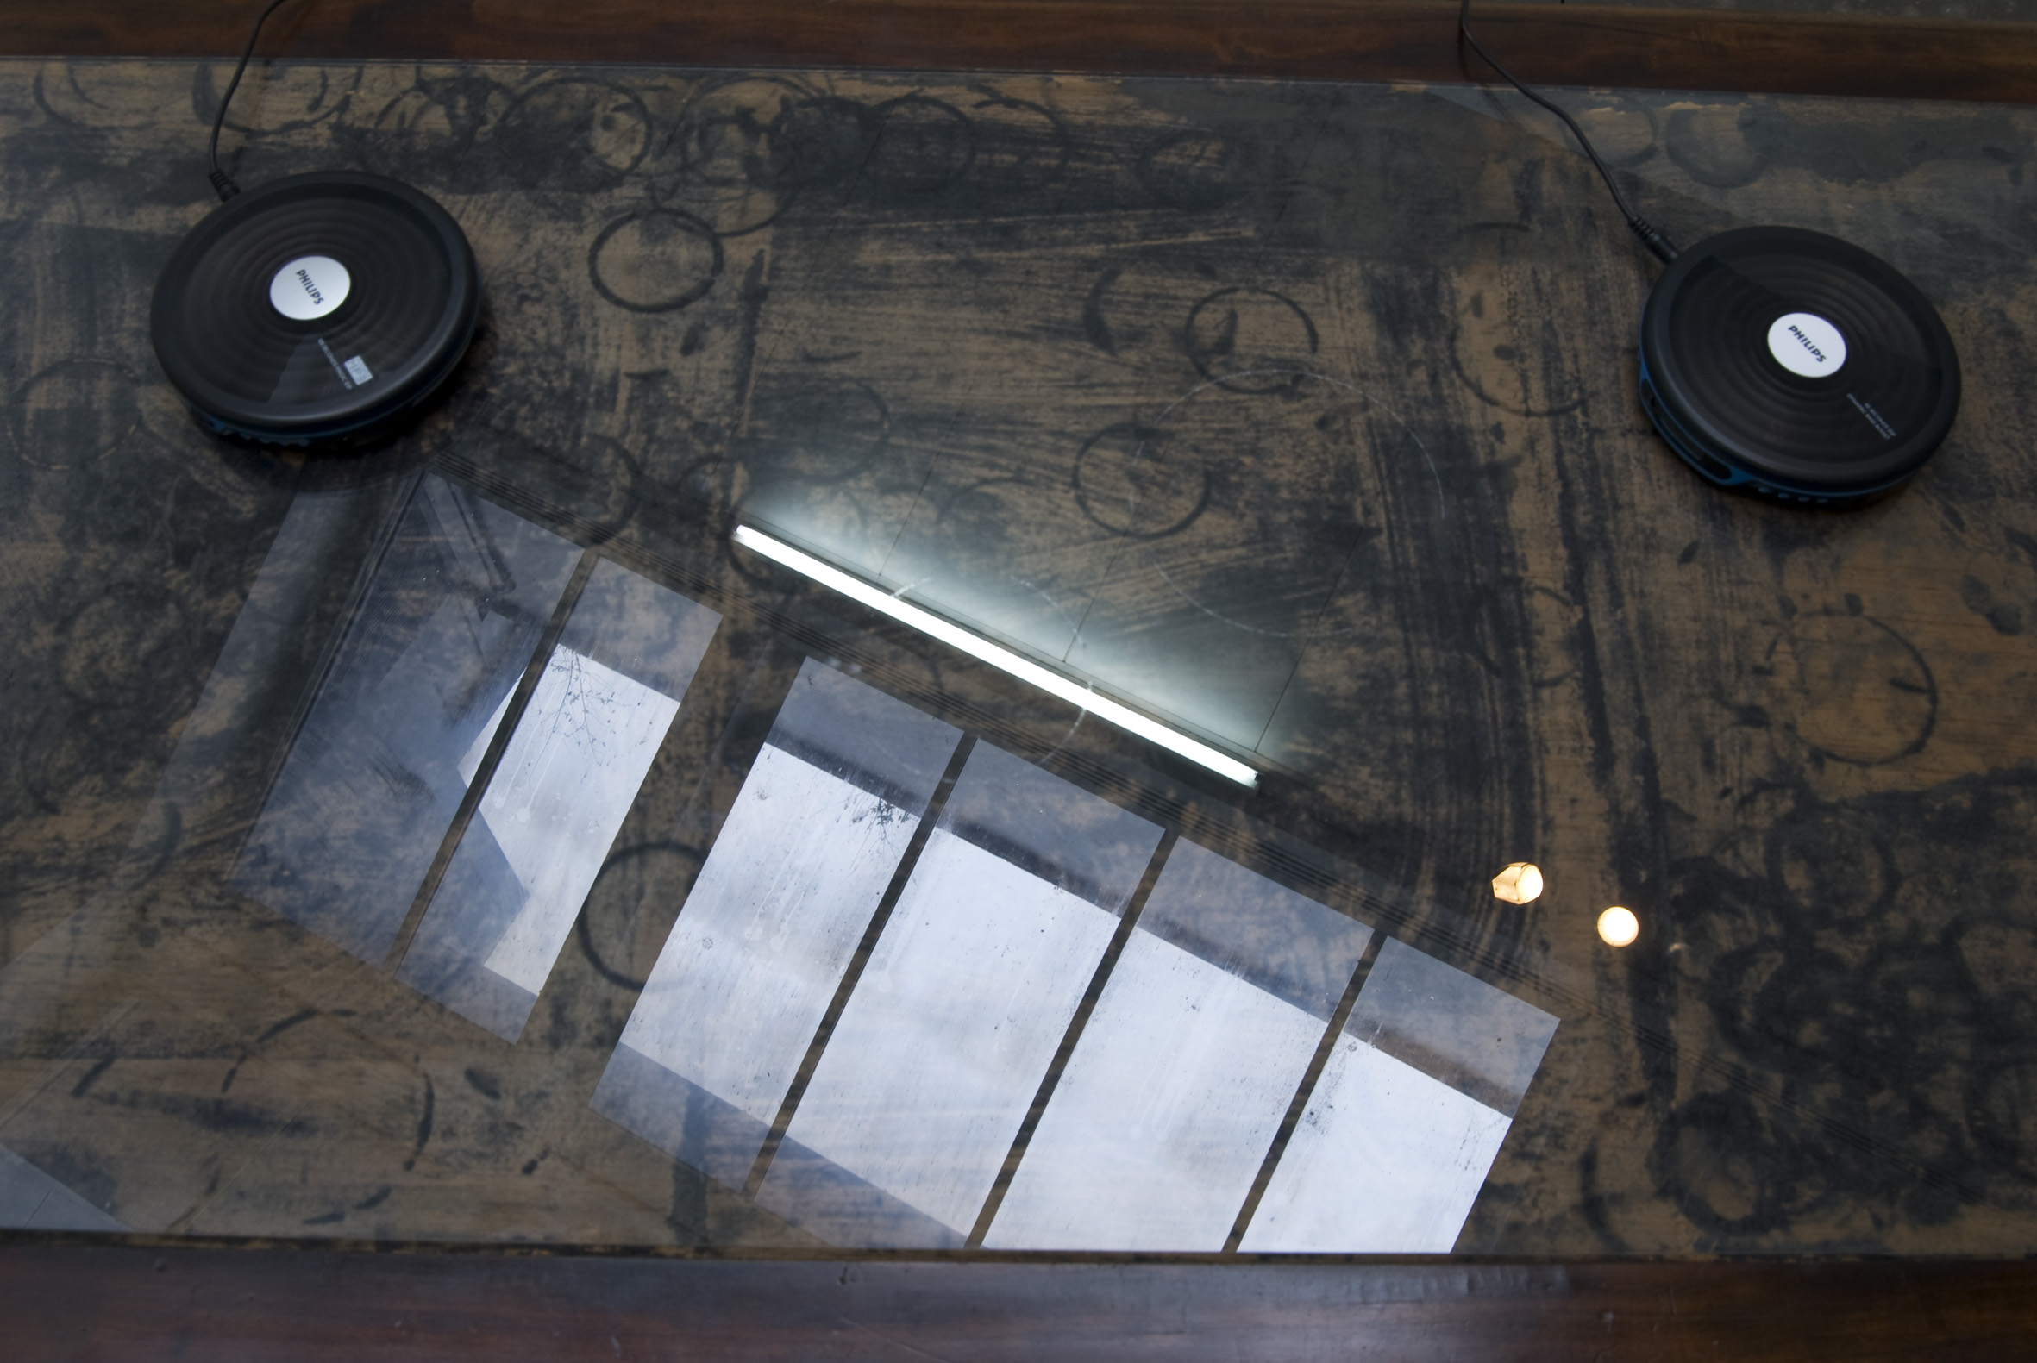

Slide 24
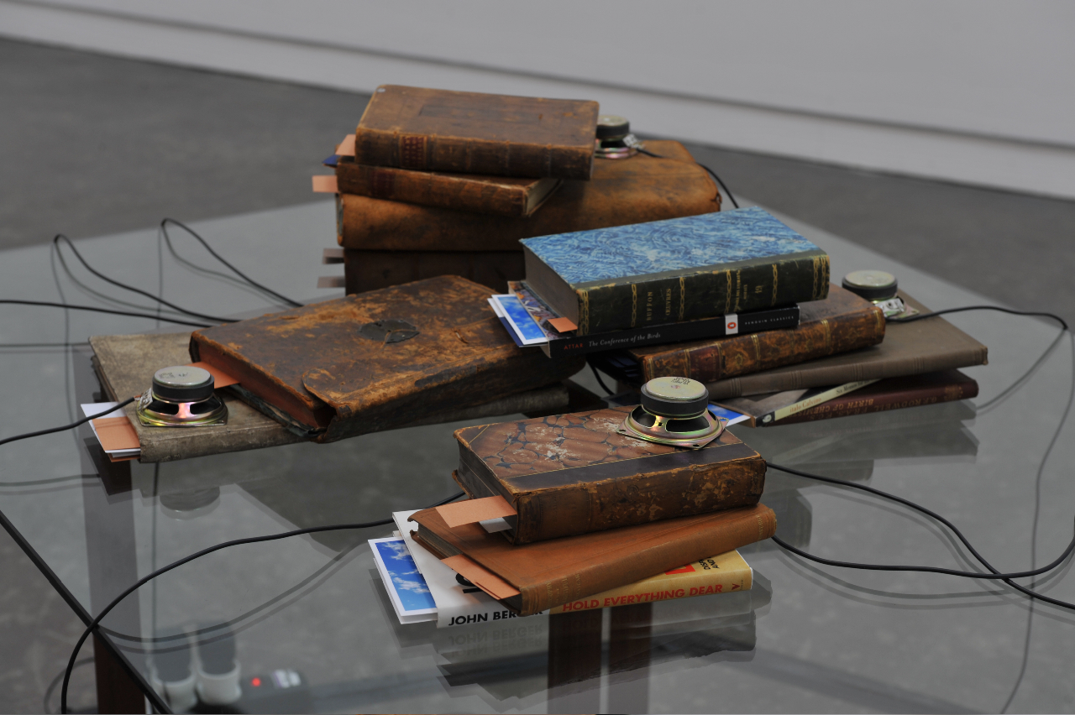

Slide 25
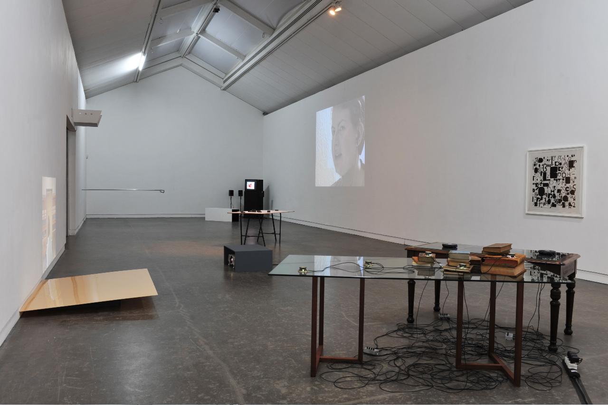

Slide 26
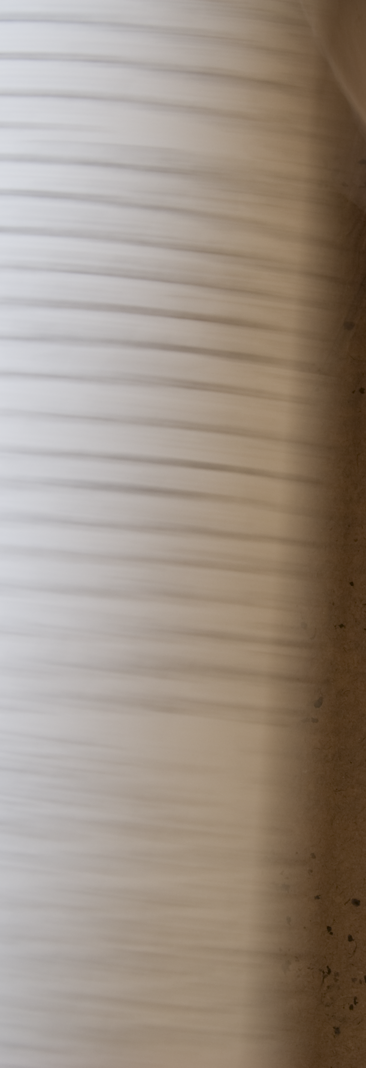
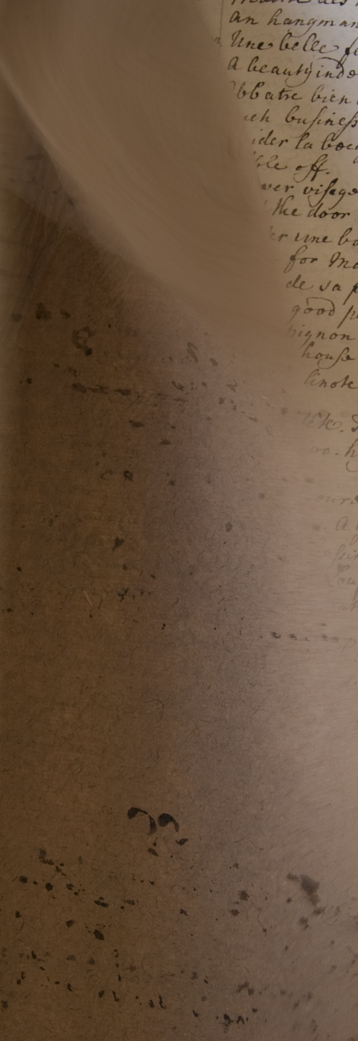
Preliminary written and photographic research undertaken in the Library of Hospitalfield House was used to produce Artists’ pages for the catalogue for
‘What we make with words’.
A copy is available in the GSA Archive.
Image one & a description of what we are looking at in the context of the project.

Slide 27
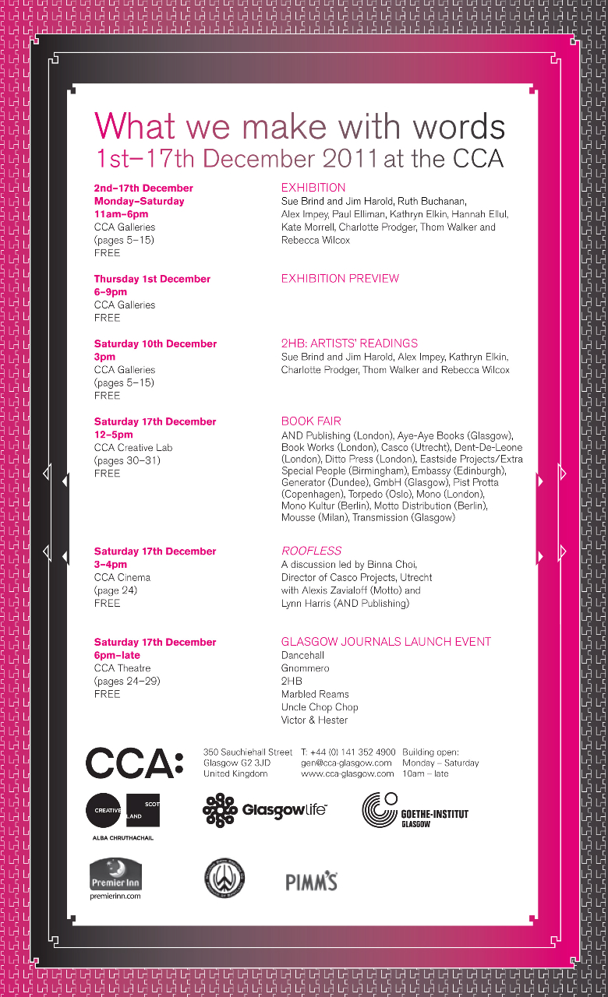
‘What we make with words’
Exhibition publicity
2011
ARTISTS READINGS
A written paper was delivered by the artists at an afternoon of talks at CCA, Glasgow by selected artists involved in the exhibition (10 December 2011). During this event, the books and journals that formed part of the installation were available for viewing by the audience.
A copy of the paper read at CCA is available in the GSA archive.
Image one & a description of what we are looking at in the context of the project.

Slide 28
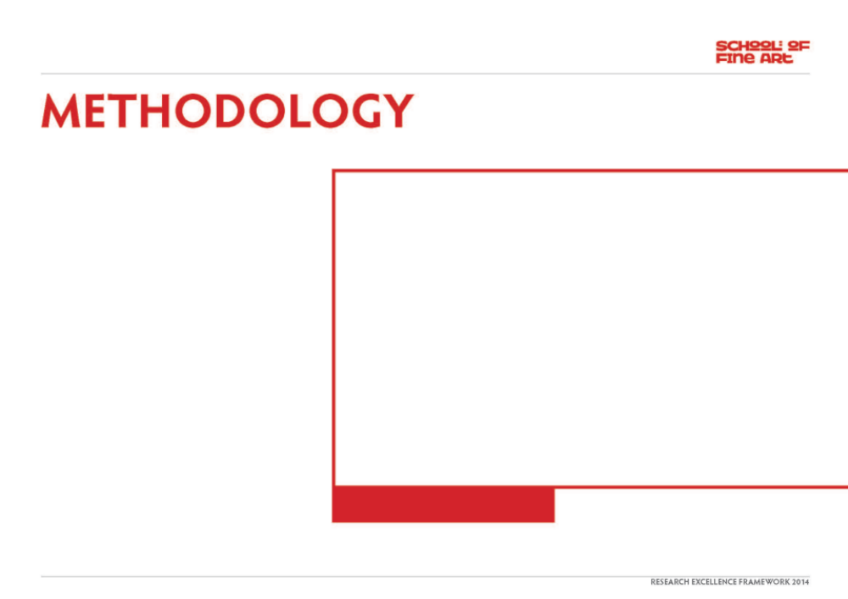
Context
The exhibition was curated for CCA by Francis McKee, Louise Shelley, Sarah Tripp and Jamie Kenyon. The original research for Brind & Harold’s exhibited work emerged from the journals of Richard Parrot (1740-1762), an ancestor of Patrick Allan Fraser, discovered during a period of research and experimentation in 2007 (funded by the RSA, Edinburgh and Hospitalfield House Trust). An earlier site-specific version of the work shown at CCA, entitled Curious Arts – No. 1, was presented in the Library of Hospitalfield House at the conclusion of the residency period. Curious Arts - No. 5 was a substantial reinterpretation of the work for a gallery setting and for an exhibition that focussed on the use of text within artistic research and practice.
The title Curious Arts is taken from a hand-written journal compiled by Richard Parrott between 1740 and 1762. The journal is indexed alphabetically; encyclopaedic topics appearing in an apparently random order under subject headings. Strange and poetic connections were made as ideas on the pages seemed to grow out of each other like rhizomes: Existence Ecliptic English Epicurism Engines Piety Pity Physick Printing Pride Philosophy Physic Printing Gospel God Glory Gold Gods Government … . When Parrott recorded facts that could not easily be categorised they appeared under the heading Curious Arts. This is the common title adopted for the whole series of works produced by Brind & Harold that have been generated from this body of research. Each individual work in the series is allocated a numerical suffix. The work developed for ‘What we make with words’ is the fifth work to emerge.
Image one & a description of what we are looking at in the context of the project.

Slide 29
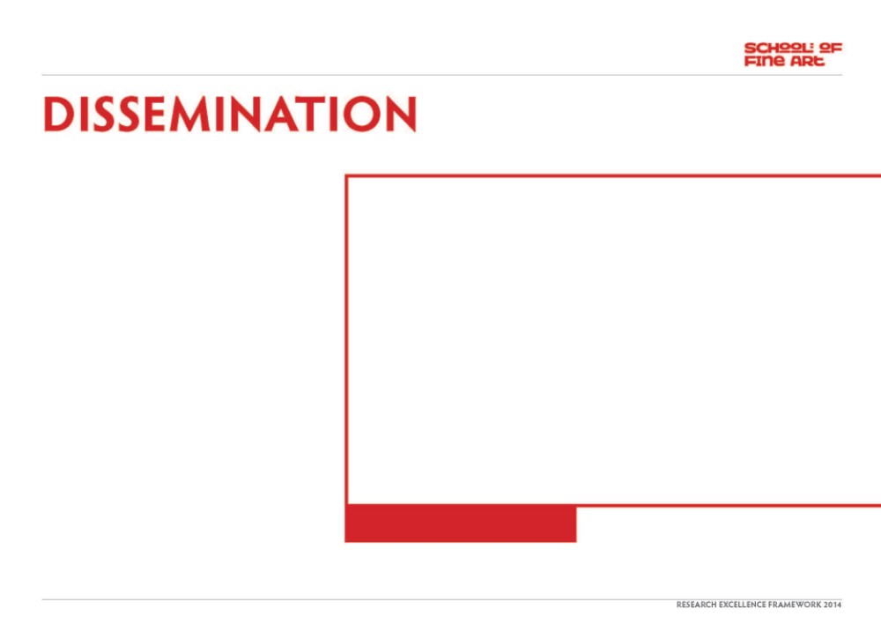
An interrogation of the relationship between rational forms of knowledge (Descartes and Locke) and embodied knowing (Valéry) underpins Brind & Harold’s thinking. In the Curious Arts series (Nos. 1-6), this has been focussed: Firstly, upon what can be collated and understood at the limits - or in the margins - of the archive (Foucault, Crimp and Stafford’s critiques of the structuring and ordering of knowledge is important here, as are the writings of Flaubert, the historical study of forms by Baltrusaitis, and the artworks of Mark Dion, Gabriel Orozco and James Welling); Secondly, upon the space where rational language falls short, and poetics and subjective imagining take over (reference to Lacan, Kristeva, Derrida, Lyotard and the work of artists such as Lothar Baumgarten, and Susan Hiller is significant here).
Curious Arts - No. 5 contributes to this artistic dialogue by questioning how we contend with that which can’t be categorised. It reinterprets historical knowledge in order to open up an imaginative space that draws attention to the relatedness of things and unfolds new ways of thinking. A work that begins with the study of the circle as a form, via the analysis of Parrott’s journals, books on astronomy, theology, architecture, ornithology and the tracing of circular marks on a table, results in a series of audio loops reminiscent of the sound of the sea.
Brind & Harold’s work also contributes to a contemporary dialogue about collaborative practice and a critical questioning of individual authorship. Artist partnerships such as Smith/Stewart, Dalziel & Scullion, Thatham and O’Sullivan provide other similar models.
Image one & a description of what we are looking at in the context of the project.

