Slide 1
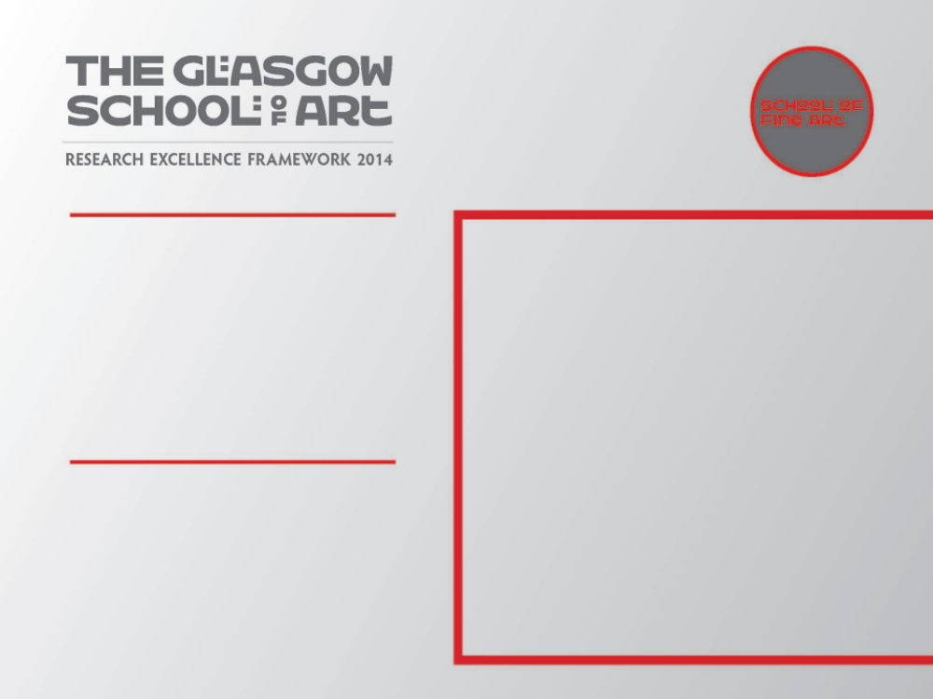
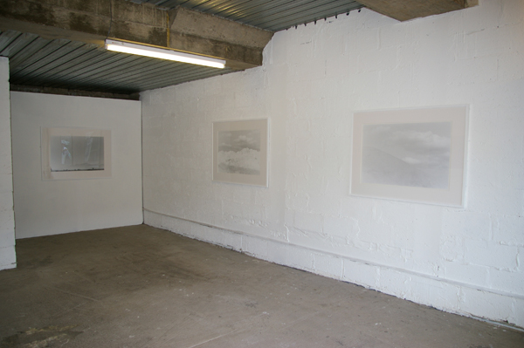
Aporia
The primary element of this output is a solo exhibition which formed part of GI, Glasgow International Festival of Visual Art, Duke Street (10.04.10 – 26.04.10.) The output is supported by several other components which include some of the work in two other exhibitions, a residency, a research trip to Japan and a presentation about the work at Universidad Autonoma Metropolitana Xochimilco, Mexico City 2012.
Submitted by C.McBride
Output No. 2

Slide 2
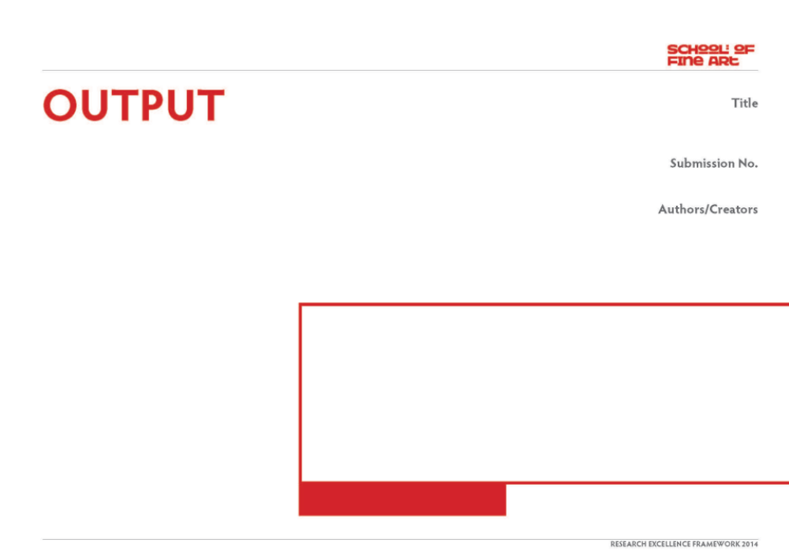
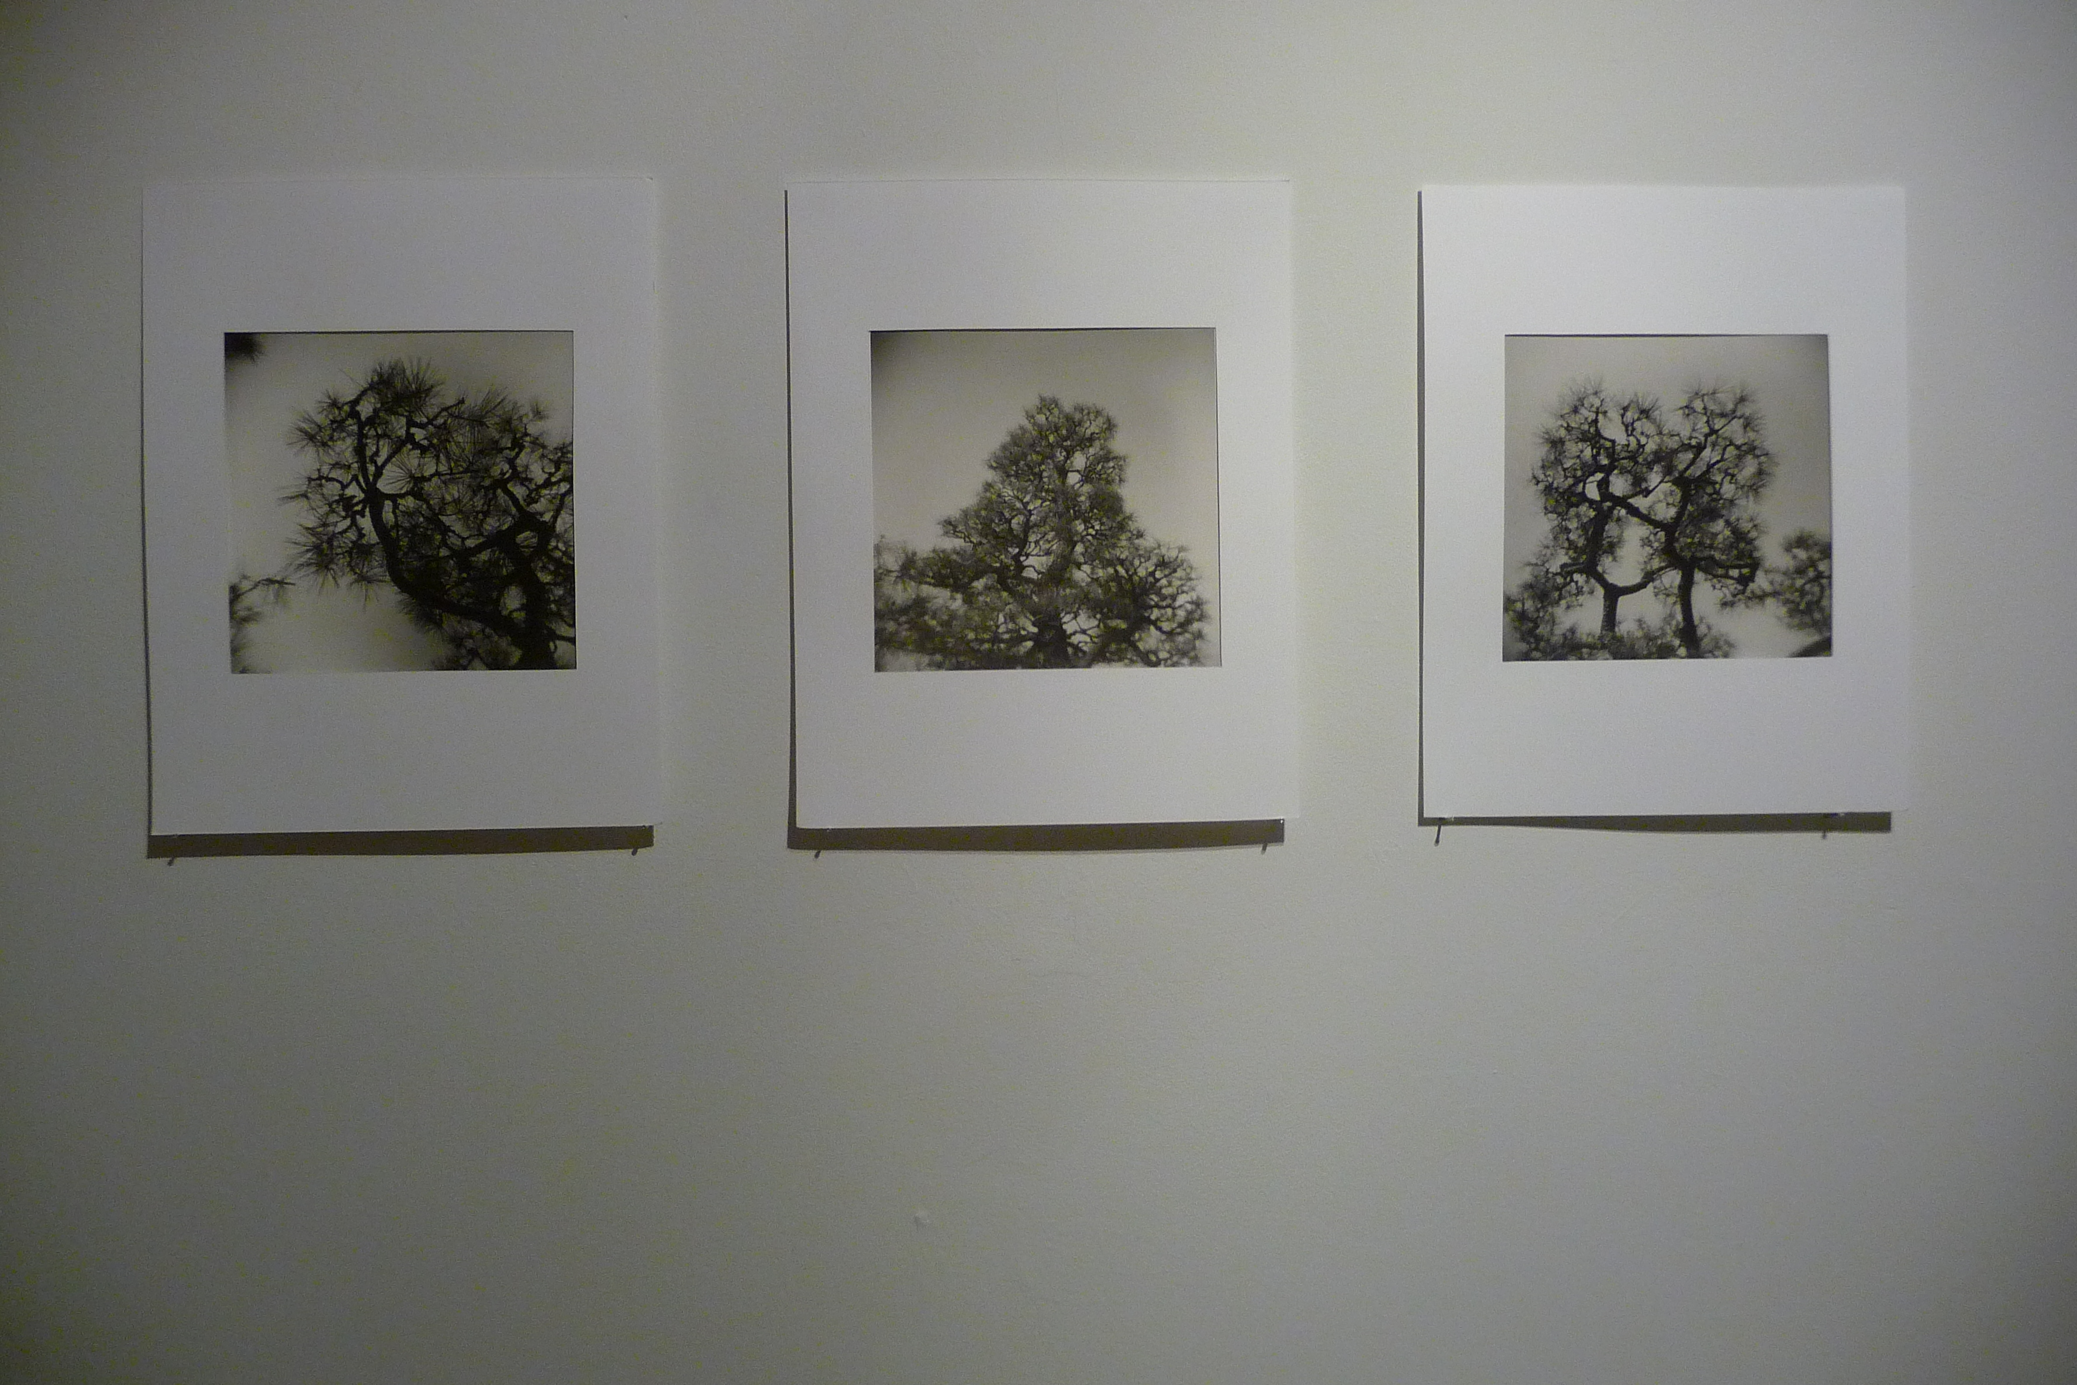
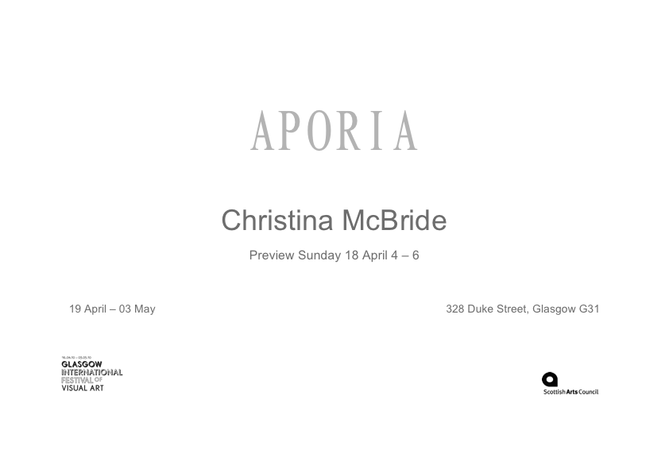
APORIA, solo exhibition. G.I. 2010
The primary focus is a solo exhibition of 12 images entitled Aporia which was part of GI, Glasgow International Festival of Visual Art (10.04.10 – 26.04.10.) Three images from this show were exhibited as part of a residency and exhibition entitled ‘Non Fiction’ at the Banff Centre of Arts, Canada, and two in Studio 58 Studio 58 – Women Artists in Glasgow since World War 2, Glasgow school of Art (06.07.12 – 30.09.12) The work is also supported by a research trip to japan (2009), and a public presentation about the work at thet Universidad Autonoma Metropolitana Xochimilco, Mexico City 2012.
Glasgow International Festival of Visual Art (GI) ran from the 16 April – 03 May and featured over 130 artists across nearly 50 venues covering the length and breadth of the city. It included Glasgows major art spaces, cultural institutions and a number of temporary spaces. My work occupied one of the temporary spaces which was sitiuated between two artists run galleries (Market Gallery and the Duchy) and on the route of the “Spin” bus tours which took the international visitors to the festival around the venues.
2
Christina McBride
Image 1. invitation forn Aporia. Image 2. documentation from ‘Non Fiction, Banff Centre

Slide 3
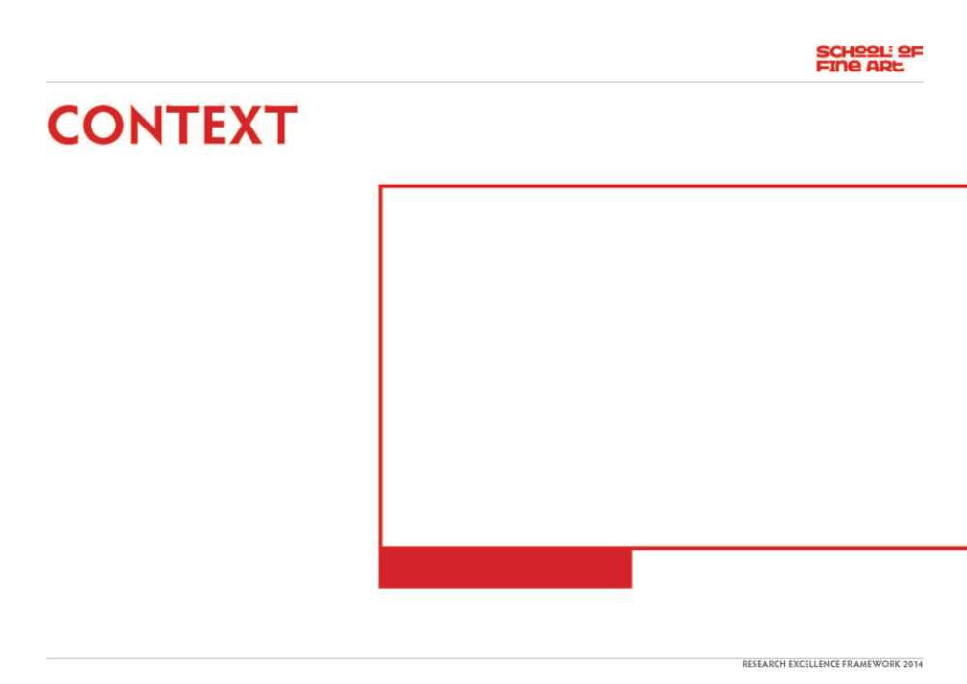
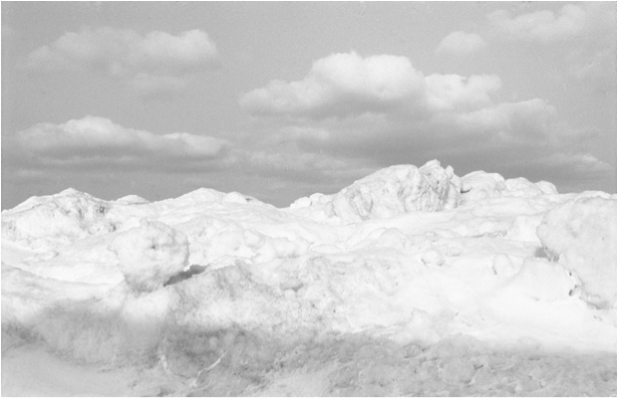
The central concern for this body of work is based around the cocept of Aporia. I first connected with ‘aporia’ because of the lyrical qualities of the word - I really liked how it sounded! It also appeared several times in my sketcbook with one page occupied by just four words ‘an aporia of reason’ . Intrigued by this phrase but not fully understanding its complexities I spent some time researching into the specifics and subtleties of aporia - which immediately connected with interests and concerns within my practice. The title of my previous work “Darkdaylight’, for example could be described as an aporia.
Originating in the Greek, Aporia can mean a number of different things, which includes a philosophical puzzle, a state of perplexity and doubt, and also that which is seemingly impassable. It also refers to a situation where contradictory positions are presented simultaneously but are equally plausible.
It has been explored by a number of different artists and writers, Kafka in particular, with his unique style is probably one of the best representatives. The more his characters try to understand and interpret the world they live
From Aporia, 2010, silver gelatin print 80 x 60 cm

Slide 4
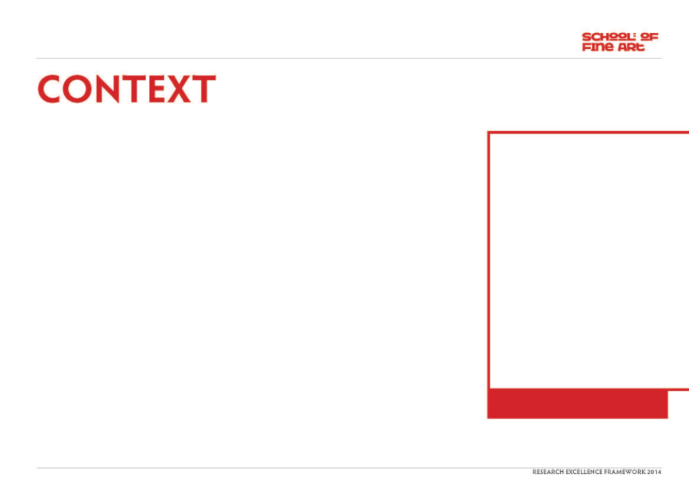
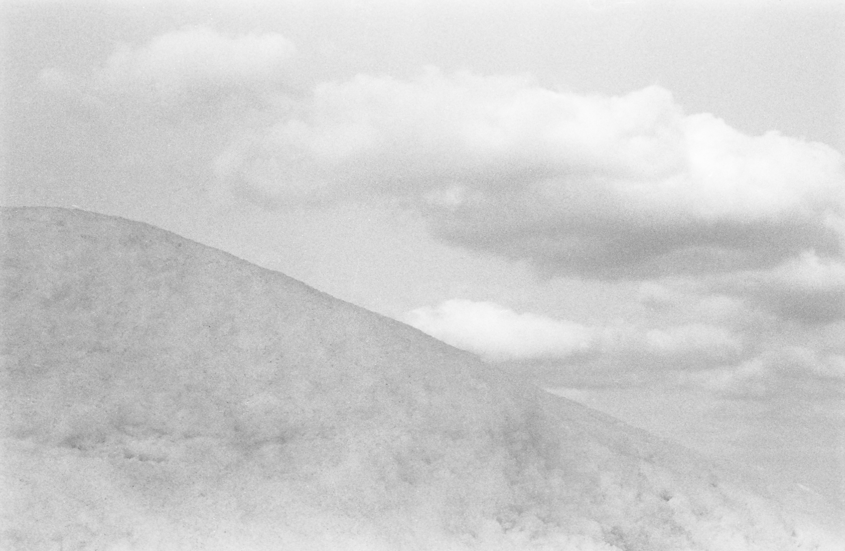
the less comprehensible it becomes. Samuel Beckett also explores this is his 1952 novel “the Unnamable” in which the monologue of the central protagonist is a stream of negative and affirmative statements. It closes with the phrase "You must go on, I can't go on, I'll go on." And despite the dominance of the monologue the character never actually speaks.
Within music Charles Ives, the American composer embraced the concept of aporia in his work ‘Unanswered Question’, from 1935. With its irregular and inconsequential musical language, tonal and atonal sounds are presented simultaneously, at different speeds. The strings represent the silence of the Druids who do not know or hear anything and the solo trumpet represents the questions sent to the cosmos, never to be answered.
Rich and innovative work in a range of language forms, has been created in response to this theme so I wanted to test the potential of the visual language and the photographic image in particular to interrogate and articulate similar concerns.
My research questions include:
What relationships can be built between unconnected places, momentary events and different experiences of time and light to articulate experiences of Aporia?
How can a lens-based artist experience space and negotiate unfamiliar territories to reveal/articulate what is known or understood but difficult to articulate through other language forms.
How does photography relate to other language forms?
This body of work emphasises the importance of rooting my research in a visual way and utilising a practice-based approach to articulate and advance my enquiries.
From Aporia, 2010, silver gelatin print 80 x 60 cm

Slide 5
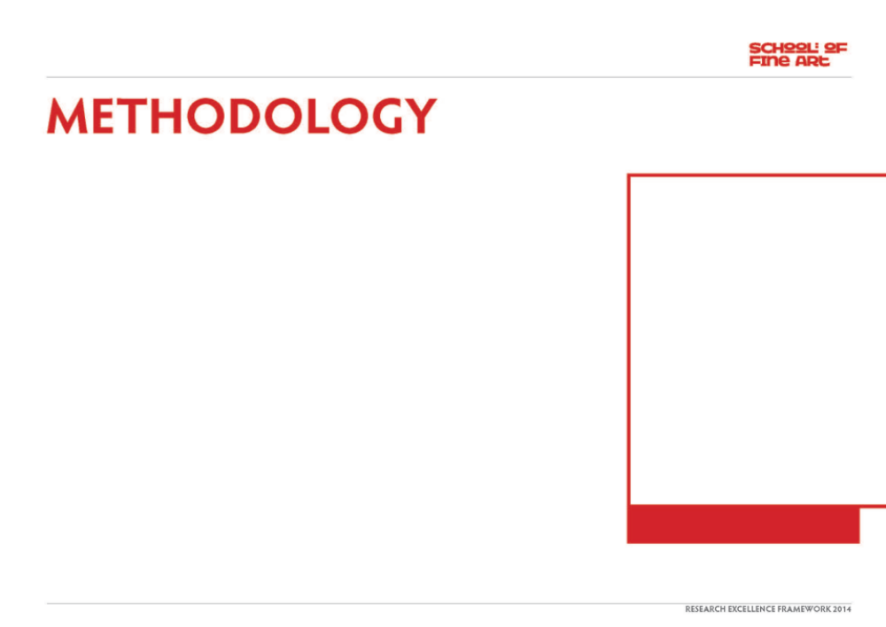
Most of the images for this work were made during 2009 and 2010 when I undertook a period of travel to several diverse locations: which included Japan, Australia and Mexico.
During my time in Japan I traveled alone, so with no understanding of the language or Japanese script there was an increased emphasis on the role of the visual to help me build connections in order to navigate my way through the land.
In both Australia and Mexico I traveled with one other person, each of whom were engaged in their own work during our time together. What was central to my/our working process were the dialectical exchanges which took place during the course of the journies which both impacted and informed the work.
Traveling, for me, represents a search for something that cannot readily be seen or experienced but which is formed through photographic encounters. My photographs reference places (land, seas and skies) and objects (predominately trees), and I use the
vocabulary of the medium to build relationships and narratives between interconnected and unconnected places and situations.
I am interested in the mnemonic role of trees and also their metaphysical potential to link the underworld, with the earth’s surfaces and skies and the past with the present and future. I am also interested in the circumambient element of air. This invisible, intangible but absolutely essential element holds great challenges for the photographic medium.
My research began with a journey where I explored the four main islands of Japan and reached the most northerly point of Wakkanai.
I traveled alone through different seasons and spent most days on the move, observing and responding to the weather conditions, qualities of light, and specifics of the physical environment.
From Aporia, 2010, silver gelatin print 60 x 60 cm

Slide 6
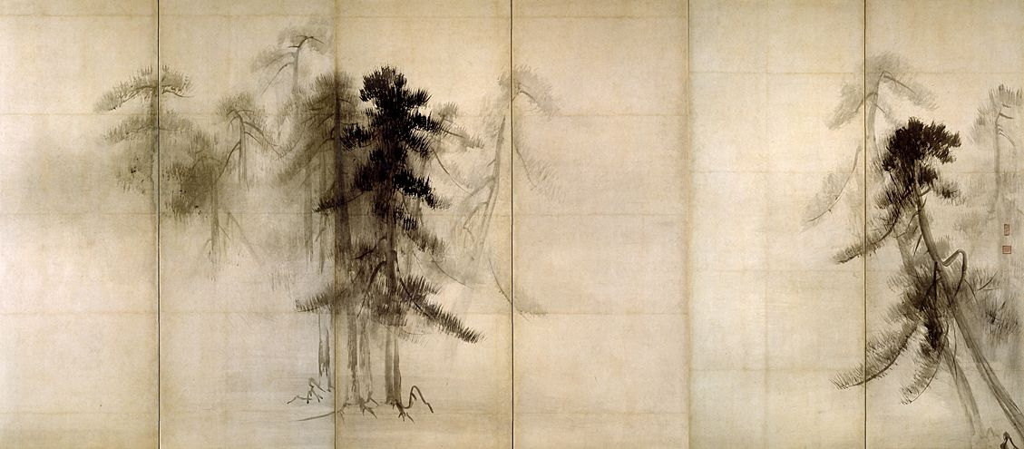
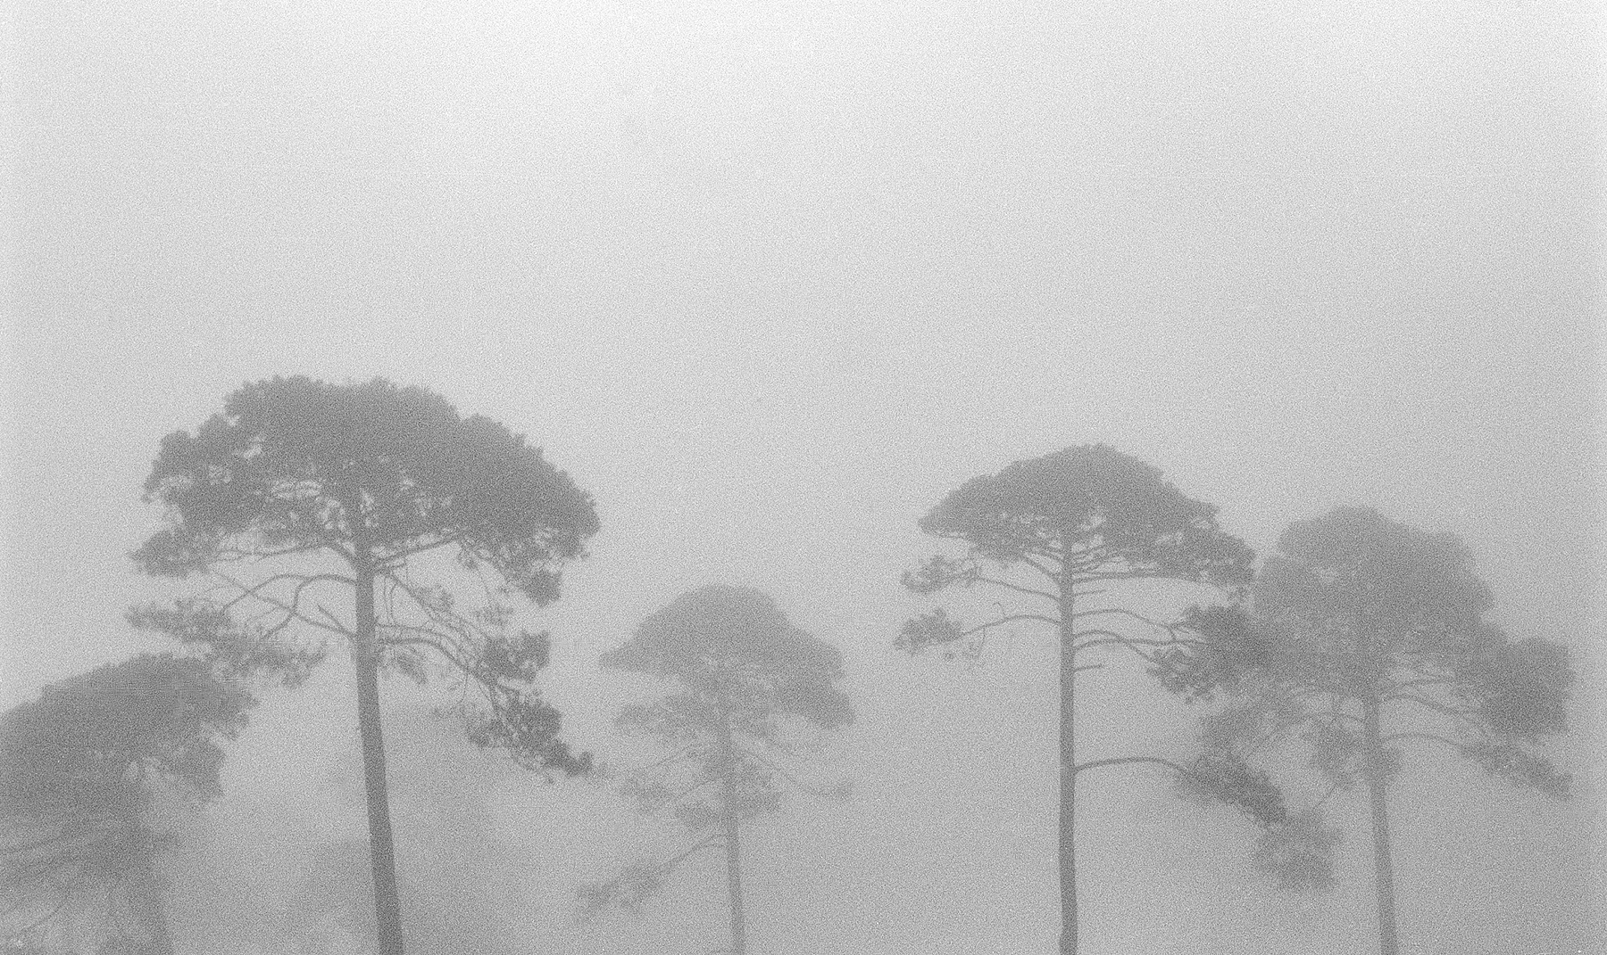
During the trip I had the opportunity of accepting an invitation from Professor John Tran from the University of Tsukuba to visit. I spent two weeks in the Photography Department and participated in a number of research and teaching activities.
I also took the opportunity of seeing some of the original work of artists I had long admired, particularly Shōrin-zu byōbu by Hassegawa Tohaku. This ink-on-paper dyptich is , considered to be one of the first paintings in the history of Sumie to depict only trees as subject matter. The image consists of a number of brush strokes which represent pine trees which are positioned in an otherwise empty space. In order to fully appreciate the complexity of the work it is important to understand the Japanese concept of ma. Ma is a word which has no equivalent in western languages and is used to describe a negative space, a space which also is a substance. So, for me the empty space within the work is used to eloquently describe the landscape .
Shortly after my return I was invited by Tacita Dean the internationally reknowned artist and champion for the medium of analogue, to accompany her to Australia where we would spend a period of three weeks traveling through a diverse range of territories. We have a long personal and professional relationship since our days as students at the Slade.
Our visit to Australia was short, given the scale of the land but significant for me in terms of the development of my work . The light and land had specific qualities which I simply could not comprehend through black and white film so I felt compelled to work with colour for the first time. This opened a new strand to my research and some of the images I made during this trip are part of a series of ongoing work entitled ‘The Colour of Air’.
Later that year I was invited to return to Banff as part of a Paul Fleck Fellowship to participate in a working group of visual artist and writers. The residency began with an exhibition entitled Non Fiction in which I exhibited three of my images from Aporia. The images formed an integral part of a seminar within the gallery space which addressed some of the limitations, expectations and possibilities of both the visual arts and writing.
Above Shōrin-zu byōbu by Hassegawa Tohaku
Below silver gelatine print . Aporia 2010

Slide 7
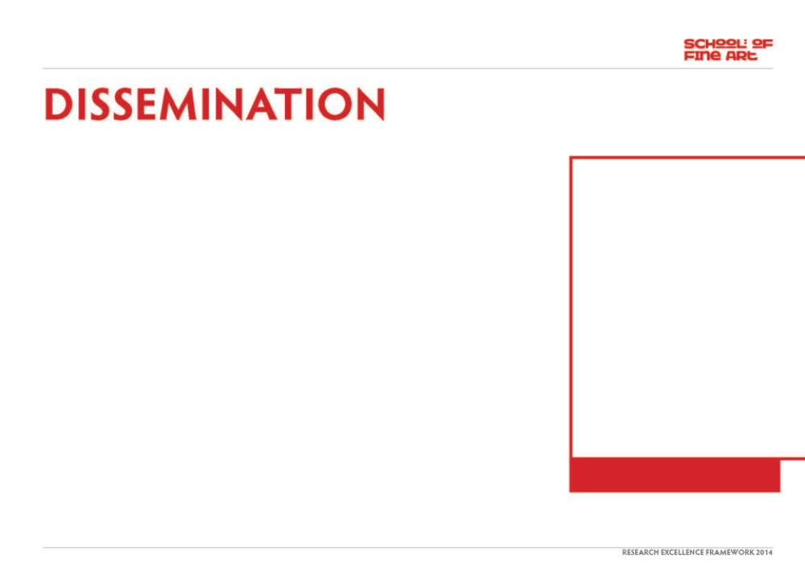
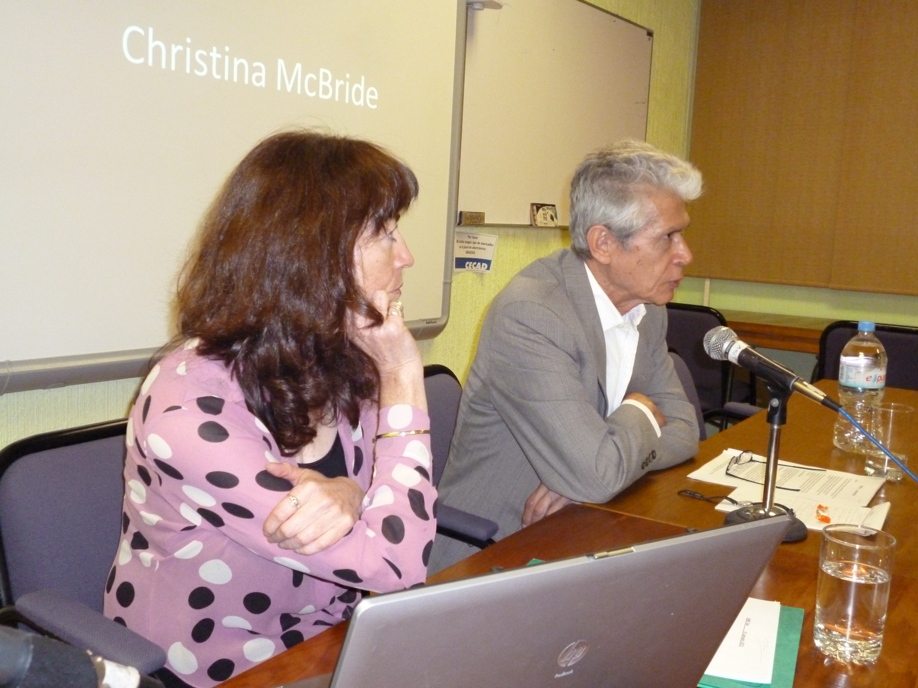
The Aporia exhibition opened up a significant body of research for me which has continued to expand and develop. In 2012 Roberto Bravo, a writer based in Mexico City, and I used it as the starting point of a collaborative process in which we undertook a journey through Patagonia. The Patagonian landscape is an area of extremes and contradictions and provided a rich and challenging context in which to expand and interrogate my/our ideas further. The research from this has now been consolidated into a forthcoming bookwork.
I was also invited to give a presentation to students and staff at the Universidad Autonoma Metropolitana Unidad Xochimilco, Mexico City in January 2013. And was further invited to participate in a filmed discussion about my working processes with Dr David Gutierrez Fuentes from the Research Department. This film was then made available as part of the teaching/learning resources of the university.
The work has been disseminated through a number of different sources:
Aporia, Glasgow Internation Festival of Art
A solo exhibition entitled Aporia was selected to be part of The Glasgow International Festival of Visual Art which is a high profile international three-week l festival involving all the major galleries, museums and artists spaces within the city. The exhibition consisted of twelve images made during my visits to Mexico, Australia and Japan.
www.glasgowinternational.org
Non-Fiction, The Other Gallery, Banff Centre for the Arts Canada
I exhibited three silver gelatine prints, originally exhibited as part of the G.I. show
www.banffcentre.ca
Studio 58 – Women Artists in Glasgow since World War 2. Glasgow school of Art 2012
Two works were also included in the Studio 58 exhibition, curated by Dr Sarah Lowndes for the Mac Museum, Glasgow School of Art. This exhibition included a publication and symposium.
www.gsa.ac.uk/life/gsa-events/events/s/studio-58-symposium
still from filmed interview of Roberto Bravo and I with Dr. David Gutierrez Fuentes . at Universidad Metropolitana Unidad Xochimilco 2013,

Slide 8
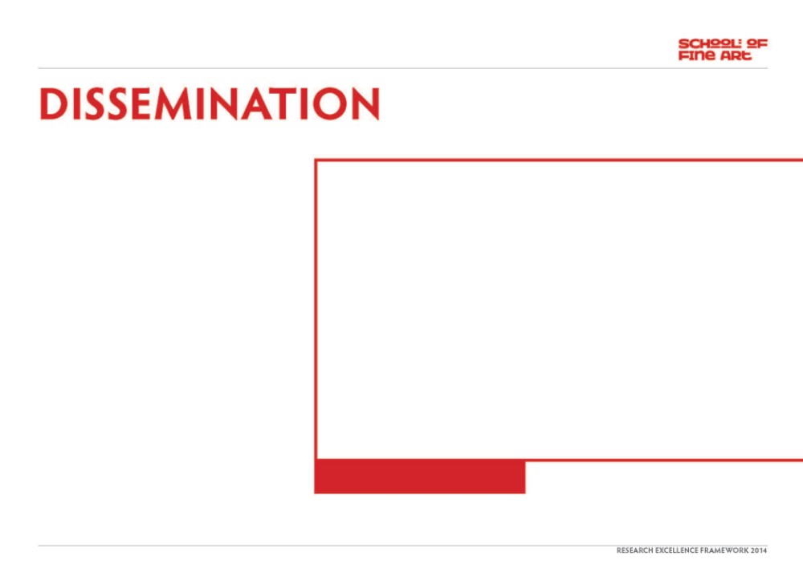
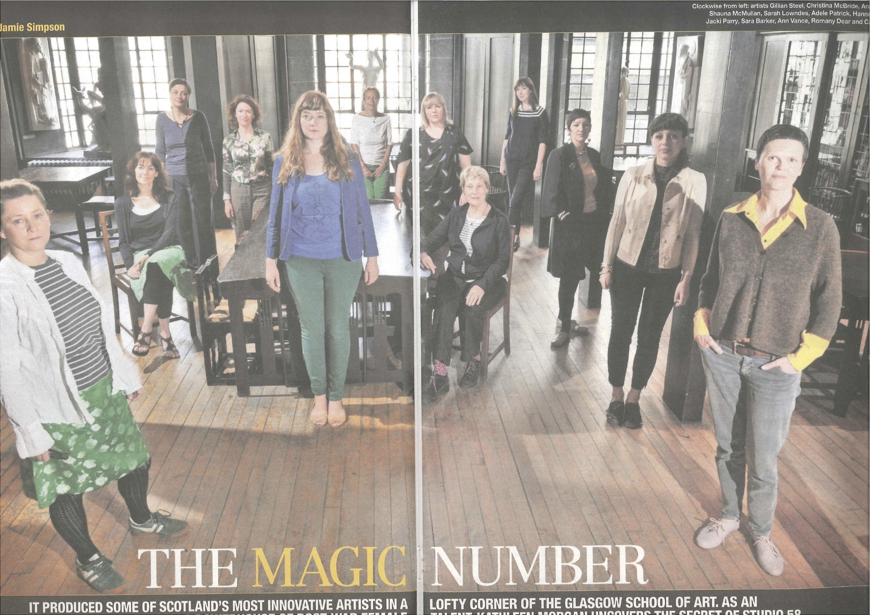
www.gsa.ac.uk/visit-gsa/exhibitions/studio-58-catalogue
www.heraldscotland.com/arts.../studio-58-the-magic-number.
Studio 58: Women Artists in Glasgow since World War II, Phil Miller, The Glasgow Herald, 10 July 2012 http://www.heraldscotland.com/arts-ents/visual/studio-58-women-artists-in-glasgow-since-world-war-ii-mackintosh-museum-glasgow-school-of-art.1341885847
Female framework, Moira Jeffrey, Scotland on Sunday, 1 July 2012, http://www.scotsman.com/scotland-on-sunday/scotland/art-female-framework-1-2386009
Studio 58: 70 years of wonderful work of women, Elaine O’Connor, STV Glasgow online, 7 July 2012 http://local.stv.tv/glasgow/going-out/events-info/109744-studio-58-70-years-of-the-wonderful-work-of-women/
Magazine articles
2012 ‘la Pampa’, by Roberto Bravo. article in El Buho literary magazine .
2013 Revista el Mollete Literario – I will be interviewd by Monica Contreras for the December 2013 edition of the cultural magazine which focuses on the visual Art, literature and music in Mexico
http://www.grupotransicion.com.mx
Revista Literaria Plan do Los Pajaros - Roberto Bravo writing about project
.
Image from 6 page feature of Studio 58 exhibition. The Herald magazine 30 June

Slide 9
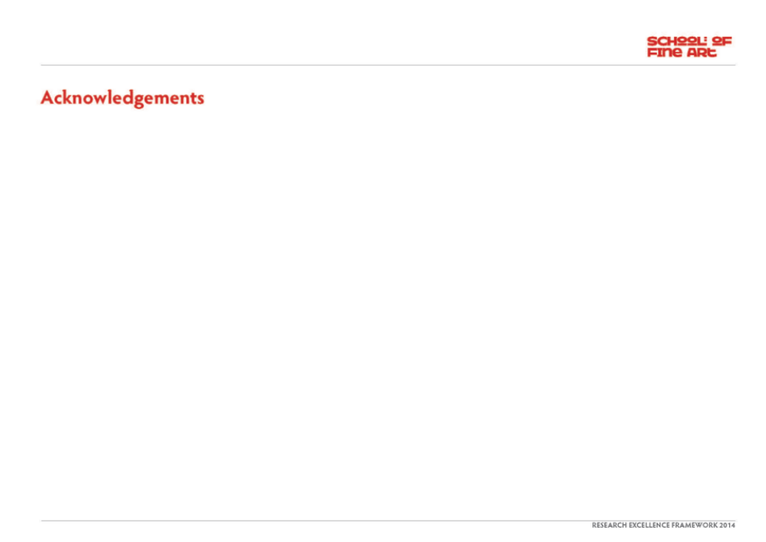
Forthcoming:
‘Bound’ bookwork, based on the collaborative journey through Patagonia. Published by Lectoram Press
Aporia solo exhibition which includes Aporia work Impressions Gallery Bradford
www.impressions-gallery.com
.

