Slide 1
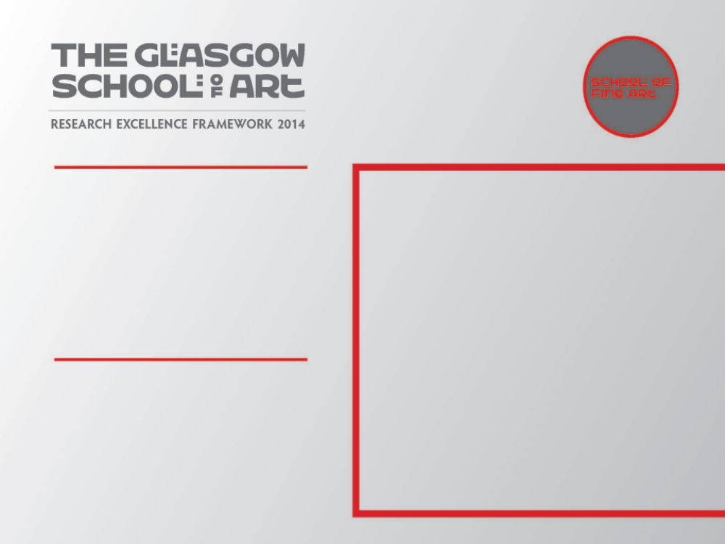
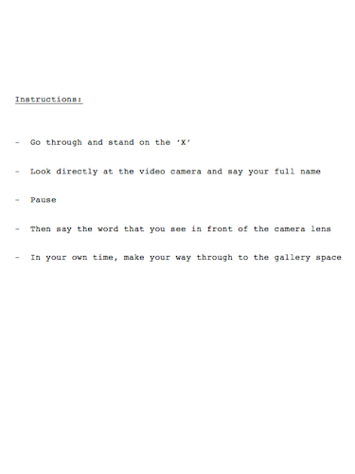
Solo Commission KYTN: Pronounce DEAD
Solo performance commission, KYTN, Dundee Contemporary Arts, Friday 26 February 2010
Submitted by Eddie Stewart
SMITH/STEWART
Output No. 3

Slide 2
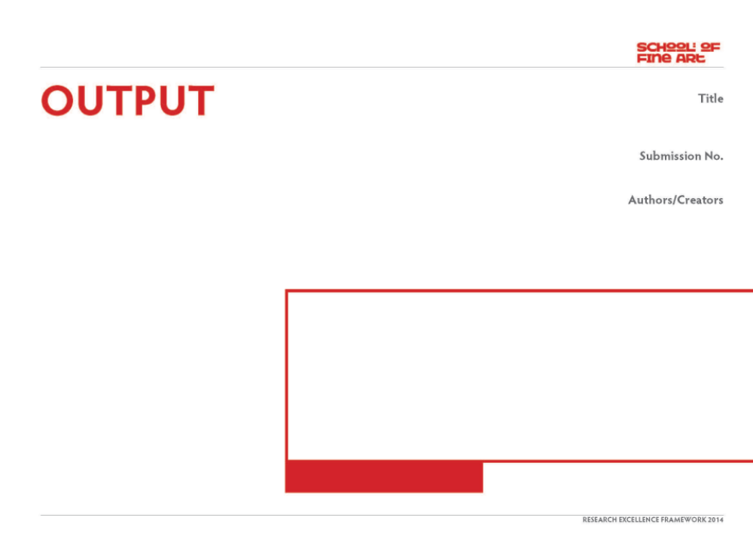
Pronounce DEAD
Output 3. Exhibition
2010 solo SMITH/STEWART performance commission
Commissioned by Arika for KYTN (Kill Your Timid Notion festival)
Dundee Contemporary Arts, Dundee
Friday 26 February 2010
3
SMITH/STEWART
Image one & a description of what we are looking at in the context of the project.

Slide 3
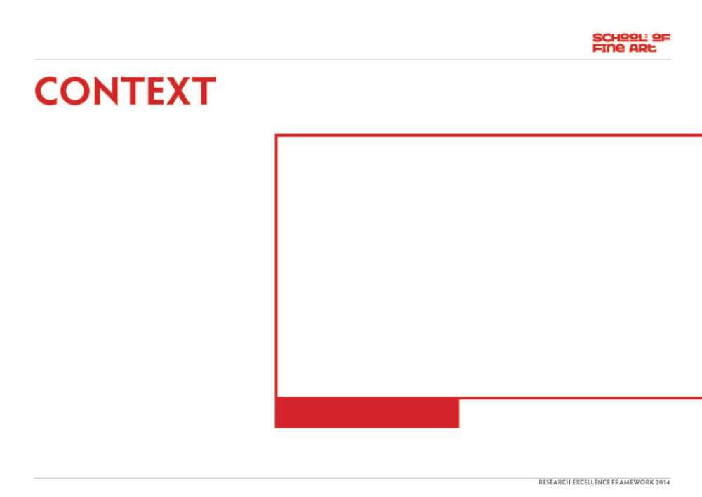
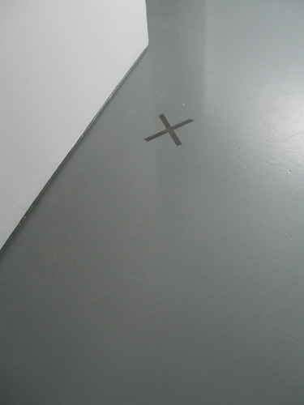
- Question/s:
Will an audience follow a specified instruction/s as participants in a live performance? A simple request for a simple truth.
Collaboration
Our work is predominantly about relationships, starting with our own. We have worked collaboratively (& been together as partners) for just over 20 years. Our roles within our collaboration are indistinguishable - we are in effect one artist, SMITH/STEWART. We both have equal input at all stages of the work, from its conception, research, fabrication (often as performers in the work itself), installation, dissemination. We haven't made work separately since the mid-nineties and our practice continues to be solely in collaboration with each another though in more recent work, such as this piece, we are reaching out to the audience &/or invited participants to extend this collaboration further.
Image one & a description of what we are looking at in the context of the project.

Slide 4
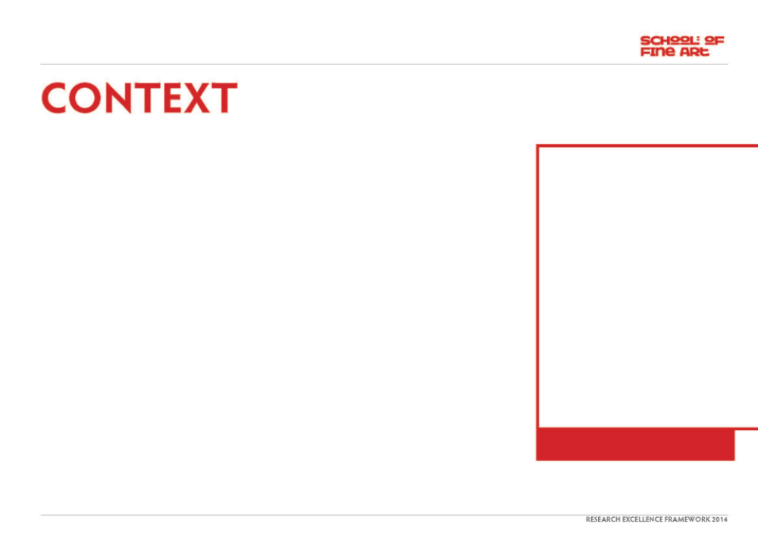
Our own practice continually pushes the possibilities of collaboration: fundamental concerns revolve around human relations and what people are capable of doing to one another, physically and psychologically. We want to engage the viewer with ideas about the nature of the relationships we have with one another (intimate, familial, social, political). Central to this exploration is the body and its context and different media are used to explore ideas of separation, unity and ultimately, mortality.
Mechanics of personal inter-relations drive our work and we aim to set up space to construct a performative situation which forces the viewer to make a decision - a decision which will have implications affecting their experience of the piece and the consequences of participating - or not - in what we’ve constructed. Either way, this decision becomes the work, as evidenced in this live work (& the resulting recorded video footage).
This work was made at the invitation of Arika to take place in the performance festival, 'Kill your timid notion' in February 2010. The theme of the festival was about embracing the possibility of failure.
"A festival of open-ended proposals for image, sound and dialogue. A week-long chance to spend time together investigating simple proposals by watching, listening and talking. We have little to no idea as to how KYTN will go this year, and that's deliberate. We don't want to know, we want to find out. Instead of knowing in advance what is going to happen, we want to ask people (artists, you, ourselves...) to make some simple proposals that we can then all investigate and see what we can produce, together." (Arika)
For an overview of selected works from 1993 to present, visit our website www.smithstewart.co.uk
Image one & a description of what we are looking at in the context of the project.

Slide 5
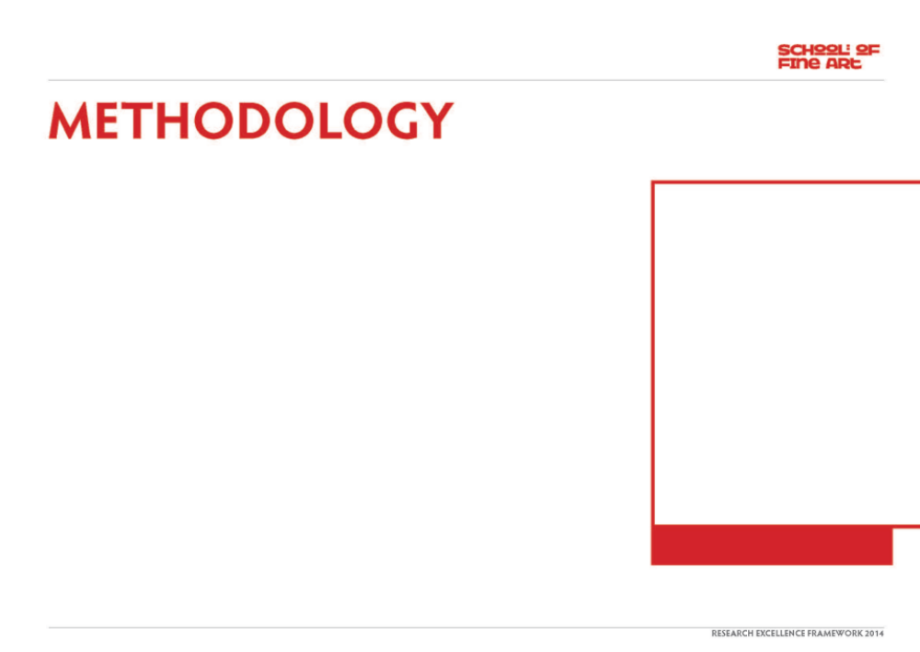
What is the work?
The idea?
The instructions?
Giving the instructions?
The person’s reaction to the instructions?
The implications of the instructions to the person?
The implications of the instructions to the person’s friends or relatives?
The implications of the instructions to the person’s friends or relatives in the person's head?
The implications of the interpretation to the person’s friends or relatives?
The event?
The resulting recorded footage?
The future?
This, our first live performance work, (though not using ourselves as performers) was the first in an ongoing series of instructional performances, where our interaction with others forms the basis of the work.
A performance made for one night, Pronounce DEAD was a piece where each participant was asked to carry out an identical specific instruction, which was only fully revealed on looking directly into a video camera. Their reaction became the work.
"Smith/Stewart’s terse, neat proposals, always tested via performance, lead to provocative outcomes, and unpredictable ones at that; an exponential function of the situation they instigate and the people involved." (Arika)
In this case the participants were the festival audience. In a strictly choreographed way they were asked to queue up on the stairs leading to one of the small galleries of DCA and were individually directed into the room and given instructions to, once inside the space, look directly at the camera, say their name followed by a pause and then the word they saw when looking at the lens.
Image one & a description of what we are looking at in the context of the project.

Slide 6
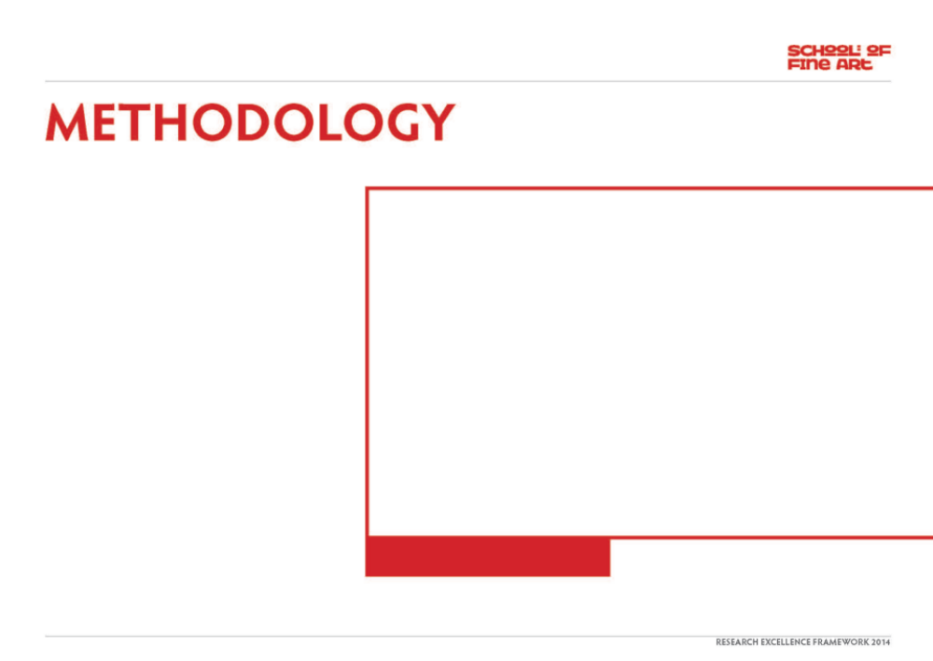
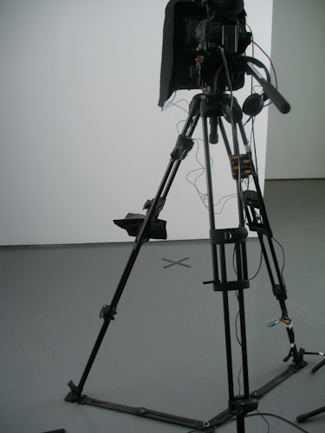
Pronounce DEAD Instructions:
Go through and stand on the ‘X’
Look directly at the video camera and say your full name
Pause
Then say the word that you see in front of the camera lens
In your own time, make your way through to the gallery space
[The word on the autocue was ‘DEAD’].
This word ‘DEAD’ is loaded with potential significance, yet at the same time just a word.
The simple request we ask of our participants actually asks an awful lot from them. It is at once intense and straightforward, complex and banal. "Dead" is just a word after all. But to link this word directly to your own name has implications.
In the adjoining large gallery space, a live feed was projected onto a screen. As each participant moved through to this main space they became aware that they had been viewed. They then saw the next person's action. So, the first person saw everyone (except themselves) and the last person saw no one.
Image one & a description of what we are looking at in the context of the project.

Slide 7
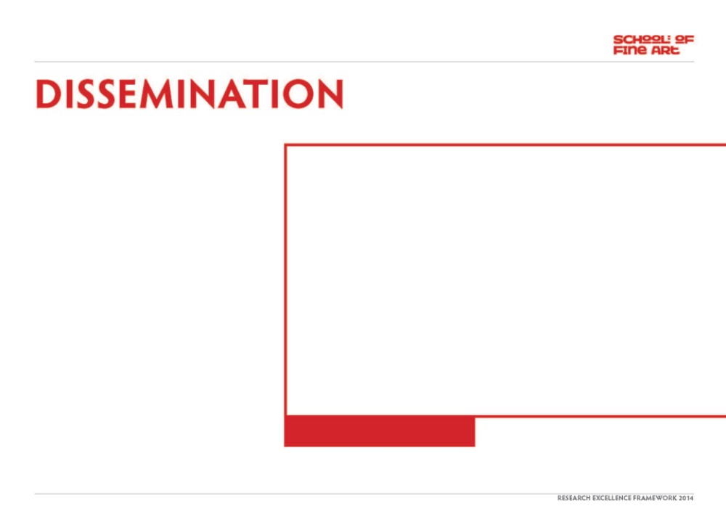
- A collaborative experience shared by the participants in the event.
http://arika.org.uk/kytn/2010/
http://arika.org.uk/kytn/2010/performances/smith_stewart
- Trajectories:
We imagined that the resulting video footage of Pronounce DEAD would just be documentation for us to be able to see and reflect on the event afterwards. However, the video is quite poignant and intense - compelling enough to watch in its entirety and use a potential work in itself.
Image one & a description of what we are looking at in the context of the project.

