Slide 1
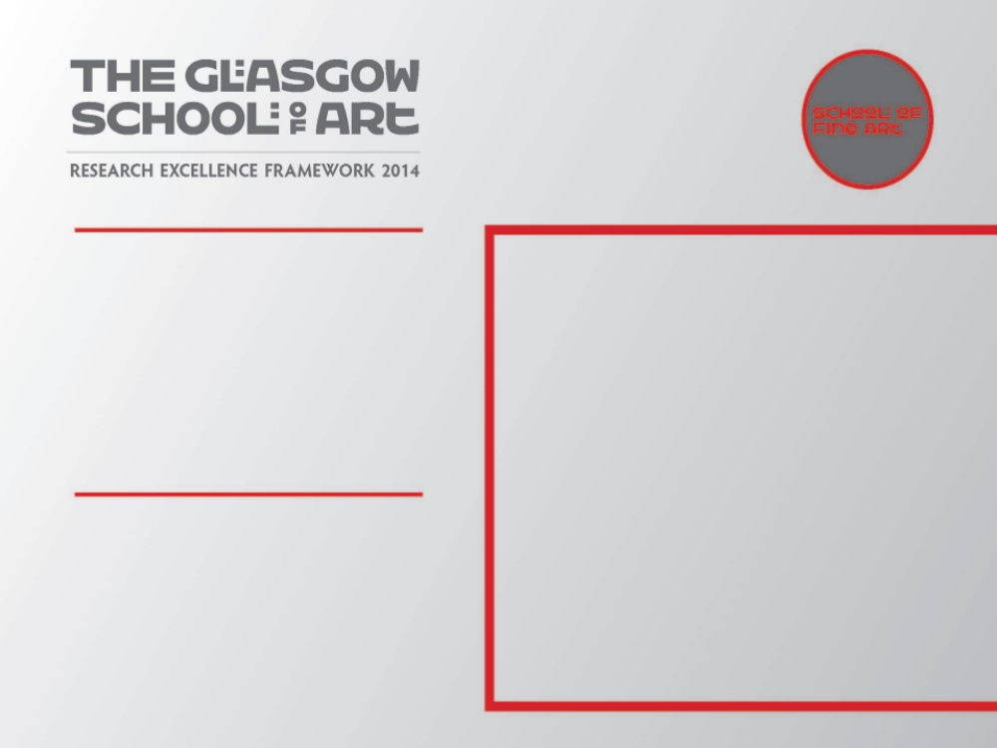
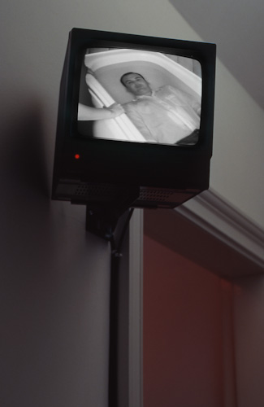
Emporte-moi / Sweep me off my feet
A performance-to-camera video installation, Mouth to Mouth (b&w, with sound) shown in the context of an international group exhibition exploring Love in Contemporary Art.
Submitted by Eddie Stewart
SMITH/STEWART
Output No. 1

Slide 2
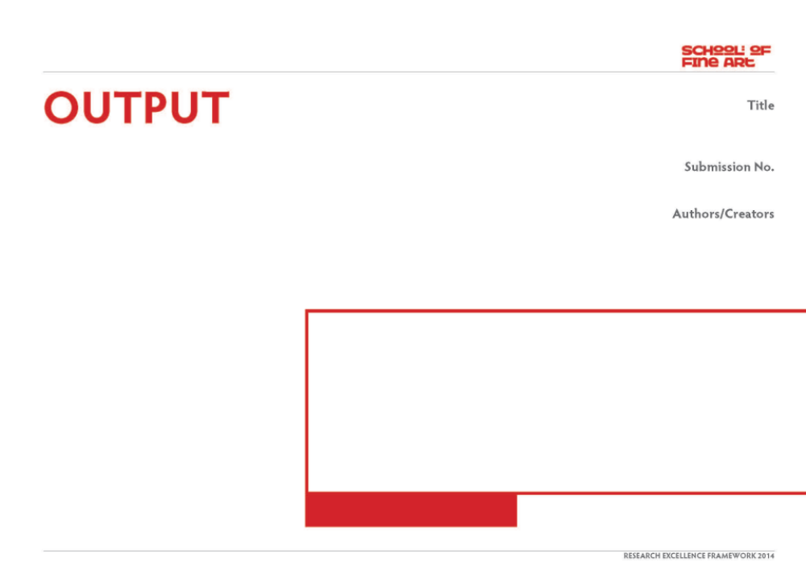
Emporte-moi / Sweep me off my feet
Output 1. Group Exhibition
2009/10
Emporte-moi / Sweep me off my feet,
Musee d'Art Contemporain du Val-de-Marne, Qubec, Canada (24 September - 13 December 2009)
& MAC/VAL, Vitry-sur-Seine, Paris, France (7 May - 5 September 2010)
- Catalogue
ISBN: 978-2-916324-50-0
1
SMITH/STEWART
Image one & a description of what we are looking at in the context of the project.

Slide 3
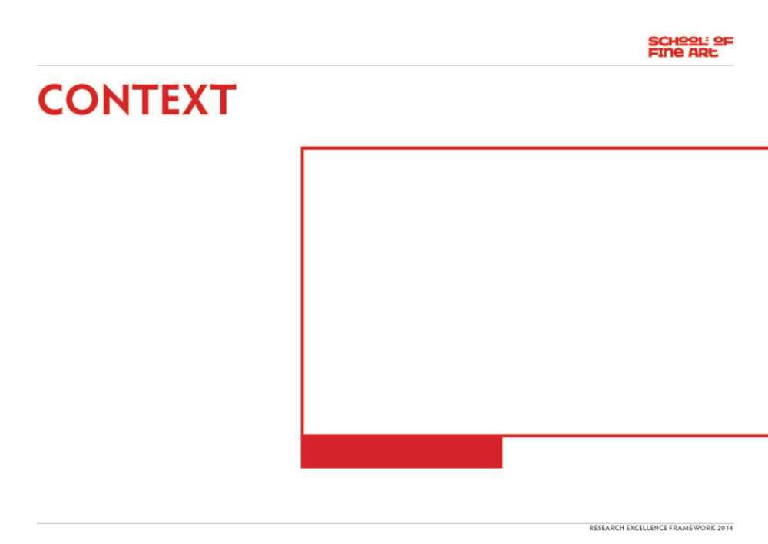
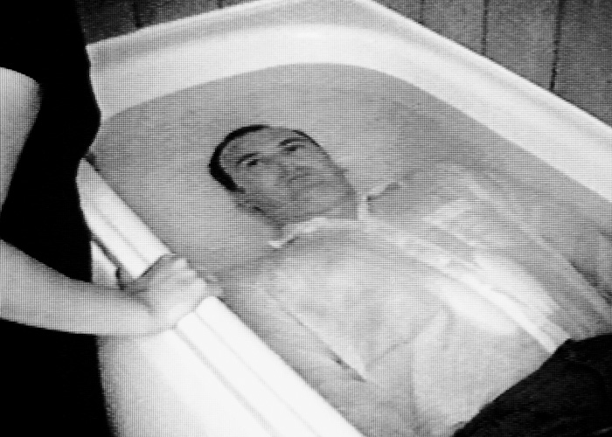
Question/s:
How can/does a collaborative artistic intimate relationship explore extremes of love, interdependence & trust?
Collaboration:
Our work is predominantly about relationships, starting with our own. We have worked collaboratively (& been together as partners) for just over 20 years. Our roles within our collaboration are indistinguishable - we are in effect one artist, SMITH/STEWART. We both have equal input at all stages of the work, from its conception, research, fabrication, (often as performers in the work itself), installation, dissemination. We haven't made work separately since the mid-nineties and our practice continues to be solely in collaboration with each another (though in more recent works we are reaching out to the audience &/or invited participants to extend this collaboration further).
Image one & a description of what we are looking at in the context of the project.

Slide 4
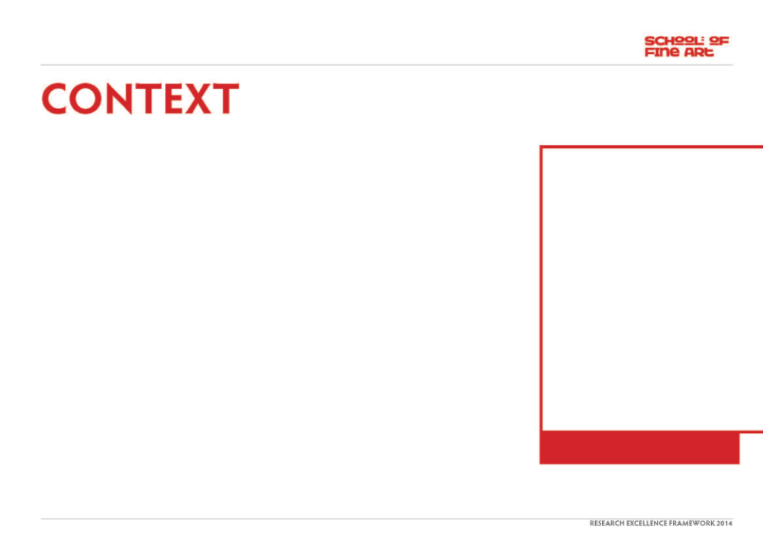
We have always stated that we make ‘sculpture’ whilst simultaneously challenging notions of what sculptural practice involves. Early pieces - predominantly performance-to-camera video installations - involved the dual interaction of a man and woman (ourselves) often in extreme situations requiring mutual complicity and trust – particularly evident in ‘Mouth to Mouth’.
Our own practice continually pushes the possibilities of collaboration: fundamental concerns revolve around human relations and what people are capable of doing to one another, physically and psychologically. We want to engage the viewer with ideas about the nature of the relationships we have with one another (intimate, familial, social, political). Central to this exploration is the body and its context and different media are used to explore ideas of separation, unity and ultimately, mortality.
For an overview of selected works from 1993 to present, visit our website www.smithstewart.co.uk
Our work ‘Mouth to Mouth’ was exhibited in Emporte Moi… international shows (in Canada & France) which set out to explore the relationship of Love in Contemporary Art.
Other artists include:
Marina Abramovic & Ulay, Bas Jan Ader, Fiona Banner, Sophie Calle, Lygia Clark, Tracey Emin, Felix Gonzalez-Torres, Douglas Gordon, Carsten Holler, Pipilotti Rist, Sam Taylor Wood, Andy Warhol, Cerith Wyn Evans.
Exhibition Catalogue:
An illustrated catalogue was produced including essays by curators Frank Lamy and Nathalie de Blois.
MAC VAL Press Release:
<http://www.macval.fr/IMG/pdf/Press_release_Emporte-moi.pdf>
Image one & a description of what we are looking at in the context of the project.

Slide 5
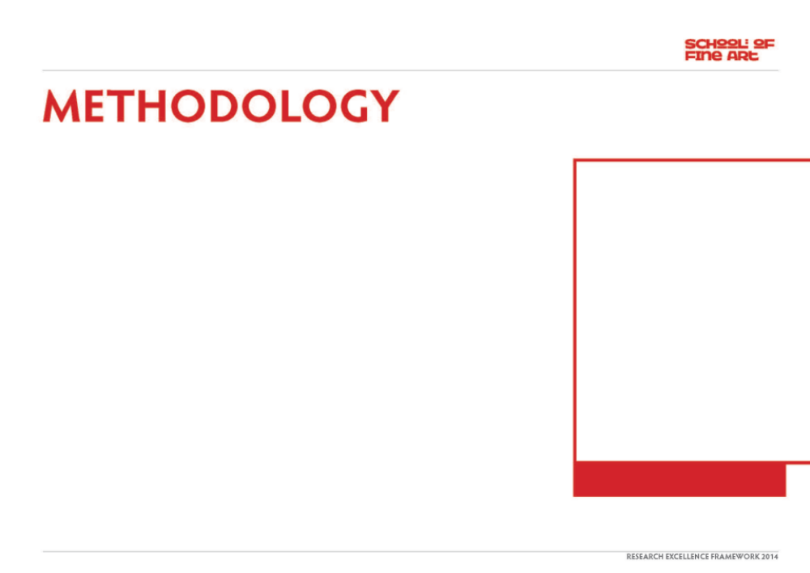
A performance-to-camera video installation, Mouth to Mouth, b&w, with sound, shown in the context of an international exhibition exploring Love in contemporary art.
"The video Mouth to Mouth shows a looped image of a repeated action: Smith, is leaning over the bathtub in which Stewart, is lying underwater. When he runs out of air she submerges her head to supply it mouth-to-mouth.
Watching the images, shown on a CCTV video, waiting with anticipation for the amplified sound of breathing, viewers involuntarily become involved in the couple's relationship. This kind of forced voyeurism enables the artists to question the authority of society and its powers to determine norms in amorous and sexual relations. [...] By revisiting the myth of Narcissus, who was mortally enamoured of his reflection, the two artists show the relationship of a couple to be a permanent reprieve that will inevitably end with one of them becoming exhausted or asphyxiated."
(Lucile Hamon, exhibition catalogue).
Shot with a black & white security camera & shown on a CCTV type monitor, Mouth to Mouth, 1995, explores themes of interdependency and trust. The static, voyeuristic viewpoint shows the artists (ourselves) in a bathroom, involved in an intimate 'closed-circuit' of actions. Stewart lies fully clothed submerged underwater whilst Smith kneels at the side of the bath, waiting for his exhalations; the cue for her to go down and give him air mouth to mouth.
The piece is a tense, endless cycle which, "exposes our dependency on others and therefore our vulnerability. As Stewart lies underwater in the bath, he is reliant on Smith to provide him with air to breathe. She, in turn, is bound to this relentless act of giving - the idea of leaving him helpless is inconceivable.”
(Kathryn Stout, 'Self Evident', Tate Britain).
Image one & a description of what we are looking at in the context of the project.

Slide 6
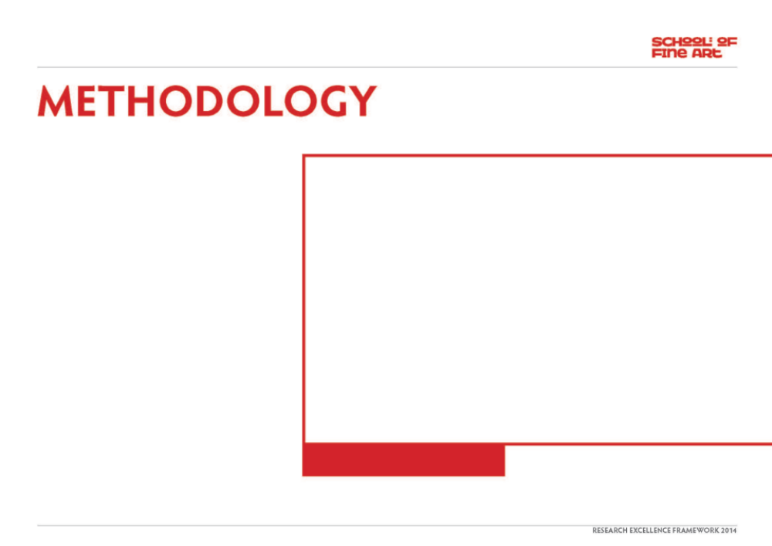
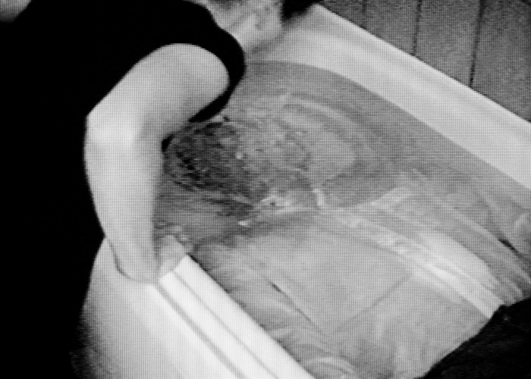
Image one & a description of what we are looking at in the context of the project.

Slide 7
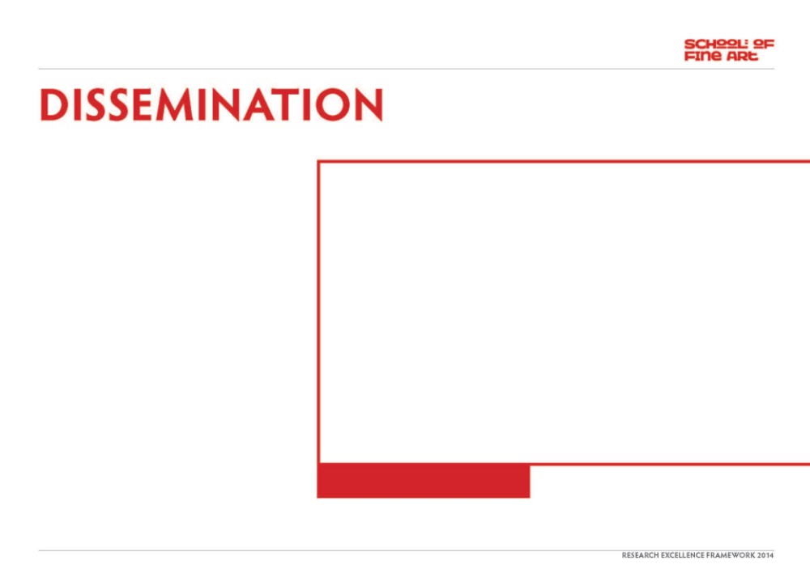
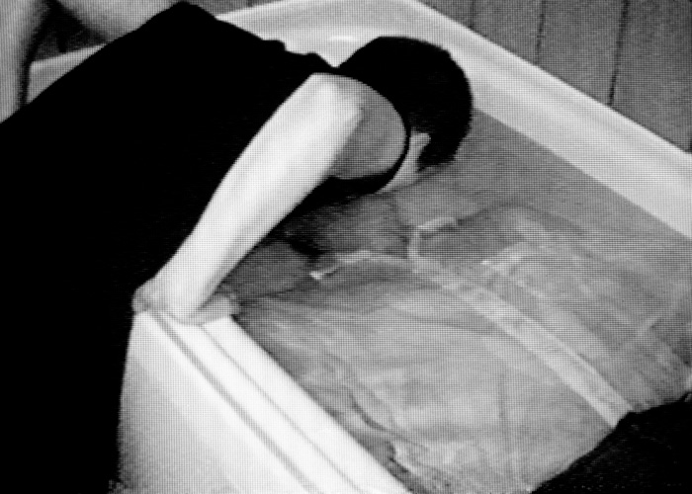
An illustrated catalogue including essays by curators Frank Lamy & Nathalie de Blois
ISBN: 978-2-916324-50-0
Weblinks re. show (in French):
http://www.macval.fr/francais/expositions-temporaires/expositions-passees/emporte-moi/article/le-mot-des-commissaires-de-l
http://www.macval.fr/francais/expositions-temporaires/expositions-passees/emporte-moi/article/presentation-4441
http://www.macval.fr/francais/expositions-temporaires/expositions-passees/emporte-moi/oeuvres-96/
http://www.macval.fr/francais/expositions-temporaires/expositions-passees/emporte-moi/article/les-artistes
Image one & a description of what we are looking at in the context of the project.

Slide 8
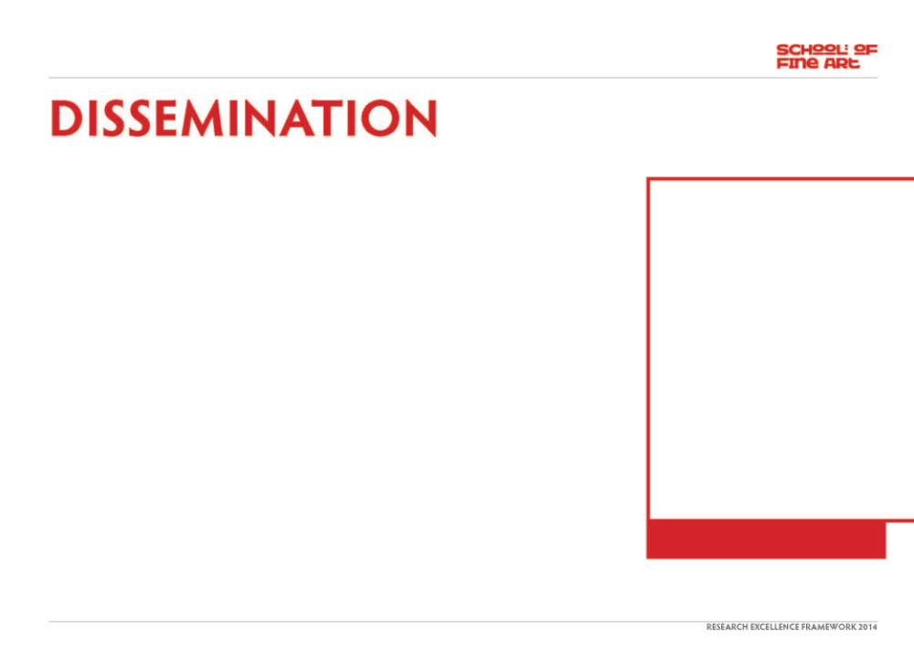
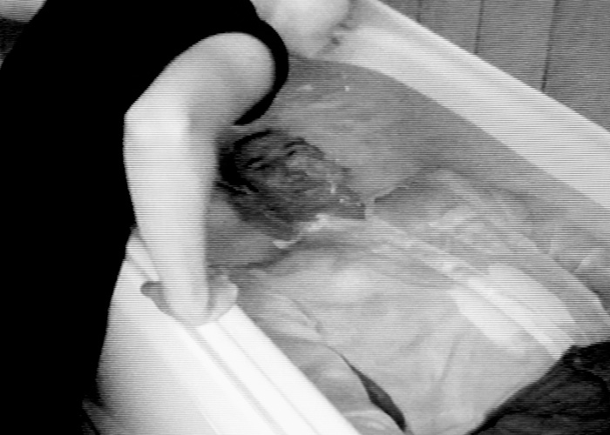
This work is also in the Tate Collection
http://www.tate.org.uk/art/artworks/smith-mouth-to-mouth-t07581
& The Arts Council Collection, London.
It has also been shown in numerous international group exhibitions and is cited in key texts on video art, eg:
Video Art, Michael Rush. Thames & Hudson. London (ill.) ISBN 9780500284872
http://www.thamesandhudson.com/Video_Art/9780500284872
Video Art, A Guided Tour, Catherine Elwes. I. B. Tauris, London (ill.) ISBN-10: 1850435464 / ISBN-13: 978-1850435464
A key essay outlining this & other works:
‘The Medium as Metaphor’ by Ulrich Loock,
in’ Smith/Stewart Videoarbeiten’, ISBN:
3-267-00128-5
Image one & a description of what we are looking at in the context of the project.

