Slide 1
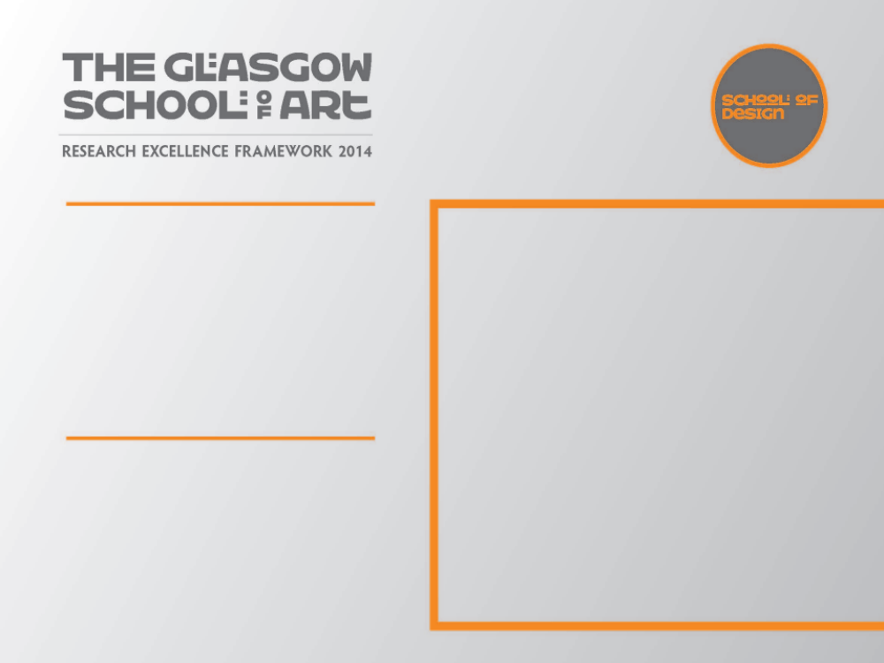
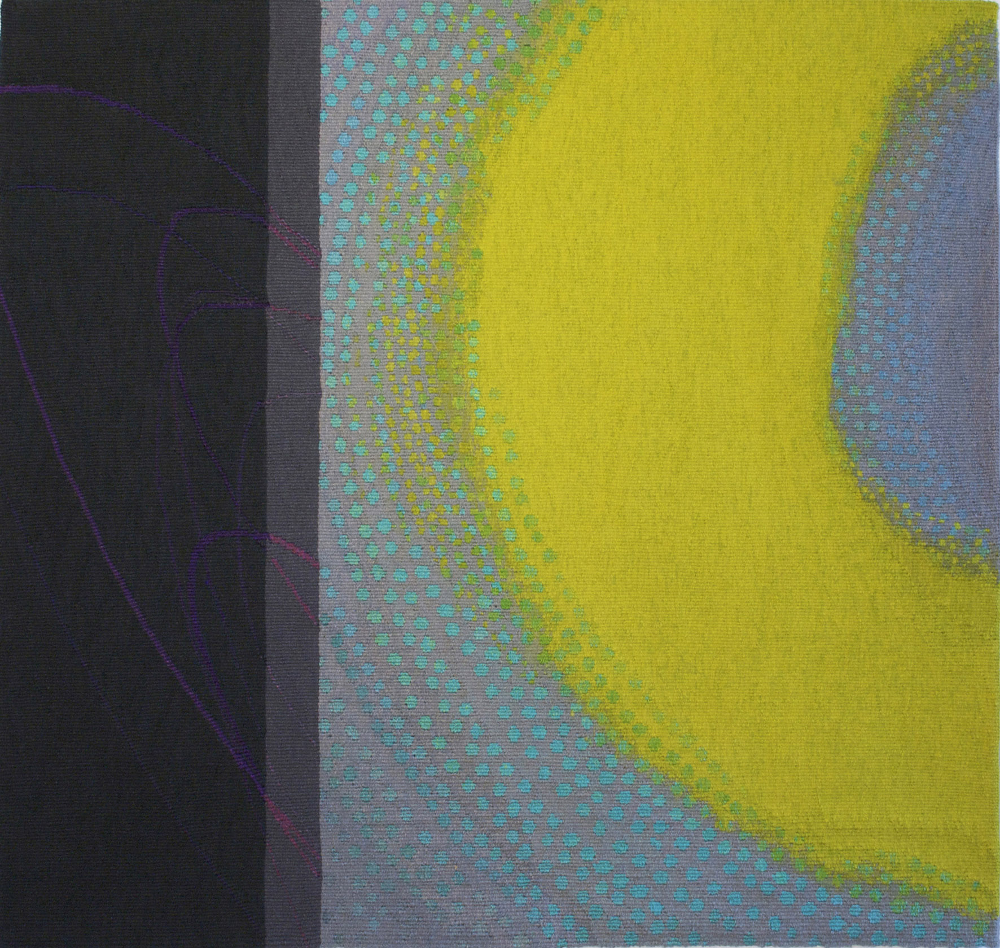
Ethereal Planes
Exhibition
New work was made as a continuation of investigations when making work for the solo exhibition ‘Jo Barker – Tapestries’ (see Output 1).
Themes were further developed as a series of tapestries looking into qualities and patterns of light. Focus is on embodied thinking from drawing to making.
Tapestry – ‘Lime Glow’ 2010
73 x 78cm
Submitted by Jo Barker
Output No. 2

Slide 2
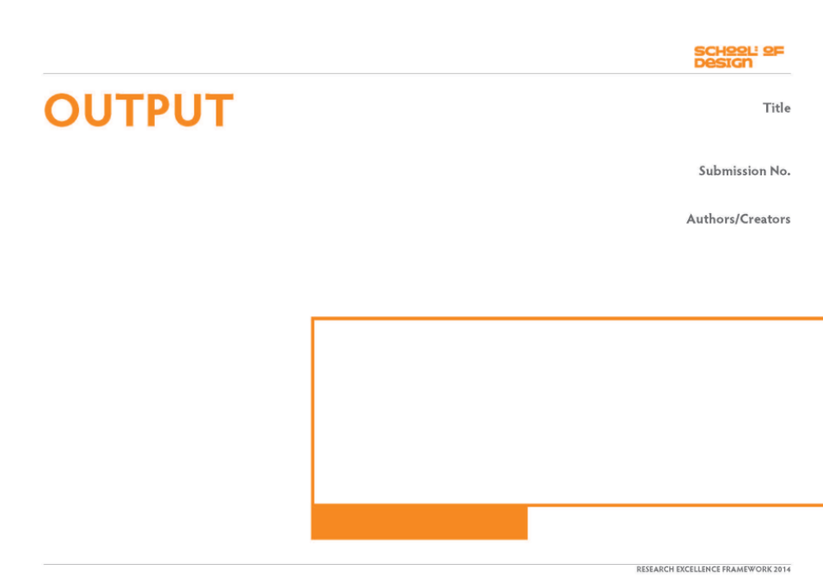
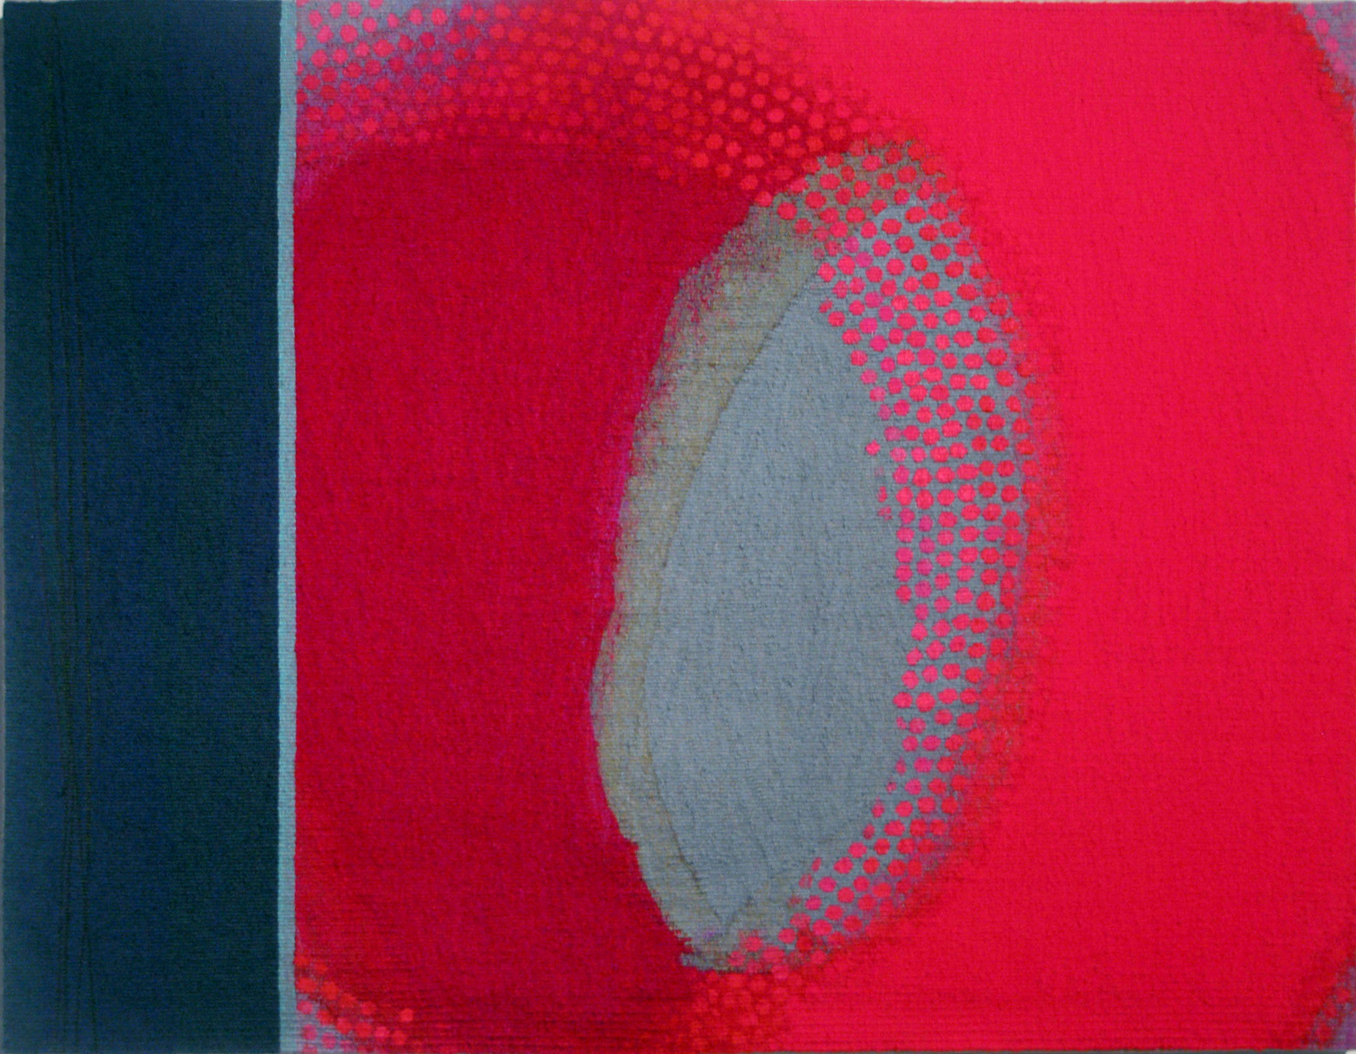
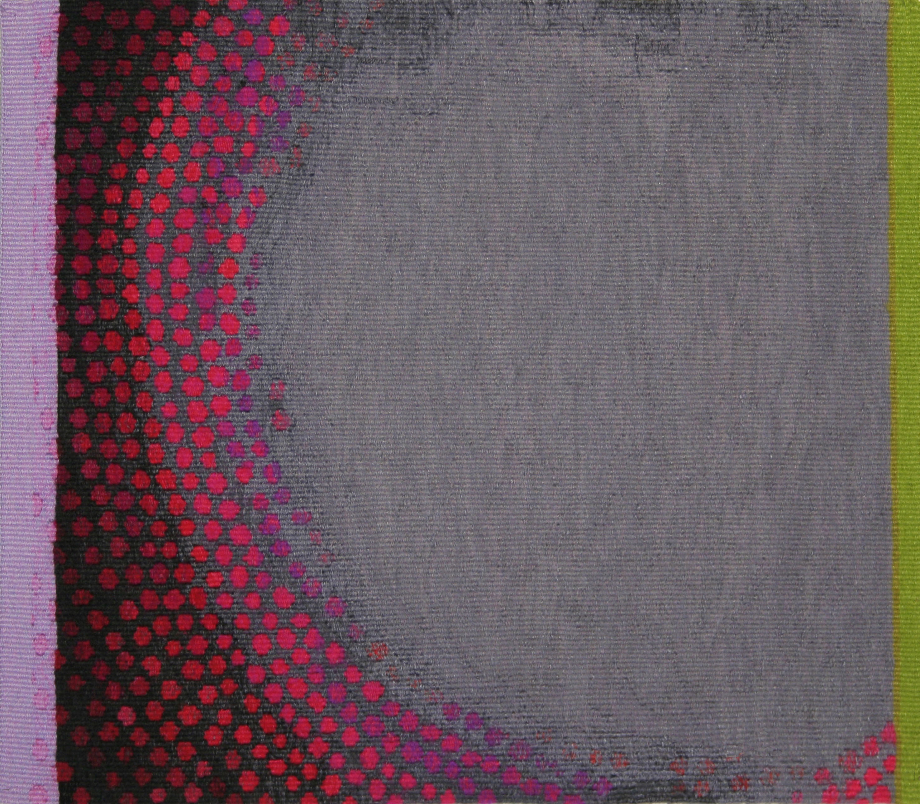
Ethereal Planes
Group exhibition
This output comprises:
3 new tapestries building on themes from Output 1.
Invitation to exhibit at Contemporary Applied Arts Gallery, London.
1 of 4 exhibitors, curated by Sally Fawkes, glass artist.
Subsequent showings: exhibitions in 2 galleries in UK
1 book section
1 catalogue
1 of 6 invited speakers at symposium - ‘Drawing & Making: The Elements of Creativity’, Edinburgh College of Art 2012.
1 documentary film of symposium presentation
Research interest lies in the meeting point between the use of digital technology as a design tool and the employment of traditional textiles hand-skills as a method of manufacture, specifically the Gobelin tapestry weaving technique.
Research questions:
Further development of themes contained in Output 1
Interests lie within the arena of embodied knowledge
and the interplay between drawing and making.
Subject matter concerns qualities and patterns of
light translated into woven tapestries.
Can the quality of digital screen colour luminosity
be translated into woven marks?
2526
Jo Barker
1.
2.
3.
Tapestries exhibited in ‘Ethereal Planes’ exhibition Contemporary Applied Arts, London 2011
1. Radiance – 73x94cm 3. Curve – 37x30cm
2. Lime Glow – 73x78cm

Slide 3
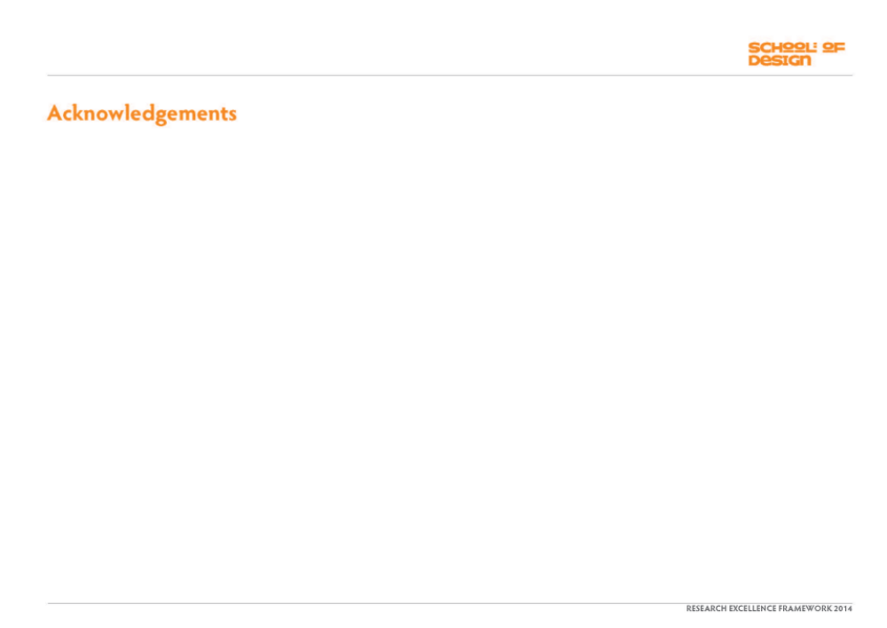
Lime Glow – 73x78cm

Slide 4
Radiance – 73x94cm
Curve – 37x30cm

Slide 5
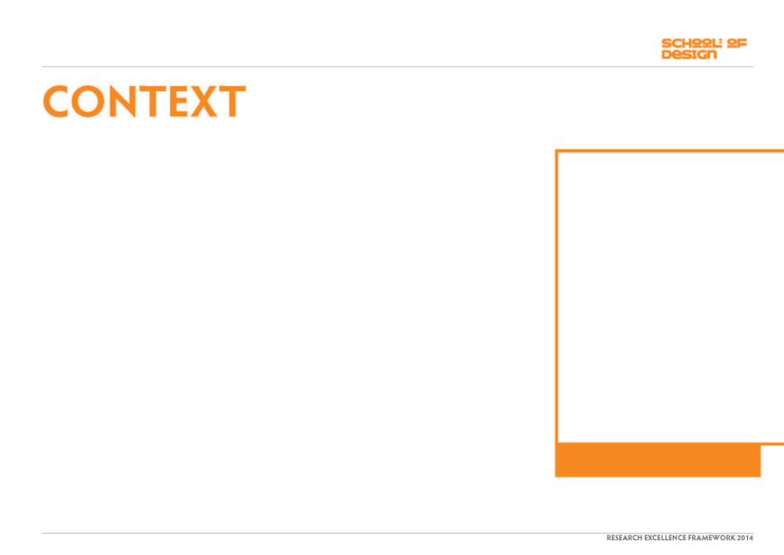
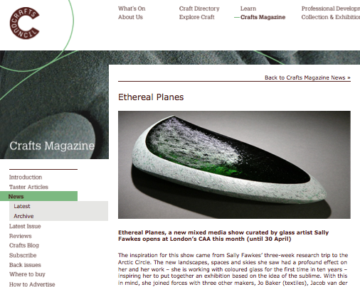
The research further developed earlier discoveries made (see Output 1), extending and refining skills in combining digital and analogue design techniques.
A series of tapestries were hand woven translating designs from digitally collaged images.
Themes of fleeting patterns of light, edges and overlaps of pools of colour with contrasting solid blocks of dark were repeated and nudged into different combinations.
The slow translation into woven tapestry using fine wool, cotton, silk and embroidery thread belies the sense of immediacy in the finished article which creates an illusion of dappled light, drawn lines and pools of paint or pigment.
An invitation was received to participate in a group exhibition at Contemporary Applied Arts, London; gallery of international renown.
Four artists were selected as a result of their work being perceived to be dealing with aspects of, or to contain qualities that related to, “the sublime”
Gallery Statement
From different starting points of enquiry, four artists are exploring boundaries, sometimes as horizons in landscapes, as changes in the body of material, the interface between colours, or the powerful effect of light.
Crafts Council website: exhibition information

Slide 6
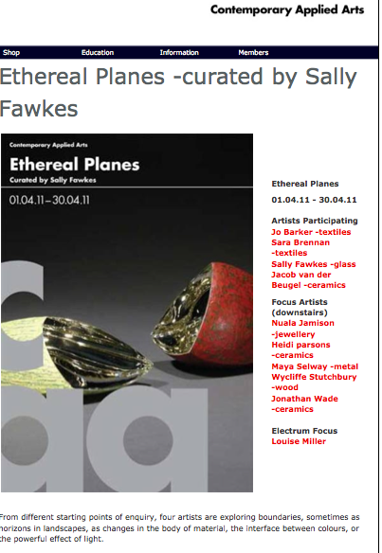
Gallery Statement (cont’d)
The artists practice in different media:
Sally Fawkes - glass
Jo Barker and Sara Brennan - textiles
Jacob van der Beugel - ceramics
Thus, the material expression of their ideas are all very diverse and distinct.
What unifies their work is that it lies in the realms of the sublime.
The inspiration for ‘Ethereal Planes’ came after a three week research trip, in 2008, by curator of the exhibition and glass artist Sally Fawkes, sailing aboard the Tall Ship “Trinovante” in the seas of northern Norway.
“What I learned on this trip is now filtering through into my work and I felt an exhibition focused on sublime craft based work would be incredibly powerful and exciting.”
“I feel there is a solidarity and cohesion between us as to why and how our work comes into being. There is a harmony of strong intent in our work to touch the senses reaching beyond what we know and understand.”
“We are all exploring the formal, the intellectual, imaginative and emotional possibilities of our materials and the outcomes are characteristically ethereal.”
Sally Fawkes
Gallery website publicity: Ethereal Planes exhibition 2011

Slide 7
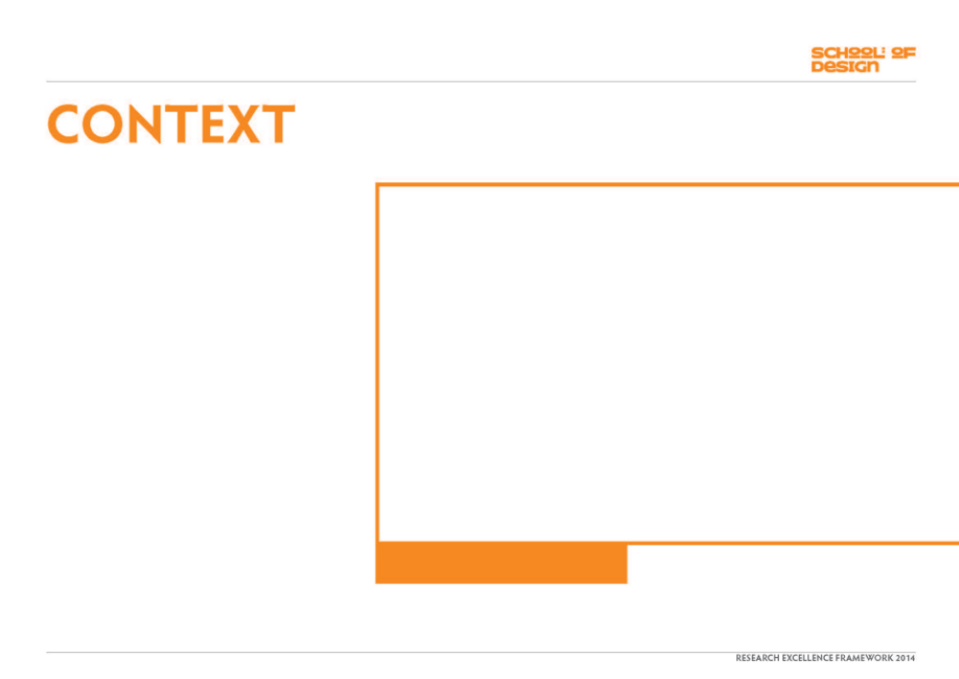
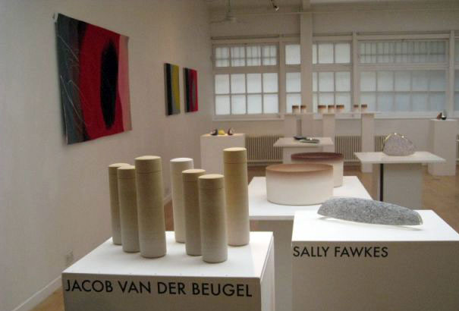
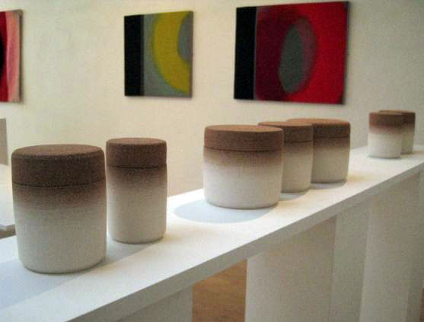
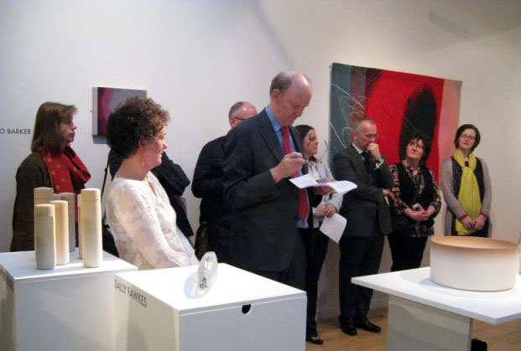
In a Crafts Council website article, the curator states:
‘I selected makers whose work I felt was creating the sublime experience through emotional and intellectual possibilities of their work and who were exploring the unknown limits and possibilities of their work perhaps in the hope of clarifying and understanding more of the unknown.’
This theme also links in to aspects of embodied
thinking:
“Routines, habits, tasks and information our bodies "understand" without conscious thought”.
Juhani Pallasmaa – The Thinking Hand
ISBN: 9780470779293
About material curiosity.
“Good work depends on the maker having curiosity about the materials at hand”.
Richard Sennett – The Craftsman
ISBN: 9780141022093
Gallery installation views

Slide 8
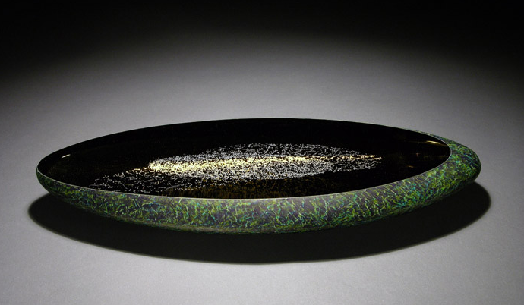
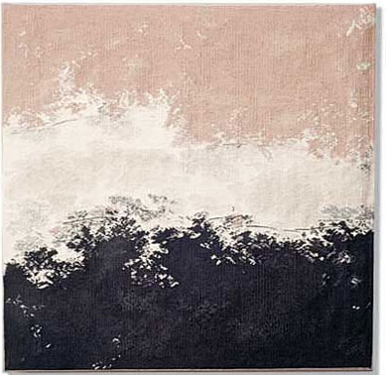
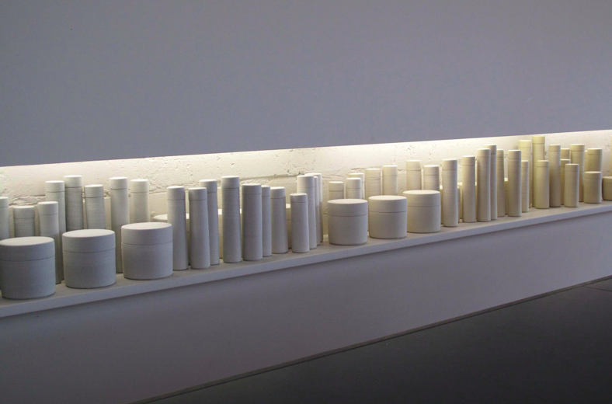
The tapestries were exhibited alongside world class practitioners in their field.
Ceramics - Jacob van der Beugel
http://www.jvdb-ceramics.com/
Glass – Sally Fawkes
http://sallyfawkes.com/
Tapestry – Sara Brennan
http://www.browngrotta.com/Pages/brennan.php

Slide 9
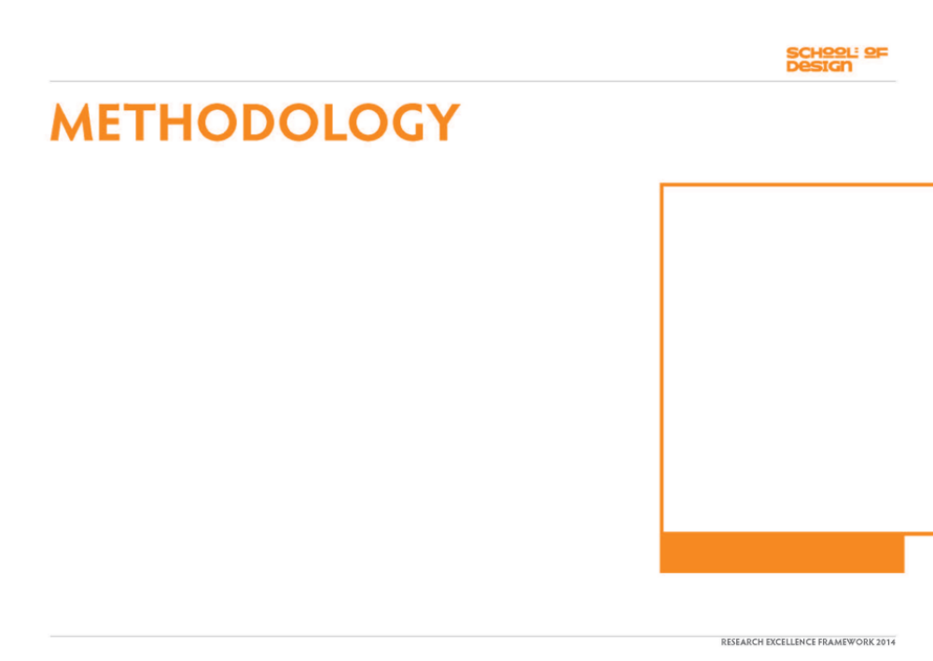
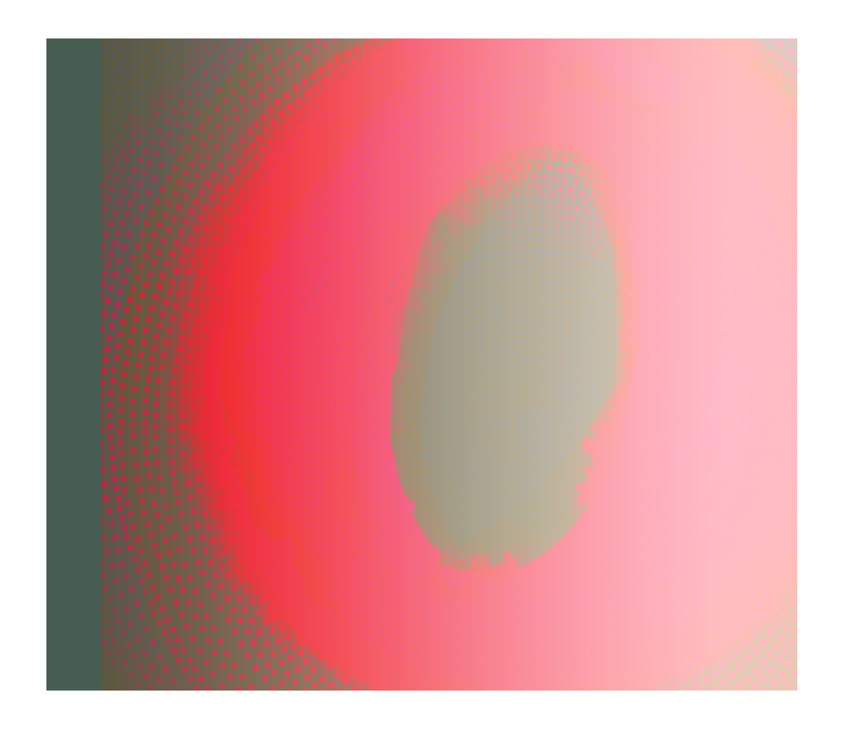
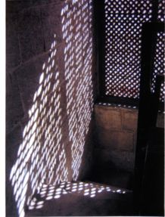
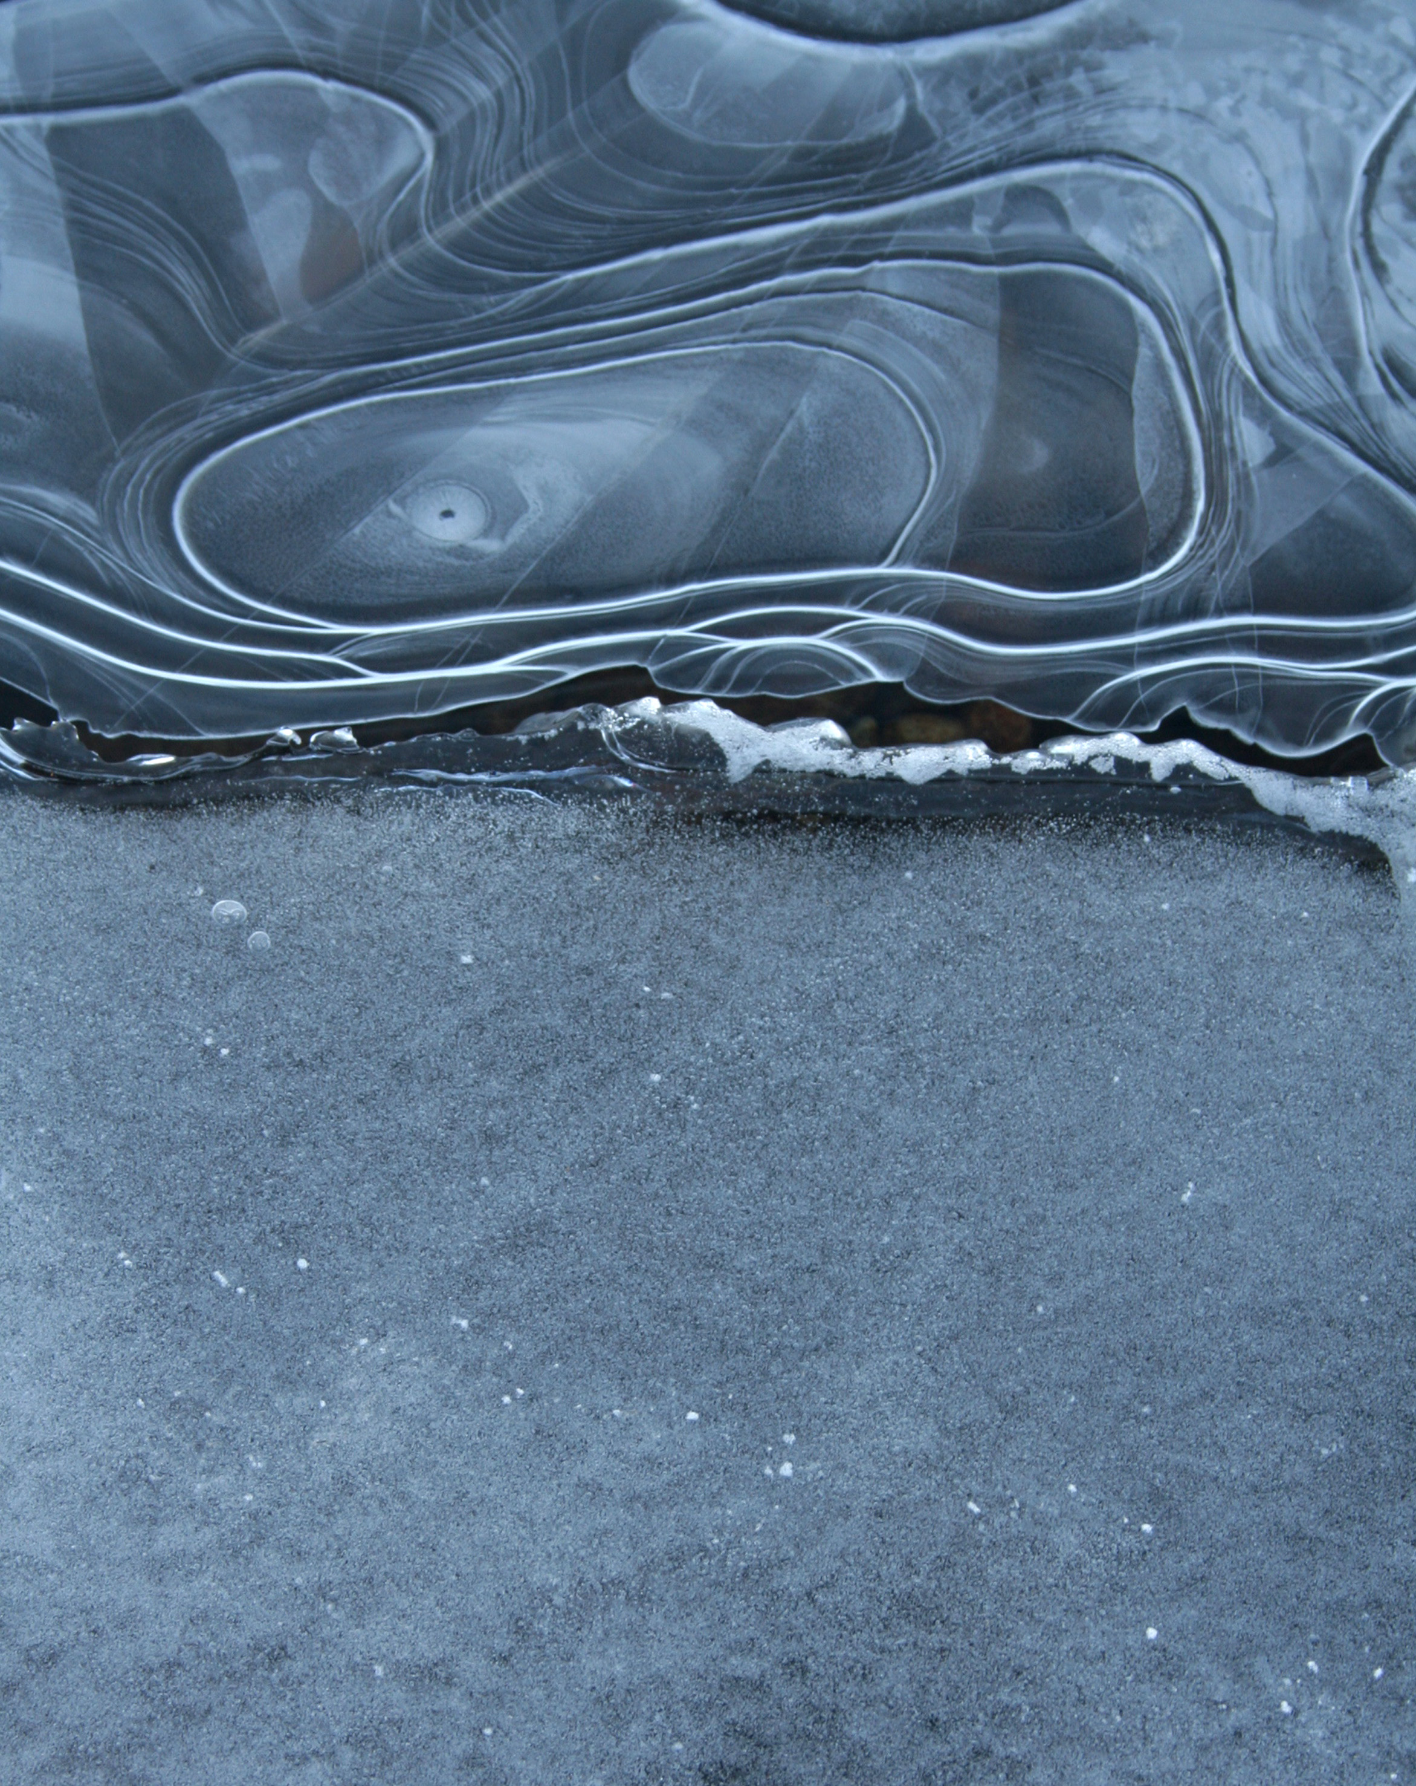
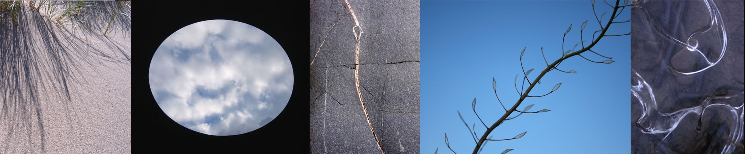
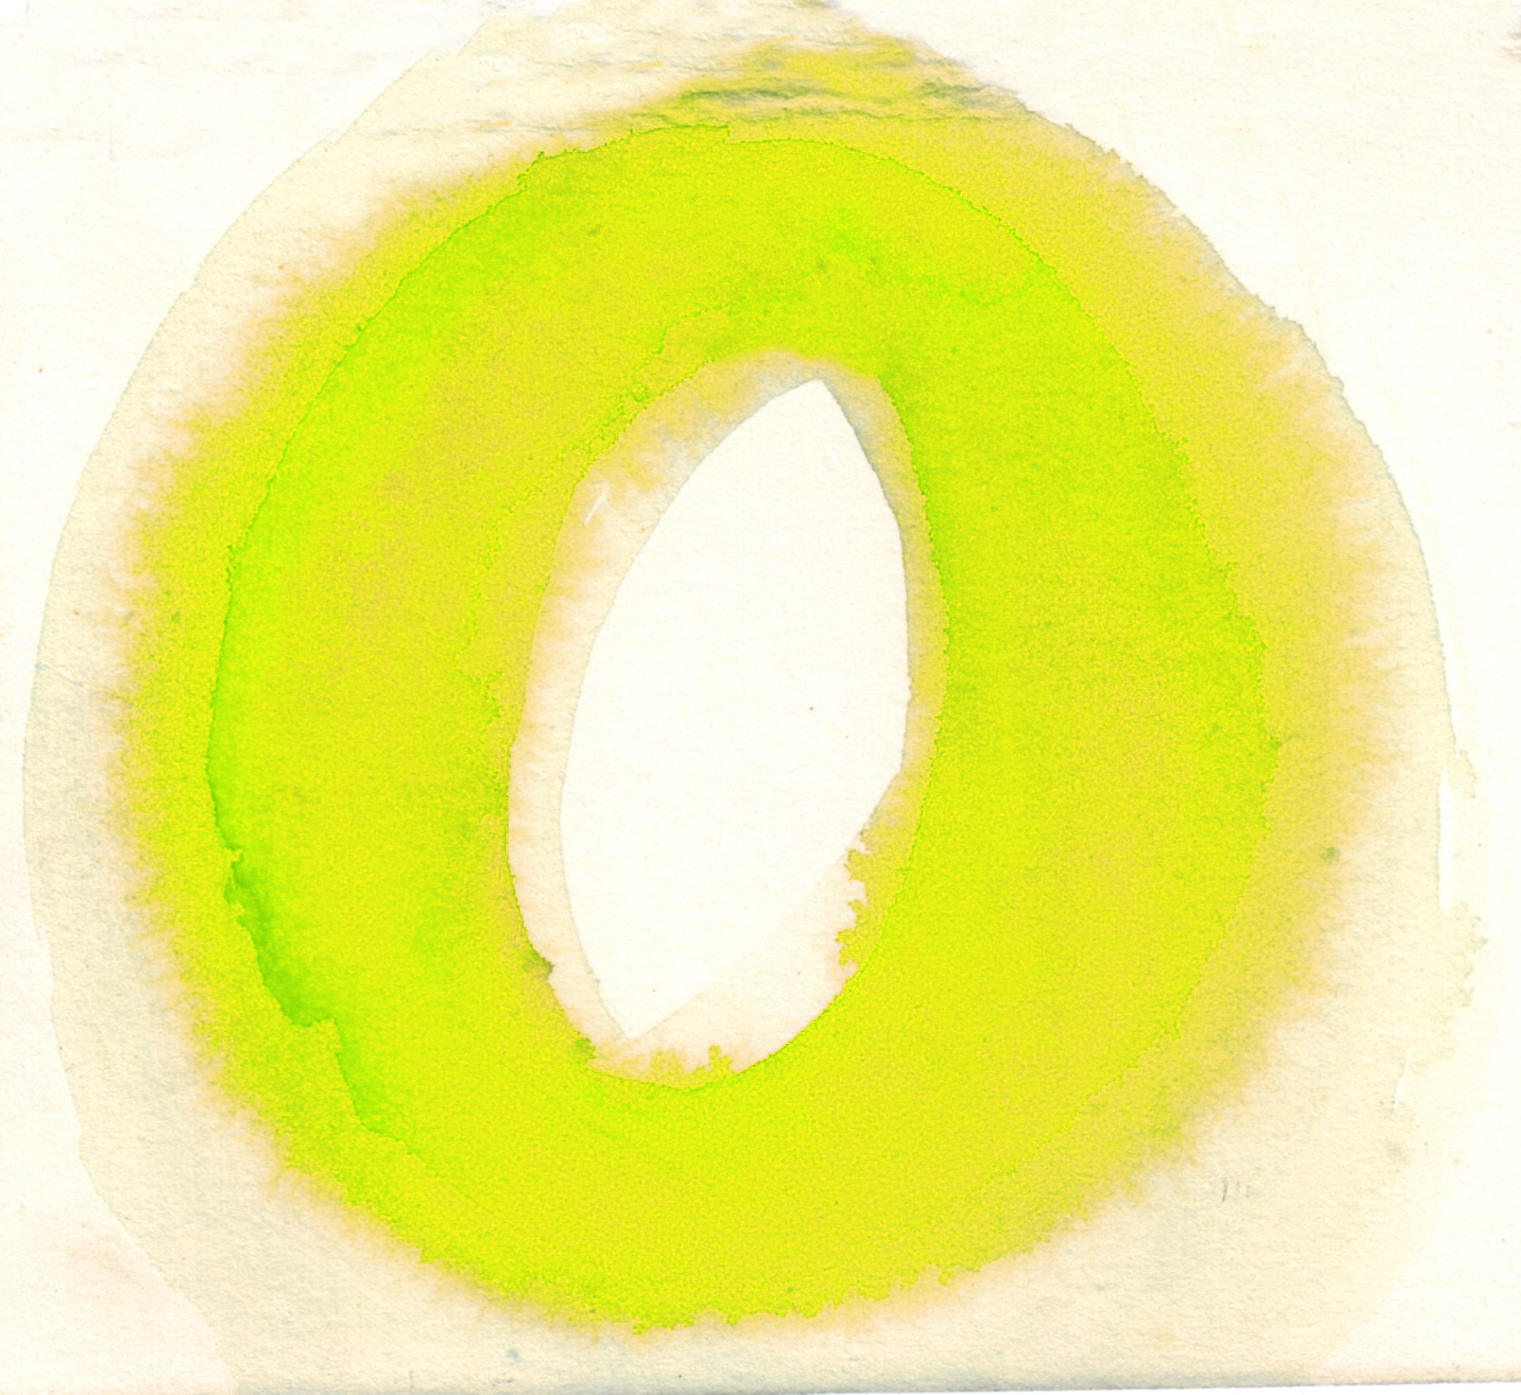
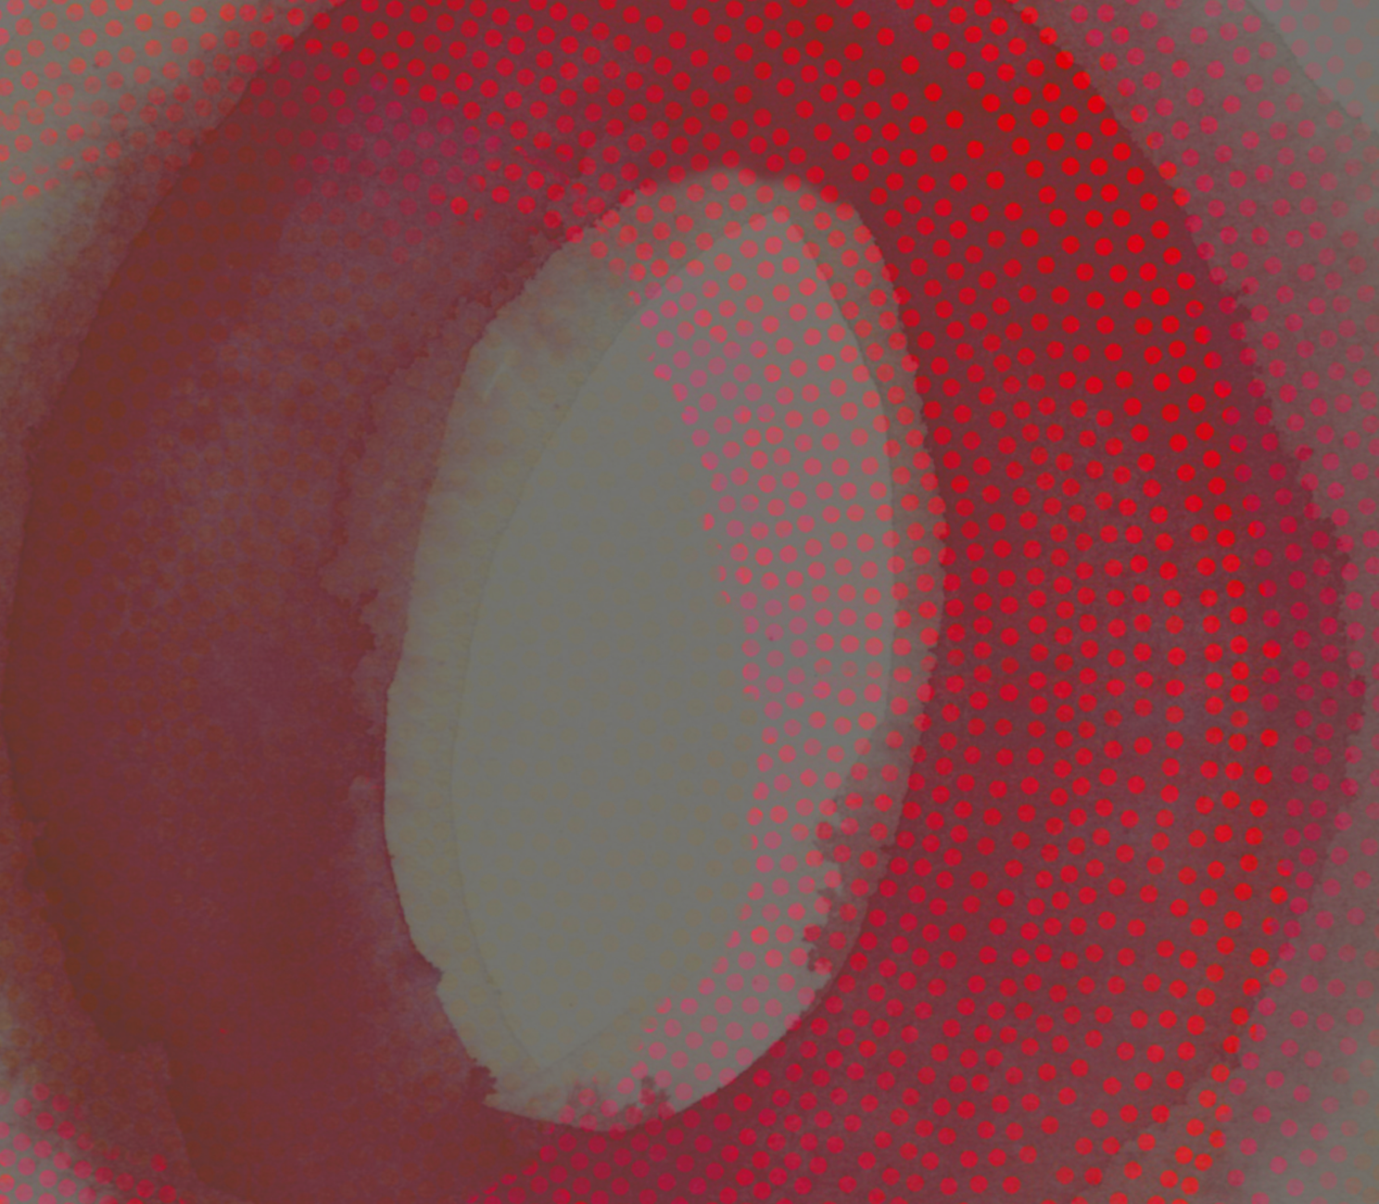
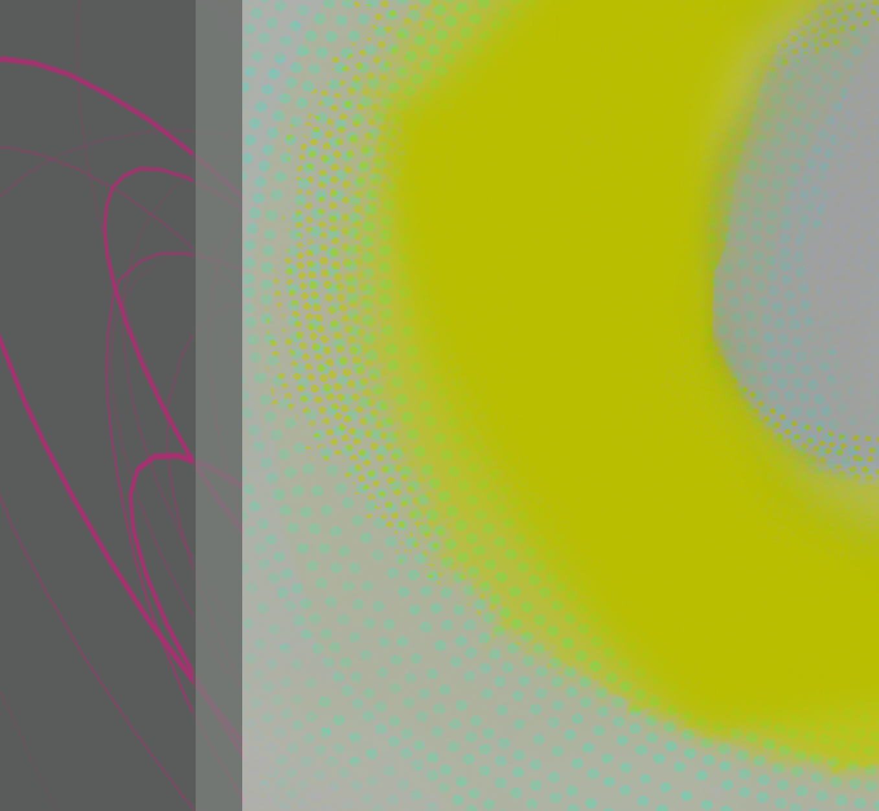
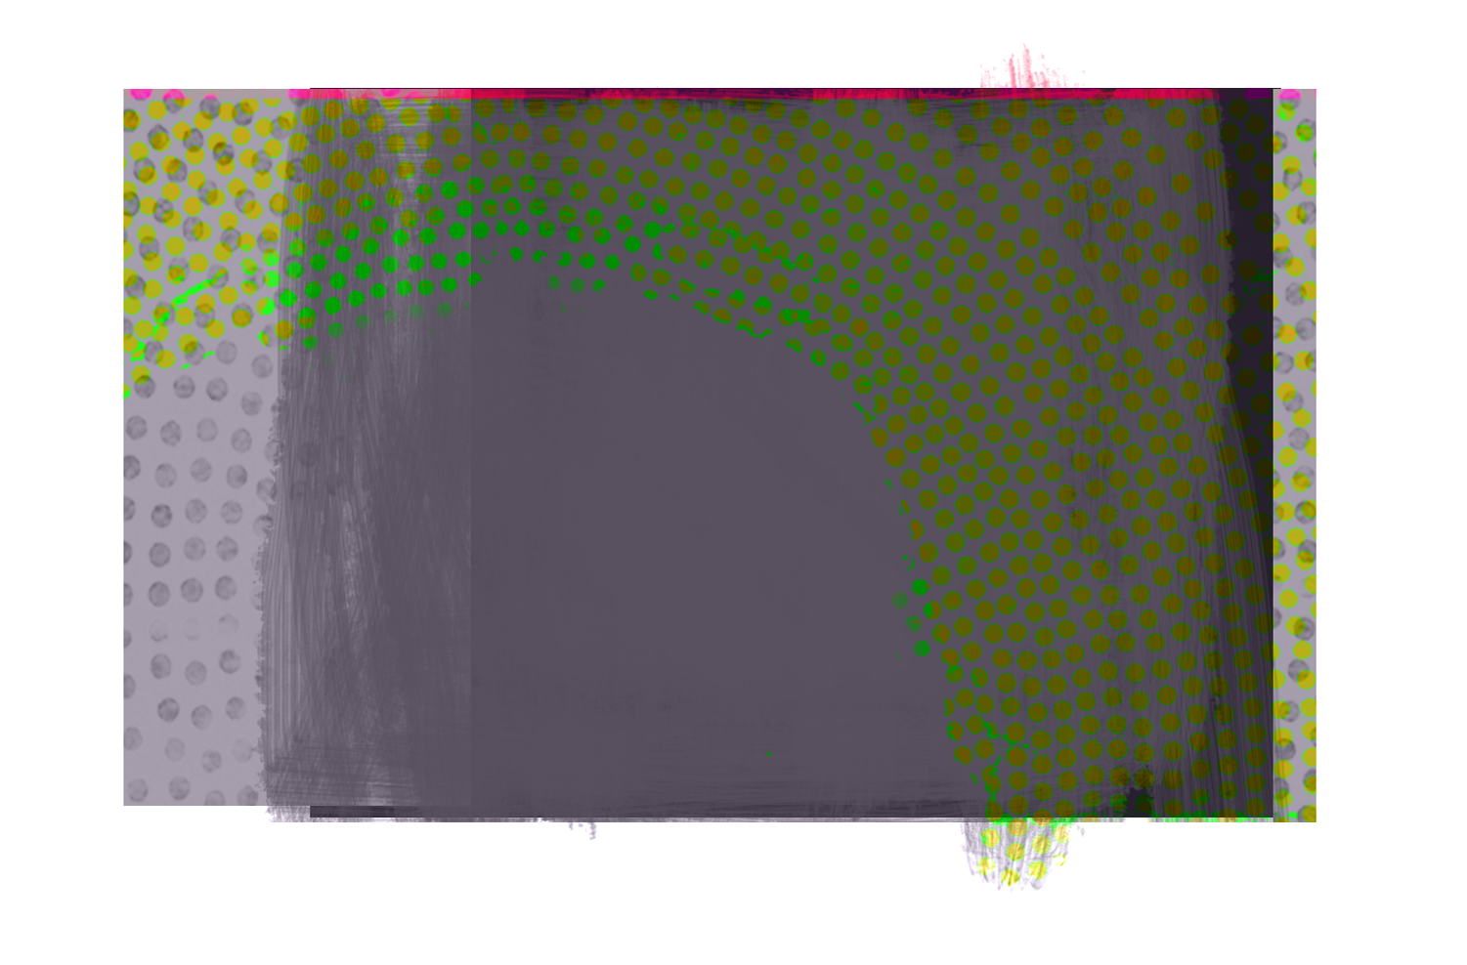

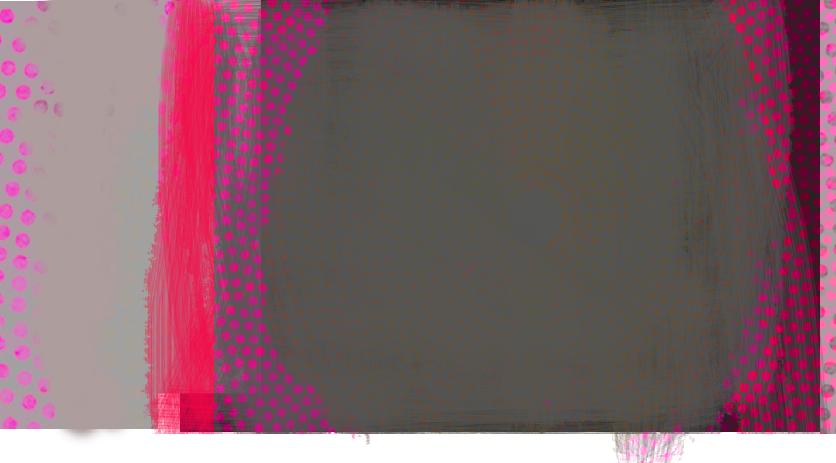
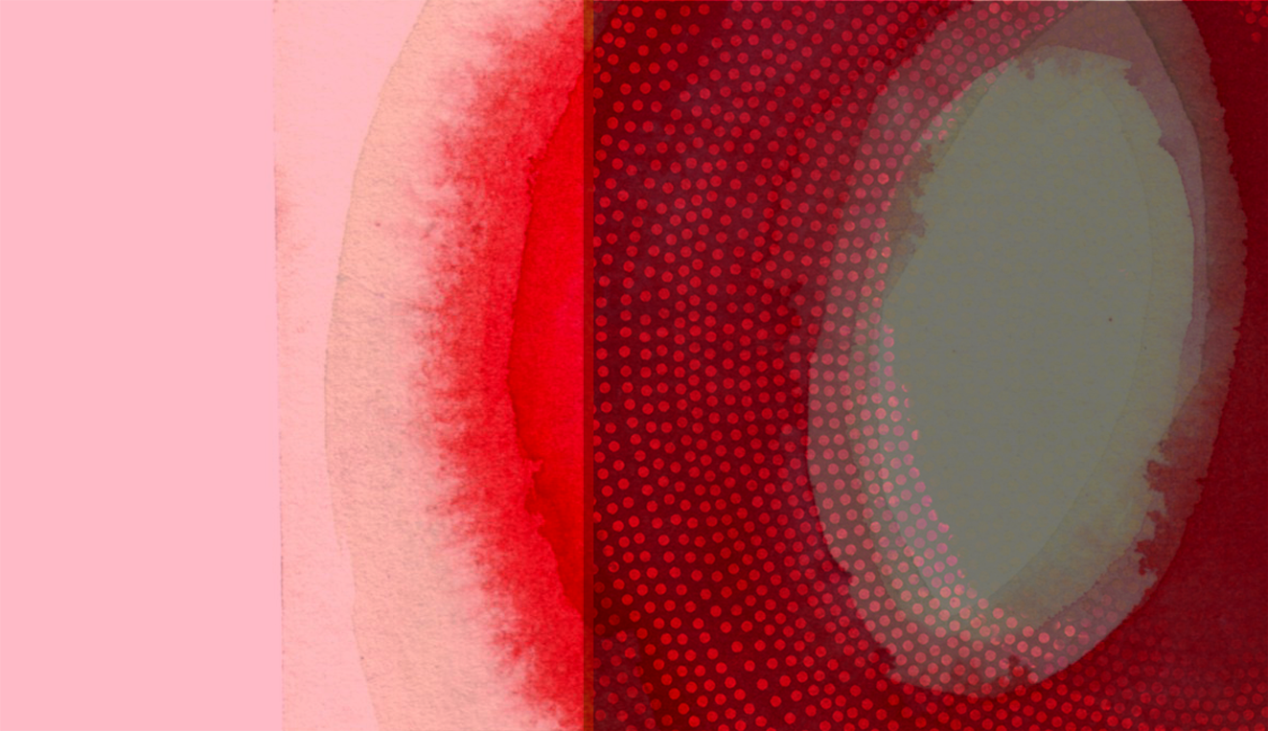
Drawings, collages, paintings and photographs were developed from selected
primary research which were manipulated & further refined in Photoshop.
(See also Output 1.)
DESIG
All images: designs in progress, from sketchbooks, photos, paintings to digital manipulations.
An intuitive response is employed at each stage of development until a suitable conclusion is reached.

Slide 10
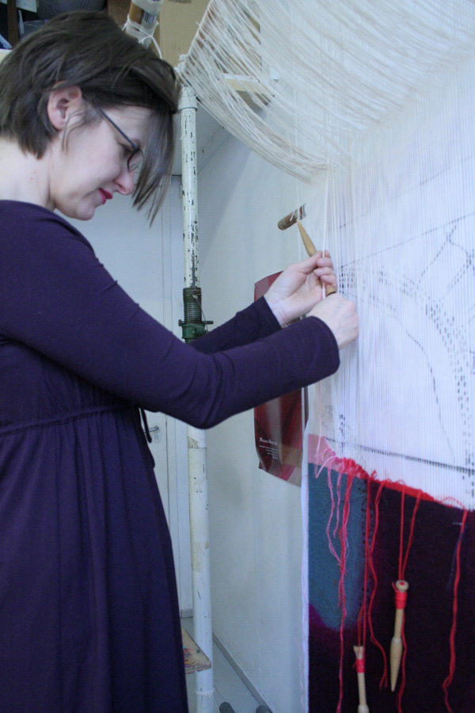
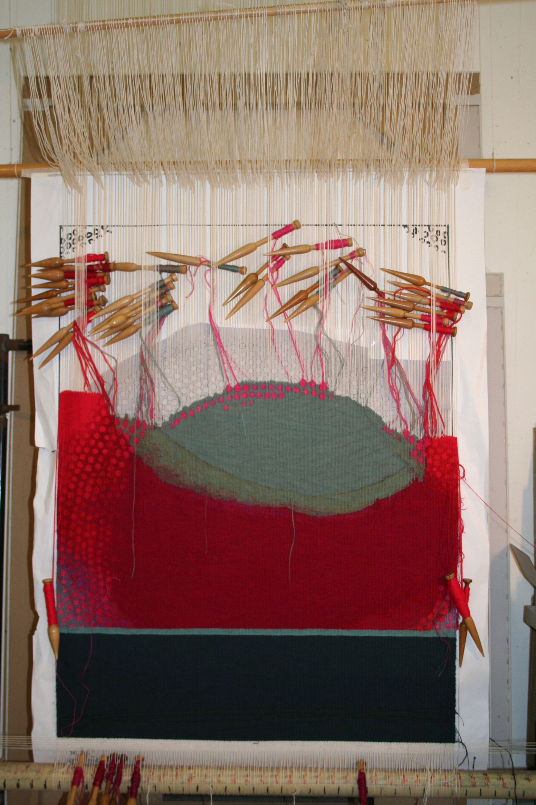
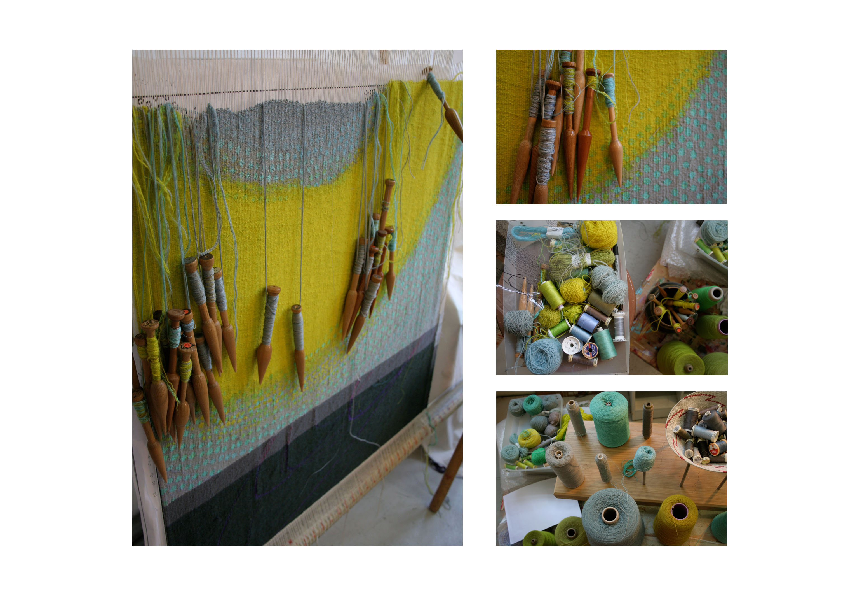
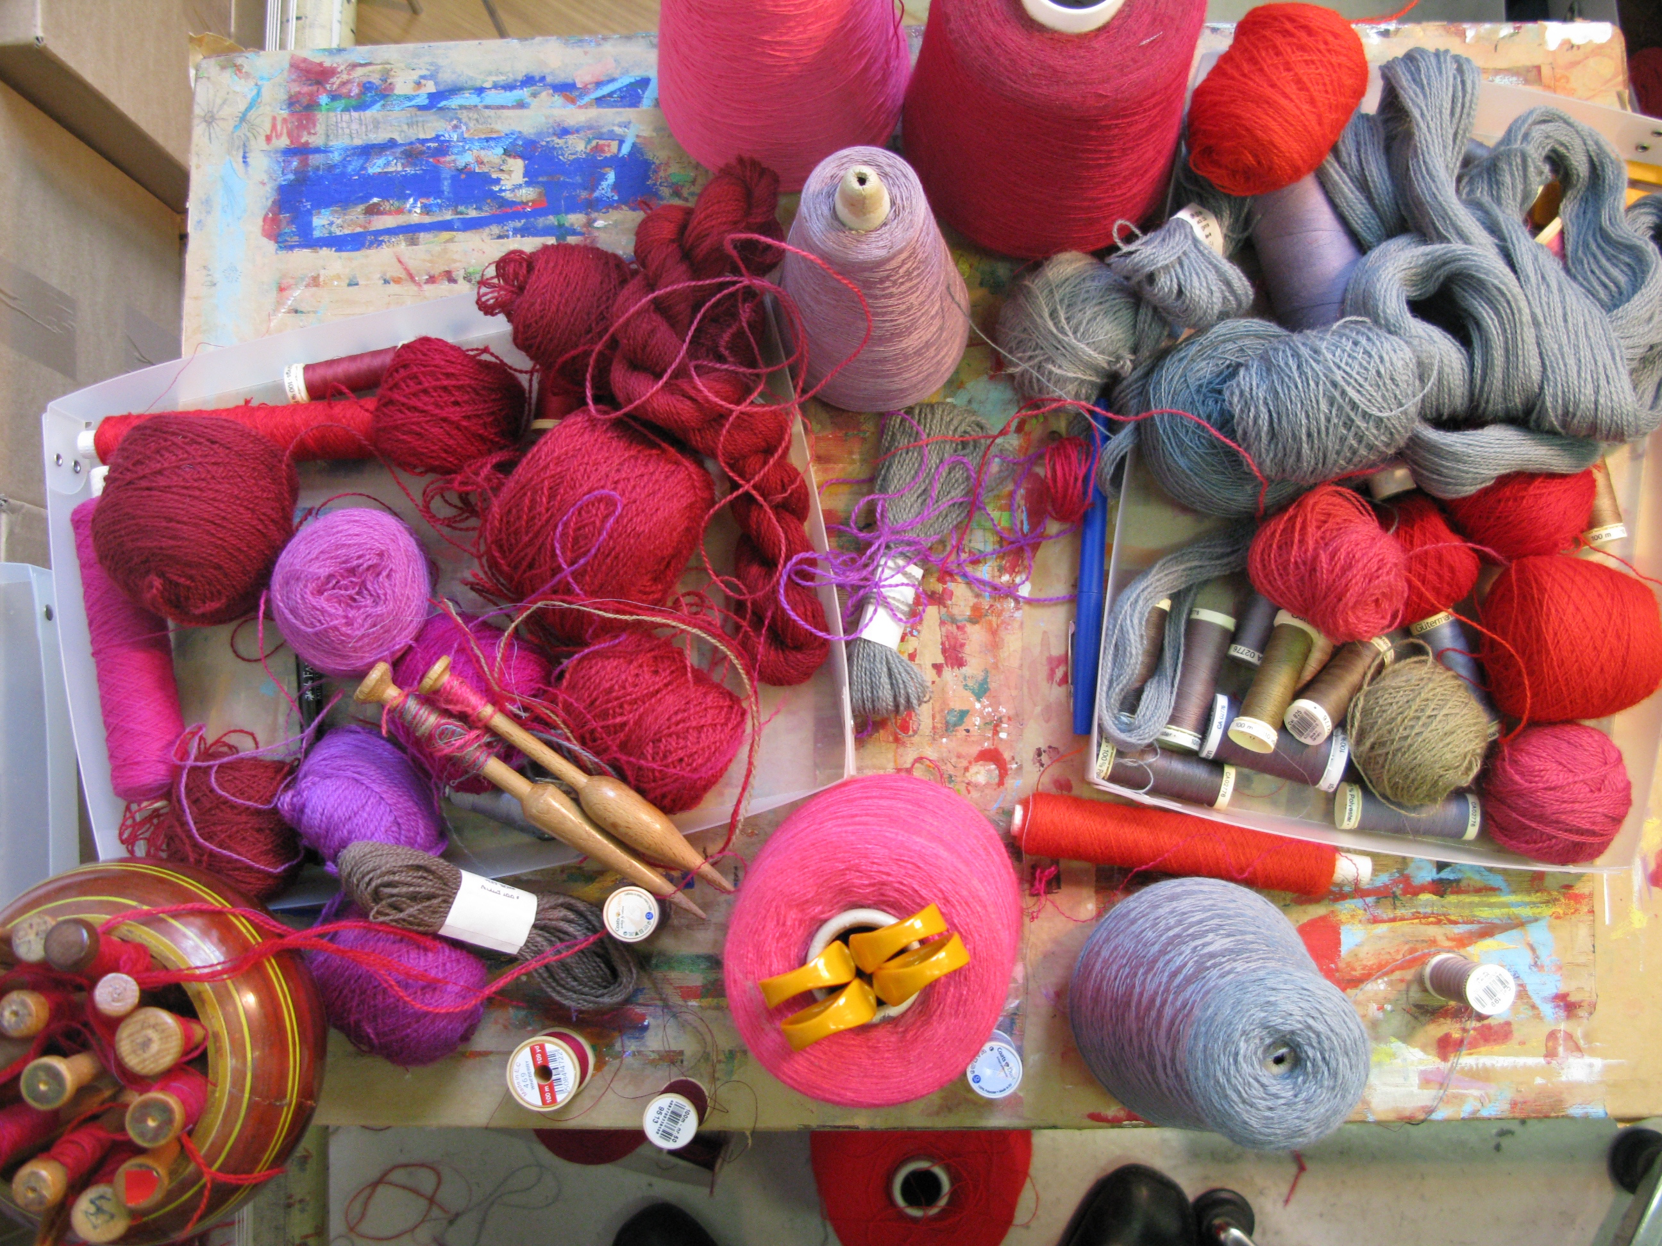
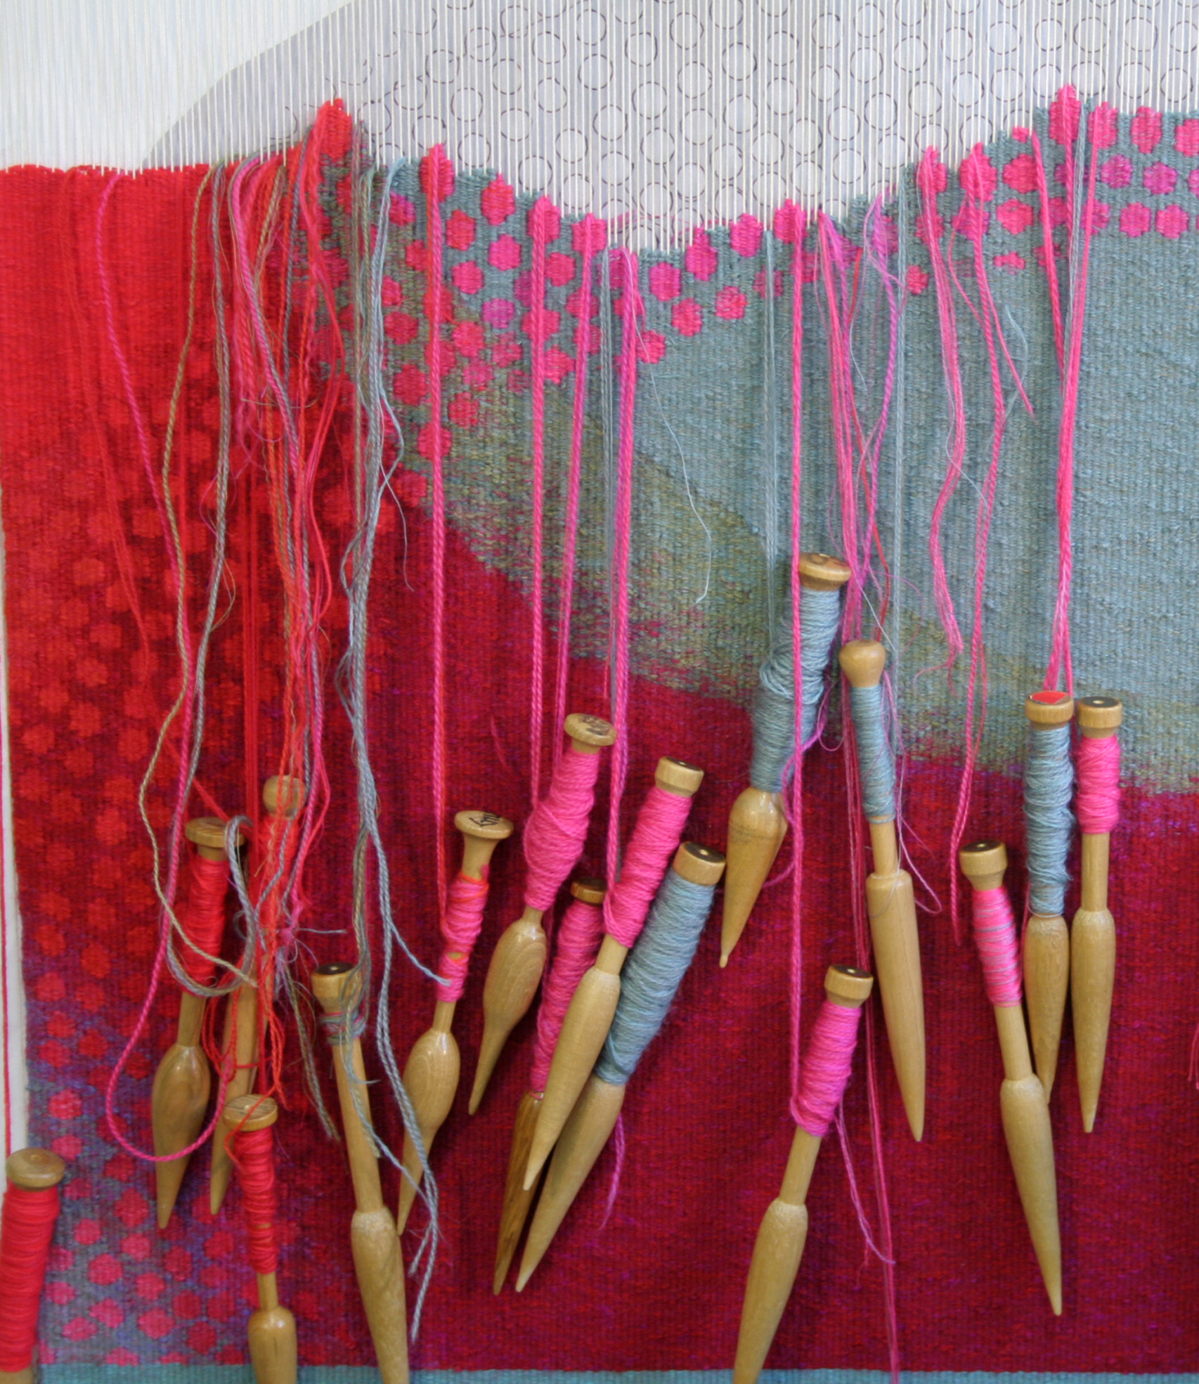
Designs were scaled up to larger dimensions to suit a gallery setting and
translated into woven tapestries using fine wool, cotton, linen and silk yarns.
Work in progress on the loom
Translation from design to woven tapestry

Slide 11
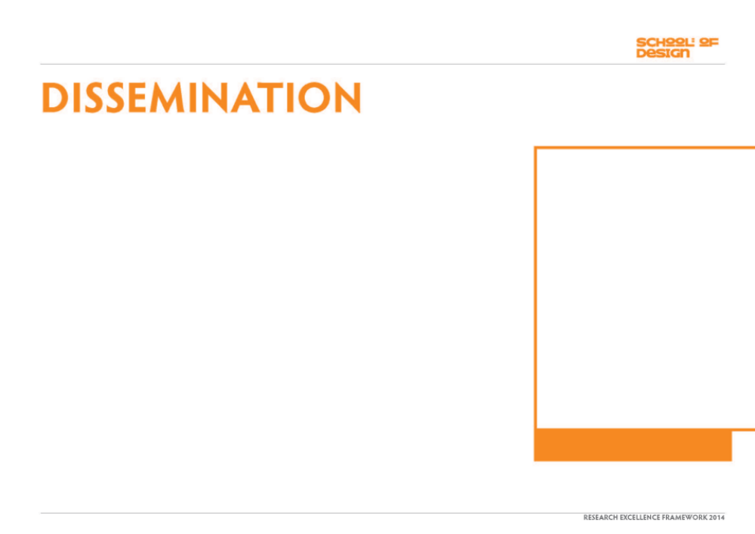
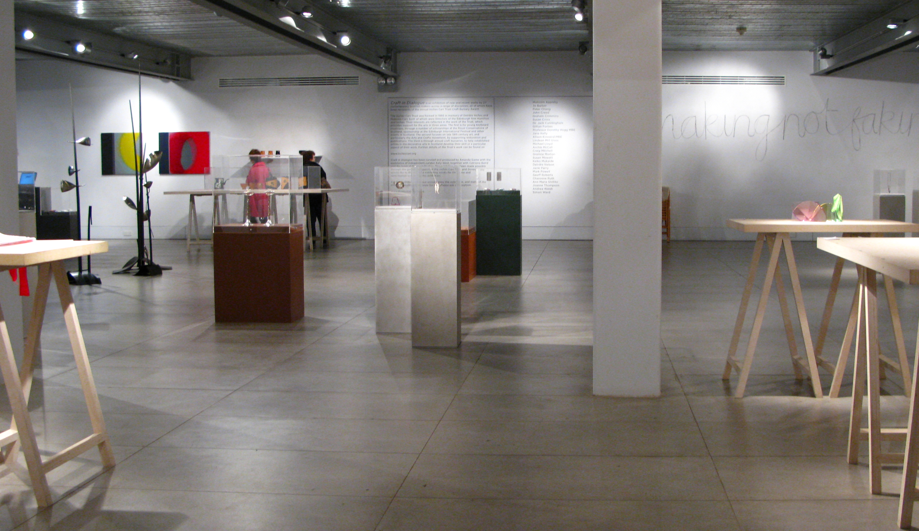
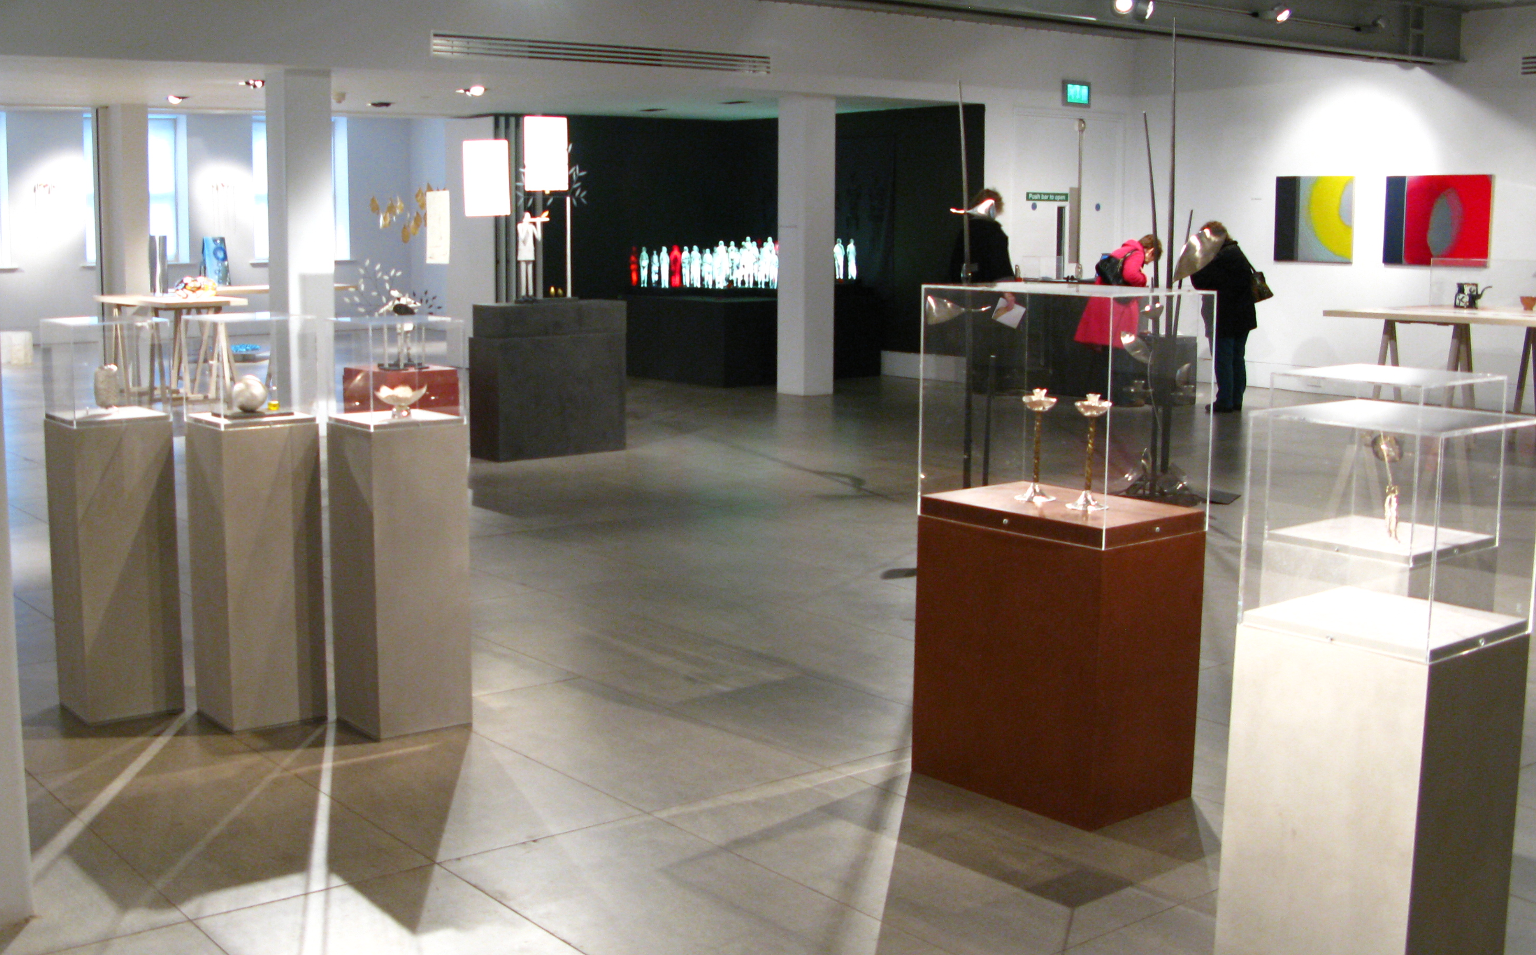
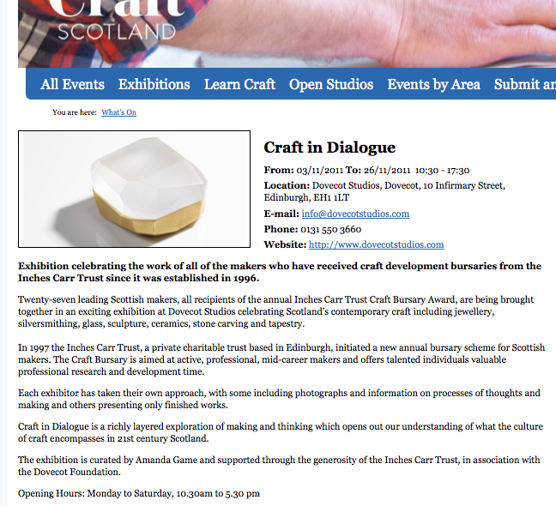
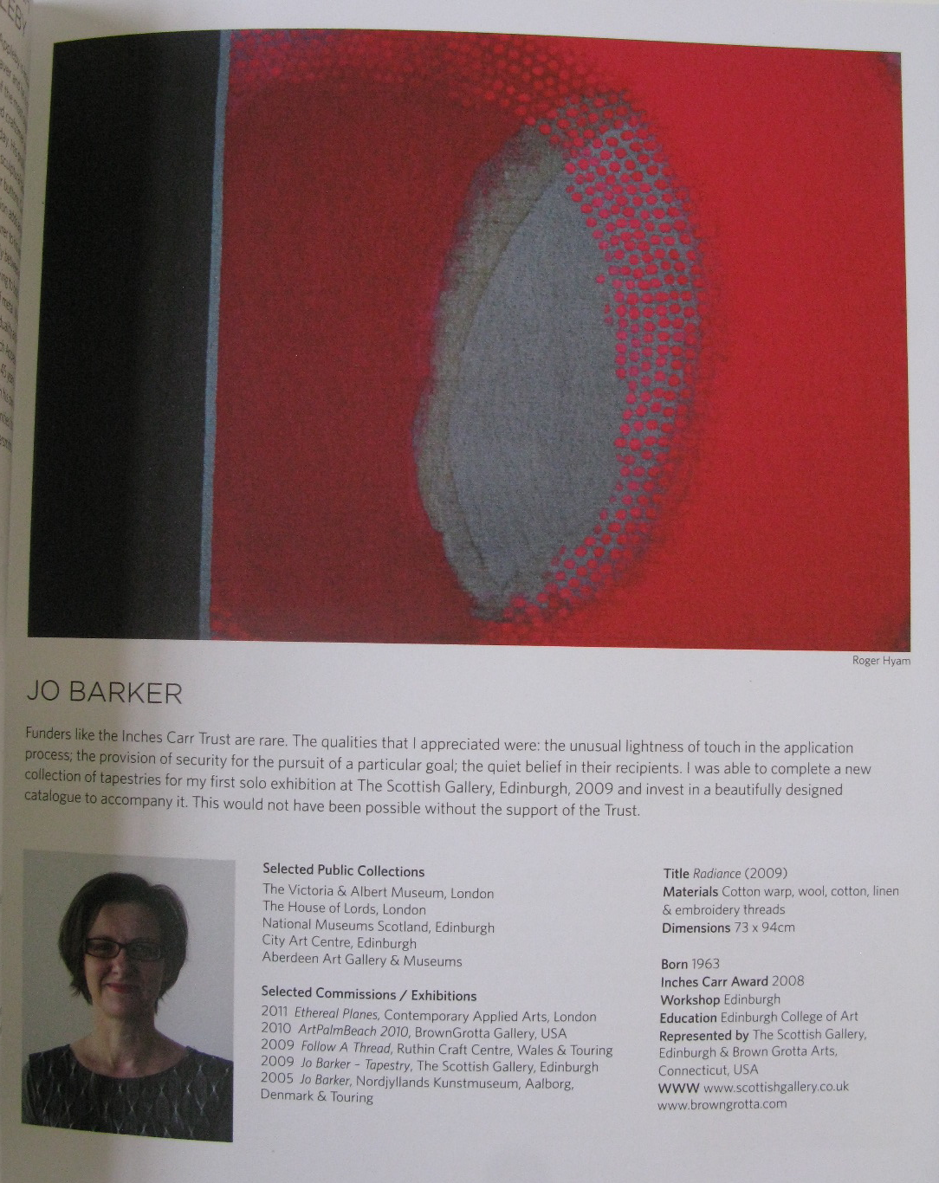
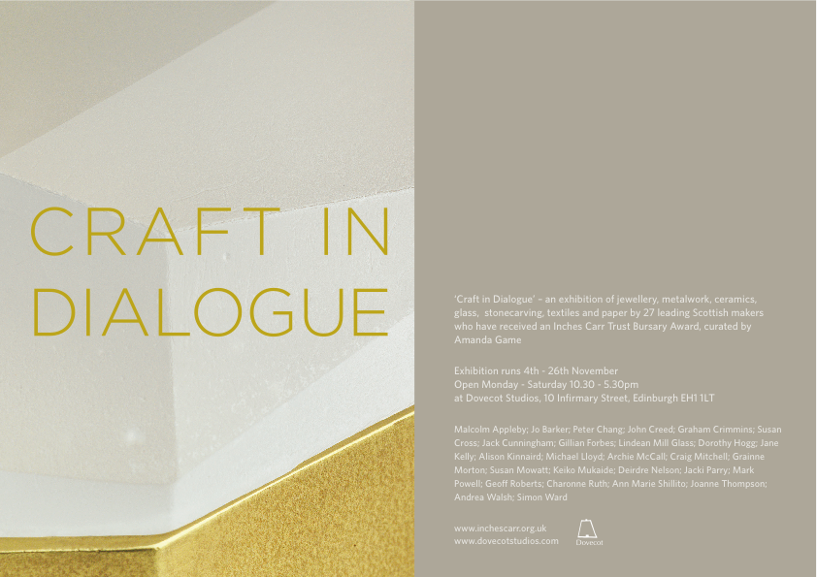
: FURTHER SHOWINGS OF WORK
2011
Craft in Dialogue
An exhibition of work by recipients of
The Inches Carr Trust Award since 1997
Dovecot Studios, Edinburgh
1 of 27 exhibitors
Catalogue
Work exhibited: ‘Radiance’, ‘Lime Glow’
An Inches Carr Trust Award was received in
2008 to contribute towards creating work for the
solo exhibition Jo Barker – Tapestries (see Output 1).
Three years further on the invitation here was to
exhibit recent work showing current
developments.
“What does this rich collection of work highlight about
the relationship of craft to wider artistic and social life
in Scotland at the moment? I think the key may be an
attentiveness and embraced within that, the words
respect and time…Most importantly the work, through
it’s rigour, imagination and attention to thought and
execution, demands our attentiveness.”
Amanda Game, Curator
Craft in Dialogue, catalogue essay p6
CraftScotland website information
Installation views of Craft in Dialogue exhibition, Dovecot Studios, Edinburgh 2011.

Slide 12
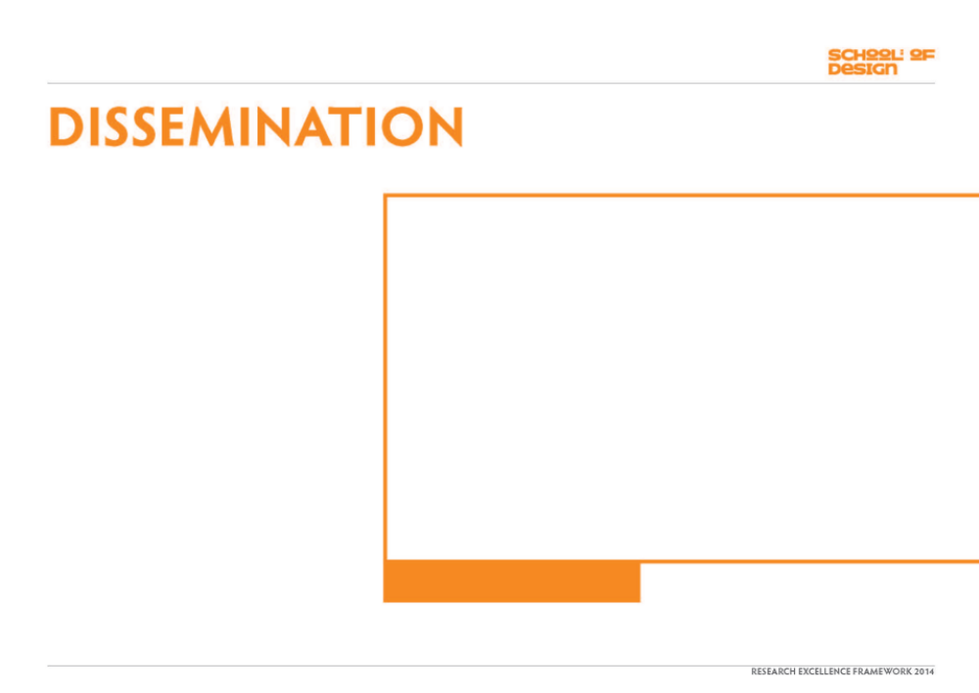
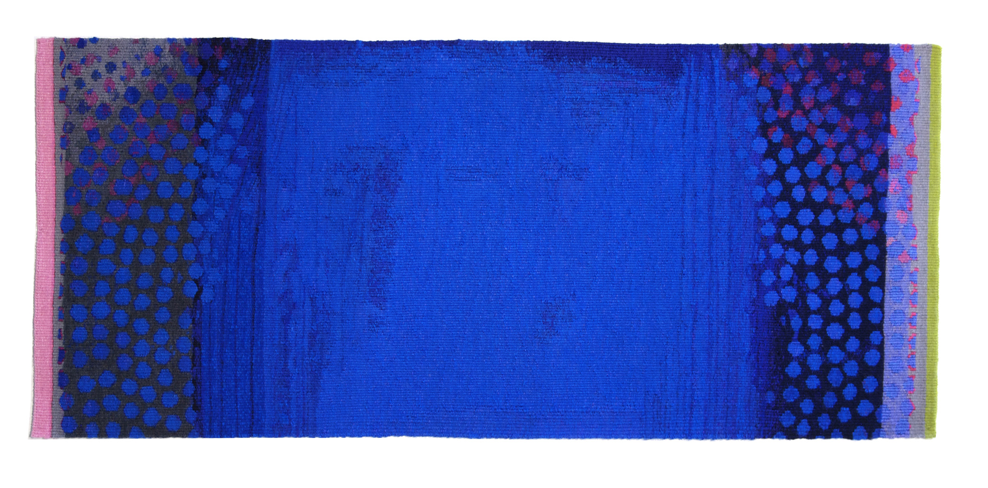
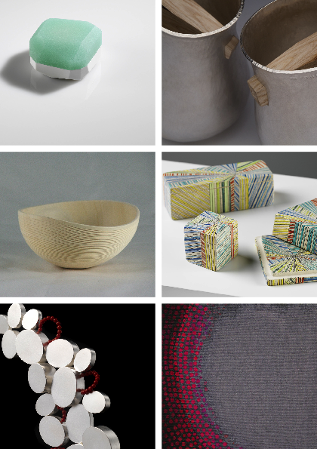
: FURTHER SHOWINGS OF WORK
2012
Made in Scotland
The Fleming Collection
12 Berkeley St, London
1 of 38 exhibitors
Work exhibited: ‘Radiance’, Lime Glow’,
‘Cobalt Haze, ‘Curve
Exhibition publicity

Slide 13
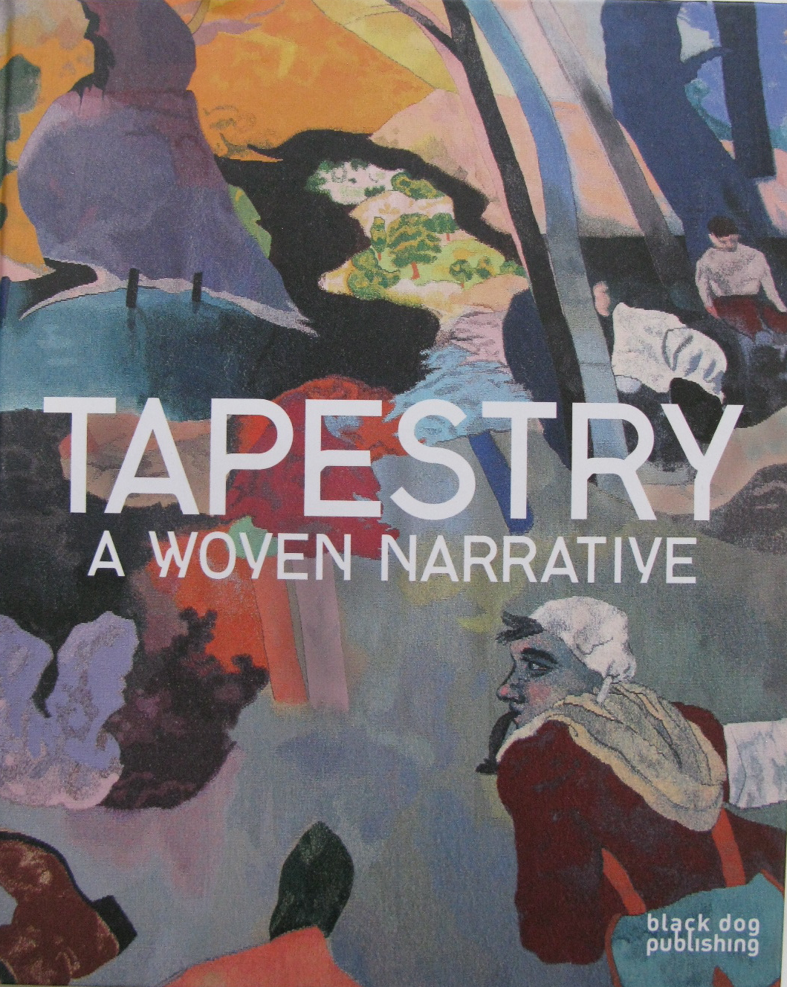
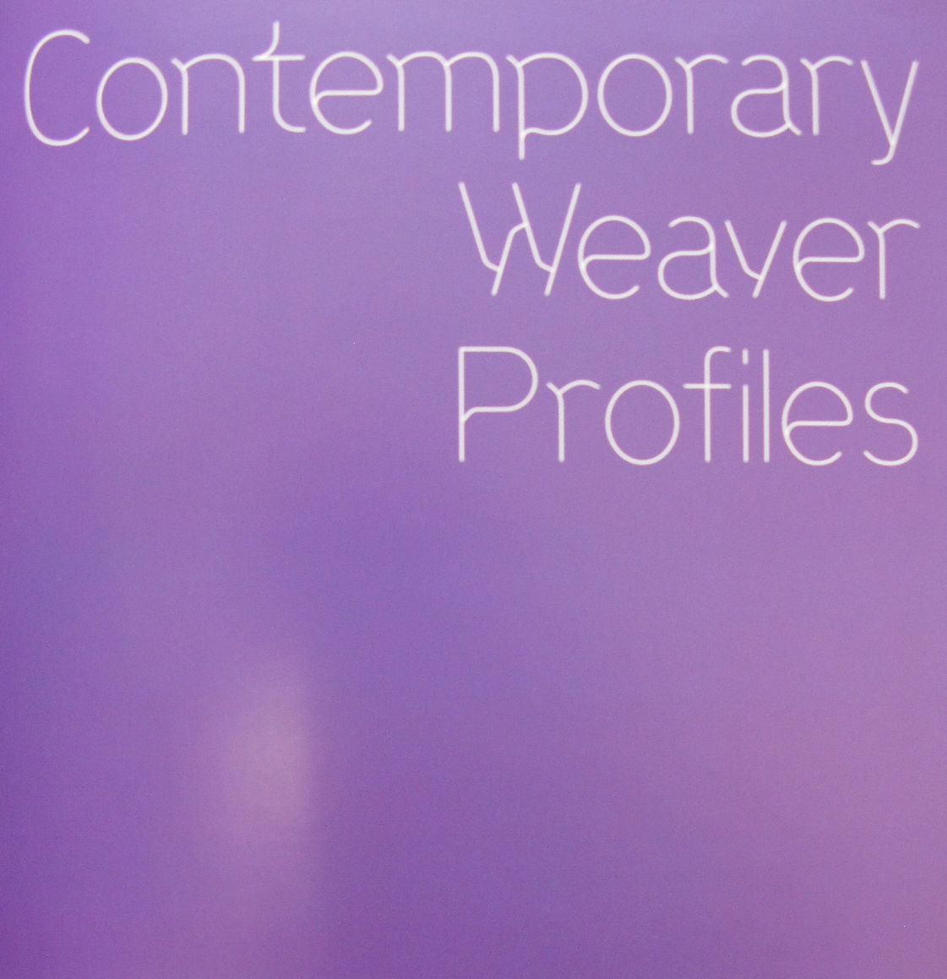
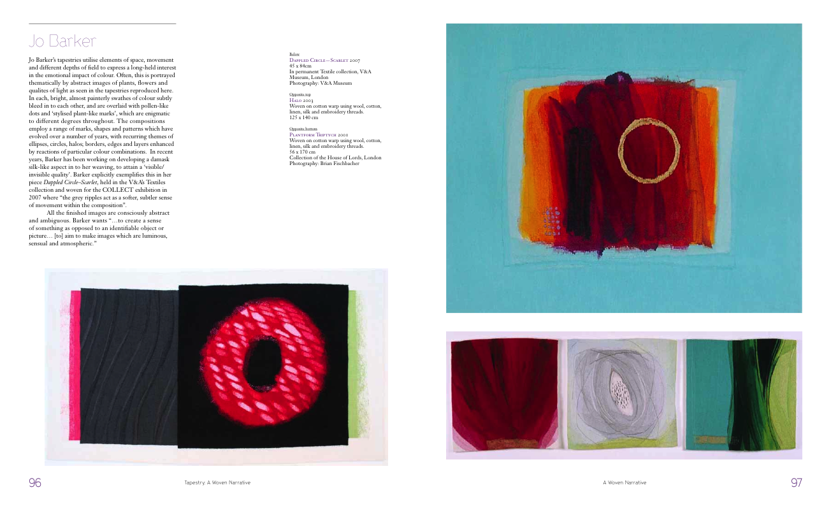
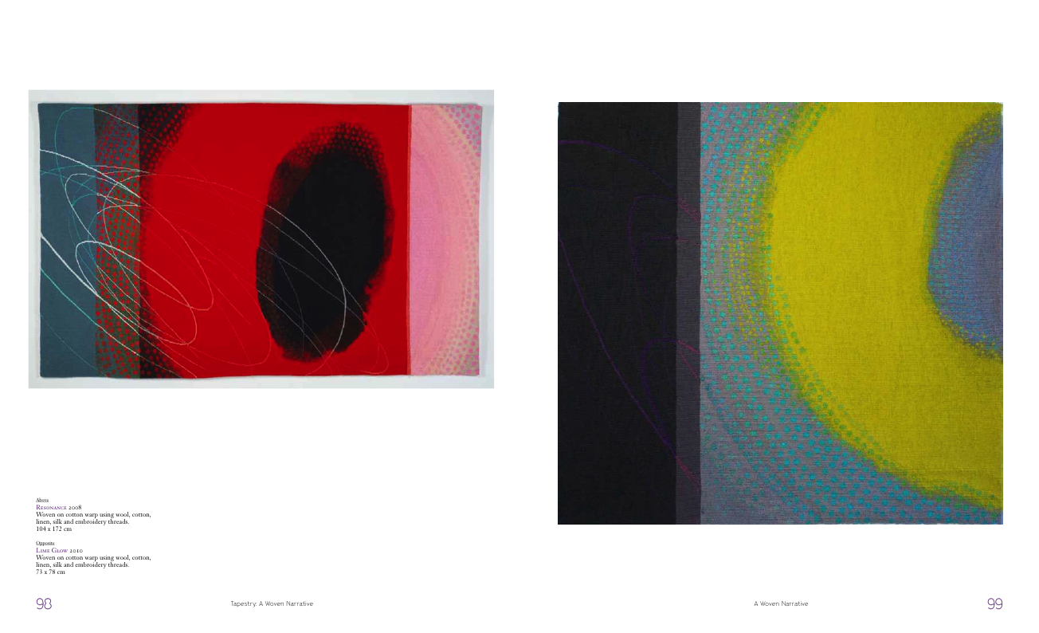
: BOOK SECTION
2011
Tapestry: A woven narrative
Authors: Timothy Wilcox, Caron Penney & Fiona Mathison
Black Dog Publishing
ISBN 978-1-907317-24-8
This book is a review of contemporary tapestry design, discussing the progression from early designs to tapestry production today. The book looks in detail at the current tapestry scene, in which weavers and artists across the globe have begun appropriating the medium to present their work and ideas in a previously unexplored fashion, creating a fascinating juxtaposition between the socio-cultural documentation of many historical works and the more abstract, contemporary and personal themes often dealt with in tapestries today.
Book : Tapestry – A Woven Narrative.
Cover (above) & pages featuring work (right)

Slide 14
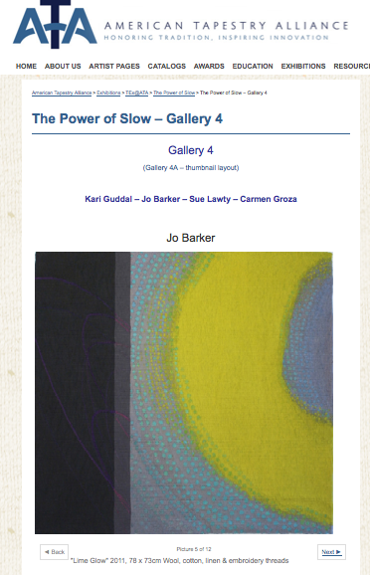
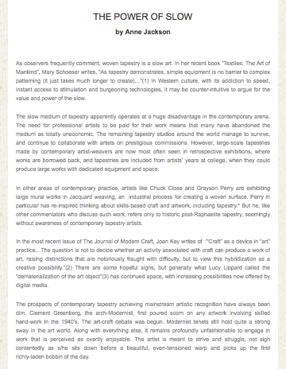
: ONLINE EXHIBITION & ESSAY
2012
The Power of Slow
Author: Anne Jackson
Venue/site: The American Tapestry Alliance
http://americantapestryalliance.org/exhibitions/tex_ata/the-power-of-slow/
15 co-exhibitors including Sue Lawty, Sara Brennan
An overview of contemporary approaches to tapestry weaving

Slide 15
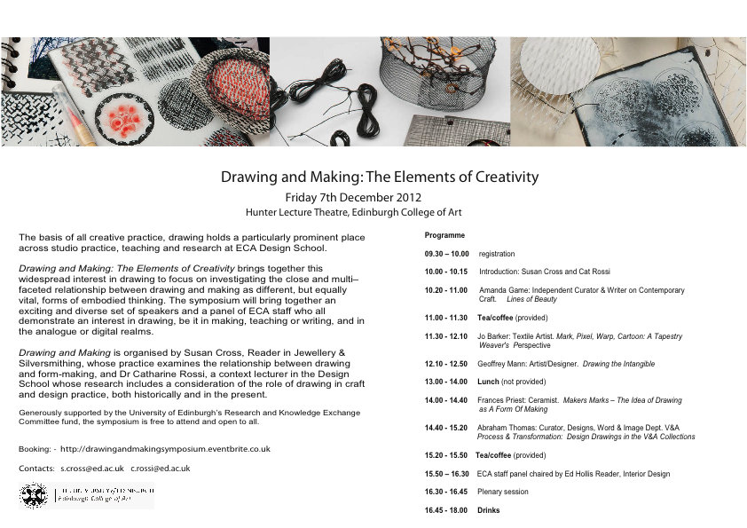
: SYMPOSIUM PRESENTATION
Invited to speak at symposium ‘Drawing and Making:
The Elements of Creativity’, Edinburgh College of Art
2012.
Speakers included ceramic and glass artists, curators
of world class exhibitions and museums eg V&A Museum.
Presentation title:
‘Mark, Pixel, Weft, Cartoon: A tapestry weaver’s perspective’.
Presentation divided into three main sections:
What I do
Why I do it
How I do it
with concluding section:
What I’m doing now
Drawing and making are key elements of my work.
Drawing with traditional methods and materials;
drawing with the camera and using the computer as a digital sketchbook. The making process translates these elements through, in effect, drawing and painting with yarns.
Edited documentary films recording speakers
presentations have been made available on the Edinburgh University website.
Symposium programme

Slide 16
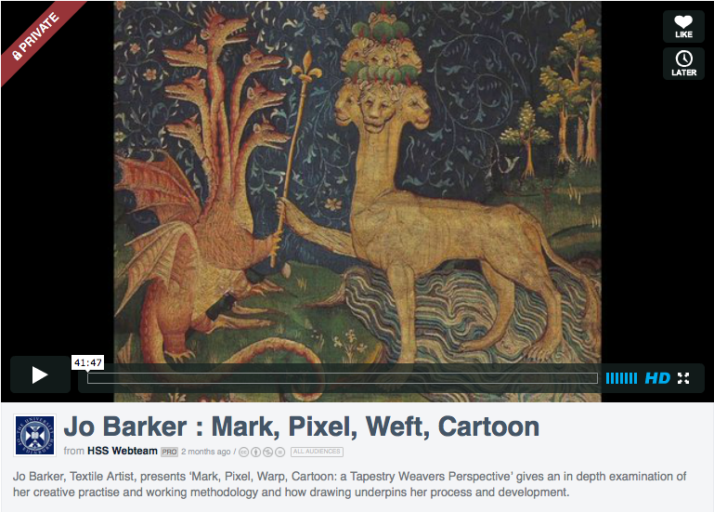
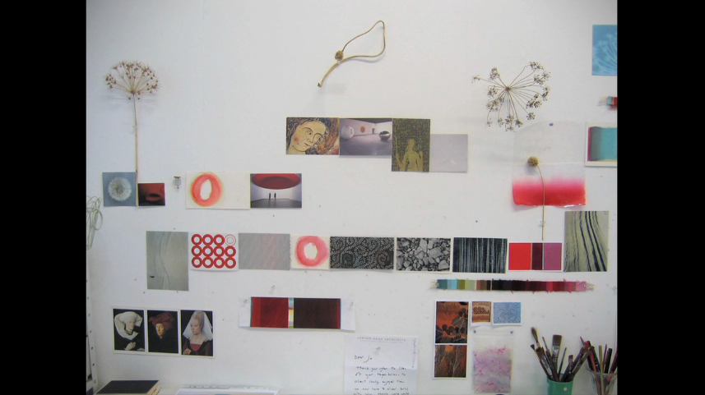



http://vimeo.com/72265525

