Slide 1
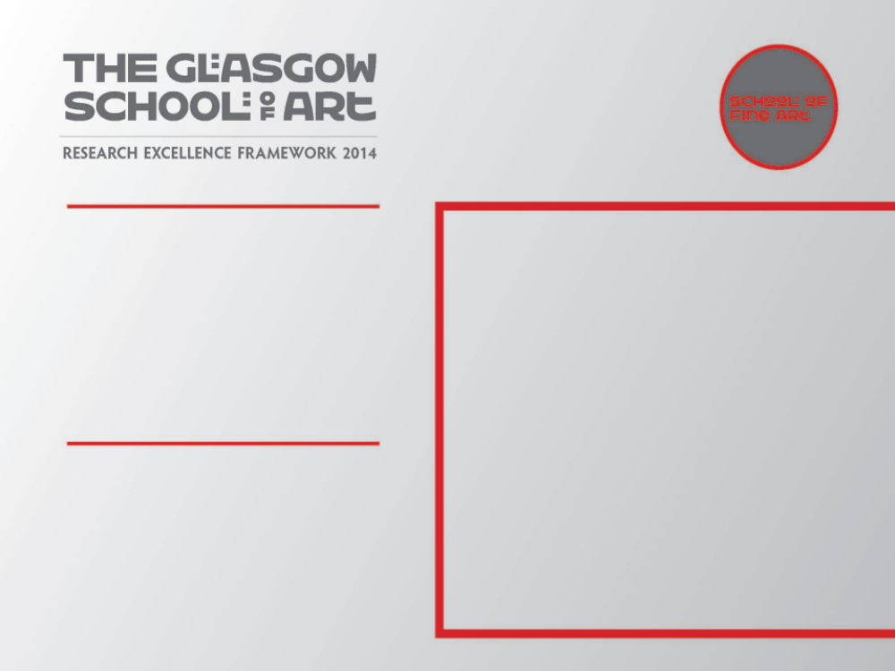
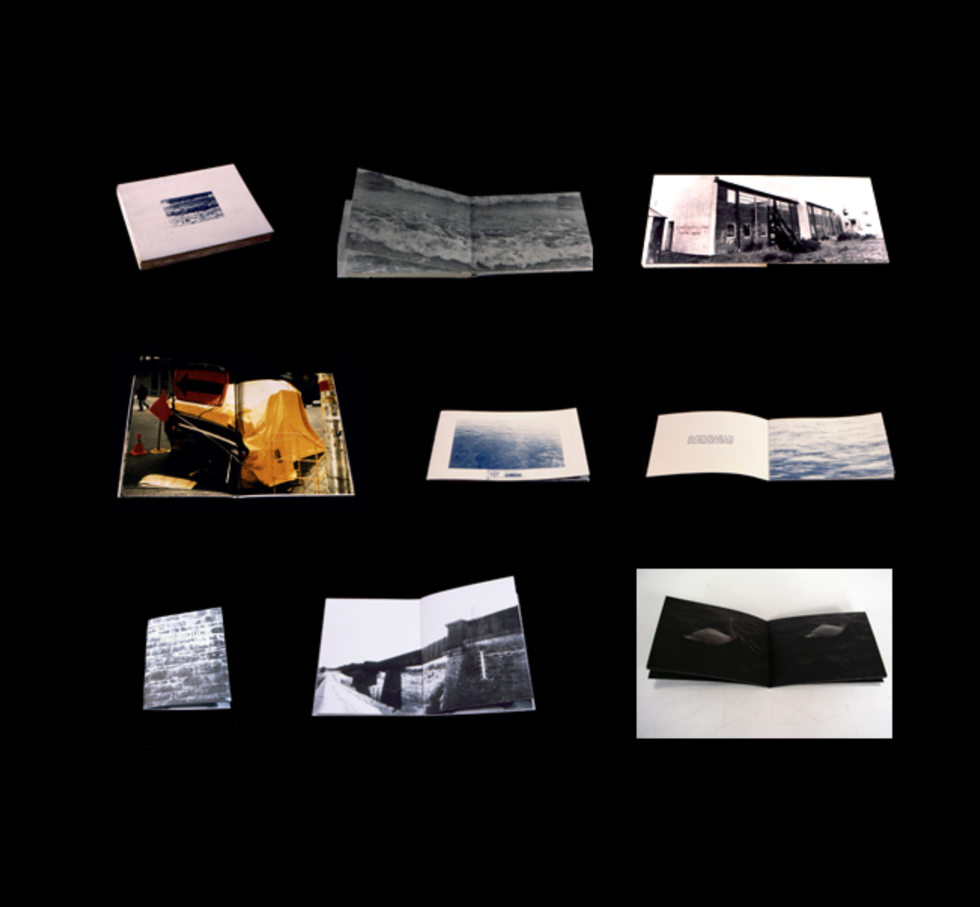
Life, the Universe and Everything +
A Sense of Place in Artist Books
Two select group exhibitions of Artist Books, one as part of the IMPACT 7 multi-disciplinary Printmaking Conference at Monash University, Melbourne, Australia, 2011 and the other as part of the Mapping Spectral Traces conference at University of Minnesota, USA, 2012.
Submitted by Mick McGraw
Output No. 1
Image one. Examples of artist books made by Mick McGraw, 1992 onwards

Slide 2
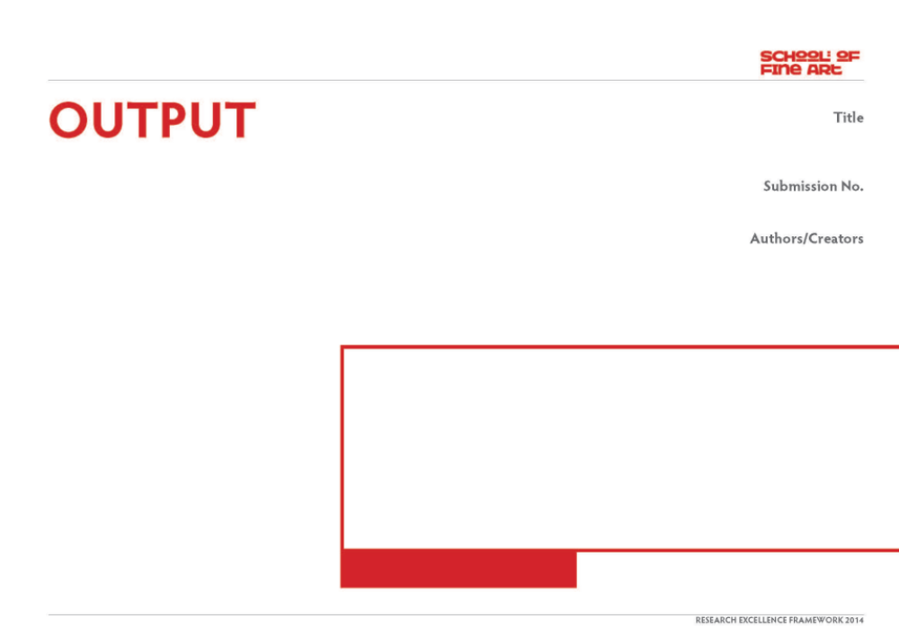
Life, the Universe and Everything: Artists books which question our relationship with nature and the way we live and also A Sense of Place in Artist Books
This output is a combination of two international exhibitions which accompanied two conferences, the first at IMPACT 7, multi-disciplinary printmaking conference at Monash University, Melbourne in 2011 (http://impact7.org.au/exhibitions/life.html) and the second at the Mapping Spectral Traces conference at the University of Minnesota, USA in 2012. The output for both exhibitions is the artist book Serpentina and examines my ongoing research with the production of artist bookwork's as part of a wider art practice which utilises printmaking, photography, sculpture and installation.
I will reference the artist book-work Serpentina which was included in both of the exhibitions in Australia and in the USA but will also examine the ideas and research methodologies which informed and shaped the final work exhibited. I will include examples of other artist books which I have made by means of tracking the history and evolution of the making of my artist books and also the influence of a larger culture of artist book-works made through commercial or mass market means which emerged in the 1960’s and laid the foundations for the inclusion of the book as art form.
No. 1
Mick McGraw
Image one Three Fifths Fluid, Mick McGraw artist book, collection of Tate Gallery

Slide 3

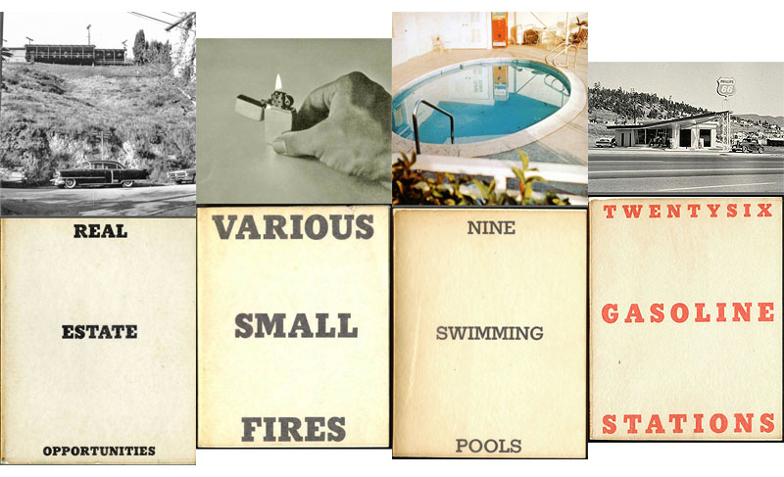
The exhibition at IMPACT 7 included works by seminal international figures working across this medium- Sarah Bodman (UK), Kurt Johannessen (Norway), Bill Burns (Canada), Ann Tyler (USA), Julie Johnstone (UK), Éric Watier (France), Sarah Bodman (UK), Finlay Taylor (UK), Radoslaw Nowakowski (Poland), Colin Sackett (UK), Tracey Bush (UK), Imi Maufe (Norway), Susan Johanknecht (UK), Angie Waller (USA), Sarah Jacobs (UK), Mick McGraw (UK)
The exhibition consisted of 28 artists’ books – placed on a shelf - which ask the viewers some questions about how we perceive, treat and respond to nature and our wider environment.
Image two. Artist books by Ed Ruscha, inspiration and background research

Slide 4
Sense of Place in Artist Books October 12-December 12, 2012 Architecture & Landscape Architecture Library University of Minnesota
Sense of Place in Artist Books is an exploration of individual art practices through an international, wide- ranging selection of artist books, and represented in a broad spectrum of ways in this collection. Not easily explained in simple context. There are as many ways of describing these books as the sky holds stars –as many thoughts about how we define artist books within the world of handmade books. Perhaps the best way to enlighten the future of artist books is to embrace their limitless and varied possibilities. As a place of identification artist books can be specific representations in personal times, or places to individually identify with, or we can be in another’s place. In very good books we can live in worlds created by someone we think understands us without having to explain ourselves, and we take similar breaths in places others have been. Books can be a place to advocate or promote justice. Policy rights may be explained in clear new reasonable ways. Books can give insights into others, or can be places to heal trauma, or compose our journey. More frequently in the field of artist books are inclusions of conceptual books, many of which stretch the definition of what makes a book. We can find ourselves amazed with conceptual structures. What’s left when coverings and containers are peeled away but to reveal a core collection of words or utterances? We need to learn to explore more than scrutinize whether or not the work fits into limitations and definitions of what a book is. How are we to save, cultivate, and recognize the contributions of artist books when a new place takes over the old ways? That will not yield entirely to current and evolving communication technologies, but will their unique ways of communicating be lost in years to come? And as the edges of our understanding are pulled, a viewer is won or lost in new ideas.
Karen Kinoshita, Curator

Slide 5
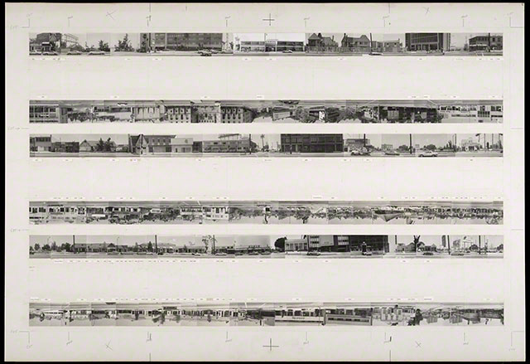
The invitation to be part of both of these exhibitions was related to the specific area of research relevant to my practice, in this case, documentary land use/intervention related to socio-political/historical influence related to contested land through civil warfare. This particular work has its earliest influences in an area of documentary artist bookwork's, notably Ed Ruscha's All the buildings on the Sunset Strip and Twenty Six Gasoline Stations, produced in Los Angeles in the 1960’s.
“Inspired by the unassuming books that he found on street stalls during a trip to Europe, in 1962 Ruscha published his first artist book, Twenty Six Gasoline Stations under his own imprint, National Excelsior Press. A slim, cheaply produced volume, then priced at $3.50, Twenty Six Gasoline Stations did exactly what its title suggests, reproducing twenty-six photographs of gasoline stations next to captions indicating their brand and location. All of the stations were on Route 66, the road mythologized by the eponymous TV series and in John Steinbeck’s The Grapes of Wrath. Ruscha’s book travelled more or less west to east, from the first service station in Los Angeles, where he moved as a young man, back to Oklahoma City, where he grew up.”
Gagosian Gallery, March 2013
Image three. Every Building on the Sunset Strip, Ed Ruscha, inspiration and background research

Slide 6
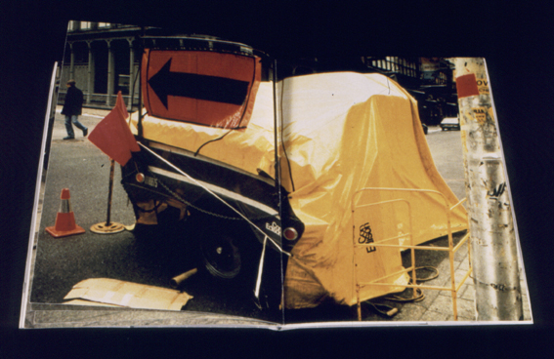
I have been involved with the making of artist books for over 20 years. The earliest influence on my work at that time was the huge lead tomes and steel bookcases of Anselm Kiefer’s The High Priestess and influenced by this, the first books I made were one off photographic originals. Although I felt these works were successful at the time, I quickly realised the potential of making a multiple or edition of my book-works and embarked on making printed editions of my books where the cost of manufacture could be recouped by selling the edition (usually with little or no profit).
I had the opportunity to study at Masters level at SUNY Purchase in New York under Clifton Meador and Phil Zimmerman, two internationally renowned artist book practitioners and from then on my practice through books widened. Although hand-made, I developed a process where the books could be made efficiently, allowing them to be sold cheaply and the ideas disseminated to a greater audience than had they been costly or difficult to acquire.
Image four. Dig We Must, artist book by Mick McGraw, made at SUNY Purchase New York 1993.

Slide 7
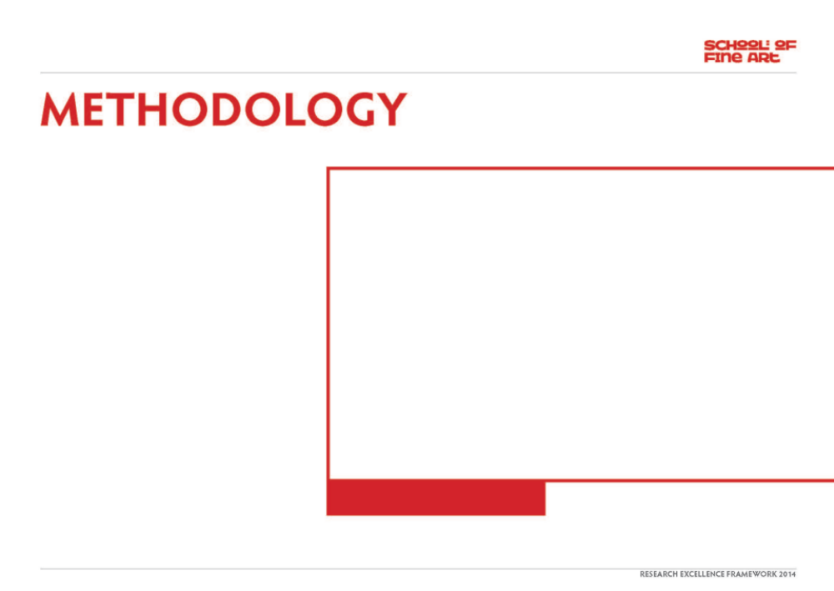
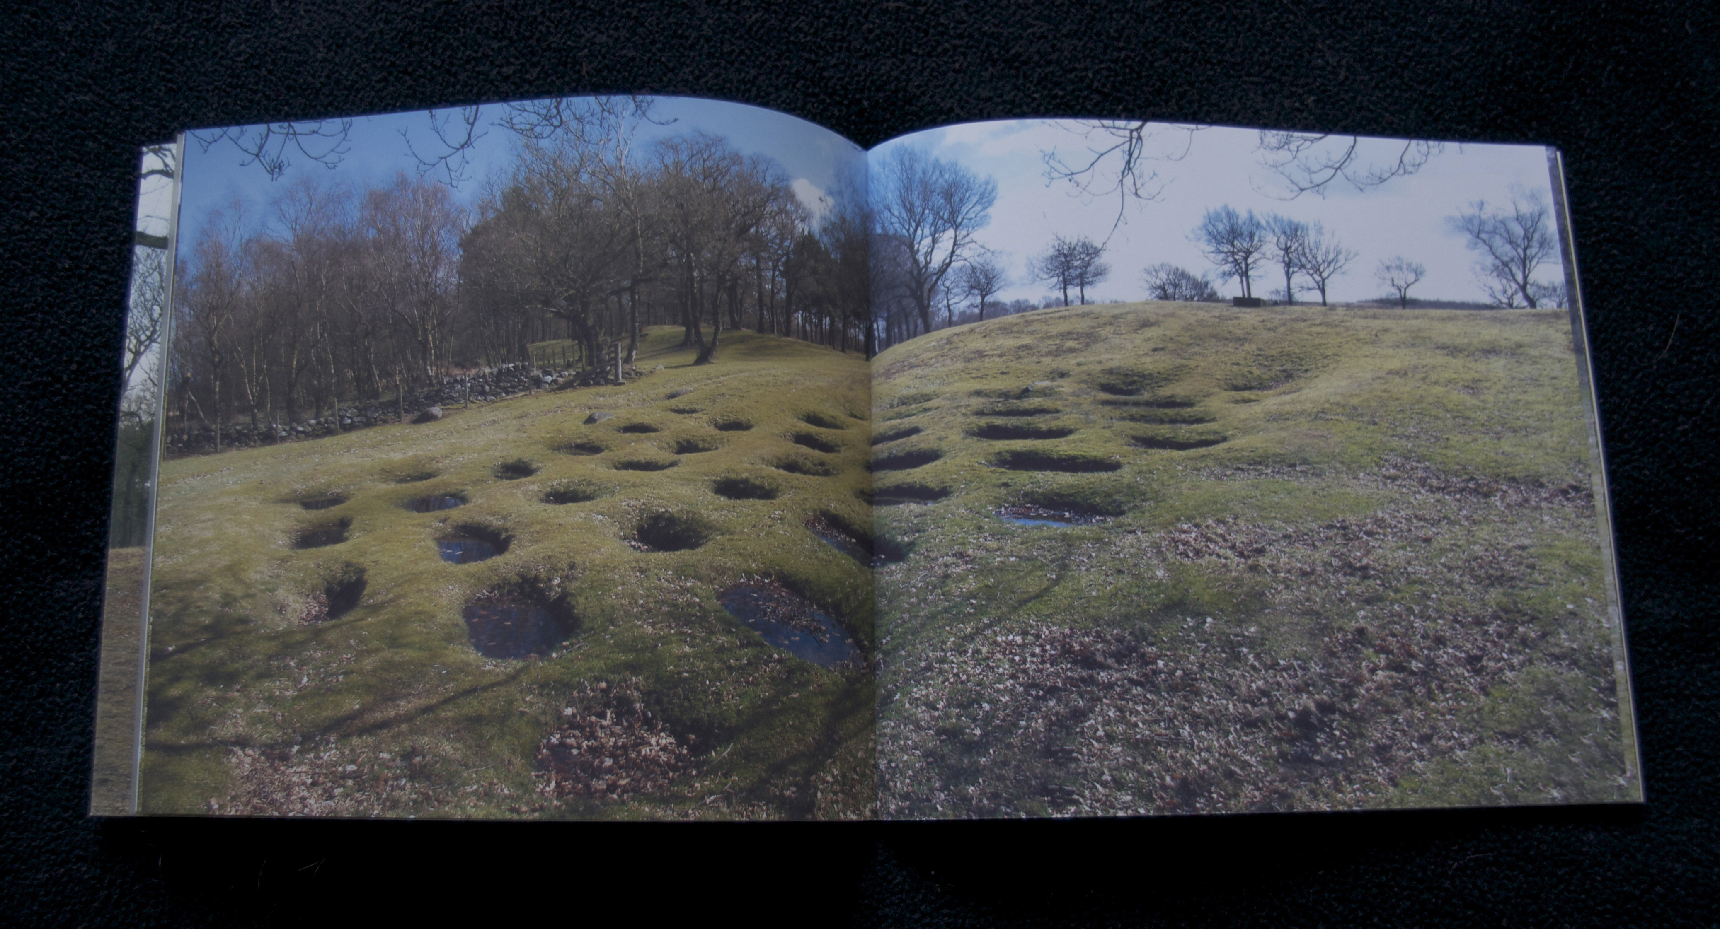
The choice of the artist book in the execution of these works is hugely important. The narrative content of some of the works I conceive make them difficult to represent as a singular work. Although I mainly work over a series or body of works on particular themes, the format of the book offers a perfect vehicle for one to contemplate time and duration. Although video and animation deal with time and duration, it is controlled by the nature of the timeline, a finite start and end point. The beauty of the book is that the reader/viewer can take control of the timeline and spend as much or as little time contemplating, indulging, absorbing the content and the ideas within the work. They can control the intimacy of the piece, at whatever pace they choose. They can read it out of sync, from back to front or purely as singular pieces.
Image five. Lilia, artist book by Mick McGraw, inner pages.

Slide 8
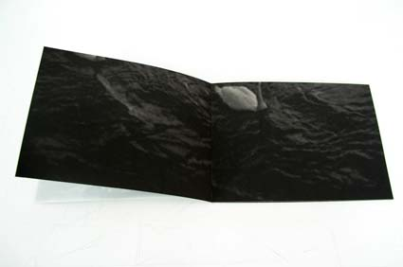
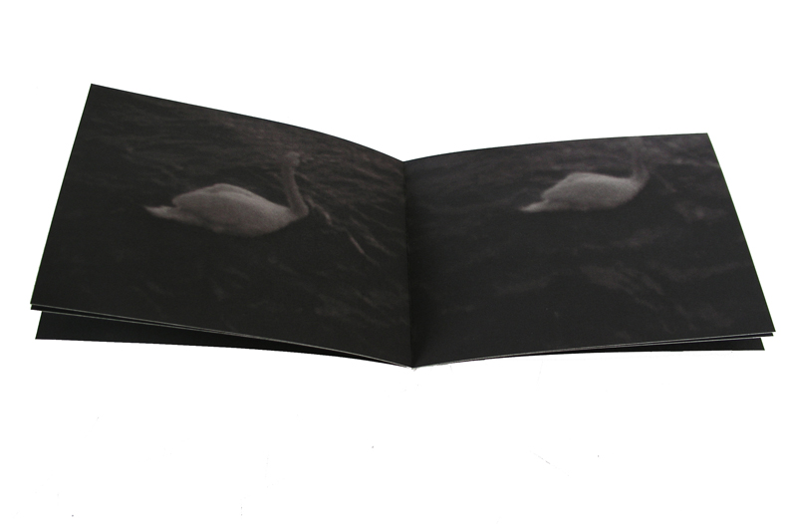
Image six. Three Fifths Fluid, 2001, Mick McGraw artist book, collection of Tate Gallery

Slide 9
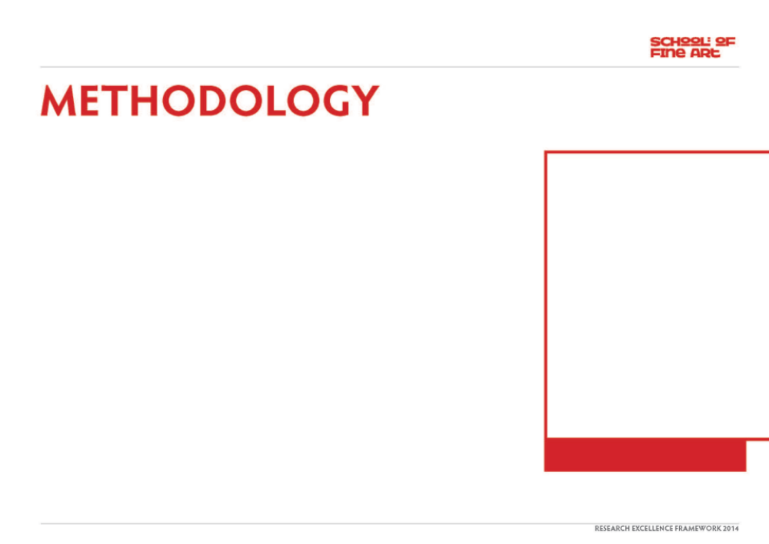
The methodology behind Serpentina came about through my continued investigation into the relationship we have with our landscapes (from industrial intervention, agriculture, leisure and warfare). I made a research trip to Dubrovnik in Croatia to document the damage and rebuilding of the medieval city walls which had been bombarded by shells in the Bosnian/Croatian/Serbian war in the early 1990’s. The investigation in to the work in the artist book came merely by chance as it was not intended as the main focus of my research whilst there but upon speaking to locals about the damage inflicted on the city, it led me to explore the remnants of the wreckage on the mountains situated high above the city (and from whence the mortar shells were fired from the mountains in Bosnia).
Serpentina is the name the locals gave to the track which snaked its way from the outskirts of the city up the mountainside to the plateau high above. I documented this track all the way to the summit. It transpired that the track is used on a pilgrimage by the mothers of those killed in the bloody war.
The track consists of 12 hairpin bends, with a wooden crucifix positioned at each turn of the track, depicting the Catholic procession of the Stations of the Cross. On the summit plateau stands a huge marble cross and altar from where a memorial service is conducted. The hillside is scattered with partially burned wooden crosses, offered in ceremony to the memory of the dead.
The format of the book is designed to fit in the hand, it has a level of intimacy that I felt was necessary for the content of the subject matter. The size is of the utmost importance as it needs to be easy to look at. The book is printed in a laser printer and the images form full page bleeds so that when opened, the image bleeds off the edge of each page. When I was taking the photographs, I was very conscious that the hairpin bends needed to be almost perfectly symmetrical on each page. The landscape and topography dictated this when I was there, the viewfinder of the camera fitted identically with the format I visualised for the eventual book. This meant that the crucifix’s and hairpins fell in the centre of each subsequent
page, creating a very strong visual dynamic coupled with the intense colours of the landscape and sky. The intention of this work (as in a number of my other pieces) is to re-visit and re-consider elements of history that may be long forgotten with the intention of drawing parallels with the everyday and a desire to heighten the awareness of our lands history.

Slide 10
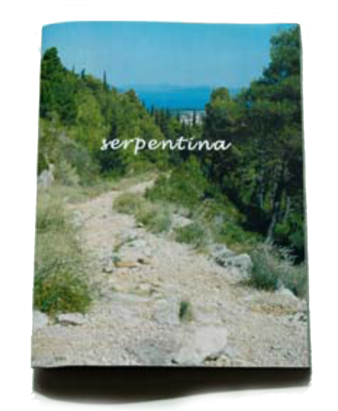
Image seven. Serpentina, artist book by Mick McGraw, exhibited at IMPACT 7, Melbourne, Australia, and Mapping Spectral Traces conference, University of Minnesota, USA.

Slide 11
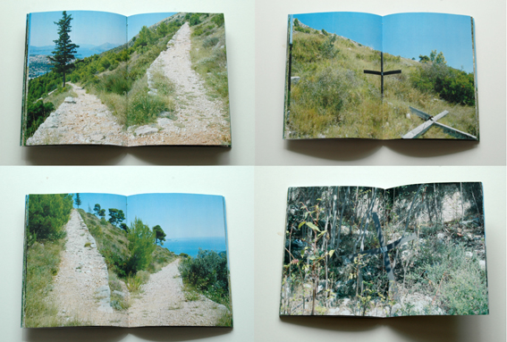
Image eight. Serpentina, artist book by Mick McGraw, inner pages.

Slide 12
The research methods behind this work took the form of on-the-ground researching and investigation. Had it not been for speaking to local people (many of whom were reticent to engage in conversation about the war) I would never have been able to piece together the facts behind the site.
Much of my work involves this notion of site specificity and the need to be at the place to record the sites, sounds and interactions. Some recent investigations have found me research more about the history of land use, particularly in Scotland, related to the occupancy of the Romans and the effect they had upon the borders and infrastructure of the land (some of our major roads are still built on the remains of early Roman roads through the most direct routes in the countryside). As mentioned in another separate REF output, my work takes many forms but a great deal of the methodology is a constant thread throughout them all. The use of the artist book as documentary recording tool is such a constant, in both projects before Serpentina and some more recent works.
I believe the timing and positioning of an art work in history can make or break the piece. Whilst attempting to conceive an art work, one cannot fully know or predict the significance of the work. Ultimately there are many factors which will impact upon this.
I attempt to make the works with rigour in the research and the methodology but as for significance, the artist may have an idea about this, why else would they be researching in the first place? But surely the significance comes after the piece has been made and others (as well as the artist) have the opportunity to reflect upon its status, value or critical acclaim. In my case, exhibiting the work and disseminating the knowledge learned from it can go some way to demonstrate the rigour and significance in terms of research and quality of output (the art work itself).
The artist book submitted here (and included in hard copy in the box file) has been widely shown and referenced in exhibitions, conference papers and collections. I believe this book is different from other artists books by way of its timing. It is unique now in the fact that the city of Dubrovnik has worked hard to overcome its legacy from the war. The city has since been transformed to its former Yugoslav tourist mecca and the remnants fixed in time in my artworks are no longer visible on the ground. This to me highlights significance but that is something which has developed through time and factors out-with my control. The originality, rigour and significance emerge out of the artwork continuing to have relevance, perhaps a sense of timelessness, as in, the work continues to challenge even although history replaces it every day.
test book by Mick McGraw, inner pages.

Slide 13

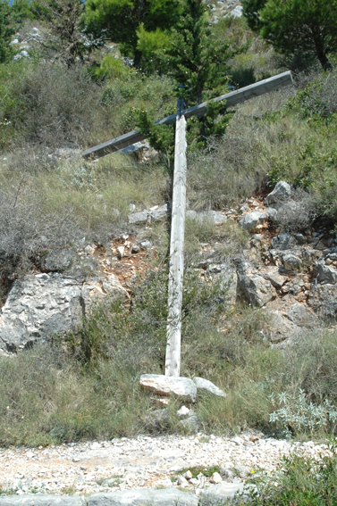
Serpentina has been exhibited in a number of national and international exhibitions. It has formed an integral part of conferences and symposia over the past 3 years.
Life, the Universe and Everything: artist books which question our relationship with nature and the way we live.
IMPACT 7 Multi-Disciplinary Printmaking Conference, Monash University, Melbourne, Australia, 2011
'Sense of Place in Artists' Books’
Architecture Library, University of Minnesota October - December 2012; coinciding with the International Conference 'Mapping Spectral Traces’ 2012
Cabin:Codex
Centrespace, Centre for Artist Books,
Duncan of Jordanstone College of Art and Design, Scotland, 2011
Image nine. Crucifix on Mount Srd, Dubrovnik.

Slide 14
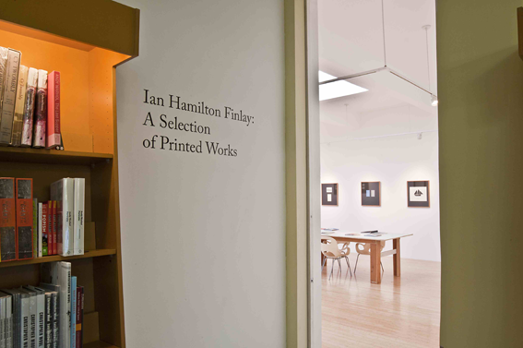
Scotland (and the rest of the UK) has an incredibly diverse and vibrant range of artists working with print and artist books, perhaps none more so than the late Ian Hamilton Finlay. Finlay’s work (artist books, prints, sculpture and poetry) have and continue to be very influential to my own practice with similarities in the quiet political investigation of land use, warfare and beauty. Finlay’s son Alec, set up the internationally renowned Centre for Artist Books at the Visual Research Centre at Duncan of Jordanstone College of Art and Design in Dundee.
Scottish artist and academic, David Faithfull has taken over the management of the Centre and believed that Serpentina was a work which he felt should be included, due to its originality and significance in the collection as it offered a unique insight into an international situation by a Scottish artist. A number of other artist books I have made have been selected for inclusion in the collections of the Tate Gallery, University of Plymouth, Centre for Fine Print in Bristol and Art Metropole in Canada.
Image ten. Ian Hamilton Finlay, A selection of Printed Works, inspiration and background research

Slide 15
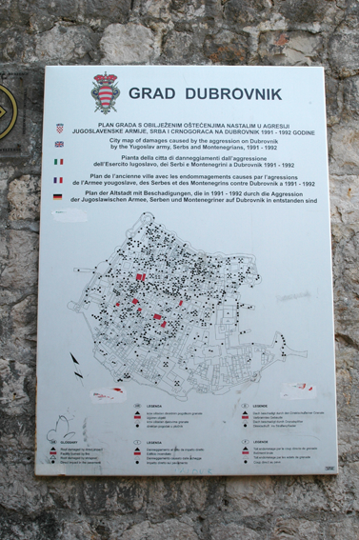
file:///Users/m.mcgraw/Desktop/REF%20portfolios/Artist%20book%20shows/Exhibitions%20%7C%20Impact7%20Conference%202011.webarchive
file:///Users/m.mcgraw/Desktop/REF%20portfolios/Artist%20book%20shows/Sense%20of%20Place%20in%20Artist%20Books.webarchive
file:///Users/m.mcgraw/Desktop/REF%20portfolios/Artist%20book%20shows/sense%20of%20place%20in%20artist%20books%20%7C%20Just%20another%20WordPress.com%20site.webarchive
file:///Users/m.mcgraw/Desktop/REF%20portfolios/Artist%20book%20shows/Dundee%20Contemporary%20Arts.webarchive
http://davidfaithfull.blogspot.co.uk/2013/04/cabin-codex-vrcdca-2011.html
file:///Users/m.mcgraw/Desktop/REF%20portfolios/Artist%20book%20shows/Urban,%20feral%20and%20in-between%20...%20artists’%20ideas%20brought%20to%20book%20%7C%20The%20Times.webarchive
Image eleven. Map of shell damage on Dubrovnik

Slide 16
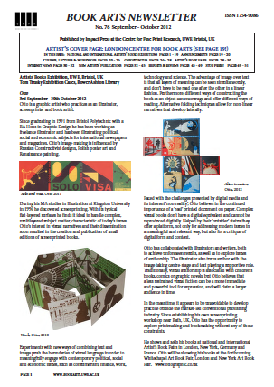
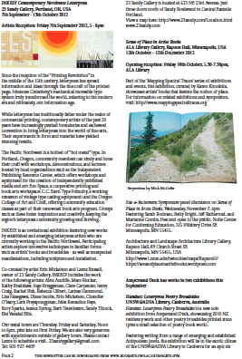

Slide 17
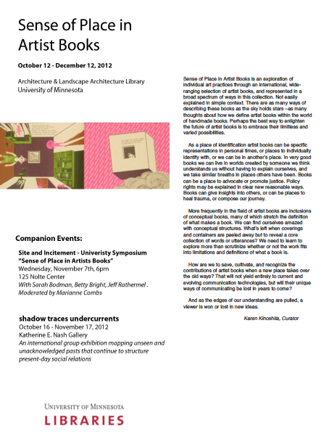
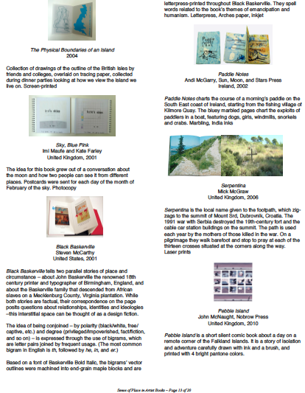

Slide 18
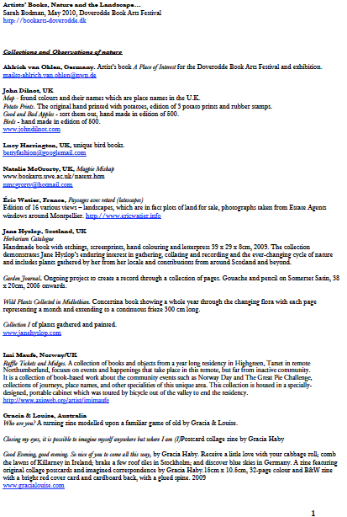
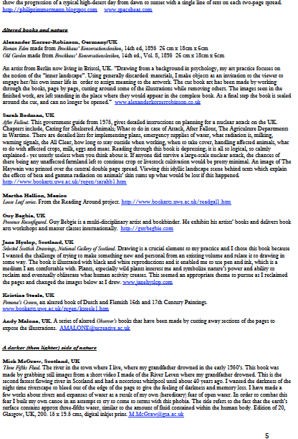

Slide 19
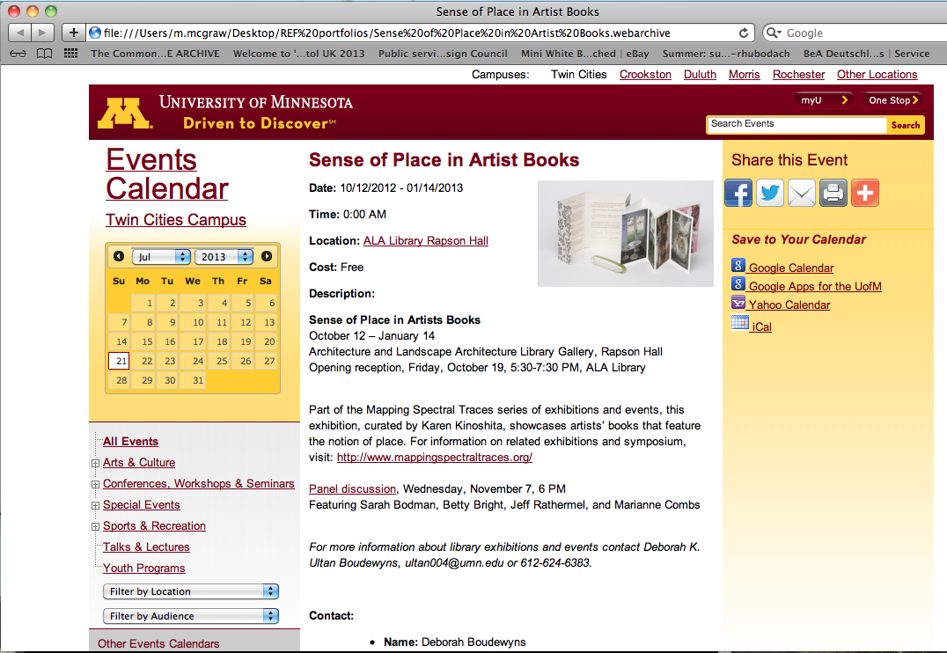

Slide 20
