Slide 1
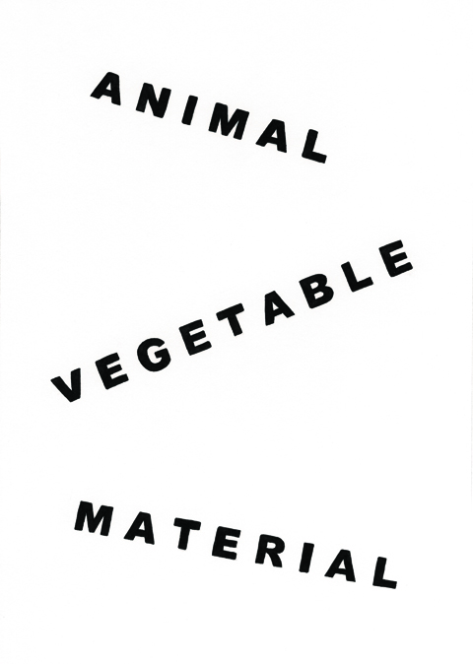
Animal Vegetable Material
David Bellingham
REF output 1

Slide 2
The following images are sample pages from the book Animal Vegetable Material.
…a few words in the place of a few others...
…not what is said but how it is said...
...words as objects in the world...
...objects as words in the world...
...making things and placing things...
...ideas leave objects standing...

Slide 3
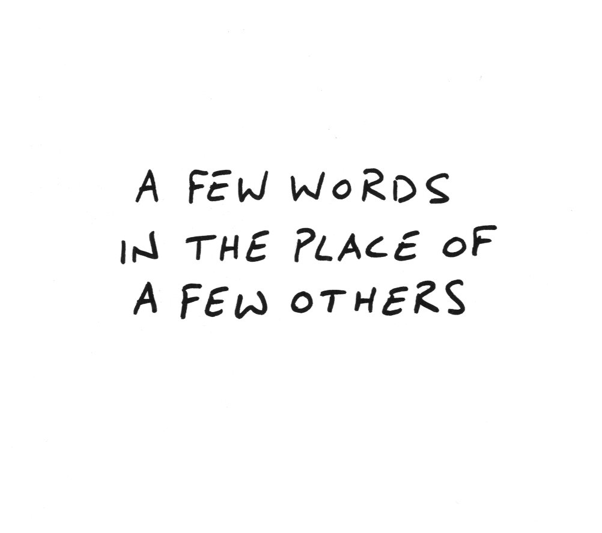
M

Slide 4
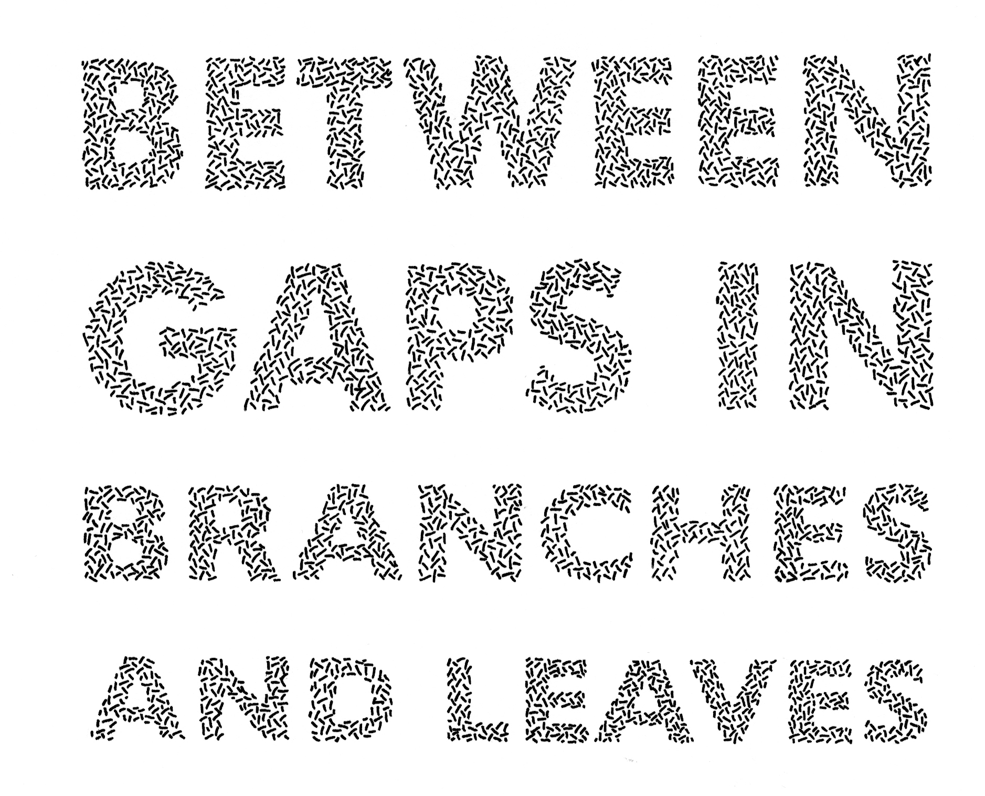

Slide 5


Slide 6
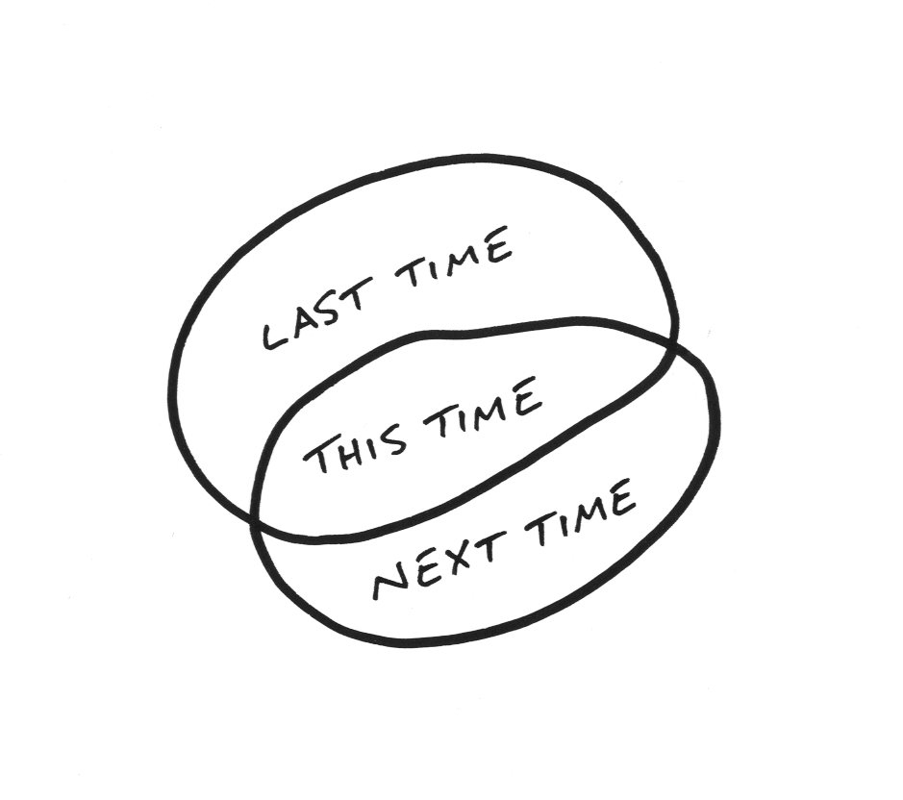

Slide 7
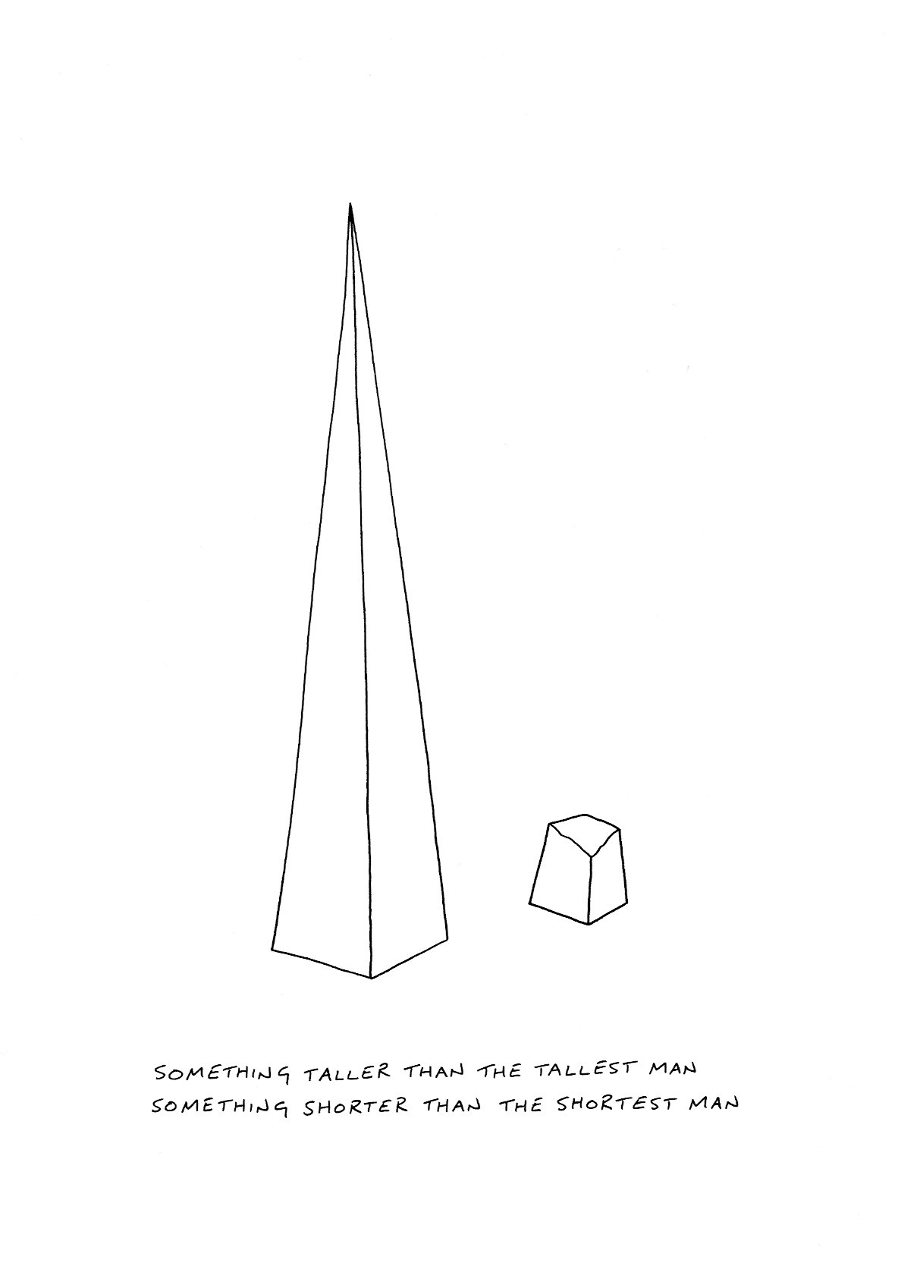

Slide 8
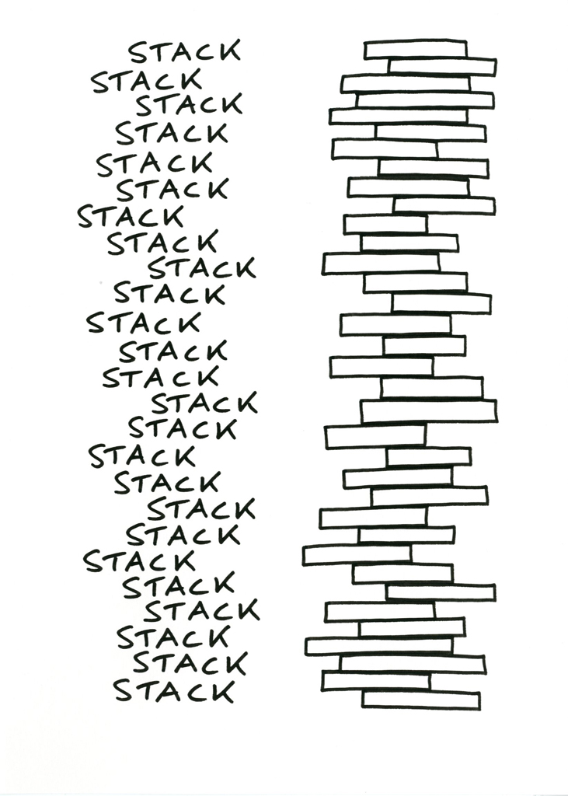

Slide 9
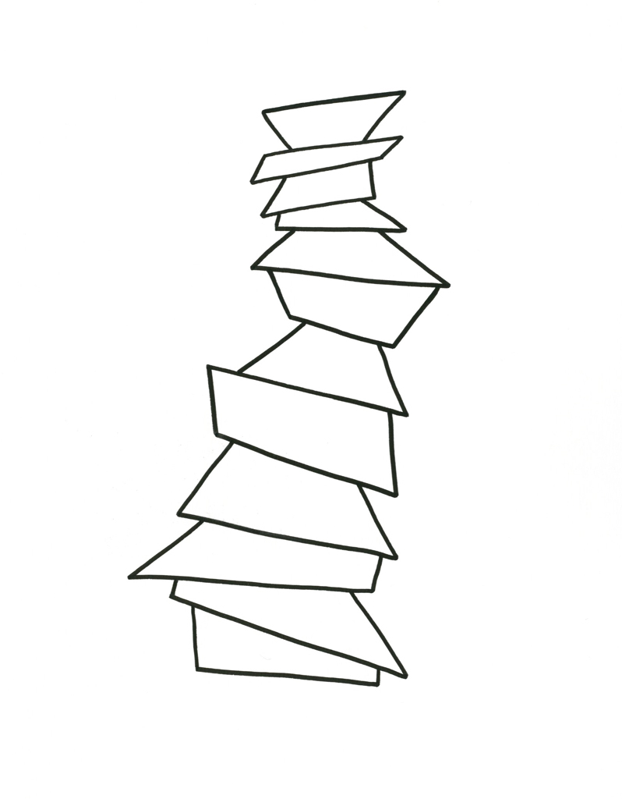

Slide 10
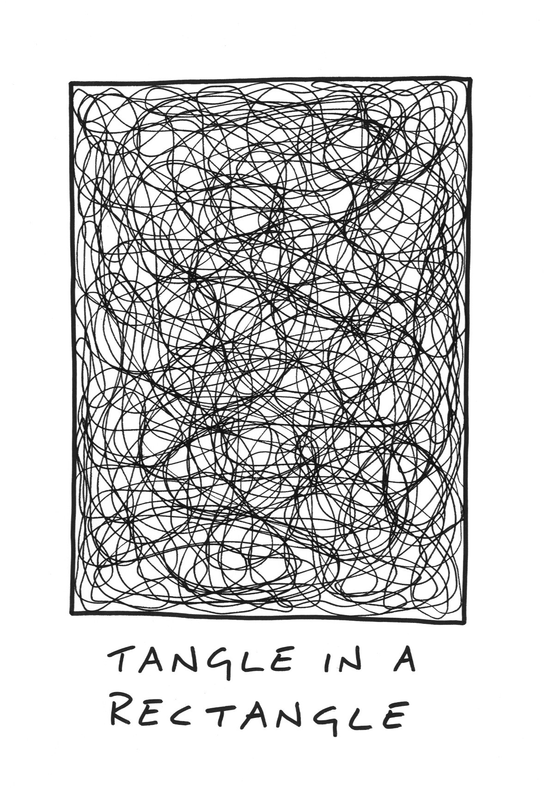

Slide 11
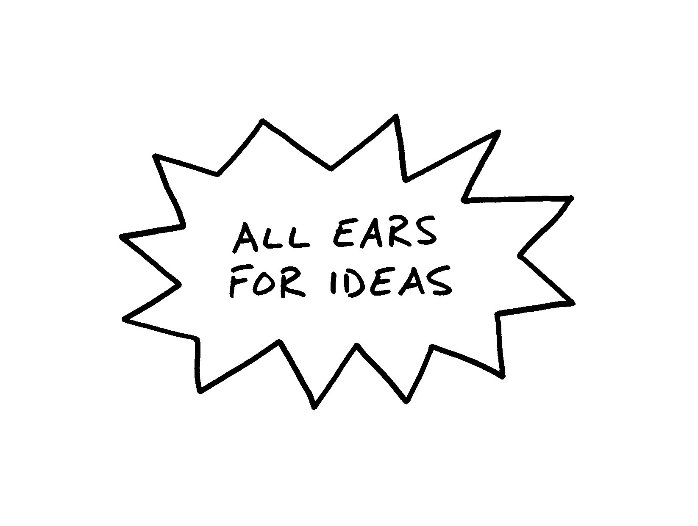

Slide 12
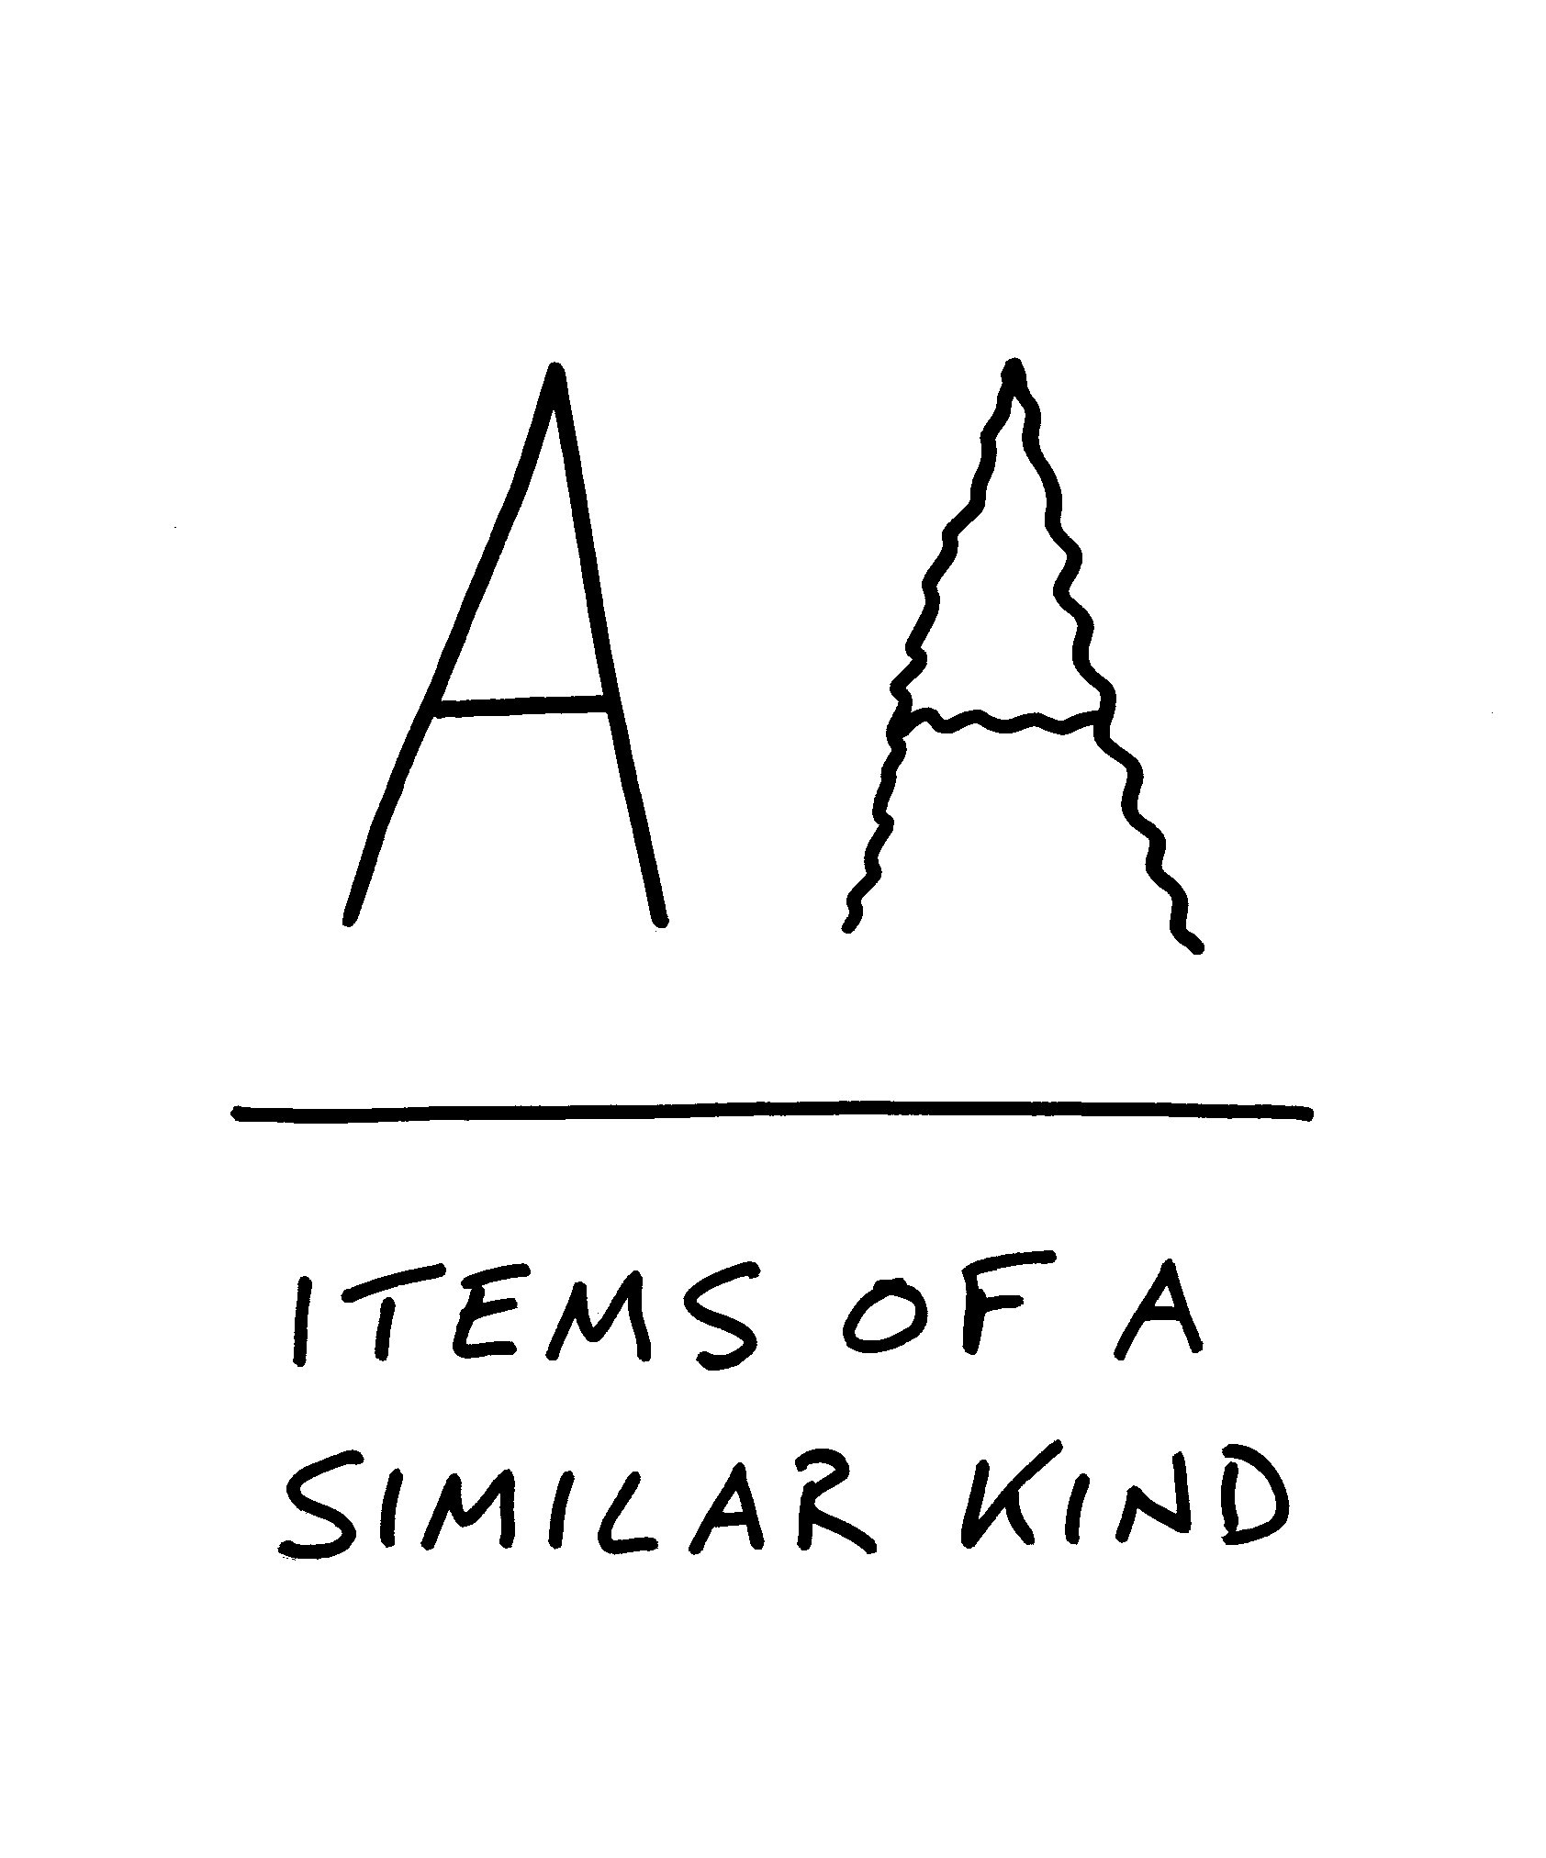

Slide 13
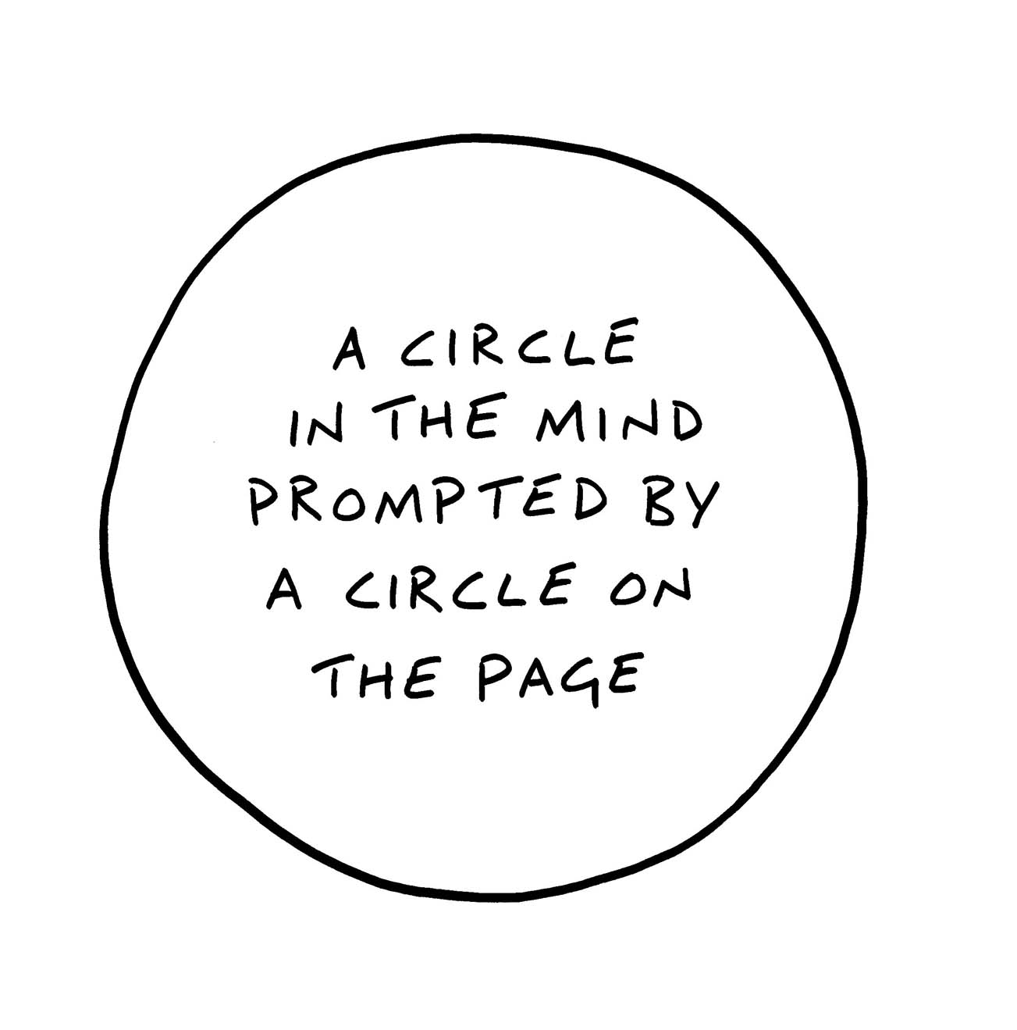

Slide 14


Slide 15
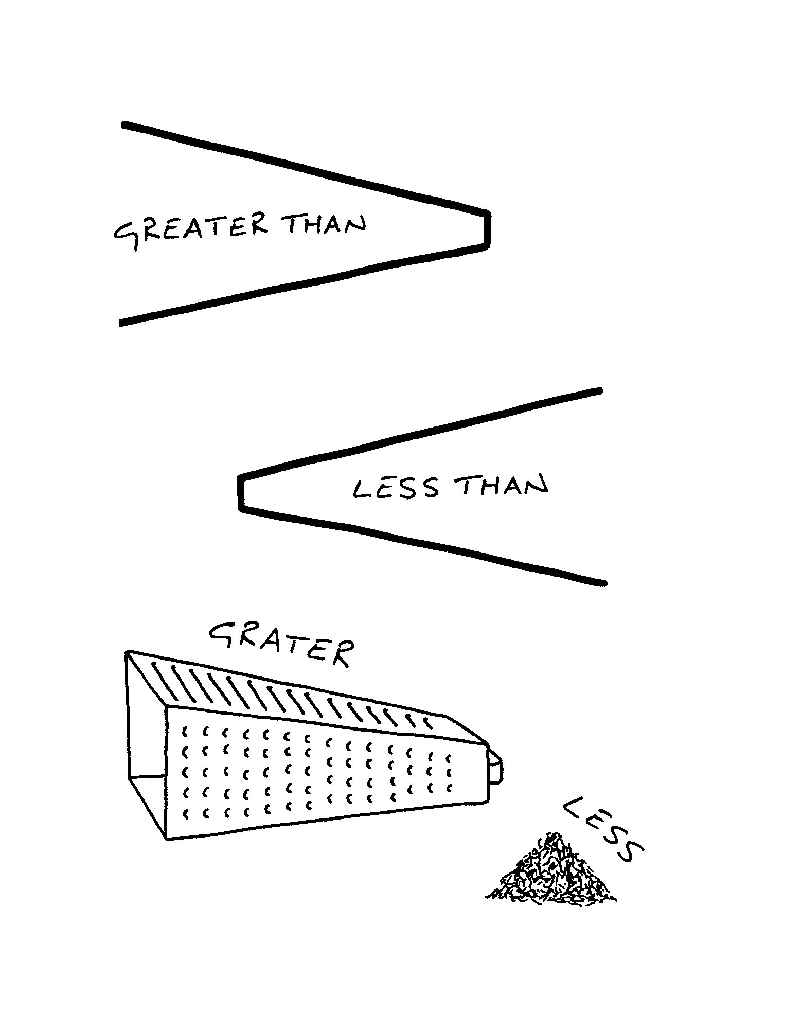

Slide 16
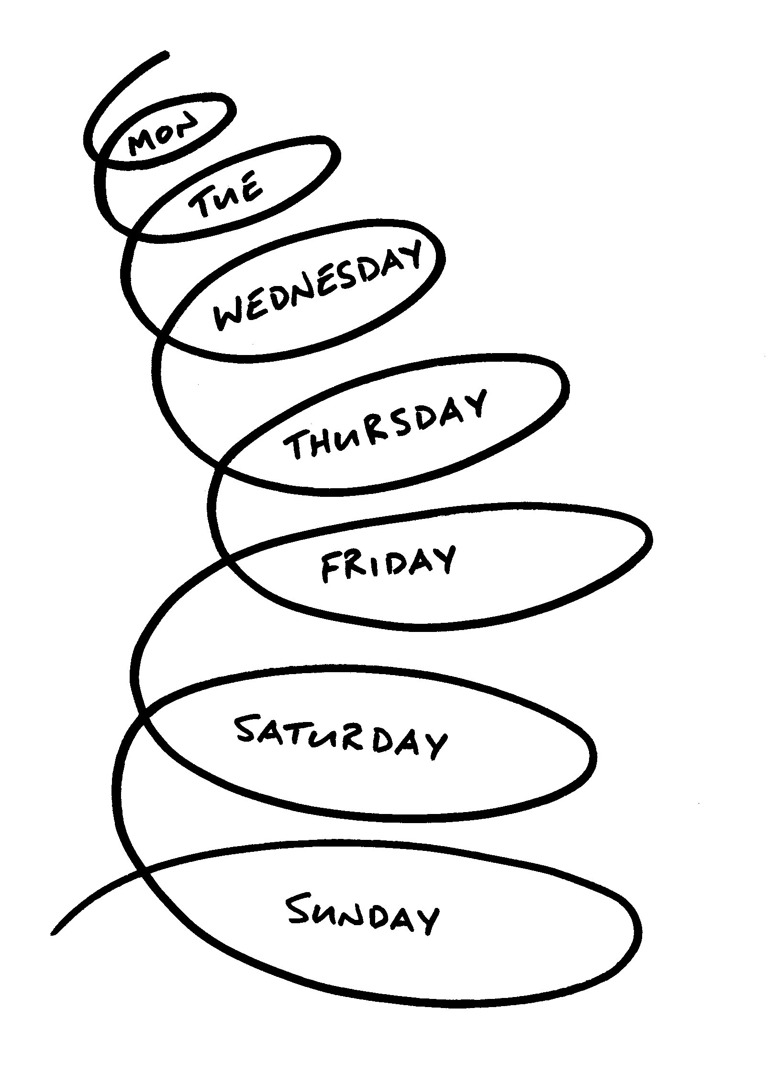

Slide 17


Slide 18


Slide 19
