Slide 1
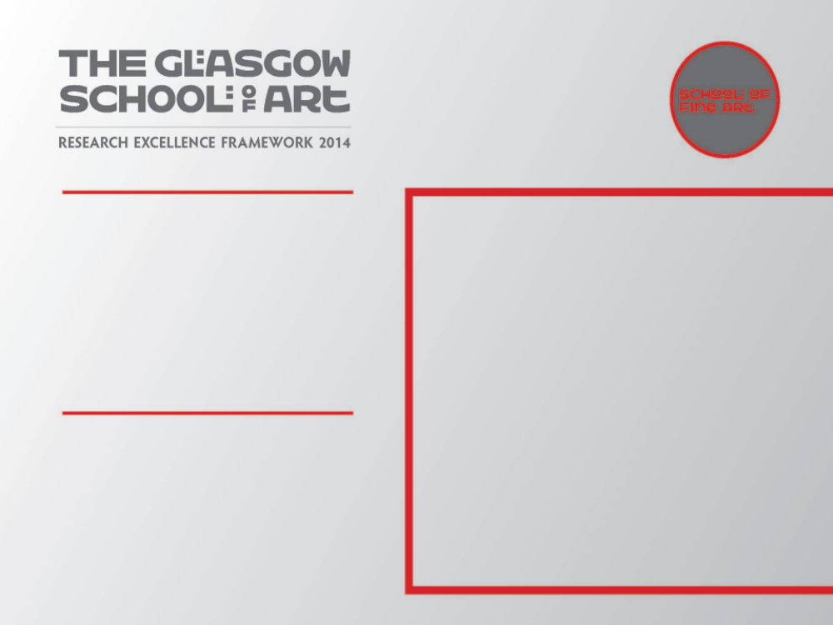
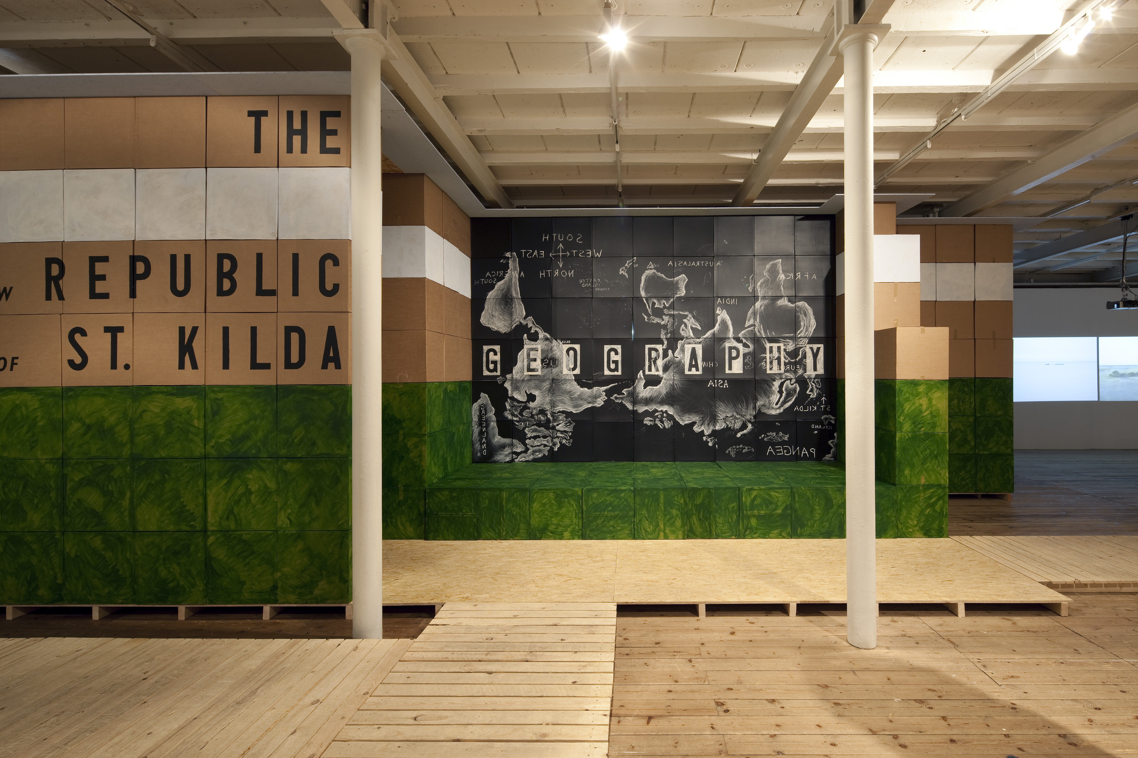
"Journey to the Edge of the World –The New Republic of St Kilda”
A large scale sculptural installation exhibited as part of a group show of 6 artists shown in Kunsthallen Brandts, Odense, Denmark; Fuglsang Kunstmuseum, Lolland, Denmark, 17/9/09 – 11/4/10, 7/5/10 - 22/8 /2010
With accompanying catalogue including commissioned essay
This project examines the story of the islands of St Kilda, 40 miles off the coast of the Outer Hebrides, inhabited for 2000 years then destroyed in 150 years of contact with the contemporary world. The project re-imagines a number of contrasting and sometimes contradictory histories, engaging the viewer in a dynamic process of re-construction, using installation films/song/drawing/text.
Submitted by Ross Sinclair
Output No. 2

Slide 2
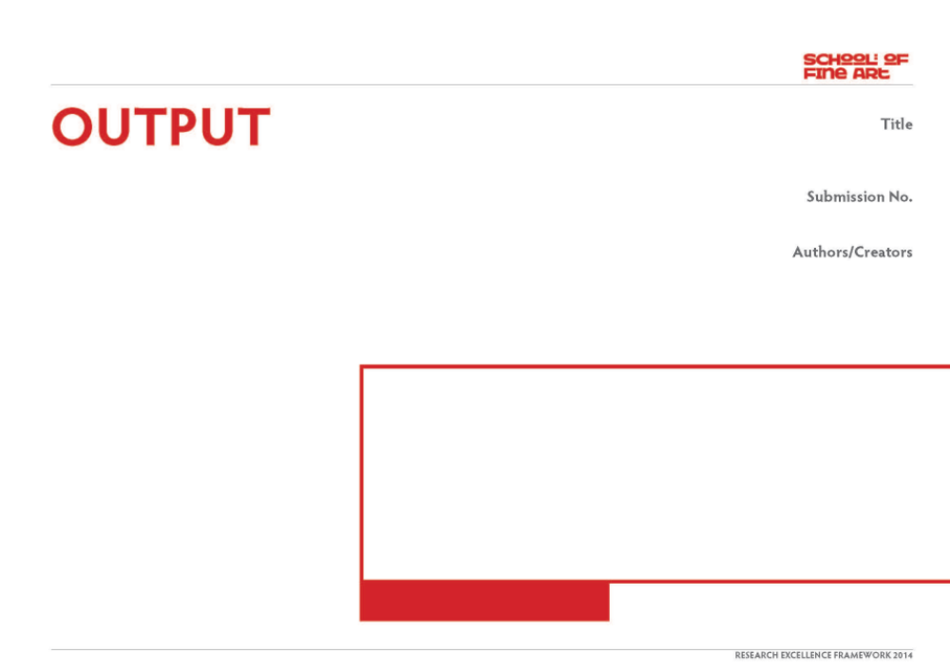
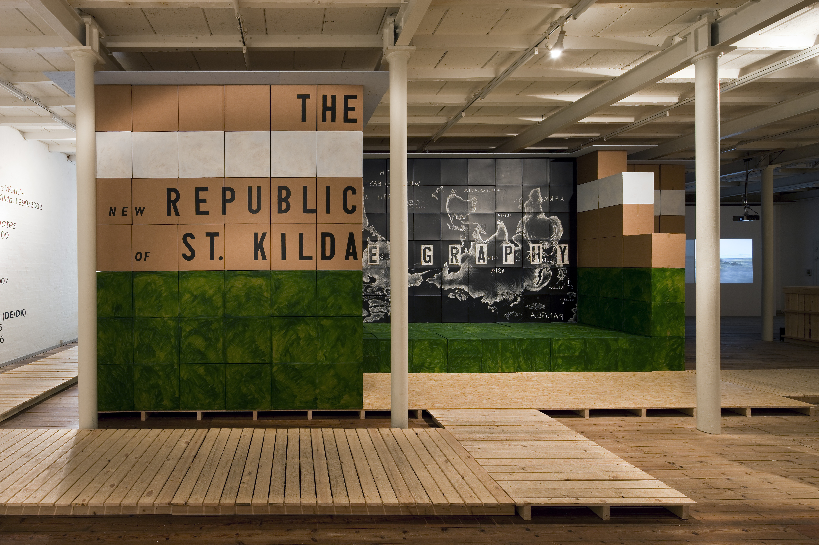
"Journey to the Edge of the world –The New Republic of St Kilda"
This was a large installation as part of a group show featuring 6 artists Amy Cutler, Bill Burns, Antti Laitinen, Andreas Shulenburg, Tim Silver and Ross Sinclair who have used islands as symbols of our ethical and moral attitudes now and in the past. The exhibition was exhibited in two museums in Denmark over the period of a year 2009/10.
My contribution was is a large scale sculptural installation(14x14m) featuring video, sound, text and drawing.
The exhibition has an accompanying book with essay by curator Lene Burkhard.
Please refer to this
(144pp ISBN : 978-87-7766-094-8 – pp13,99-115 essay by Lene Burkard Danish/English)
2
Ross Sinclair
"Journey to the Edge of the World –
The New Republic of St Kilda”

Slide 4
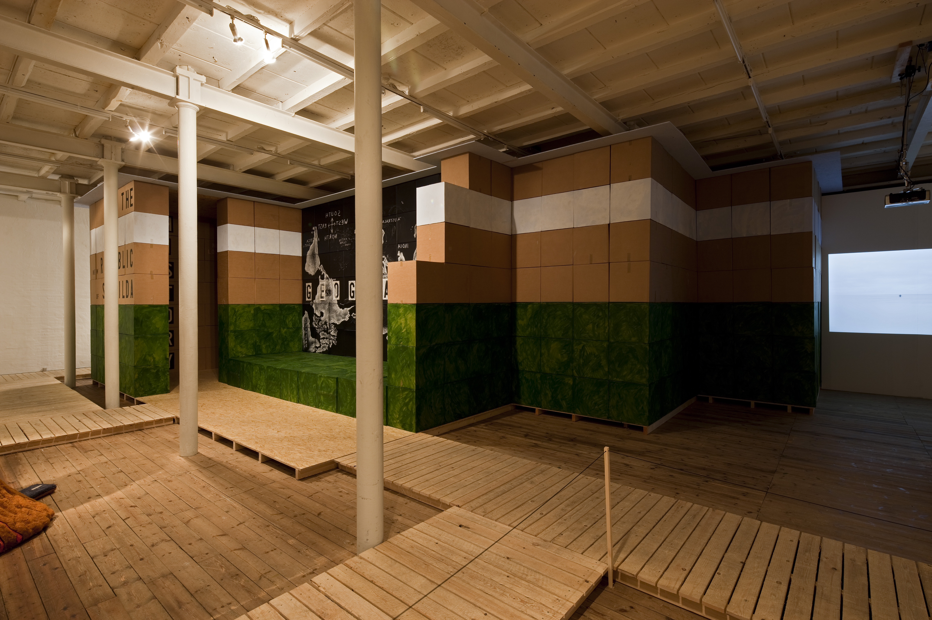

Slide 5
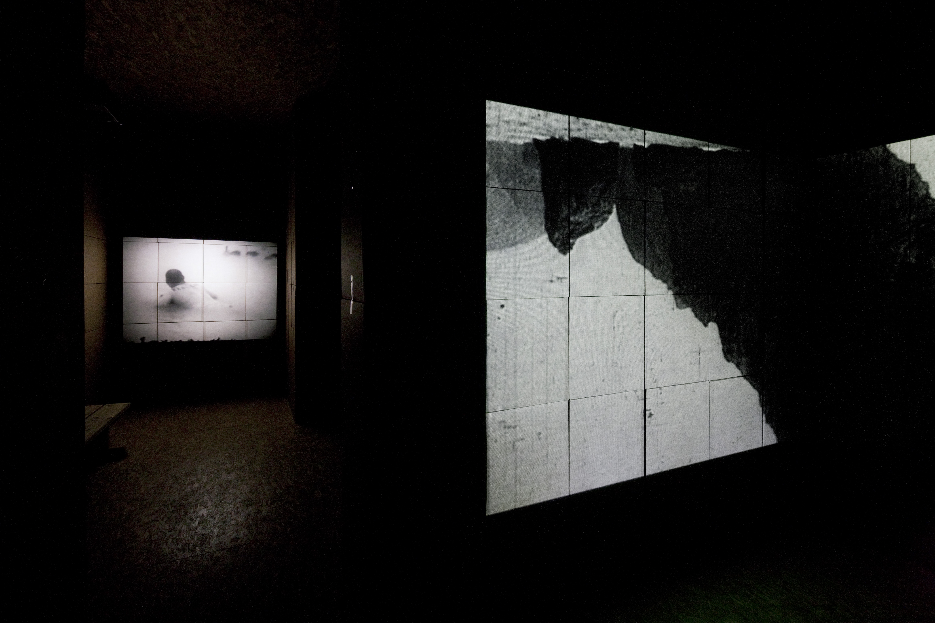

Slide 6
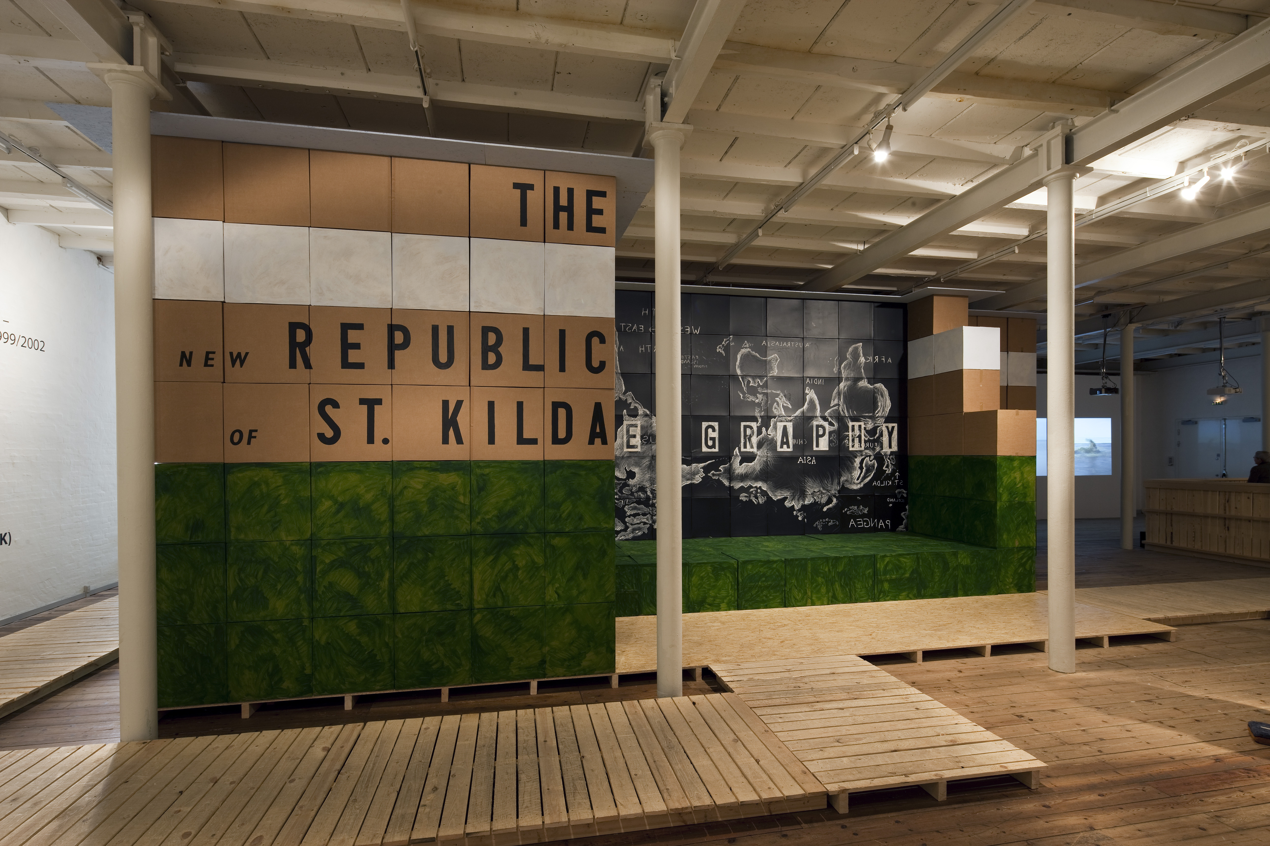

Slide 7
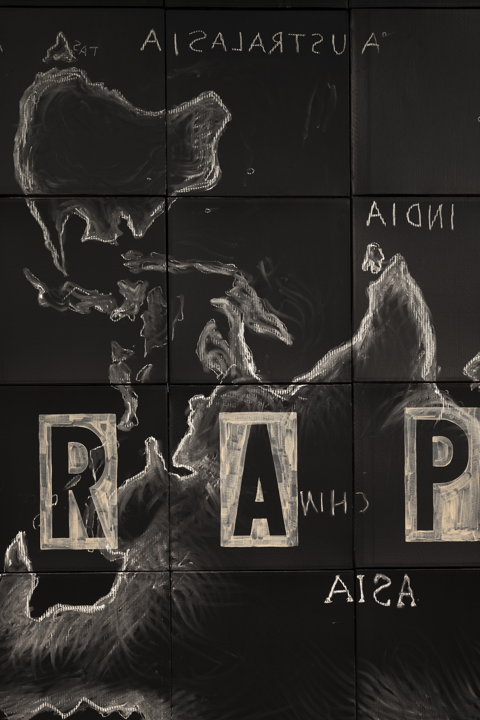
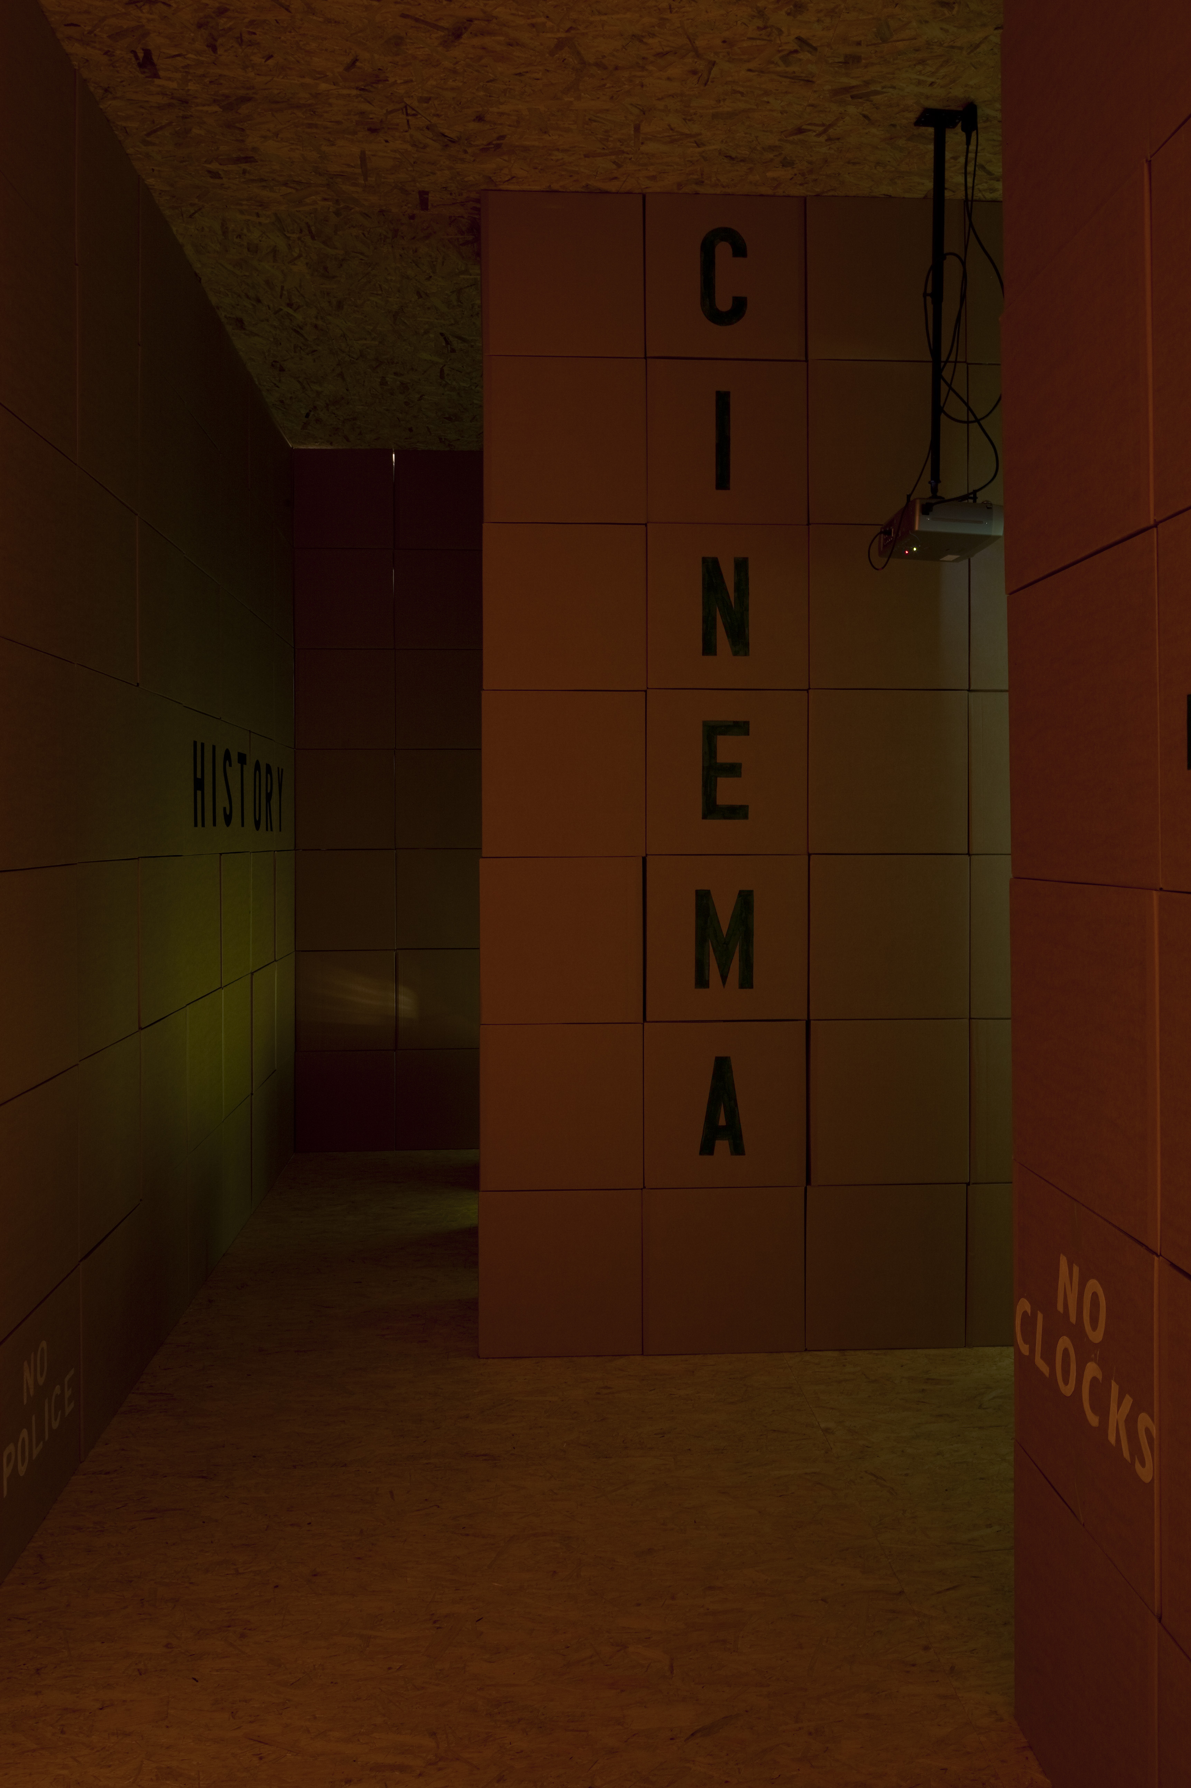

Slide 8
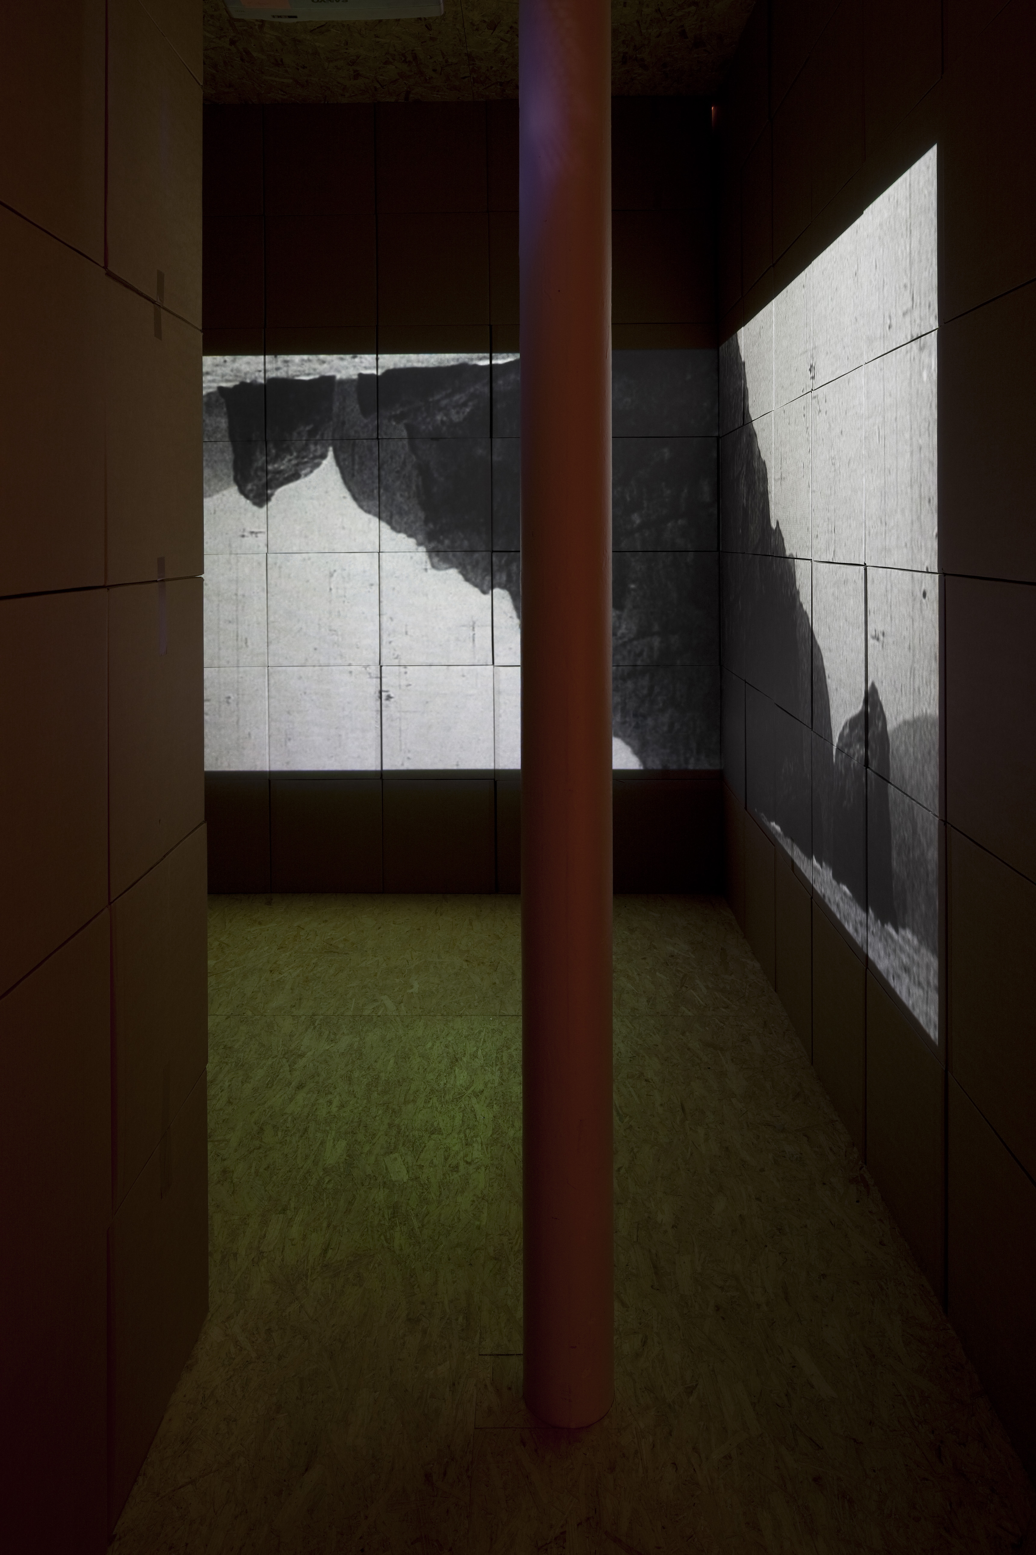

Slide 10
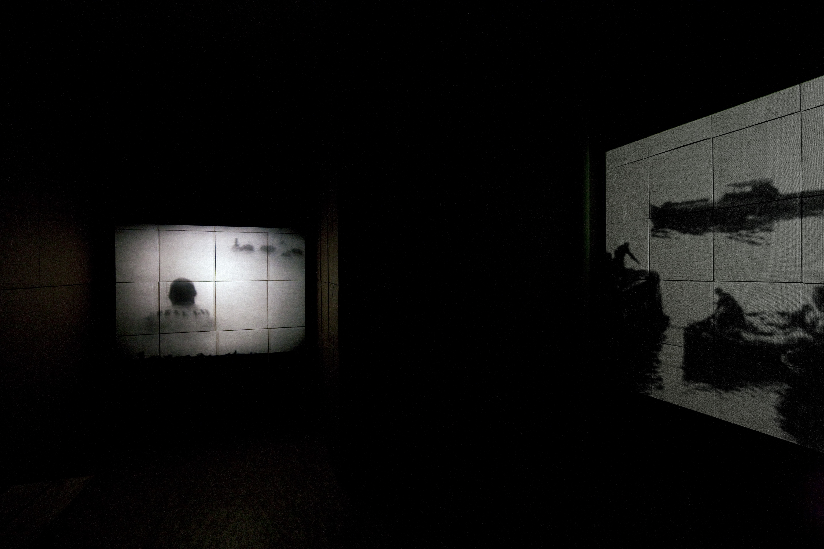

Slide 11
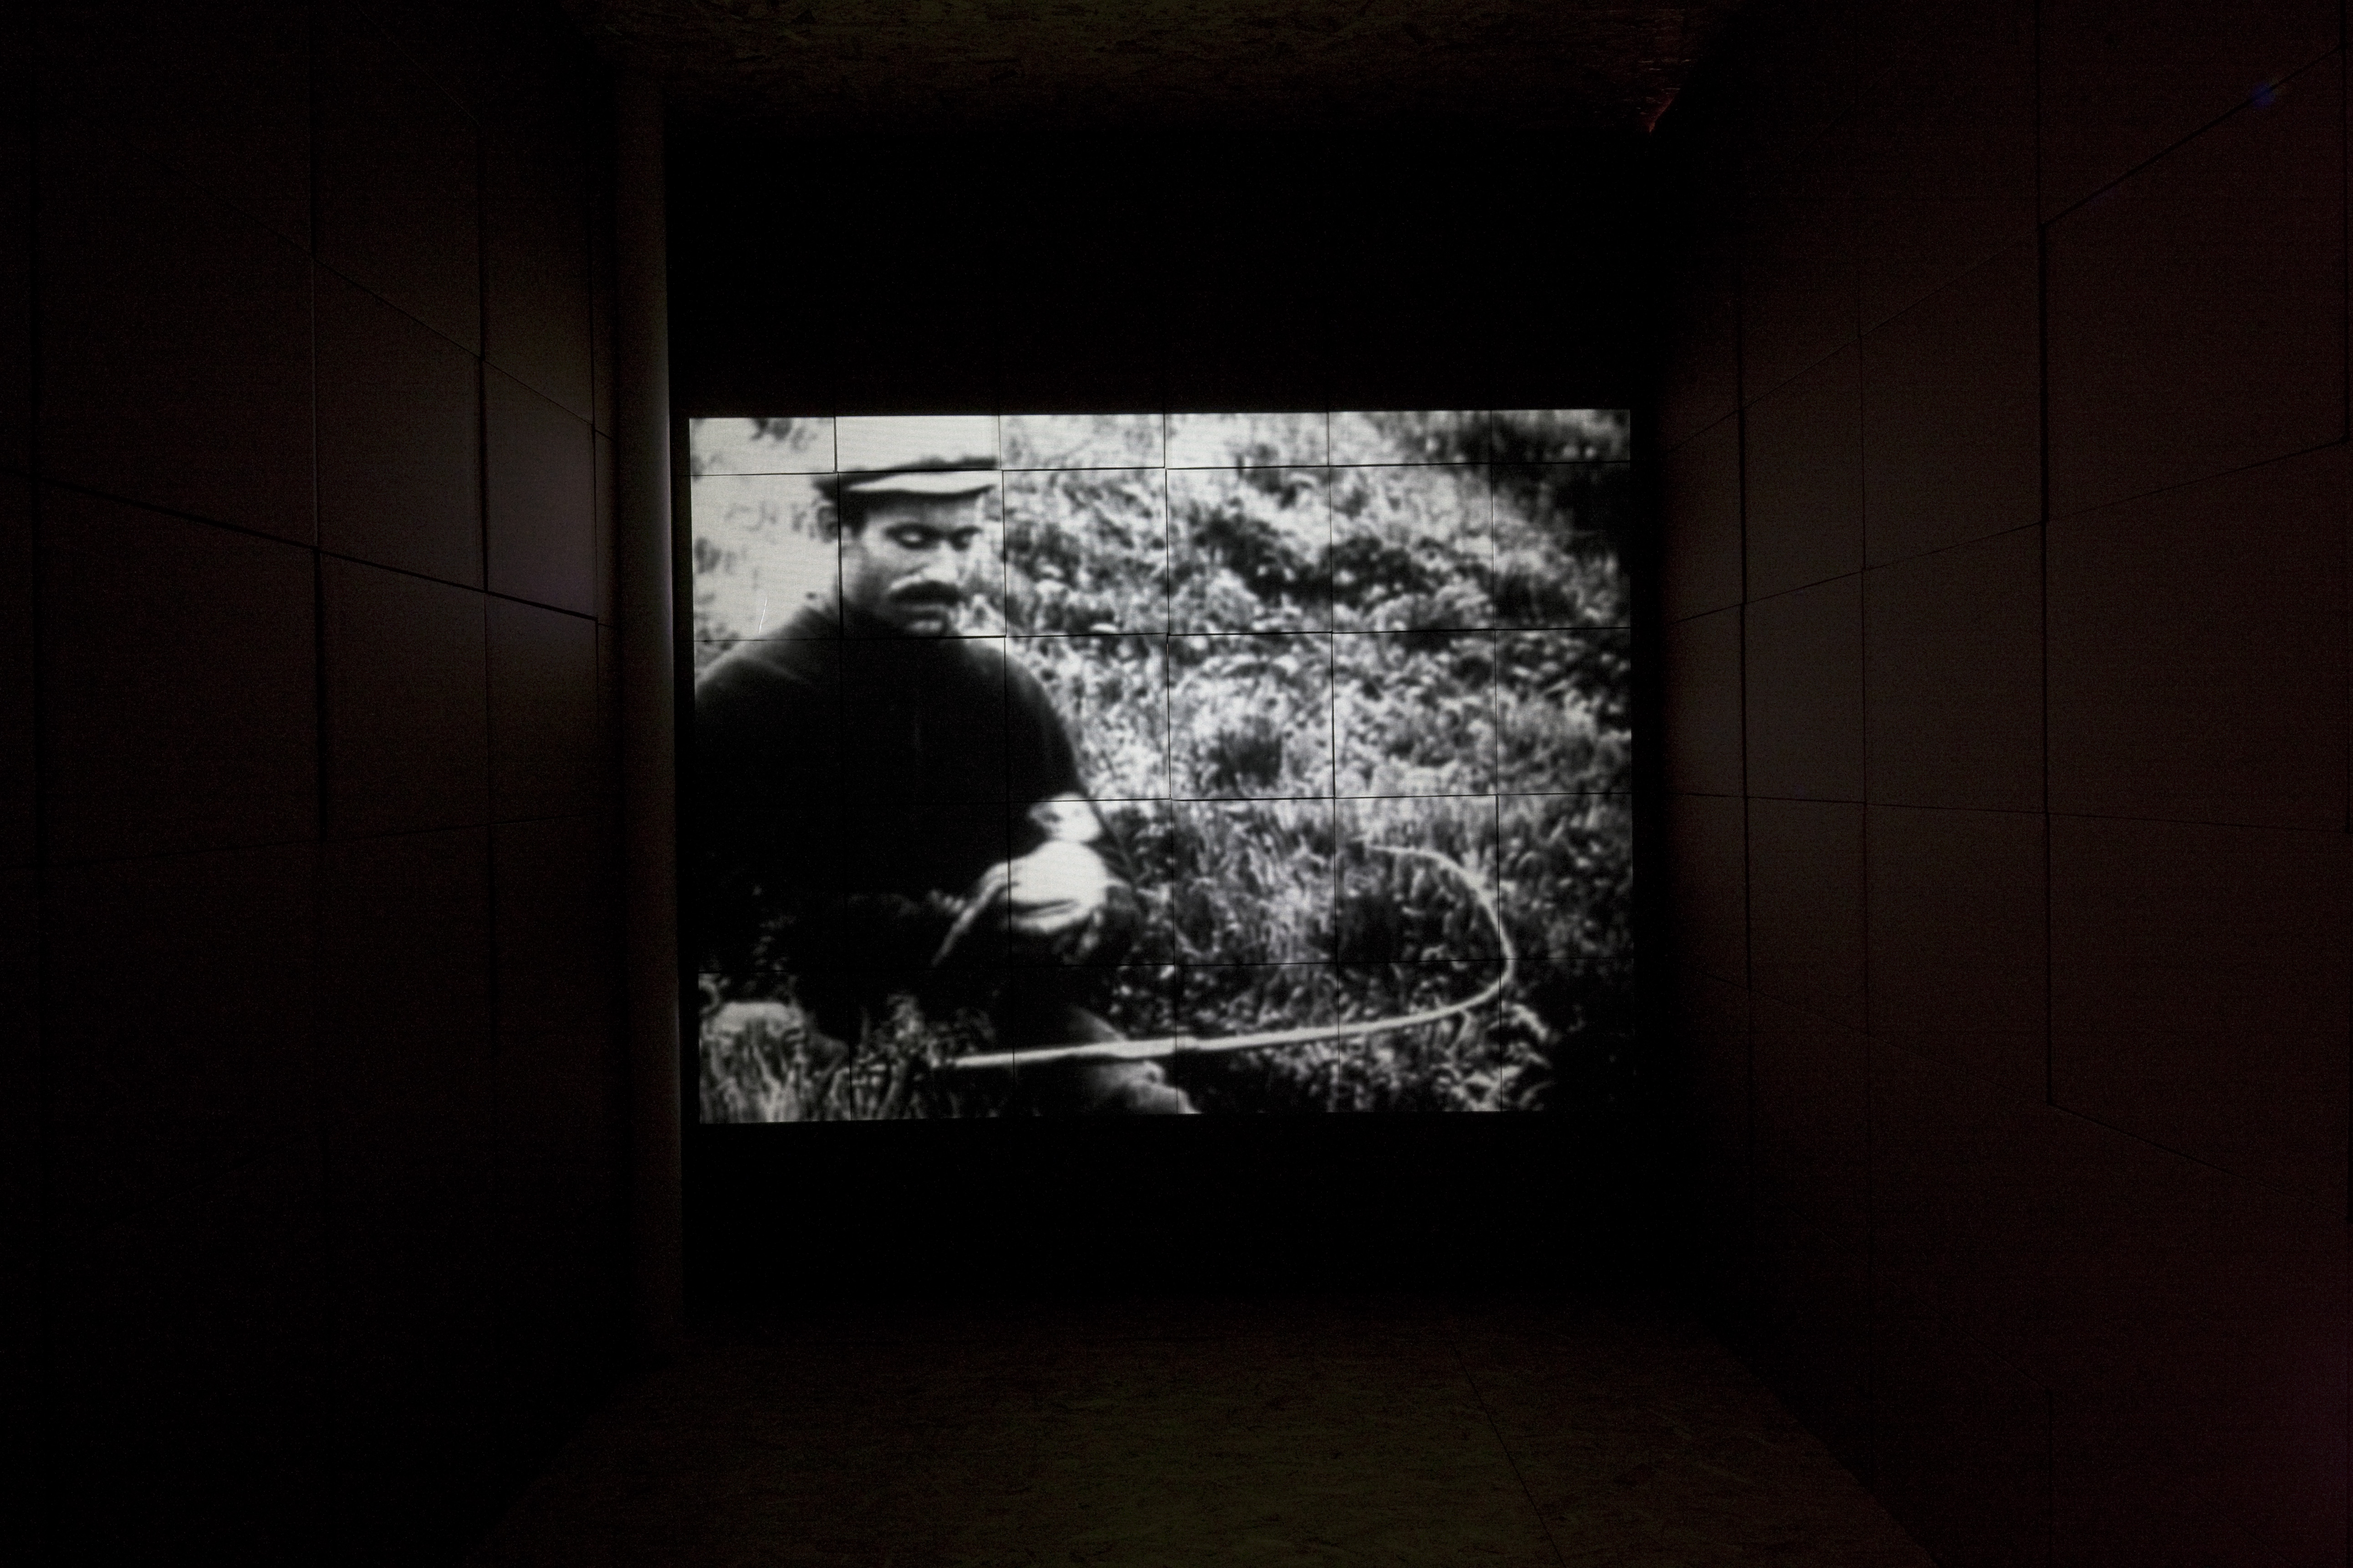

Slide 12
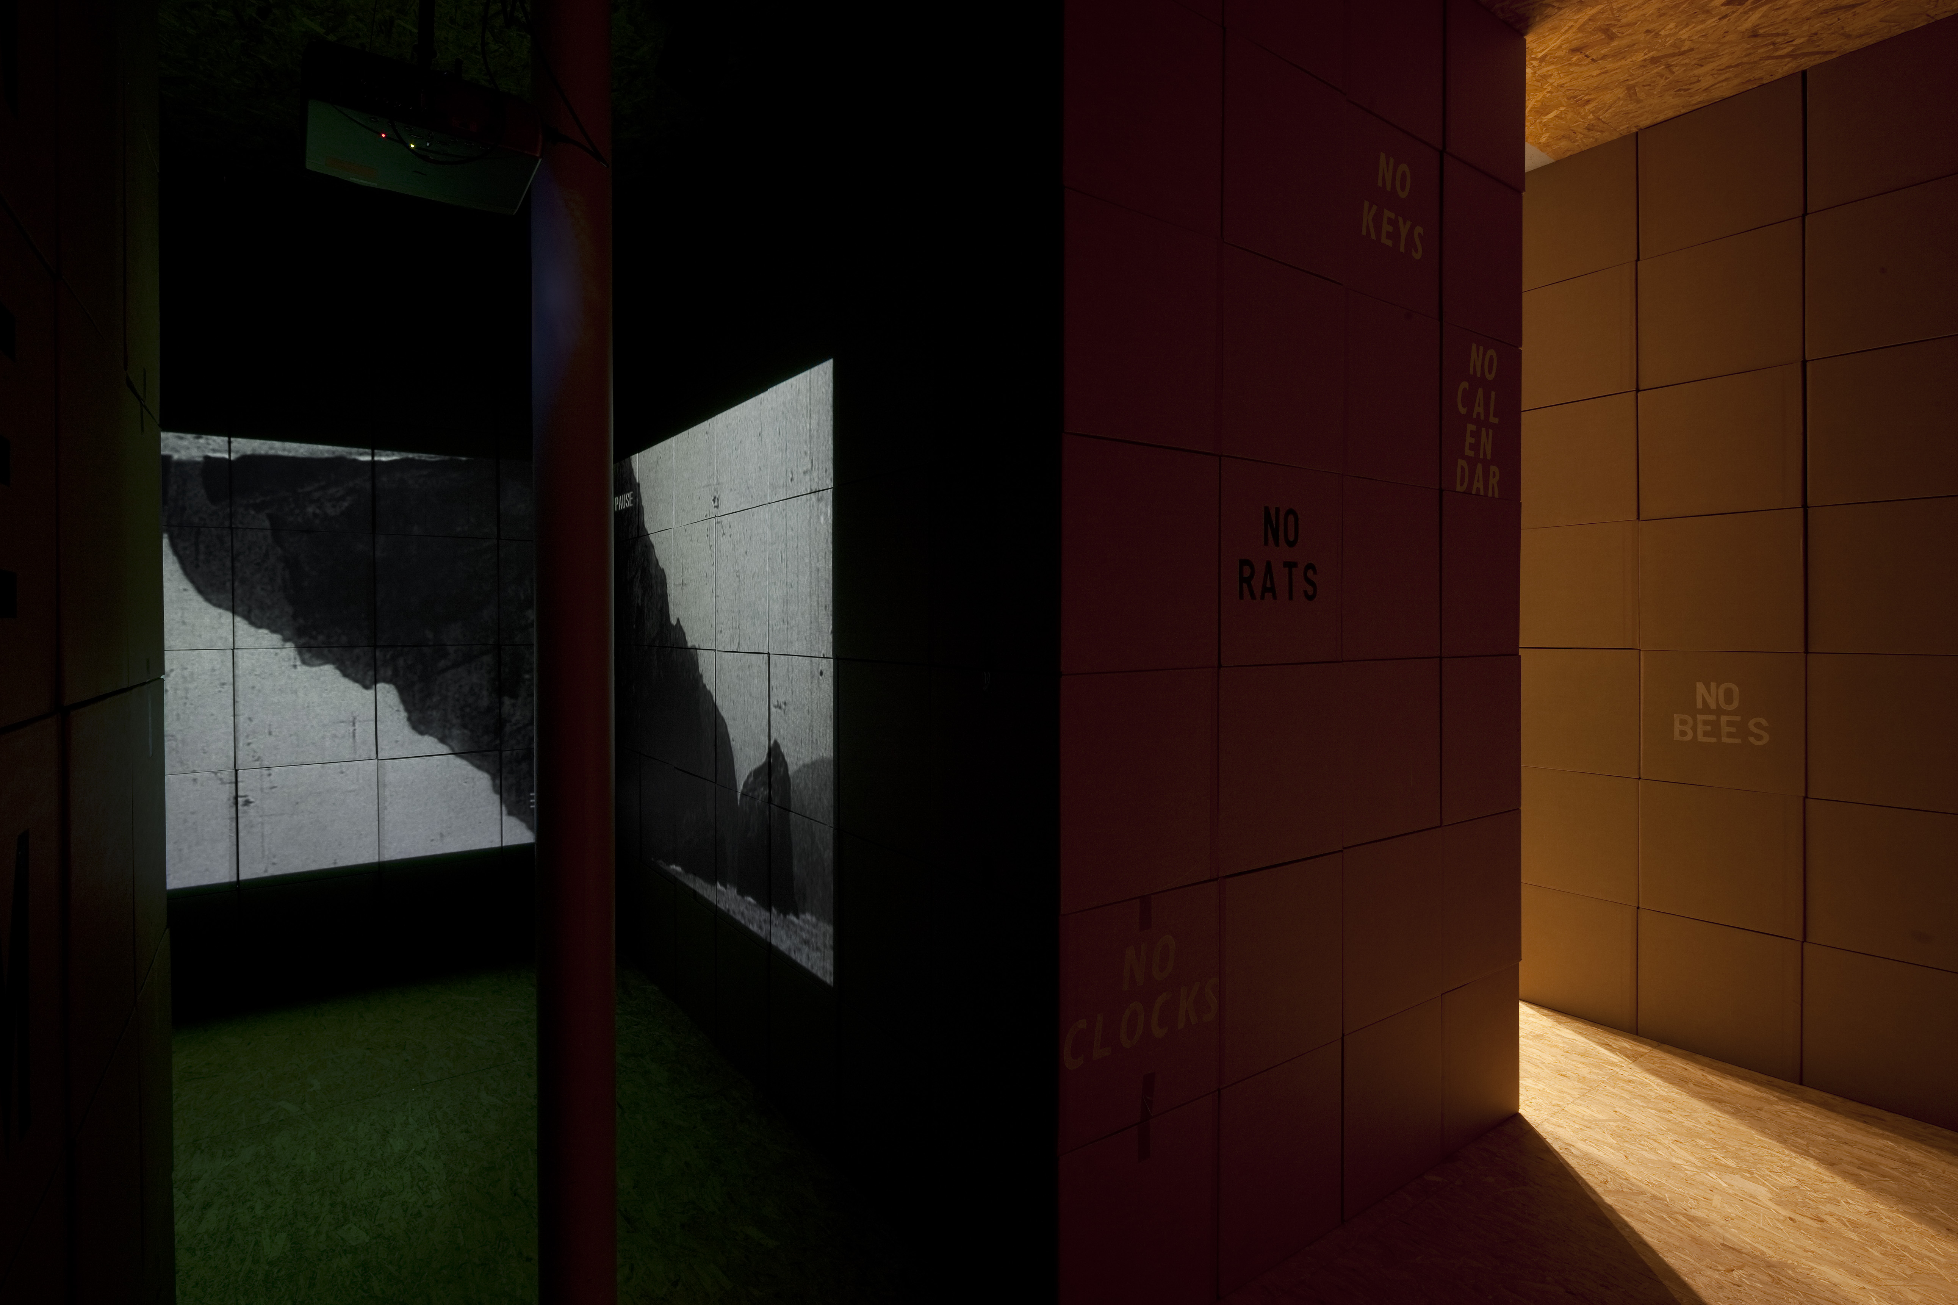

Slide 16
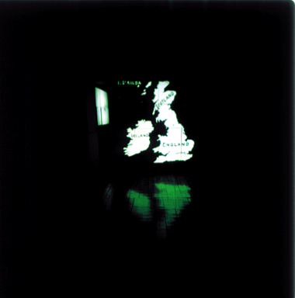

Slide 17
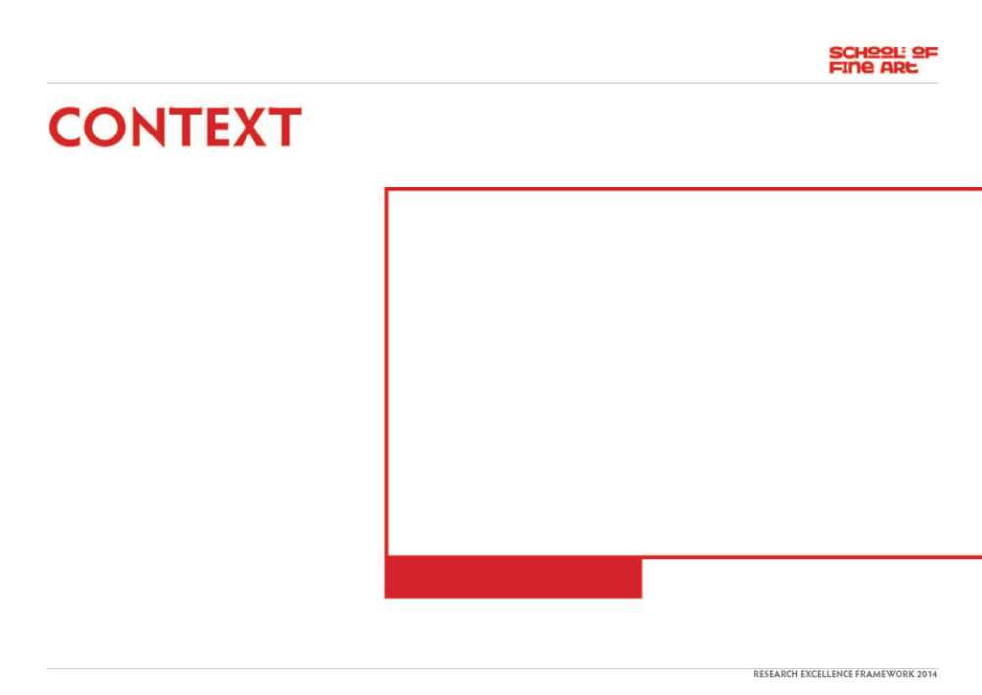
The project was first made as a solo exhibition at the Fruitmarket Gallery in Edinburgh in 1999. Then subsequently exhibited at Aspex Gallery in Portsmouth in 2000. A version of the project was shown with my (then) London Gallery The Agency in the ‘Statements section’(solo presentations) of the Basel Art fair in 2001.
During this showing I was awarded of The Baloise Art Prize which consisted of a money prize(£10,0000) and a purchase of the work by a major museum. Consequently the work is now owned by Hamburg Kunsthalle who purchased it as part of the prize.
In 2009 I was invited by curator Lene Burkard at Kunsthallen Brandts in Denmark to re-present the work for a group show of large scale installation works by 6 artists entitled “I-lands” in 2 Museums in Denmark over the period of a year (9/09 -8/10). This involved a complete re-design in order to exhibit this work in different spaces, at this moment in time. In addition Hamburg Kunsthalle decided the work was too fragile to loan. As the work is constructed mainly from cardboard boxes built into a series of rooms and viewing areas with drawings text and sound, everything had to be re-designed, re-made re-painted and reconstructed. The installation was completely re-made for the 2 different Museum spaces for showing over the period of a year.
"Journey to the Edge of the World –
The New Republic of St Kilda(detail,interior)”

Slide 18
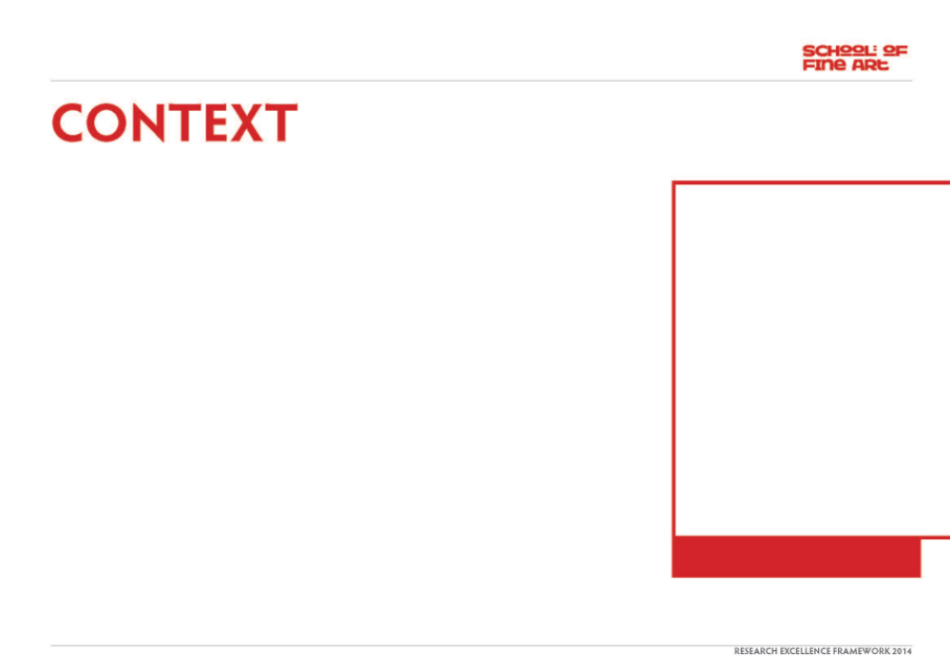
Until its evacuation on the 29 August 1930 St Kilda was the most remote inhabited part of the United Kingdom. It lies 100 miles west of the British mainland - seventeen hours by boat from Oban. The community of St Kilda had survived alone, cut off from civilisation, for over a thousand years. The islanders of St Kilda had more in common with the natives of Tristan da Cunha or Tierra del Fuego than with the urban city dwellers of Glasgow or Edinburgh living a mere 200 miles away. The inhabitants climbed the highest sea cliffs in Britain to hunt for seabirds, the staple of their existence. The unique Soay sheep provided wool for their clothing. St Kilda had a republican parliament which met every morning to make all the important decisions of the day. This could sometimes take many hours as there was no quick show of hands to make a decision. Every important issue was talked through thoroughly, till a consensus was reached. They had no money system, no police, no crime, no clocks, no calendar. The islands had no trees, no bicycles, and its inhabitants had never seen a rabbit, a rat a pig or a bee. It was a cold, harsh, inhospitable place, nevertheless filled with a barren, melancholic beauty. When the first recorded visitors went to St Kilda in the 16th and 17th centuries they heard strange songs, laments, poetry and dances. Evidence of a people’s history together in this epic wilderness.
This way of life on the islands of St Kilda was virtually unchanged for a millennium. However, by the 19th century, pressures from the outside world over education, organised religion and tourism all attempted to throw into doubt the St Kildans’ way of life. As this contact with the mainland increased the community became weakened. When first smallpox and, later, other diseases caught from Victorian tourists decimated their number, the beginning of the end was inevitable. This society, which had stayed trapped out of time for more than a thousand years, was all but destroyed in 100 years of contact with the modern world, its money and its religion. By the end of the 1920’s the remaining islanders had no alternative but to ask to be evacuated to the mainland, as there were no longer enough able-bodied men to man the island’s little rowing boat. When the remaining 36 St Kildan’s finally left on the 29 August 1930 they built large fires in their hearths so that the chimneys were still smoking as the HMS Harebell pulled away to take them to a new and uncertain life. When these last fires finally died it was the first time there had been no fire burning on the island for a thousand years
"Journey to the Edge of the World - The New Republic of St Kilda” (detail, Map)

Slide 19
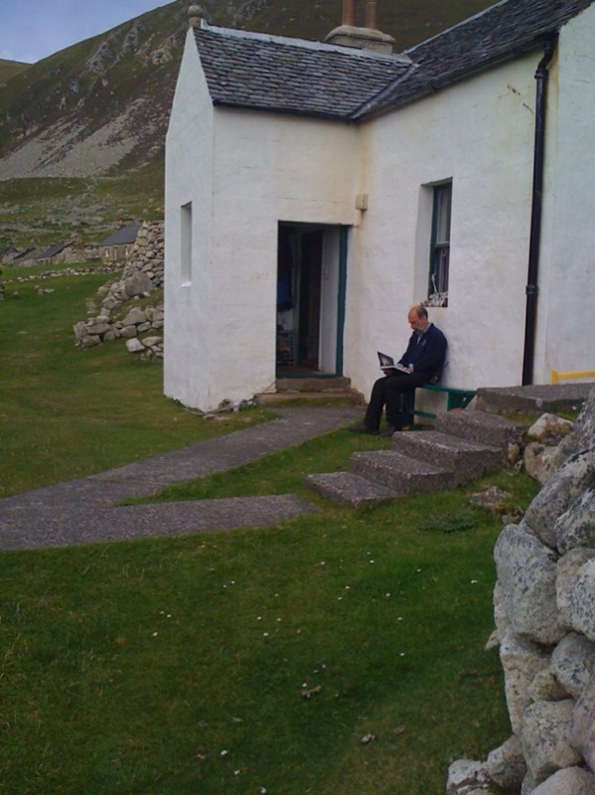
One of the aims of this project was to challenge the viewer to reflect on the possibilities of a Utopian social contract in a contemporary context, viewed through this unreliable historical lens. The work proposes various different interpretations of the ‘Real Life’ paradigm (which I have been exploring since I had the words tattooed on my back in 1994) The work explores the History of this very particular place, St Kilda, seen from a contemporary standpoint using film/video, drawing, text, singing, slides and invites the viewer explore and interrogate these histories, to intellectually reconstruct them in new and challenging ways.
It was very interesting the re-present the project, a decade after its initial showing. In that time there has been a marked rise in interest in a discussion of utopian paradigms in relation to contemporary living to which this project contributed. Also of note in the discussions surrounding the new version of the work was the inexorable rise of the internet. When I originally made the piece there were 2 books available, already 50 years old then, and I did most of my research in newspaper archives in the Mitchell library in Glasgow. Now everything you could ever want to know about St Kilda is only a mouse click away and in fact the curator visitor shortly after the show and I recently note there is now an artist in residence programme on the islands run by Historic Scotland
National Trust for Scotland Keeper reading
my catalogue on St Kilda

Slide 20
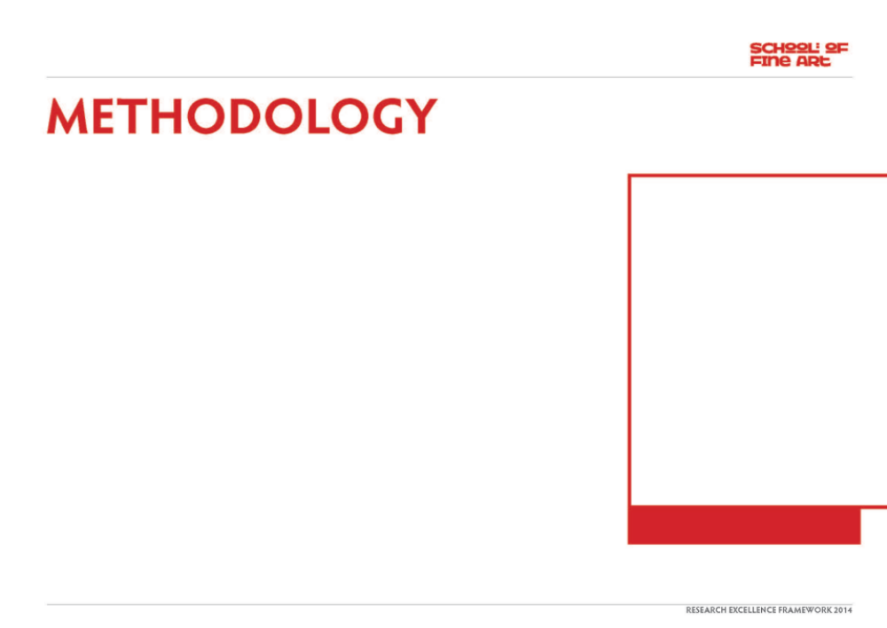
The year of the first showing of the work was the 70th anniversary of the evacuation. Journey to the Edge of the World offers various histories, some factual, some more ambiguous, of this incredible story and links the idea of the St Kilda Parliament with the then, new Scottish Parliament, currently in session about 100 yards from the Fruitmarket Gallery, during the first showing, after a 300yr hiatus. I presented another parliament in the show constructed from cardboard boxes, flimsy and transient. Cardboard boxes completely surround the interior of the gallery, creating the effect of a large warehouse, perhaps stocked with the hopes and fears of the evacuated population. Or maybe they hold the anthropological essence of this society, carefully stored for future use. On a soundtrack, audible all around the space, there is the sound of me singing traditional Scottish Songs and Religious Hymns played backwards in order to reflect on the ambiguous and questionable influences of mainstream society on the island’s history.In a room, at the start of the exhibition, two slide projectors move endlessly round and round. One displays texts which punctuate the history of the last 1000 years on St Kilda, while the other offers texts which describe the events unfolding in the wider world on these same dates(refer to introduction cd). I presented original film footage of the final evacuation of the island, re-edited, mixed with other footage and slowed down and played backwards.
There are three ‘cinema’ spaces in the exhibition which each offer a reading of this history. One is a double projection housed in a makeshift building with a solid roof but cardboard walls. This shows the solitary mass of Stac Lee, rising vertically 720 ft from the sea bed, in a short clip taken from a boat in the early 1900’s, which heaves up and down with the incredible sea swell. In the third space we see a floating figure in an ambiguous, indistinct body of water, two words are only just visible through the mist and the gloom ; Real Life. On another wall there is a large blackboard with the word ‘Geography’ across it. This depicts a map of the world, drawn crudely in chalk upside down and the wrong way round. The whole space is like a museum where there are many outcomes of history instead of one straight linear reading. When the people of St Kilda were finally evacuated, a vacuum was created into which was sucked the desires of people who live in dirty, ugly cities to find a place where everything is perfect, a Utopia, literally, no-place. The terrible irony is that the culture of St Kilda had to die and the people had to leave the island before this perfect place could be complete. The modern world would demand nothing less.
"Journey to the Edge of the World –
The New Republic of St Kilda”

Slide 21
Through the design and complex installation of different linked rooms constructed from cardboard boxes, drawing, video, text and backwards singing, the audience were encouraged to explore this contemporary manifestation of the image of this defunct ‘utopian society’ and consider it alongside a current paradigm of utopian debate. The archipelago of islands known as St Kilda, off the west coast of Scotland were almost completely cut off from the mainland but had a thriving community living there for 2000 years until the last remaining residents were finally evacuated in 1930. They were perceived to have lived a perfect utopian existence. Of course in reality this was not the case and the social structure was eventually destroyed by religion, money and illness as the place became more accessible after the maritime developments of the industrial revolution. The audience of the exhibition could watch different films and listen to backwards singing, a slide show, maps spend time in the space and explore, reflect, and consider the relative veracity of the different histories offered through the work and how it may or may not relate to the life they themselves are leading.
"Journey to the Edge of the World –
The New Republic of St Kilda”

Slide 22
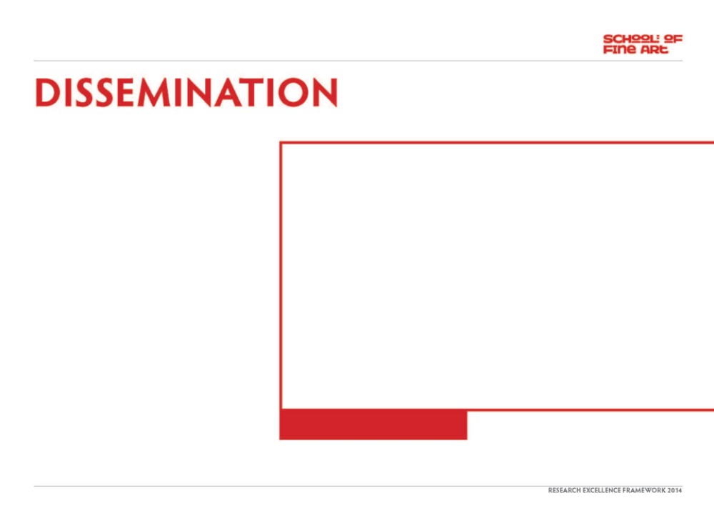
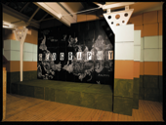
This is a large scale installation first made in 1999 as a solo exhibition at the Fruitmarket Gallery in Edinburgh to coincide with the reconvening of the Scottish Parliament nearby after a 300 year layoff. It was subsequently shown at Aspex gallery in Portsmouth. It was subsequently purchased by and is held in the collection of Hamburg Kunsthalle after it won the Baolise ‘Statements’ prize at the Basel Art fair in 2001. https://www.baloise.com/en/mediarelations/pictureservice/baloiseartprize.html
It has been documented and discussed in solo monographs in Ross Sinclair, Real Life and How to Live it, Fruitmarket Gallery, Edinburgh, 96pp 2000, ISBN 0-947912-67-3 and If North was South and East was West, Badischer Kunstverein, 200pp ISBN, 3-89309-106-8 2004 (included) as well as in the book on the current submission. The work has been viewed by thousands of visitors over the years. Essay on this version by Lene Burkard, Ross Sinclair - Utopia – At the Edge of the World.(pp98-114) I-Lands - ISBN : 978-87-7766-094-8
Featured in Place(Art Works series) Jeremy Miller/Tacita Dean, Thames and Hudson pp134-7 isbn 0-500-93007-4
The project is discussed in great detail reflecting a project by the conservator at Hamburg Kunsthalle website here http://www.inside-installations.org/artists/artist.php?r_id=107
"Journey to the Edge of the World –
The New Republic of St Kilda”

